Slide 1
Lecture 12: Intro to Machine Learning
CS 181E Fall 2026

Slide 2
Machine Learning is…
Machine learning is about predicting the future based on the past.
past
future
predict
learn
ML Model
ML Model
Training
Data
Testing
Data
Notes:
Quote attributed to -- Hal Daume III

Slide 3
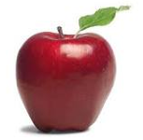
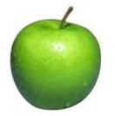
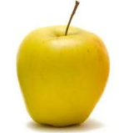
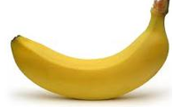
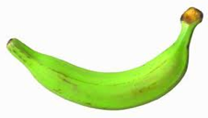
Type #1: Supervised Learning
training data is labeled with correct answers
past
future
label₁
predict
learn
ML Model
ML Model
label₂
Predicted
Label
label₃
Testing Data
label₅
Training Data

Slide 4
Type #1a: Supervised Classification
training data is labeled with correct answers
there is a finite, pre-defined set of possible labels
ML task is to predict which of these labels applies
past
future
apple
apple
banana
banana
predict
label₁
learn
ML Model
ML Model
label₂
Predicted
Label
apple
label₃
Testing Data
label₅
Training Data

Slide 5
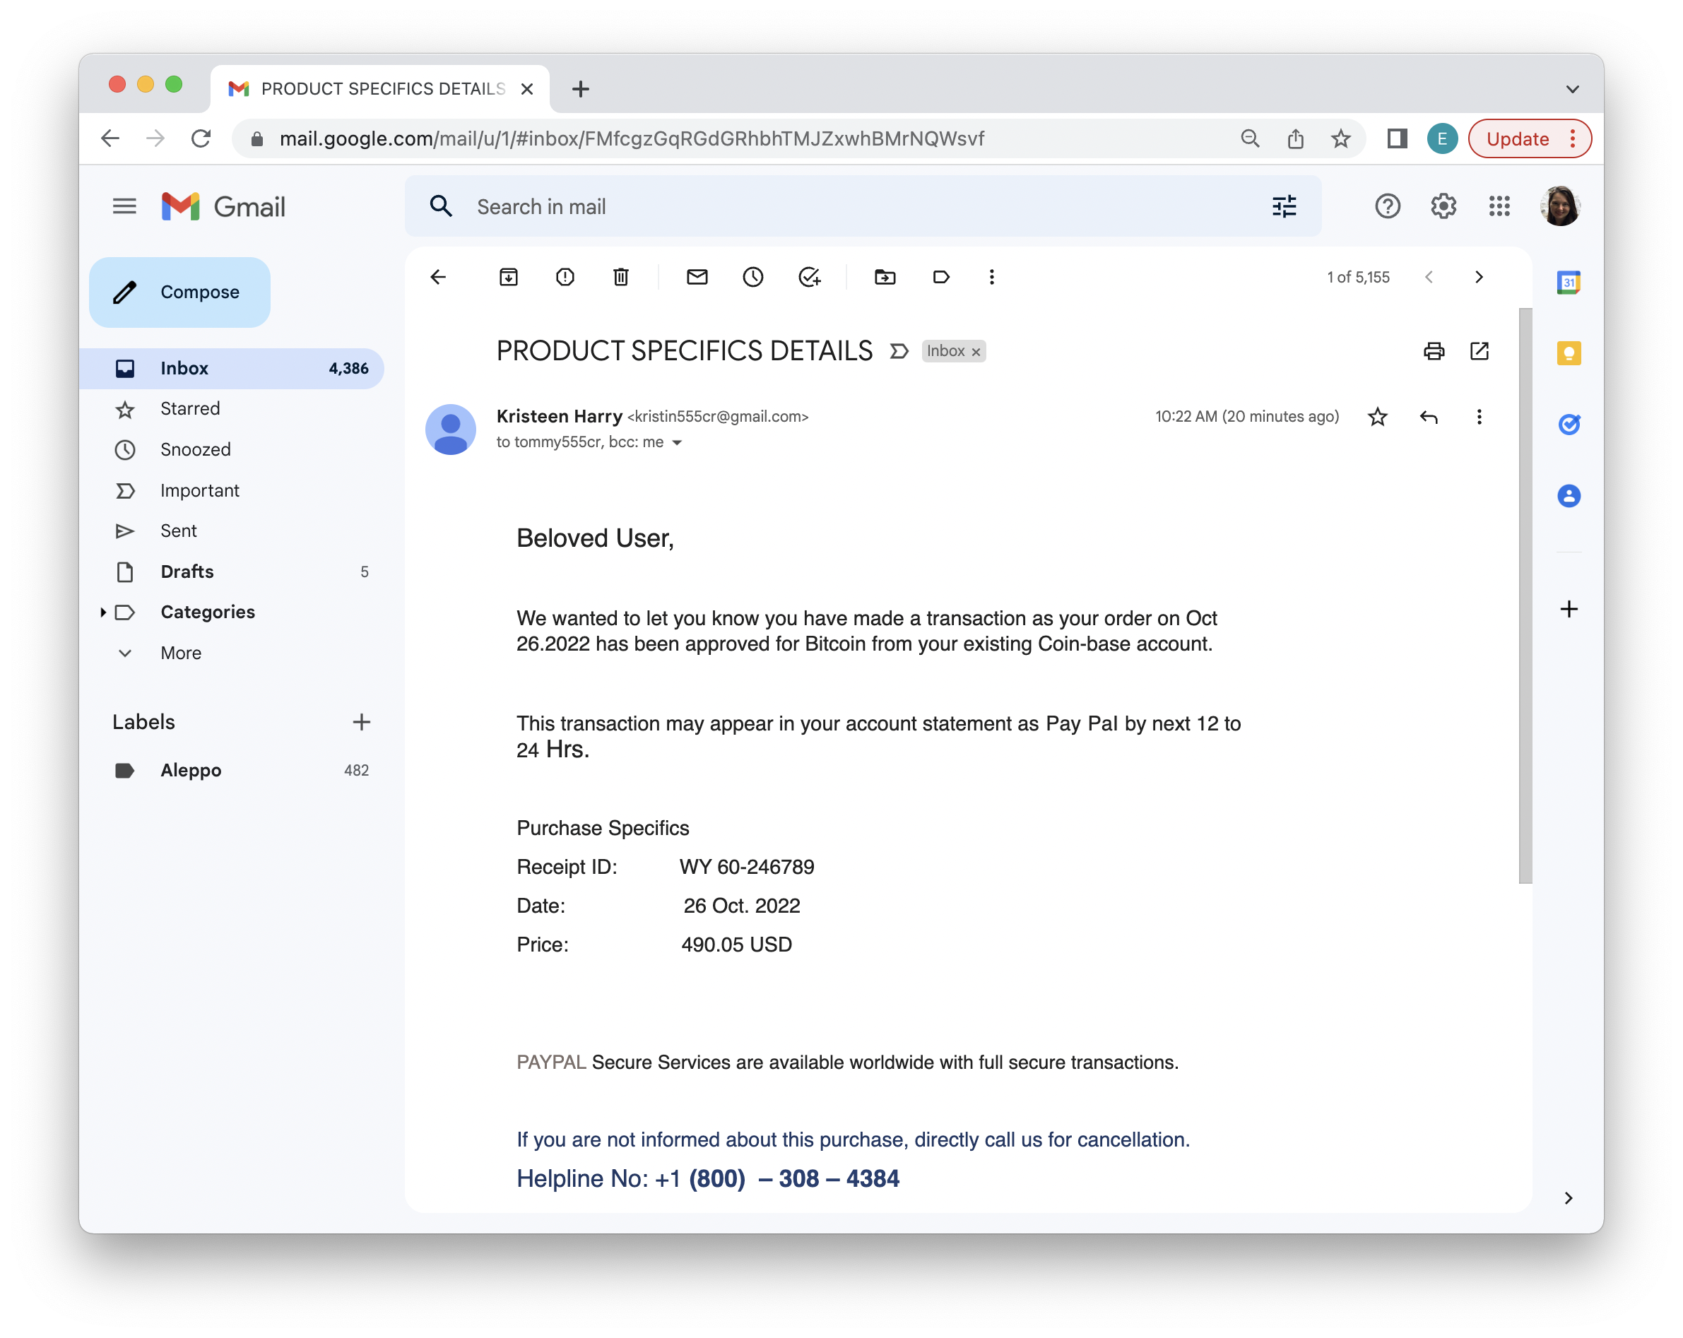
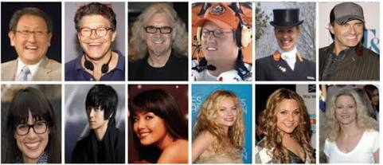
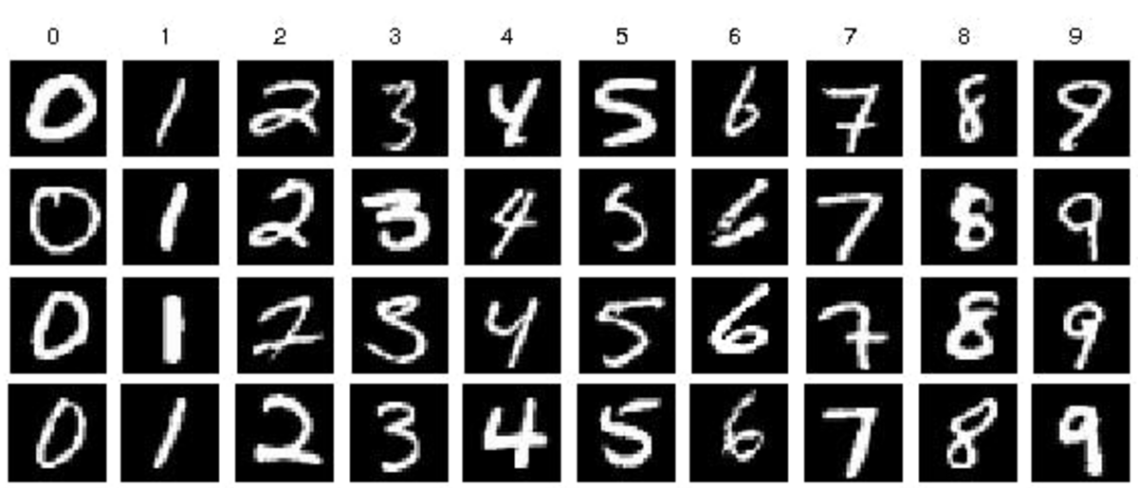
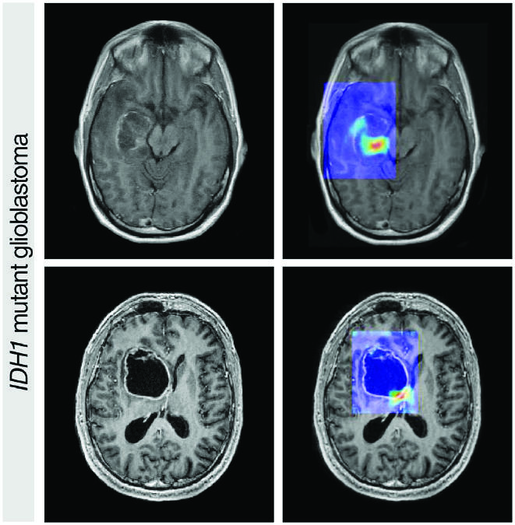
Examples of Classification
Spam filters
Facial recognition
Character recognition
Medical diagnosis

Slide 6
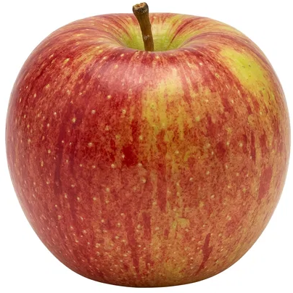
Type #1b: Supervised Regression
training data is labeled with correct answers
labels are real numbers
ML task is to predict the right number
past
future
-4.5
6.1
3.2
1.3
predict
label₁
learn
ML Model
ML Model
label₂
Predicted
Label
9.2
label₃
Testing Data
label₅
Training Data

Slide 7


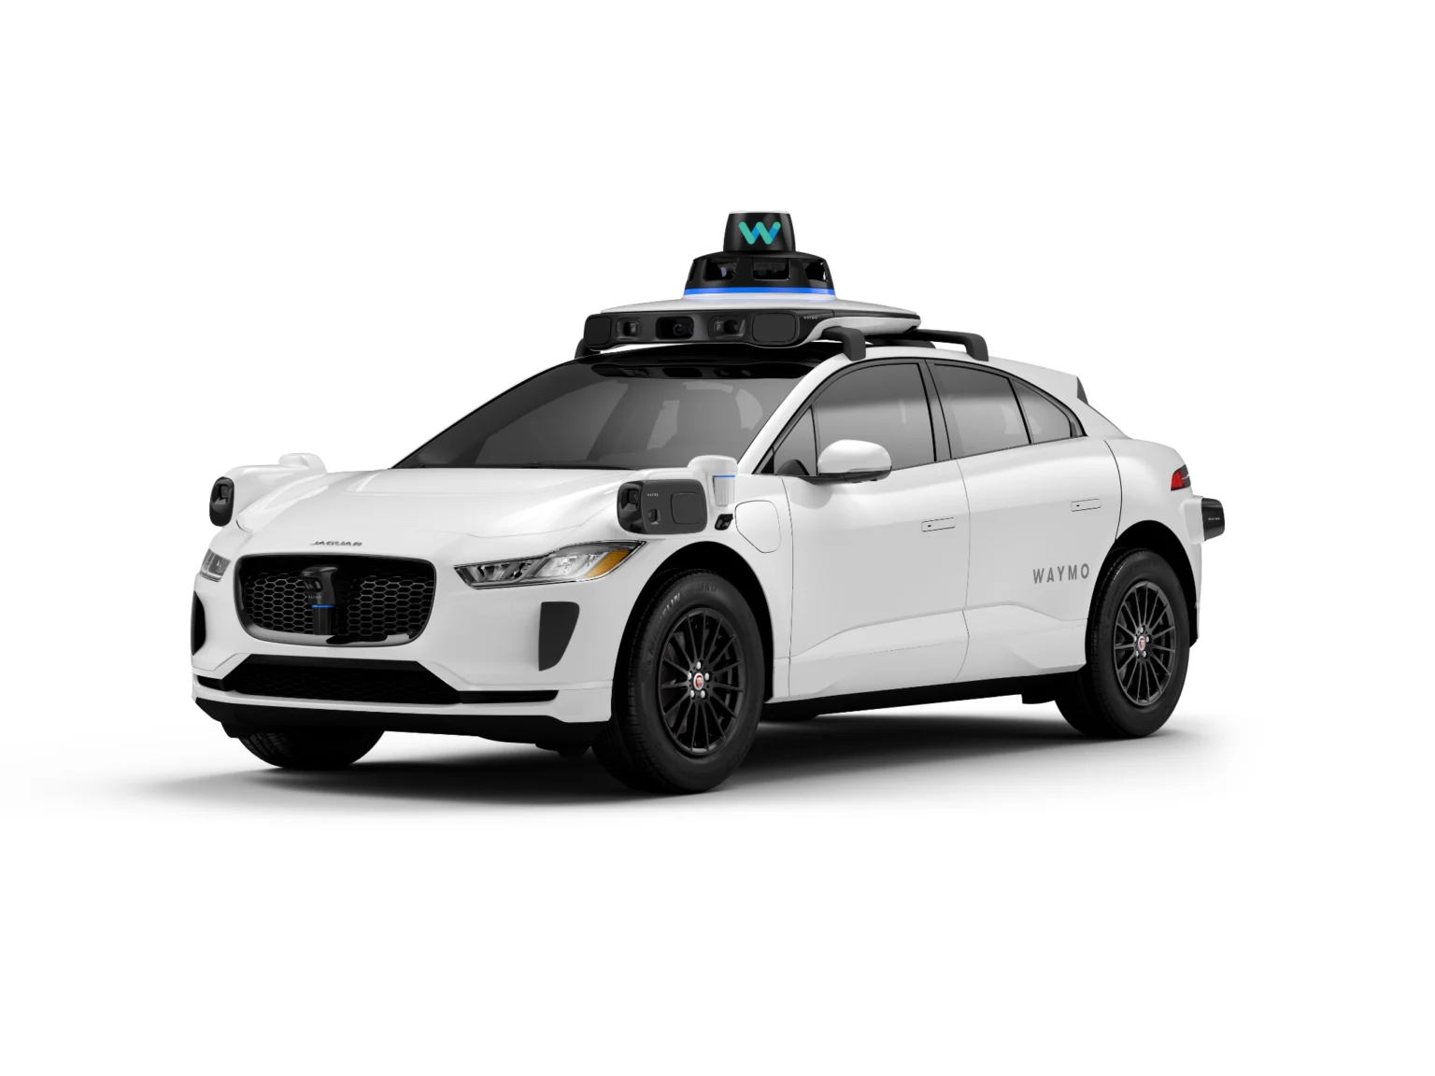
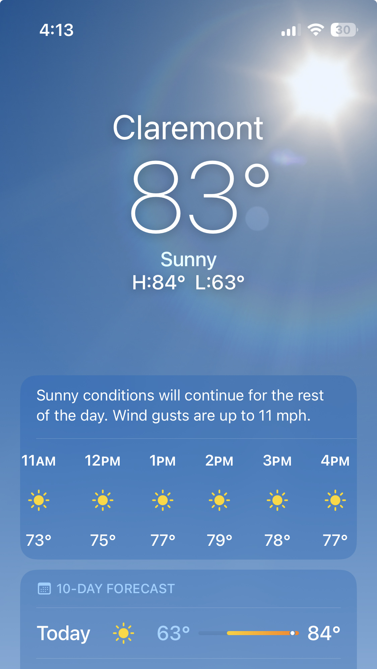
Examples of Regressions
Online Advertising: predict the likelihood a user will click on an ad
Epidemiology: predict likelihood/severity of a disease
Car/Plane Navigation: predict angle of steering wheel, acceleration, etc
Weather: predict temperature, likelihood of rain, etc

Slide 8
Type #2: Unsupervised Learning
training data is unlabeled
goal: discover patterns or structures in the data
Examples: clustering, principal component analysis
past
future
predict
learn
ML Model
ML Model
Testing Data
Training Data

Slide 9
Type #2: Unsupervised Learning
training data is unlabeled
goal: discover patterns or structures in the data
Examples: clustering, principal component analysis
past
learn
ML Model
Training Data

Slide 10
Examples of Unsupervised Learning
Clustering: Learn clusters/groups without any label
  customer segmentation: which users “look-alike” in terms of buying habits
  anomaly detection: which events are “normal” vs which are unusual
Principal Component Analysis (PCA): reduce number of dimensions while keeping most important information
  network intrusion detection: efficiently detect malicious network traffic
  image compression: reduce image size (useful for optimizing facial recognition and image analysis pipelines)

Slide 11
Reinforcement learning
left, right, straight, left, left, left, straight
GOOD
left, straight, straight, left, right, straight, straight
BAD
left, right, straight, left, left, left, straight
18.5
left, straight, straight, left, right, straight, straight
-3
Given a sequence of examples/states and a reward after completing that sequence, learn to predict the action to take for an individual example/state

Slide 12
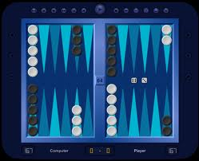
Reinforcement learning example
Backgammon
…
WIN!
…
LOSE!
Given sequences of moves and whether or not the player won at the end, learn to make good moves

Slide 13
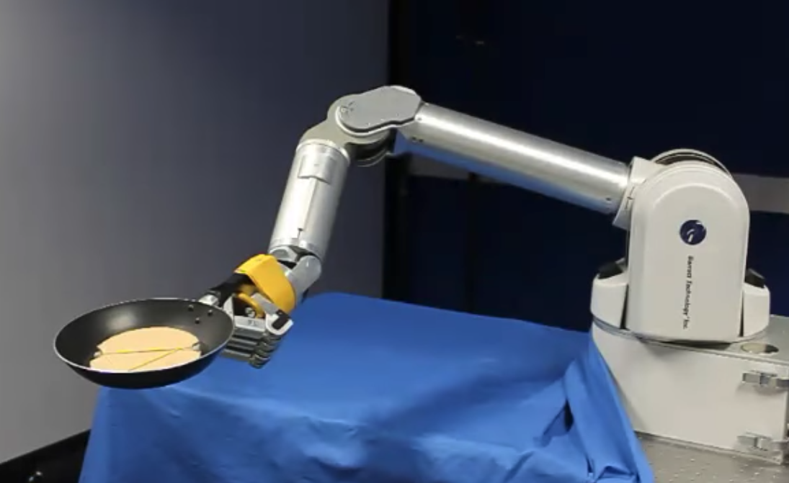
Reinforcement learning example
https://www.youtube.com/watch?v=W_gxLKSsSIE

Slide 14
Other learning variations
What data is available:
    Supervised, unsupervised
    reinforcement learning, semi-supervised, active learning, …
How do we get the data:
    online vs. offline learning
Type of model:
    generative vs. discriminative
    parametric vs. non-parametric

Slide 15
Example Supervised Learning Methods
Method | Classif./Regress. | Gen./Discr. | Param/Non
Naïve Bayes | Classification | Generative | Parametric
Linear Regression | Regression | Discriminative | Parametric
Logistic Regression | Classification | Discriminative | Parametric
Neural Networks | Both | Depends | Parametric
K-Nearest Neighbor | Classification | Generative | Nonparametric
Support Vector Machines | Both | Discriminative | Nonparametric
Notes:
From: Kevin Murphy. Machine Learning: A Probabilistic Perspective

Slide 16
Representing Data

Slide 17
Features
training data
features
f₁, f₂, f₃, …, f_{n}
How our machine learning algorithms actually “view” the data
f₁, f₂, f₃, …, f_{n}
f₁, f₂, f₃, …, f_{n}
f₁, f₂, f₃, …, f_{n}

Slide 18
Features
training data
features
red, round, leaf, 3oz, …
green, round, no leaf, 4oz, …
How our machine learning algorithms actually “view” the data
yellow, curved, no leaf, 4oz, …
green, curved, no leaf, 5oz, …

Slide 19
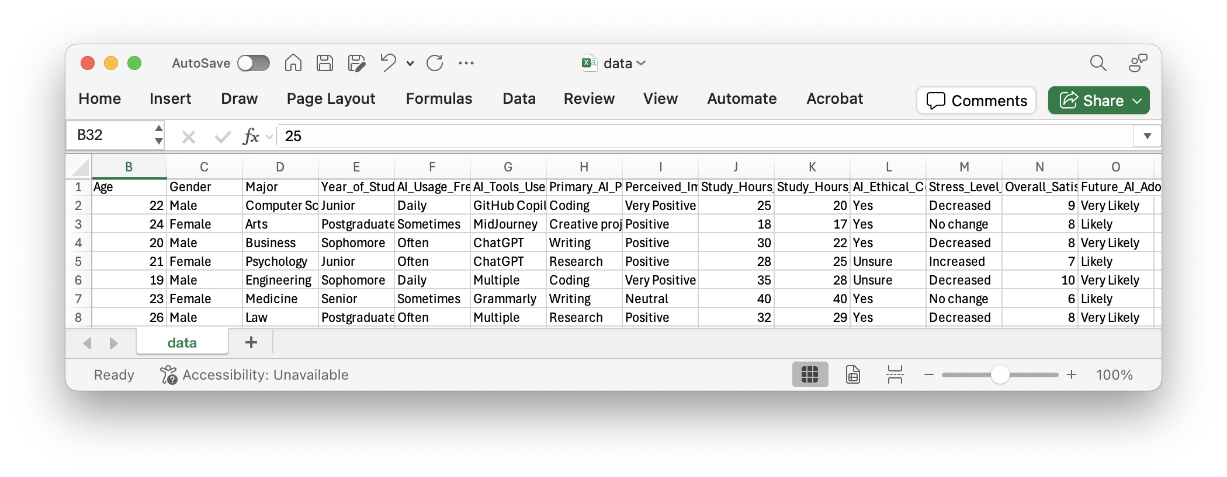
Provided features
the data has been collected and the relevant features have been identified
  This is common in many domains (e.g. medicine, social science, etc.)
  we cannot collect more features from the examples (at least “core” features)

Slide 20

Raw data vs. features
In other domains, we are provided with the raw data, but must extract/identify features
For example
  image data
  text data
  audio data
  log data
  …
Raw data
Features
  pixels OR
  “patches”
  texture features
  shape features
  “bag of words”
  frequency
  bigram counts
  …
Clinton said banana repeatedly last week on tv, “banana, banana, banana”

Slide 21
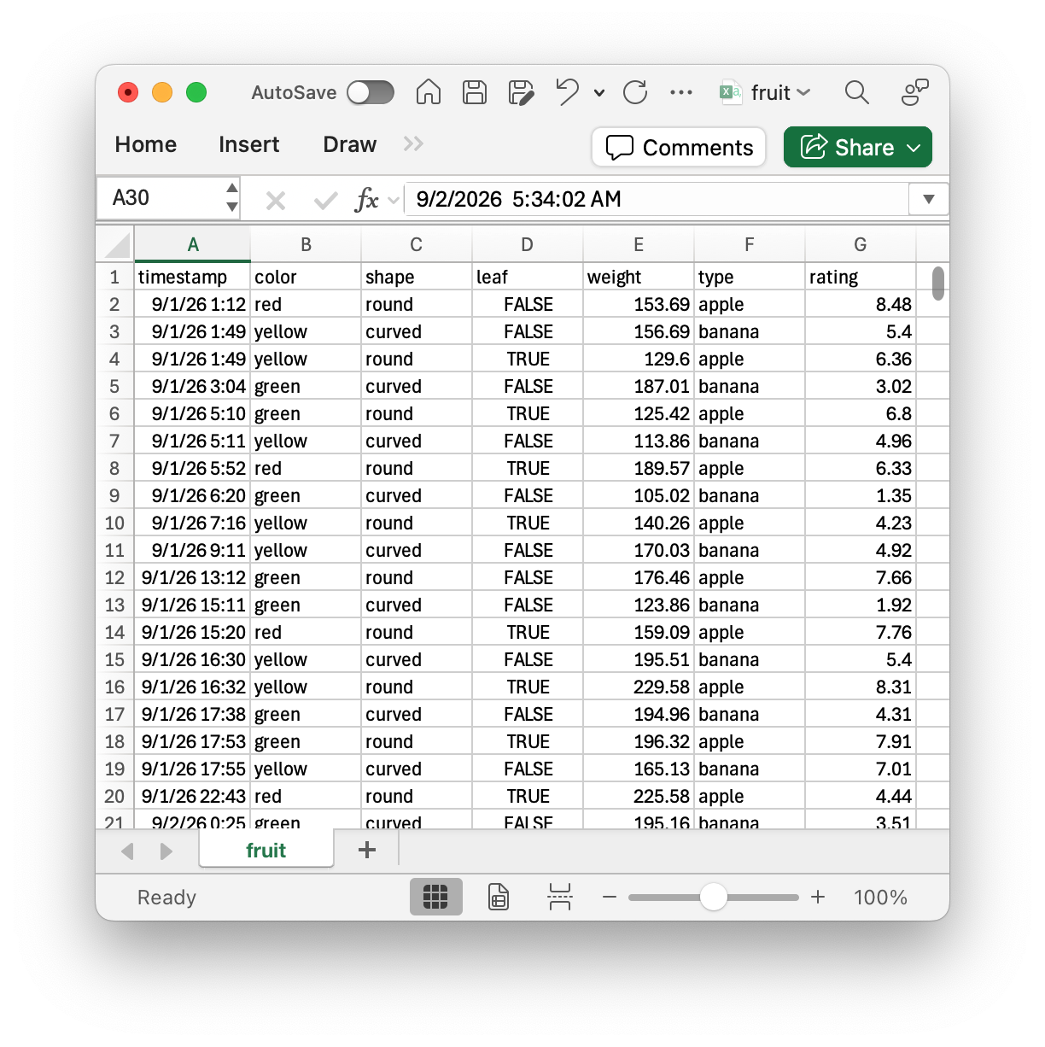
Pre-processing
pre-process
learn
learn
ML Model
ML Model
Encode data
  hot-one encoding
  dummy encoding
Throw out outlier examples
Remove noisy features
Pick “good” features
Normalize feature values
  center data
  scale data

Slide 22
Example: Pre-processing w/ Pandas
import pandas
# read csv file into pandas dataframe
data = pandas.read_csv("fruit.csv")
# ways to delete columns
data = data.drop(columns=["timestamp","rating"])
type = data.pop("type")
# one-hot encode
cat_cols = ["color","shape"]
encoded_data = pandas.get_dummies(data,columns=cat_cols)
# add column
encoded_data["type"] = type
# write pandas dataframe to csv file
encoded_data.to_csv("fruit-encoded.csv")

Slide 23
Exercise: Pre-processing Data
Pre-process the file example.csv to make the following changes:
  drop the Student_ID column and the columns about ethical concerns, overall satisfaction, and future AI intentions
  one hot or dummy encode the remaining categorical columns (except the one about stress level)

Slide 24
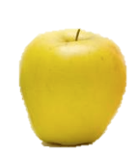
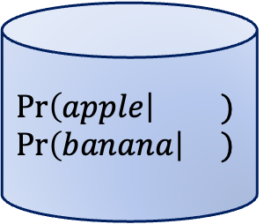
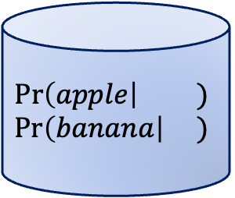
Naïve Bayes
Idea: for each possible label, calculate probability that testing data would have that label, pick label with highest probability conditioned on that data
training = figuring out those probabilities
past
future
label₁
learn
predict
ML Model
$$Pr\left(apple\right| )$$
$$Pr\left(banana\right| )$$
$$Pr\left(apple\right| )$$
$$Pr\left(banana\right| )$$
ML Model
label₂
Pick
argmax
label₃
Testing Data
label₅
Training Data

Slide 25
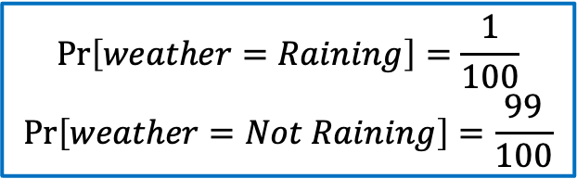

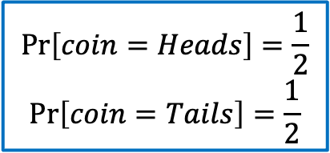
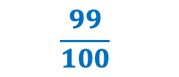
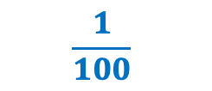

Review: Probability
Probability is the math of describing how likely something is
A probability is a number in the range [0,1] that describes how likely something is.
Flip a coin
Coin
Weather
$$\frac{1}{2}$$
$$\frac{1}{2}$$
$$\frac{1}{100}$$
$$\frac{99}{100}$$
Heads
Tails
Raining
Not Raining
$$Pr\left[coin=Heads\right]=\frac{1}{2}$$
$$Pr\left[coin=Tails\right]=\frac{1}{2}$$
$$Pr\left[weather=Raining\right]=\frac{1}{100}$$
$$Pr\left[weather=Not Raining\right]=\frac{99}{100}$$
Notes:
Things that happen with probability 1 definitely happen.
Things that happen with probability 0 definitely don’t happen.

Slide 26
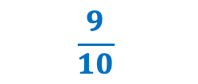
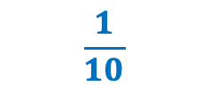
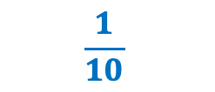
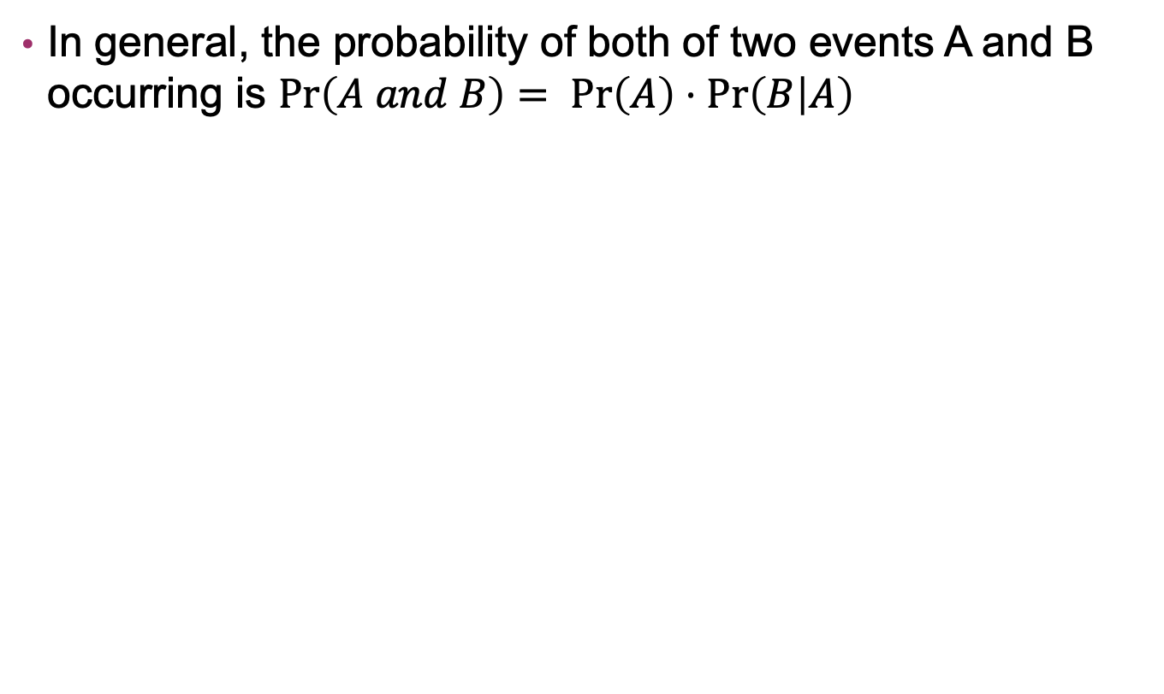

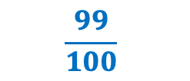

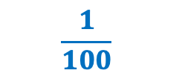
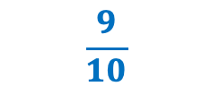
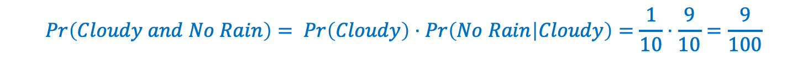
Review: Combining Probabilities
In general, the probability of both of two events A and B occurring is $Pr\left(A and B\right)= Pr\left(A\right)⋅Pr\left(B | A\right)$
Weather
Weather
$$\frac{1}{10}$$
$$\frac{9}{10}$$
$$\frac{1}{100}$$
$$\frac{99}{100}$$
Cloudy
Not Cloudy
Rain
No Rain
$$\frac{1}{10}$$
$$\frac{9}{10}$$
$$0$$
$$1$$
Rain
No Rain
Rain
No Rain
$$Pr\left(Cloudy and No Rain\right)= Pr\left(Cloudy\right)⋅Pr\left(No Rain | Cloudy\right)=\frac{1}{10}⋅\frac{9}{10}=\frac{9}{100}$$

Slide 27
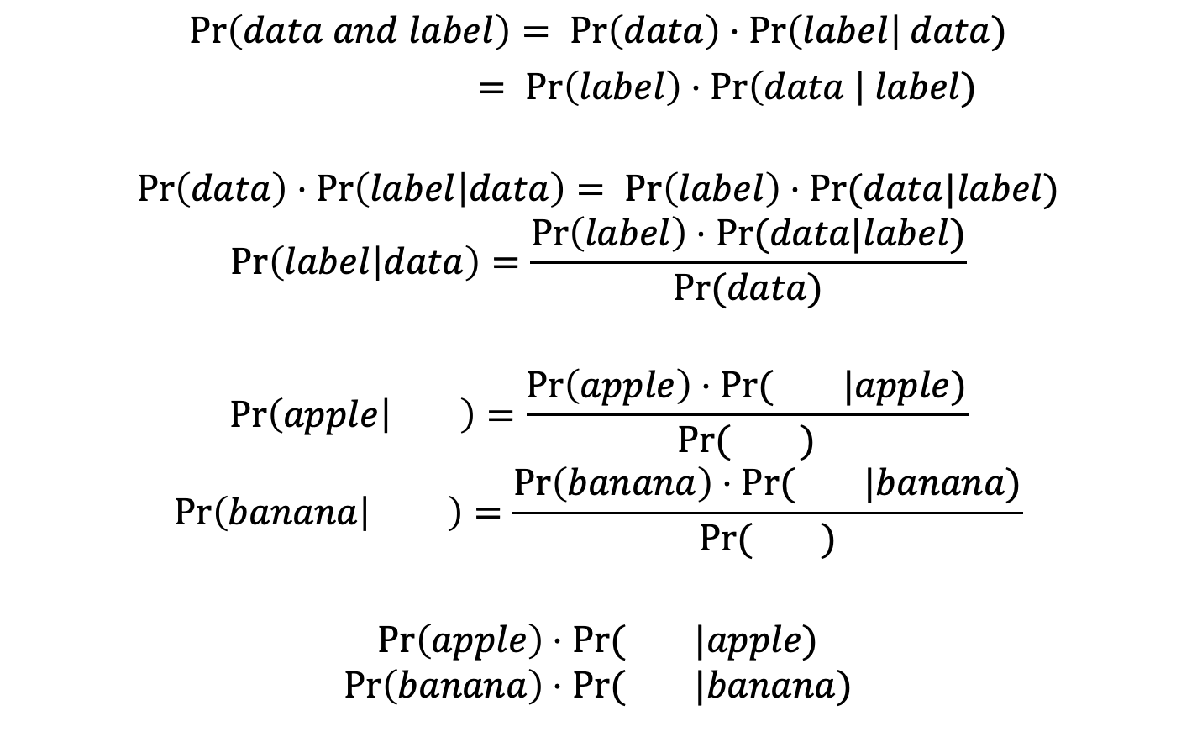
Bayes Rule
$$Pr\left(data and label\right)= Pr\left(data\right)⋅Pr\left(label\right| data)$$
$= Pr\left(label\right)⋅Pr\left(data \right| label)$
$$Pr\left(data\right)⋅Pr\left(label | data\right)= Pr\left(label\right)⋅Pr(data|label)$$
$$Pr\left(label | data\right)=\frac{Pr\left(label\right)⋅Pr(data|label)}{Pr(data)}$$
$$Pr\left(apple | \right)=\frac{Pr\left(apple\right)⋅Pr( |apple)}{Pr( )}$$
$$Pr\left(banana | \right)=\frac{Pr\left(banana\right)⋅Pr( |banana)}{Pr( )}$$
$$Pr\left(apple\right)⋅Pr( |apple)$$
$$Pr\left(banana\right)⋅Pr( |banana)$$
Pick
argmax
Pick
argmax

Slide 28
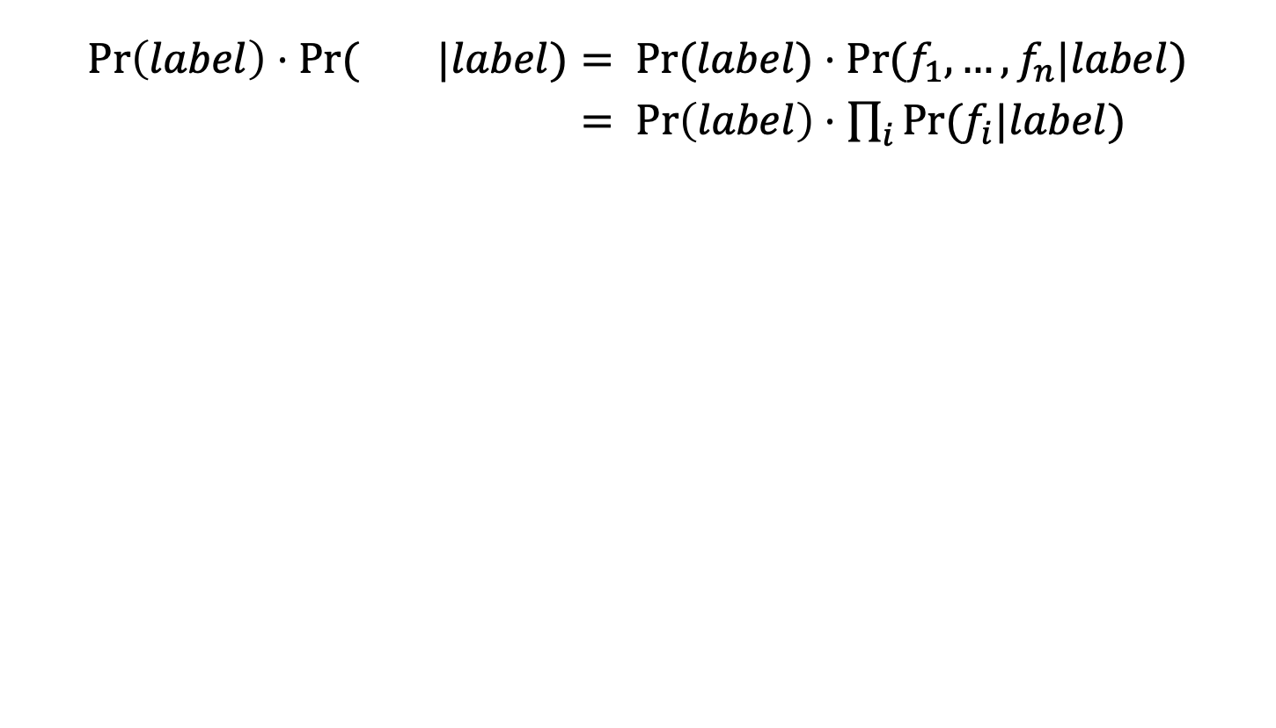
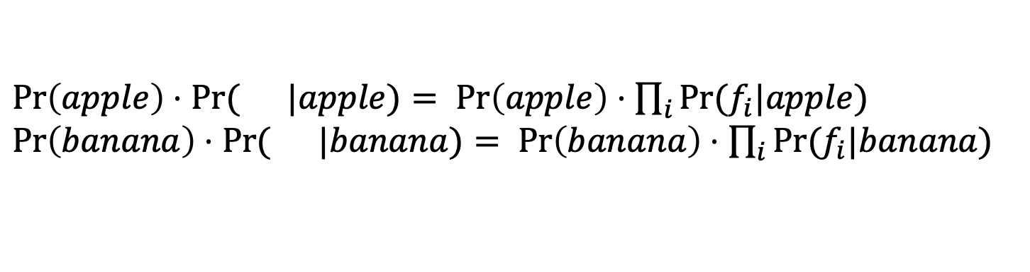
Naïve Bayes
$$Pr\left(label\right)⋅Pr( |label)= Pr(label)⋅Pr(f_{1},…,f_{n}|label)$$
$= Pr\left(label\right)⋅\prod_{i}{Pr(f_{i}|label})$
$Pr\left(apple\right)⋅Pr( |apple)$ $= Pr\left(apple\right)⋅\prod_{i}{Pr(f_{i}|apple})$
$Pr\left(banana\right)⋅Pr( |banana)$ $= Pr\left(banana\right)⋅\prod_{i}{Pr(f_{i}|banana})$
Pick
argmax

Slide 29
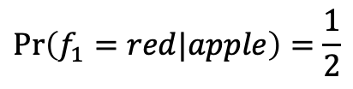
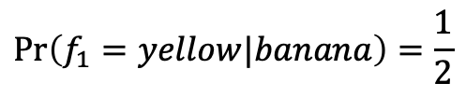
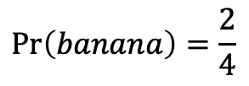
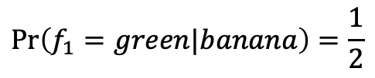
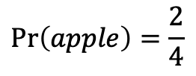
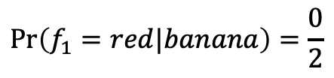
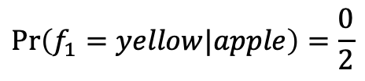
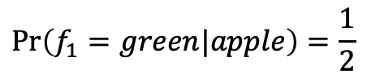
Estimating Probabilities
training
data
$$Pr\left(apple\right)=\frac{2}{4}$$
features
labels
$$Pr\left(banana\right)=\frac{2}{4}$$
red, leaf
apple
$$Pr\left(f_{1}=red|apple\right)=\frac{1}{2}$$
$$Pr\left(f_{1}=green|apple\right)=\frac{1}{2}$$
green, no leaf
apple
$$Pr\left(f_{1}=yellow|apple\right)=\frac{0}{2}$$
yellow, no leaf
banana
$$Pr\left(f_{1}=red|banana\right)=\frac{0}{2}$$
green, no leaf
banana
$$Pr\left(f_{1}=green|banana\right)=\frac{1}{2}$$
$$Pr\left(f_{1}=yellow|banana\right)=\frac{1}{2}$$

Slide 30
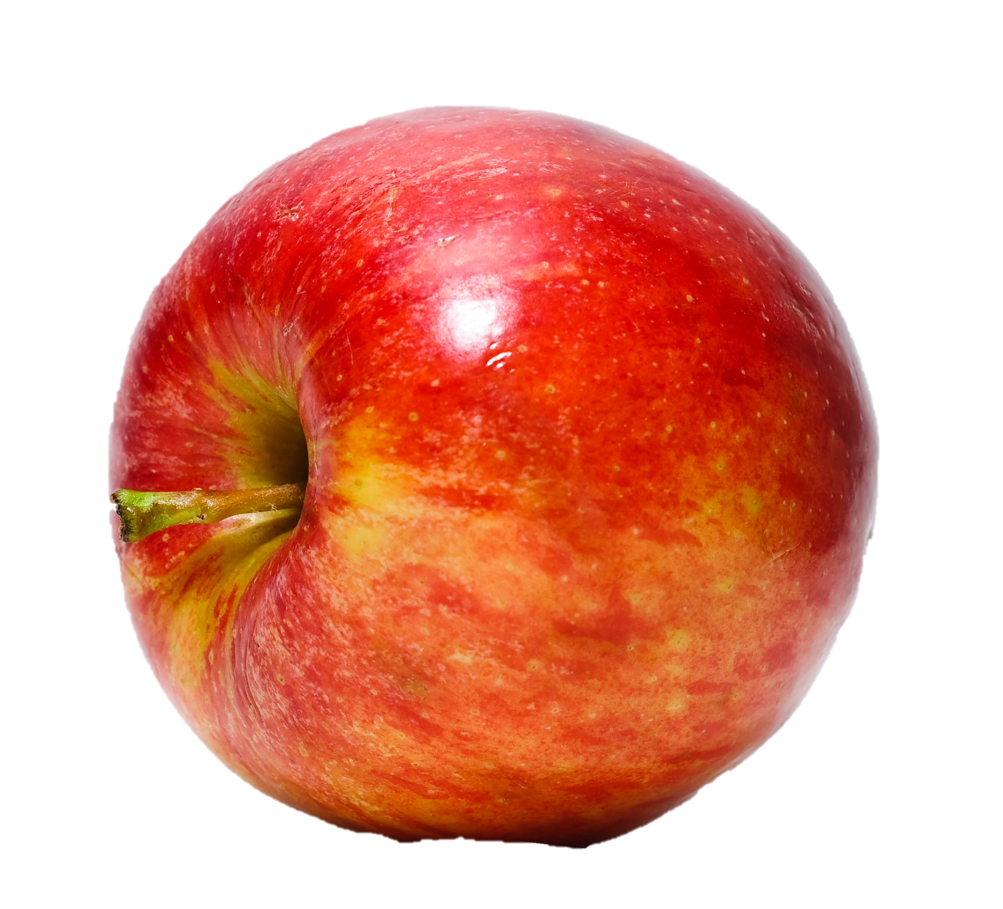
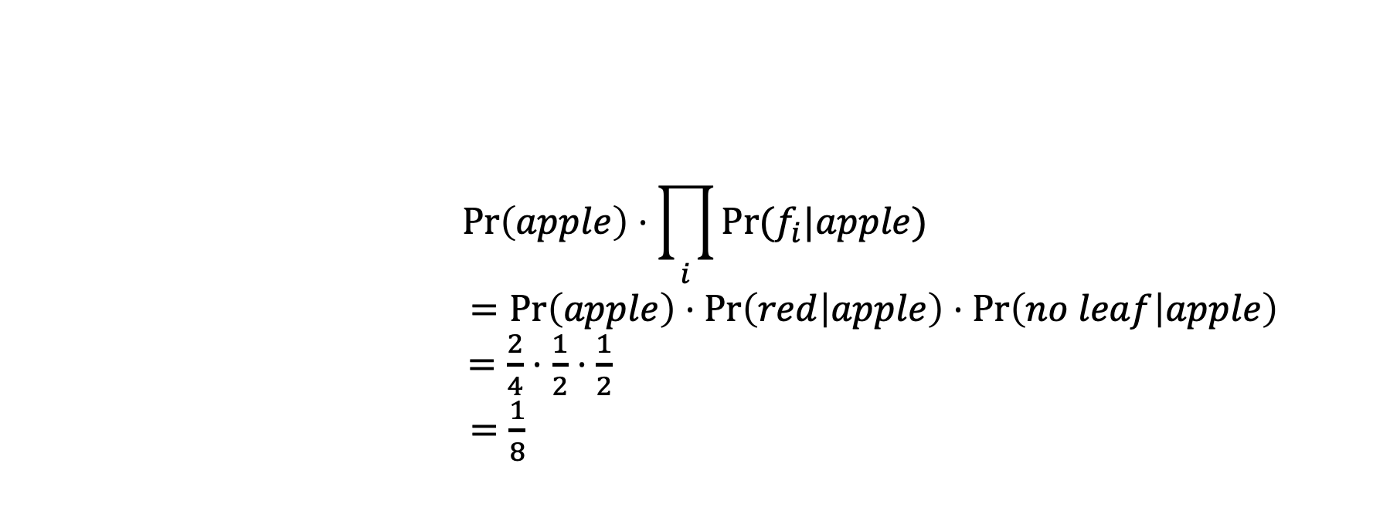
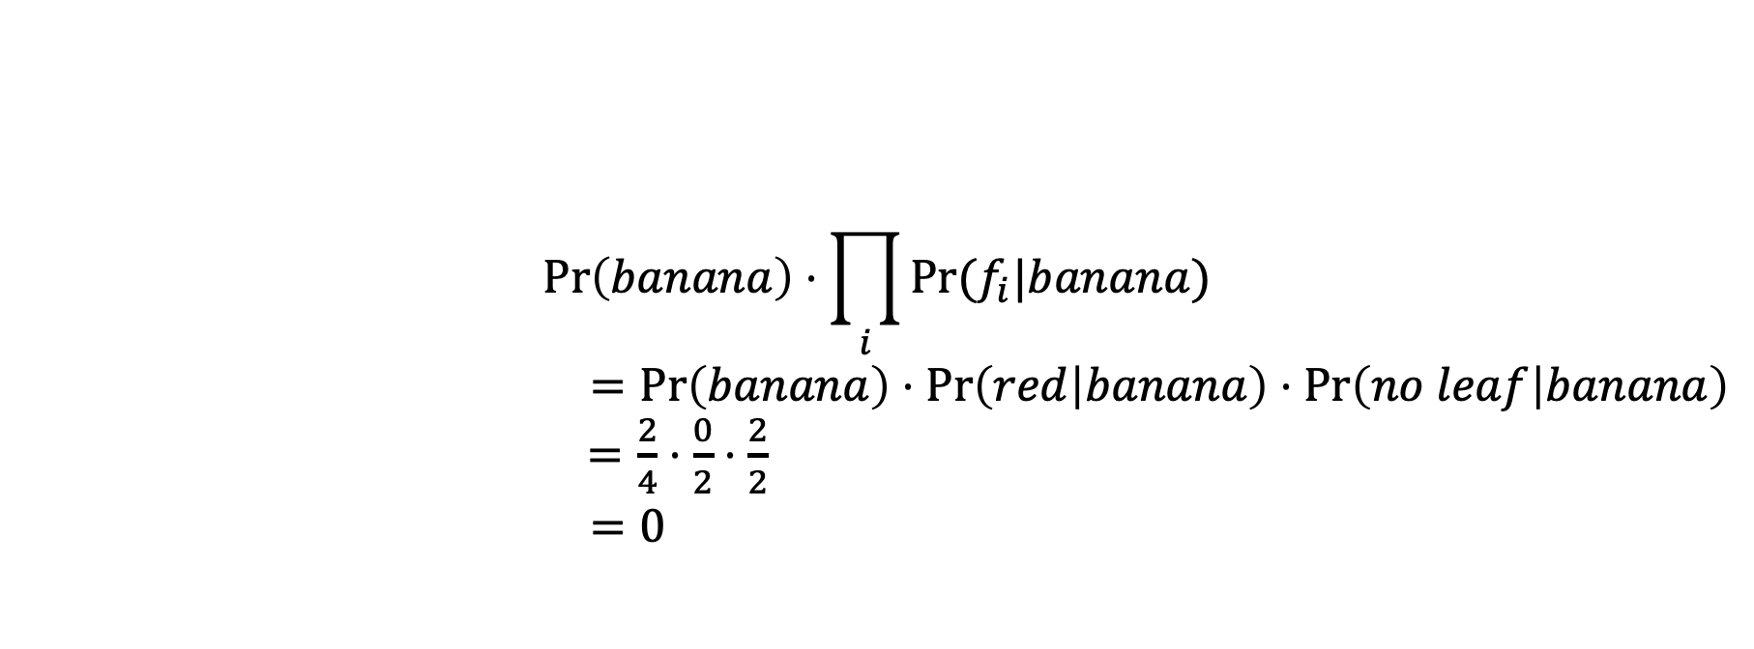
Making Predictions
red, no leaf
$$Pr\left(apple\right)⋅\prod_{i}{Pr⁡(f_{i}|apple})$$
$=Pr\left(apple\right)⋅Pr\left(red | apple\right)⋅Pr\left(no leaf | apple\right)$
$=\frac{2}{4}⋅\frac{1}{2}⋅\frac{1}{2}$
$=\frac{1}{8}$
We’ll go with apple
$$Pr\left(banana\right)⋅\prod_{i}{Pr⁡(f_{i}|banana})$$
$=Pr\left(banana\right)⋅Pr\left(red | banana\right)⋅Pr\left(no leaf | banana\right)$
$=\frac{2}{4}⋅\frac{0}{2}⋅\frac{2}{2}$
$=0$

Slide 31
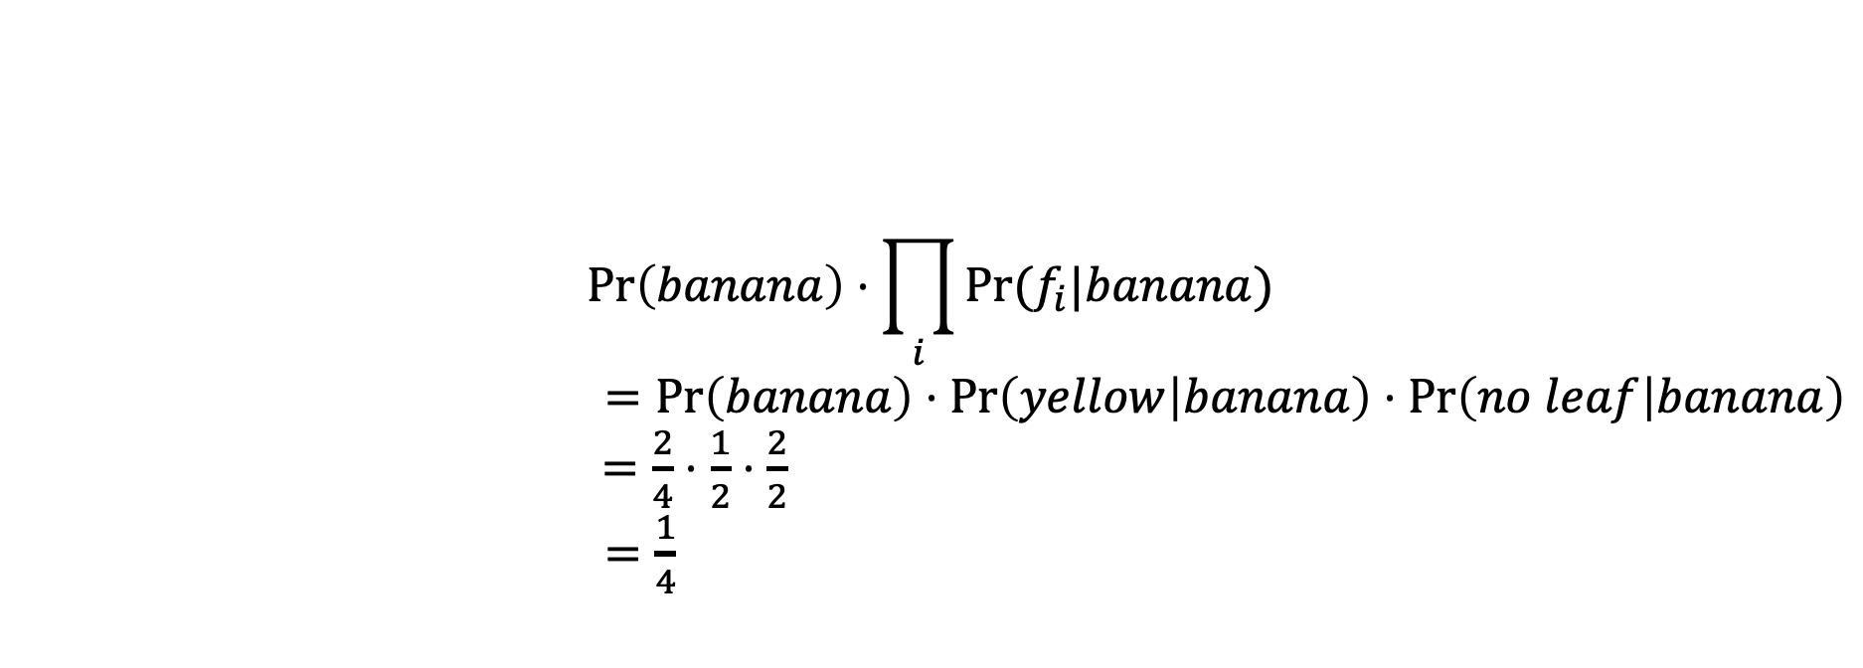
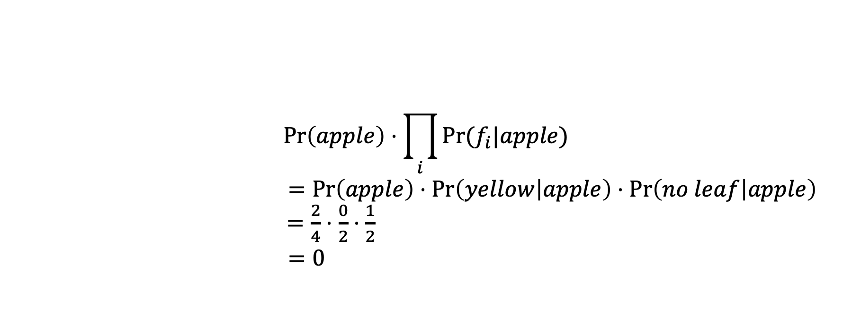
Making Predictions
yellow, no leaf
$$Pr\left(apple\right)⋅\prod_{i}{Pr⁡(f_{i}|apple})$$
$=Pr\left(apple\right)⋅Pr\left(yellow | apple\right)⋅Pr\left(no leaf | apple\right)$
$=\frac{2}{4}⋅\frac{0}{2}⋅\frac{1}{2}$
$=0$
$$Pr\left(banana\right)⋅\prod_{i}{Pr⁡(f_{i}|banana})$$
$=Pr\left(banana\right)⋅Pr\left(yellow | banana\right)⋅Pr\left(no leaf | banana\right)$
$=\frac{2}{4}⋅\frac{1}{2}⋅\frac{2}{2}$
$=\frac{1}{4}$
We’ll go with banana

Slide 32
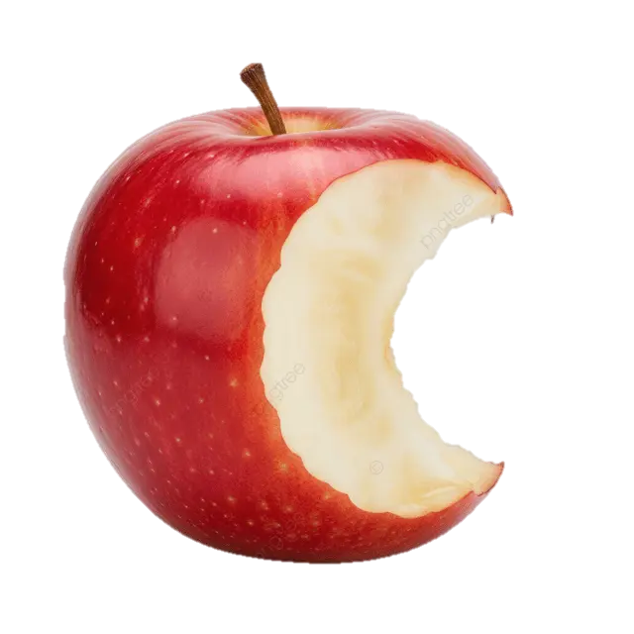
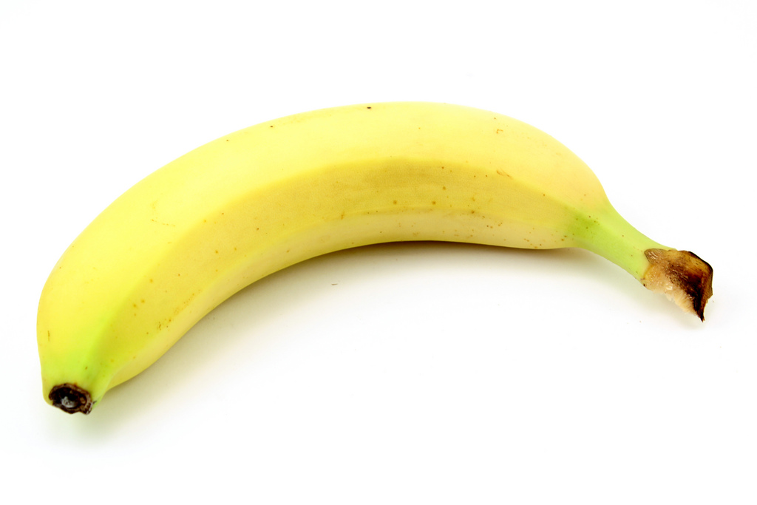
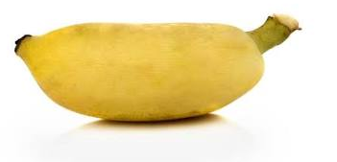


















Exercise: Naïve Bayes
$$Pr\left(label\right)⋅\prod_{i}{Pr⁡(f_{i}|label})$$
$f_{1}$, $f_{2}$ label
Given the training set on the left:
Evaluate the likelihood that a new value (green, curved) is an apple
Evaluate the likelihood that a new value (green, curved) is a banana.
Evaluate the likelihood that a new value (green, round) is an apple.
Evaluate the likelihood that a new value (green, round) is a banana
red, curved apple
green, round apple
$$\frac{5}{8}$$
$$⋅\frac{1}{5}$$
$$⋅\frac{1}{5}$$
$$=\frac{1}{40}$$
green, curved banana
yellow, curved banana
$$\frac{3}{8}$$
$$⋅\frac{1}{3}$$
$$⋅\frac{2}{3}$$
$$=\frac{1}{12}$$
We’ll go with banana
yellow, round apple
red, round. apple
$$\frac{5}{8}$$
$$⋅\frac{1}{5}$$
$$⋅\frac{4}{5}$$
$$=\frac{1}{10}$$
We’ll go with apple
yellow, round. banana
yellow, round apple
$$\frac{3}{8}$$
$$⋅\frac{1}{3}$$
$$⋅\frac{1}{3}$$
$$=\frac{1}{24}$$

Slide 33



Aside: NB generative story
$$Pr\left(label\right)⋅\prod_{i}{Pr(f_{i}|label})$$
Pick a label according to $p(ℓ)$
  roll a biased, num_labels-sided die
For each feature:
  randomly choose value with probability $p(f_{i}|label)$:

Slide 34
Example: Training a NB model
from sklearn.model_selection import train_test_split
from sklearn.naive_bayes import GaussianNB, BernoulliNB
# define your training data and target labels
data = pandas.read_csv("fruit-encoded.csv")
labels = data.pop("type")
# split training + labels into training & test data
X_train,X_test,y_train,y_test = train_test_split(data, labels,
test_size=0.3, random_state=47)
# train model
model = BernoulliNB()
model.fit(X_train, y_train)
BernoulliNB for binary training data
GaussianNB for real-valued training data

Slide 35
Exercise: Training a NB model
Train a Naïve Bayes model to predict whether student stress increased, decreased, or stayed the same post-AI.

