Slide 1
Lecture 11: Opt-out of Sale
CS 181E Fall 2026

Slide 2
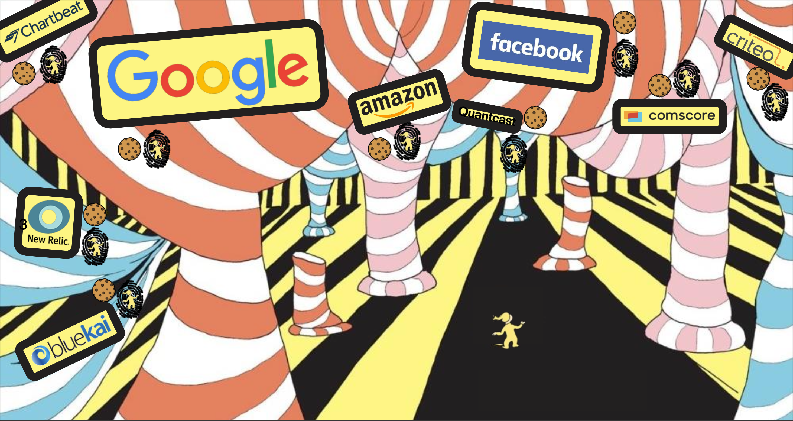
Review: Online Tracking

Slide 3
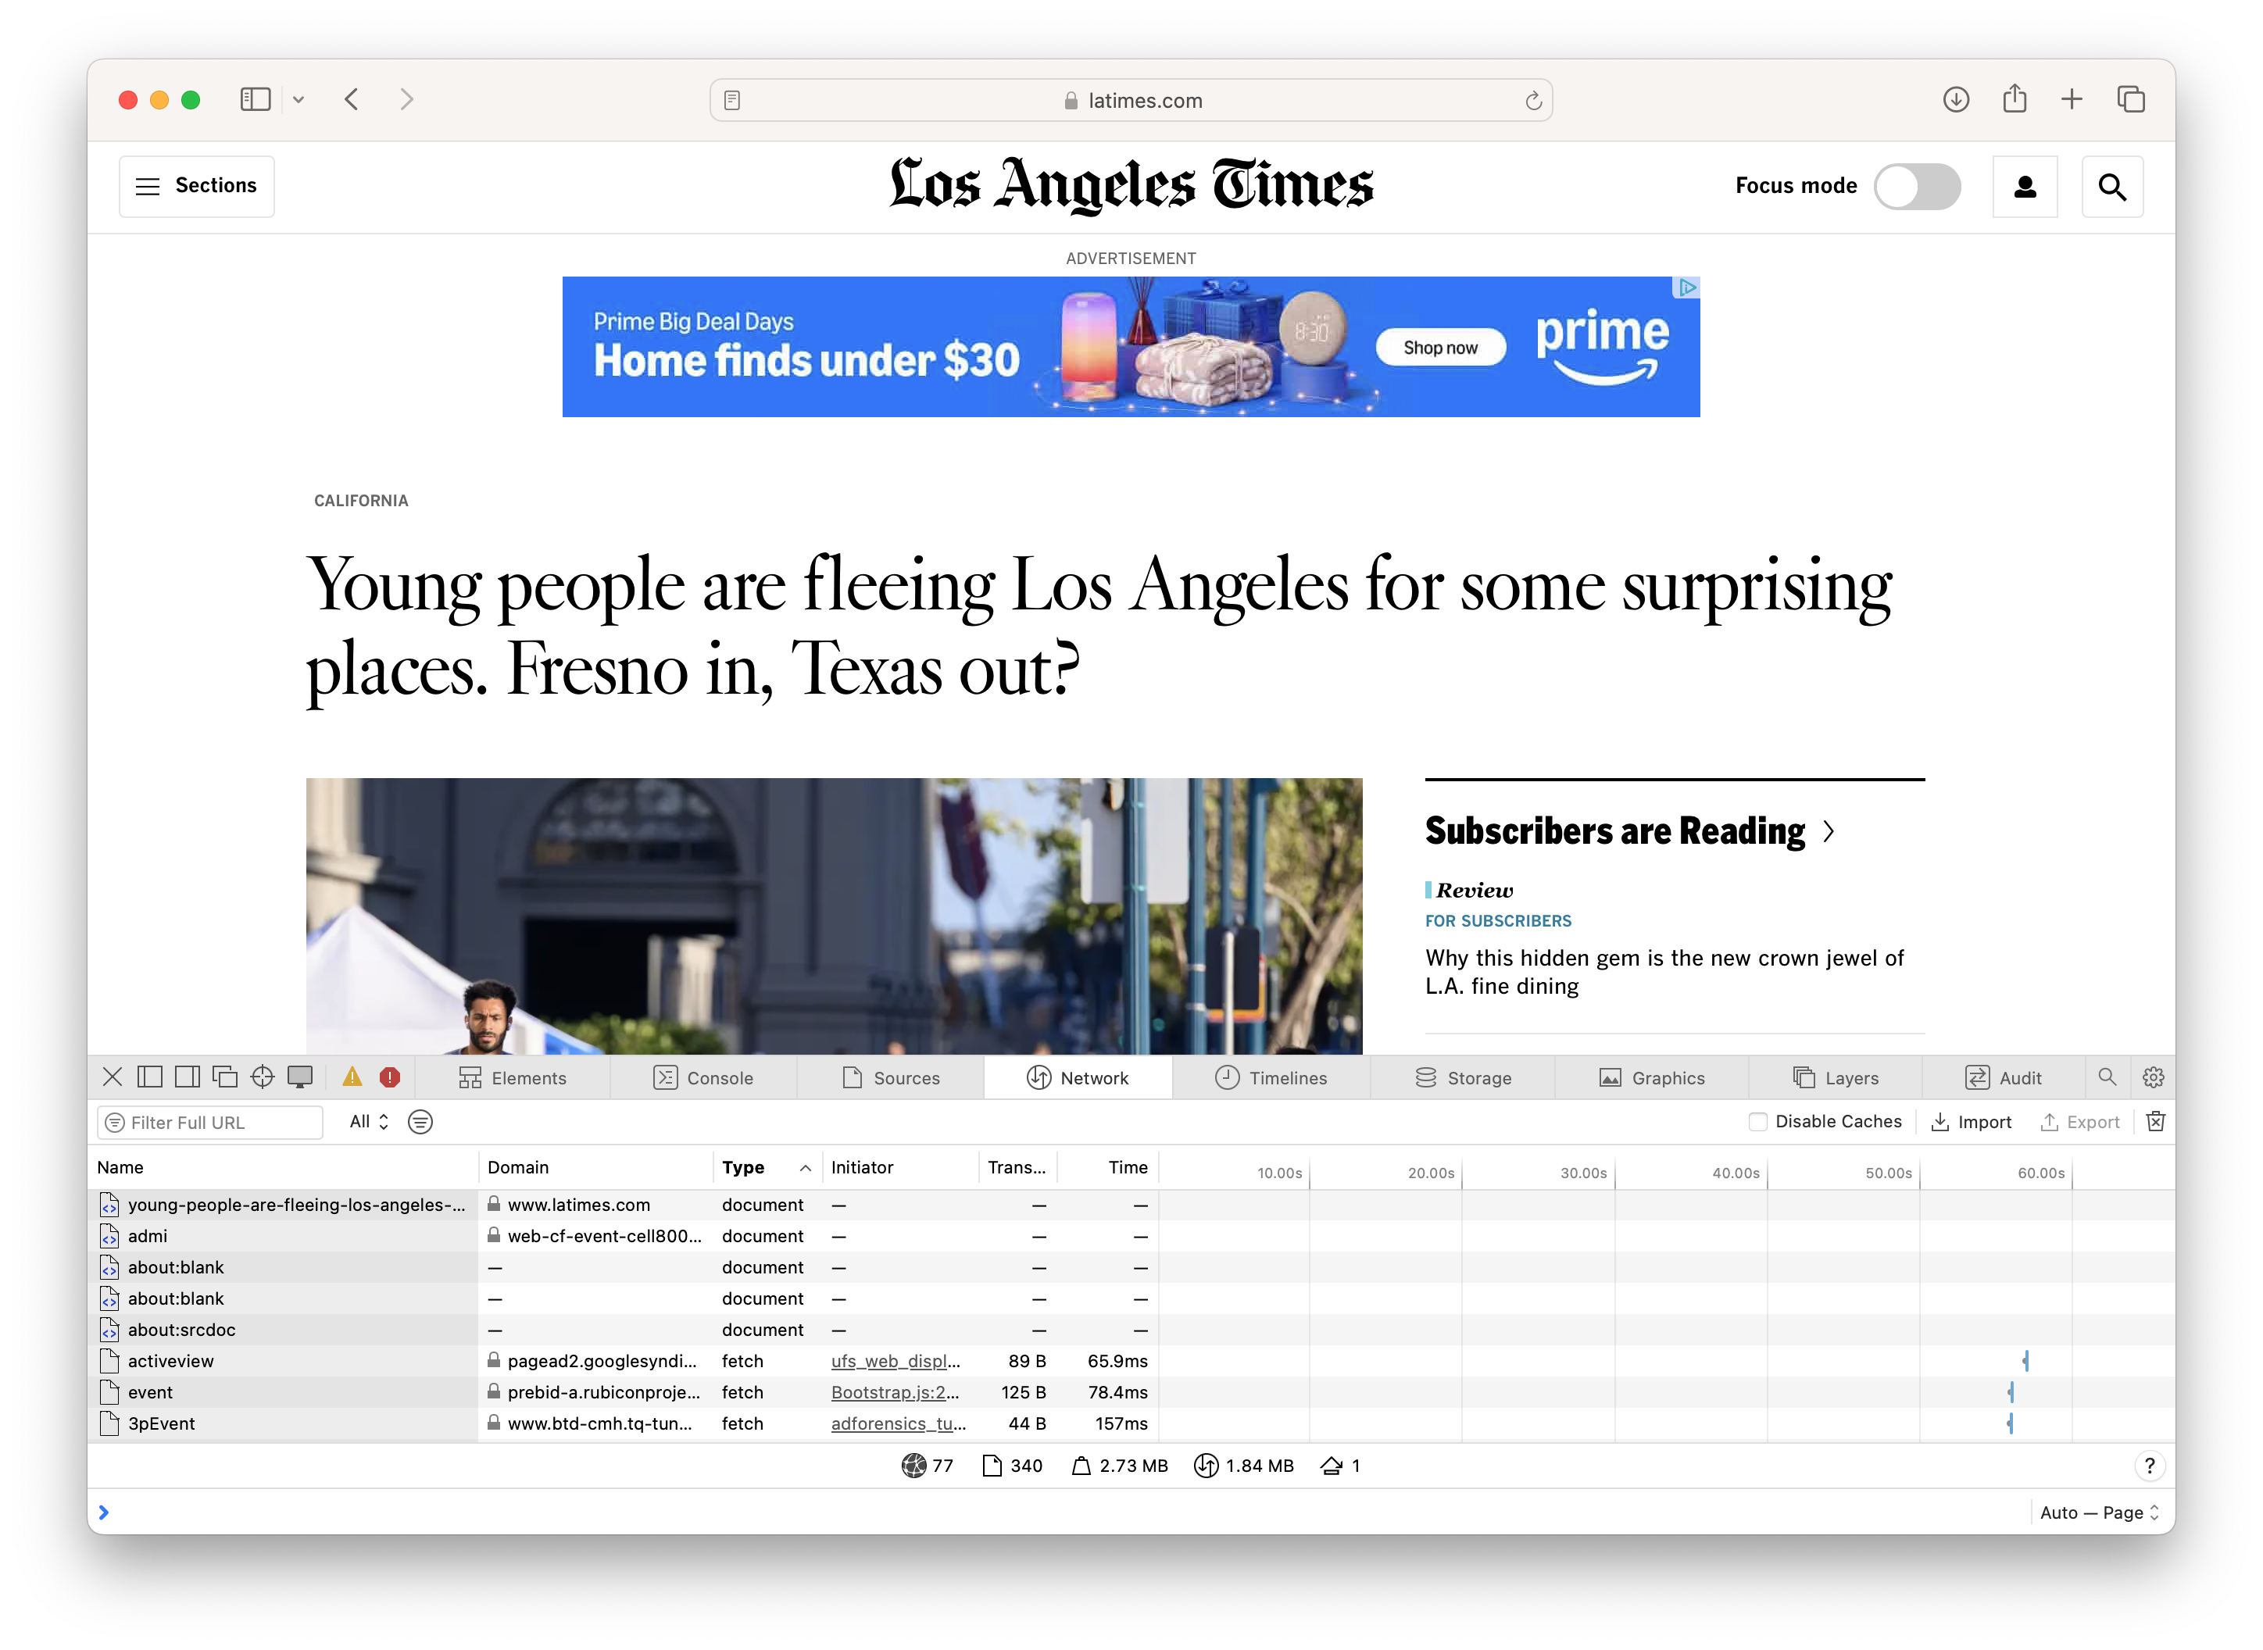
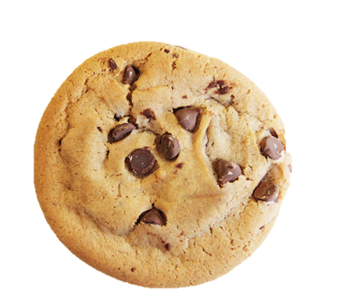
Review: Third-Party Tracking Cookies
Notes:
Demo: show latimes page in Chrome, click through all the images received over the network on preview mode, then click through images in preview mode and look at cookies for advertisers

Slide 4

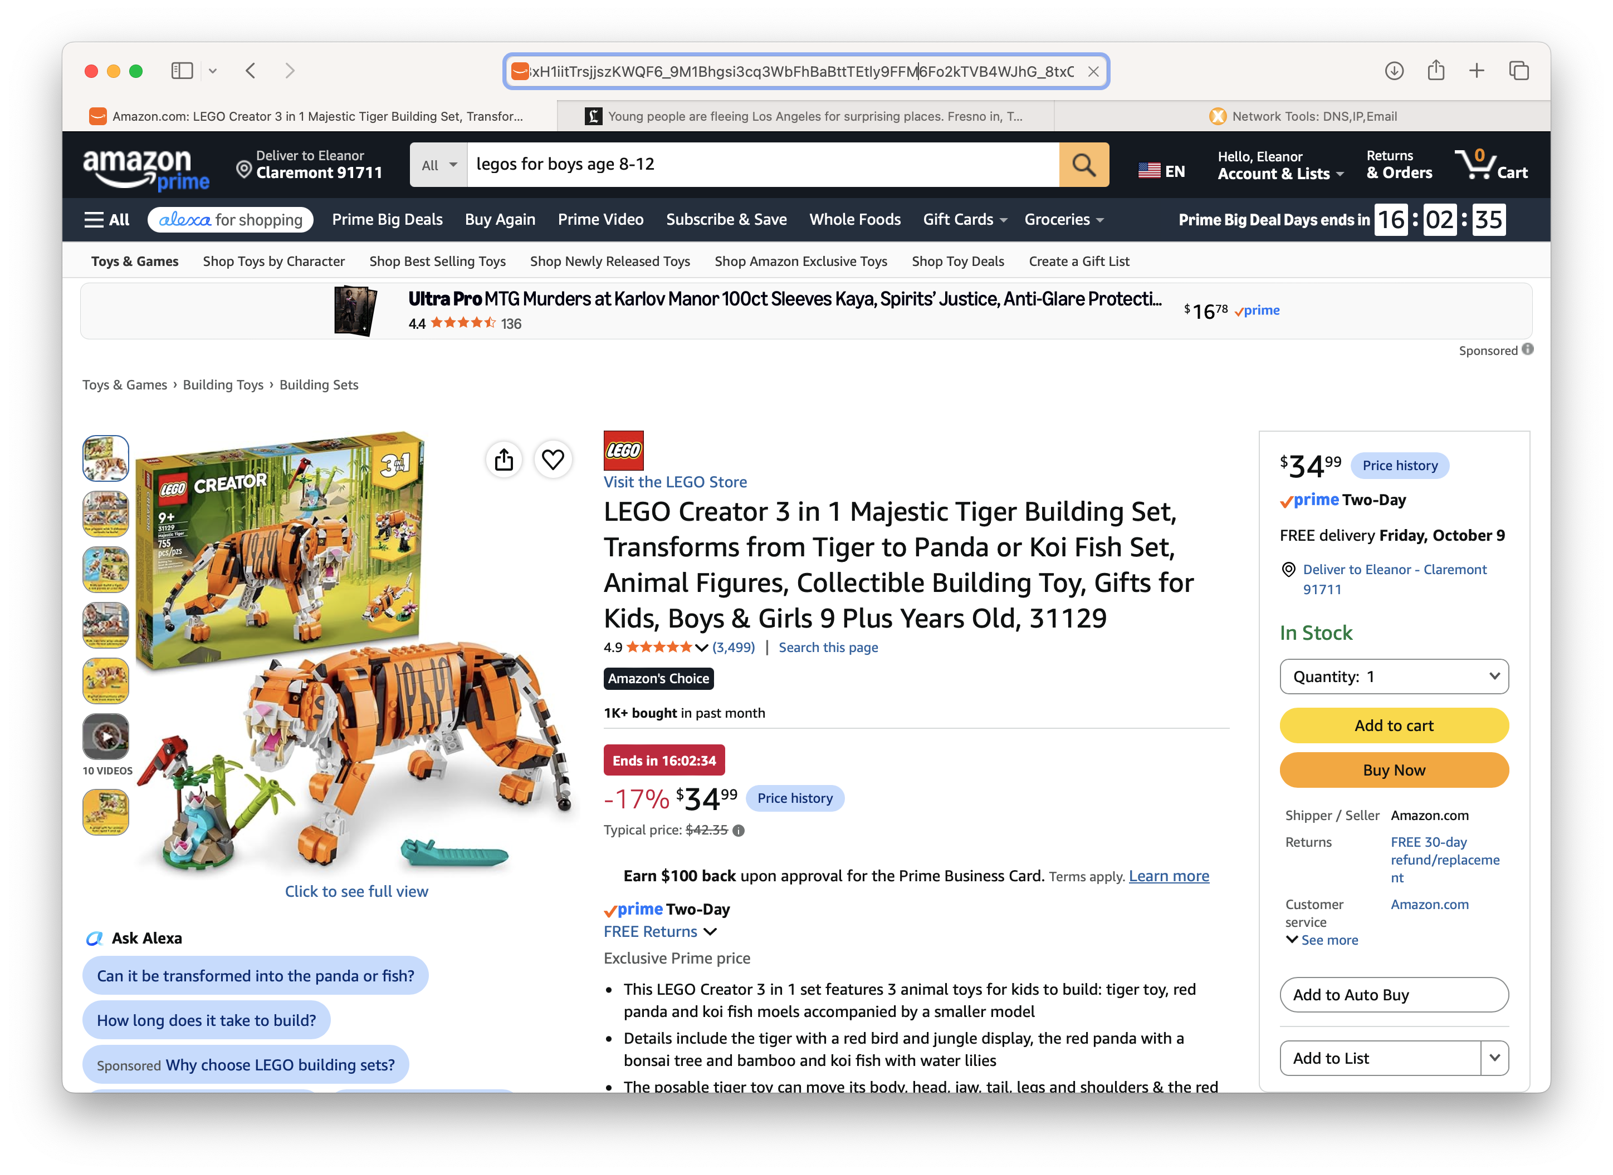
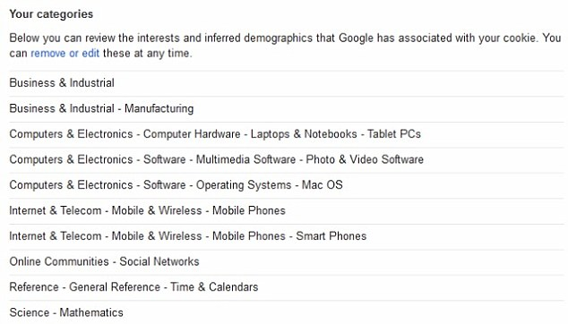
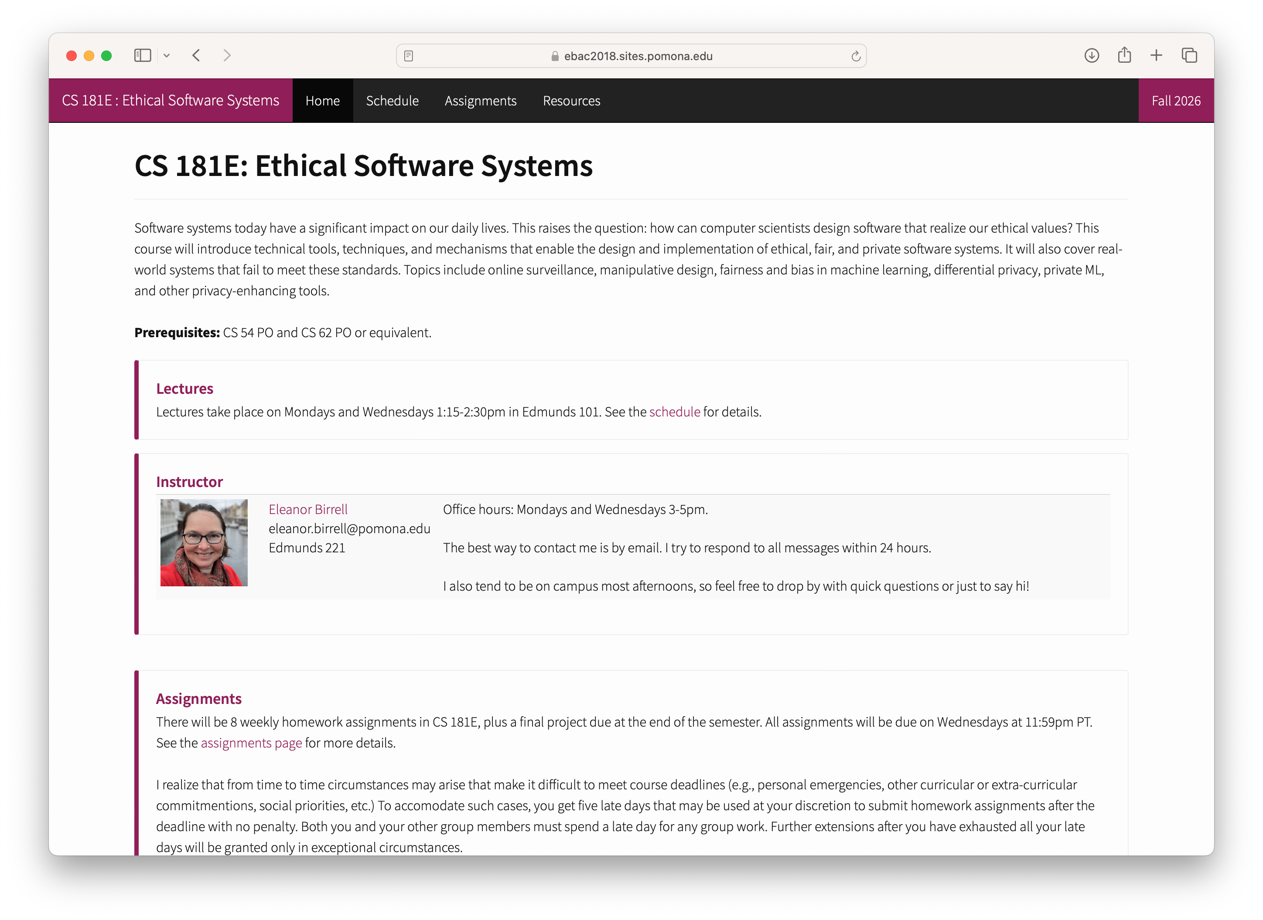
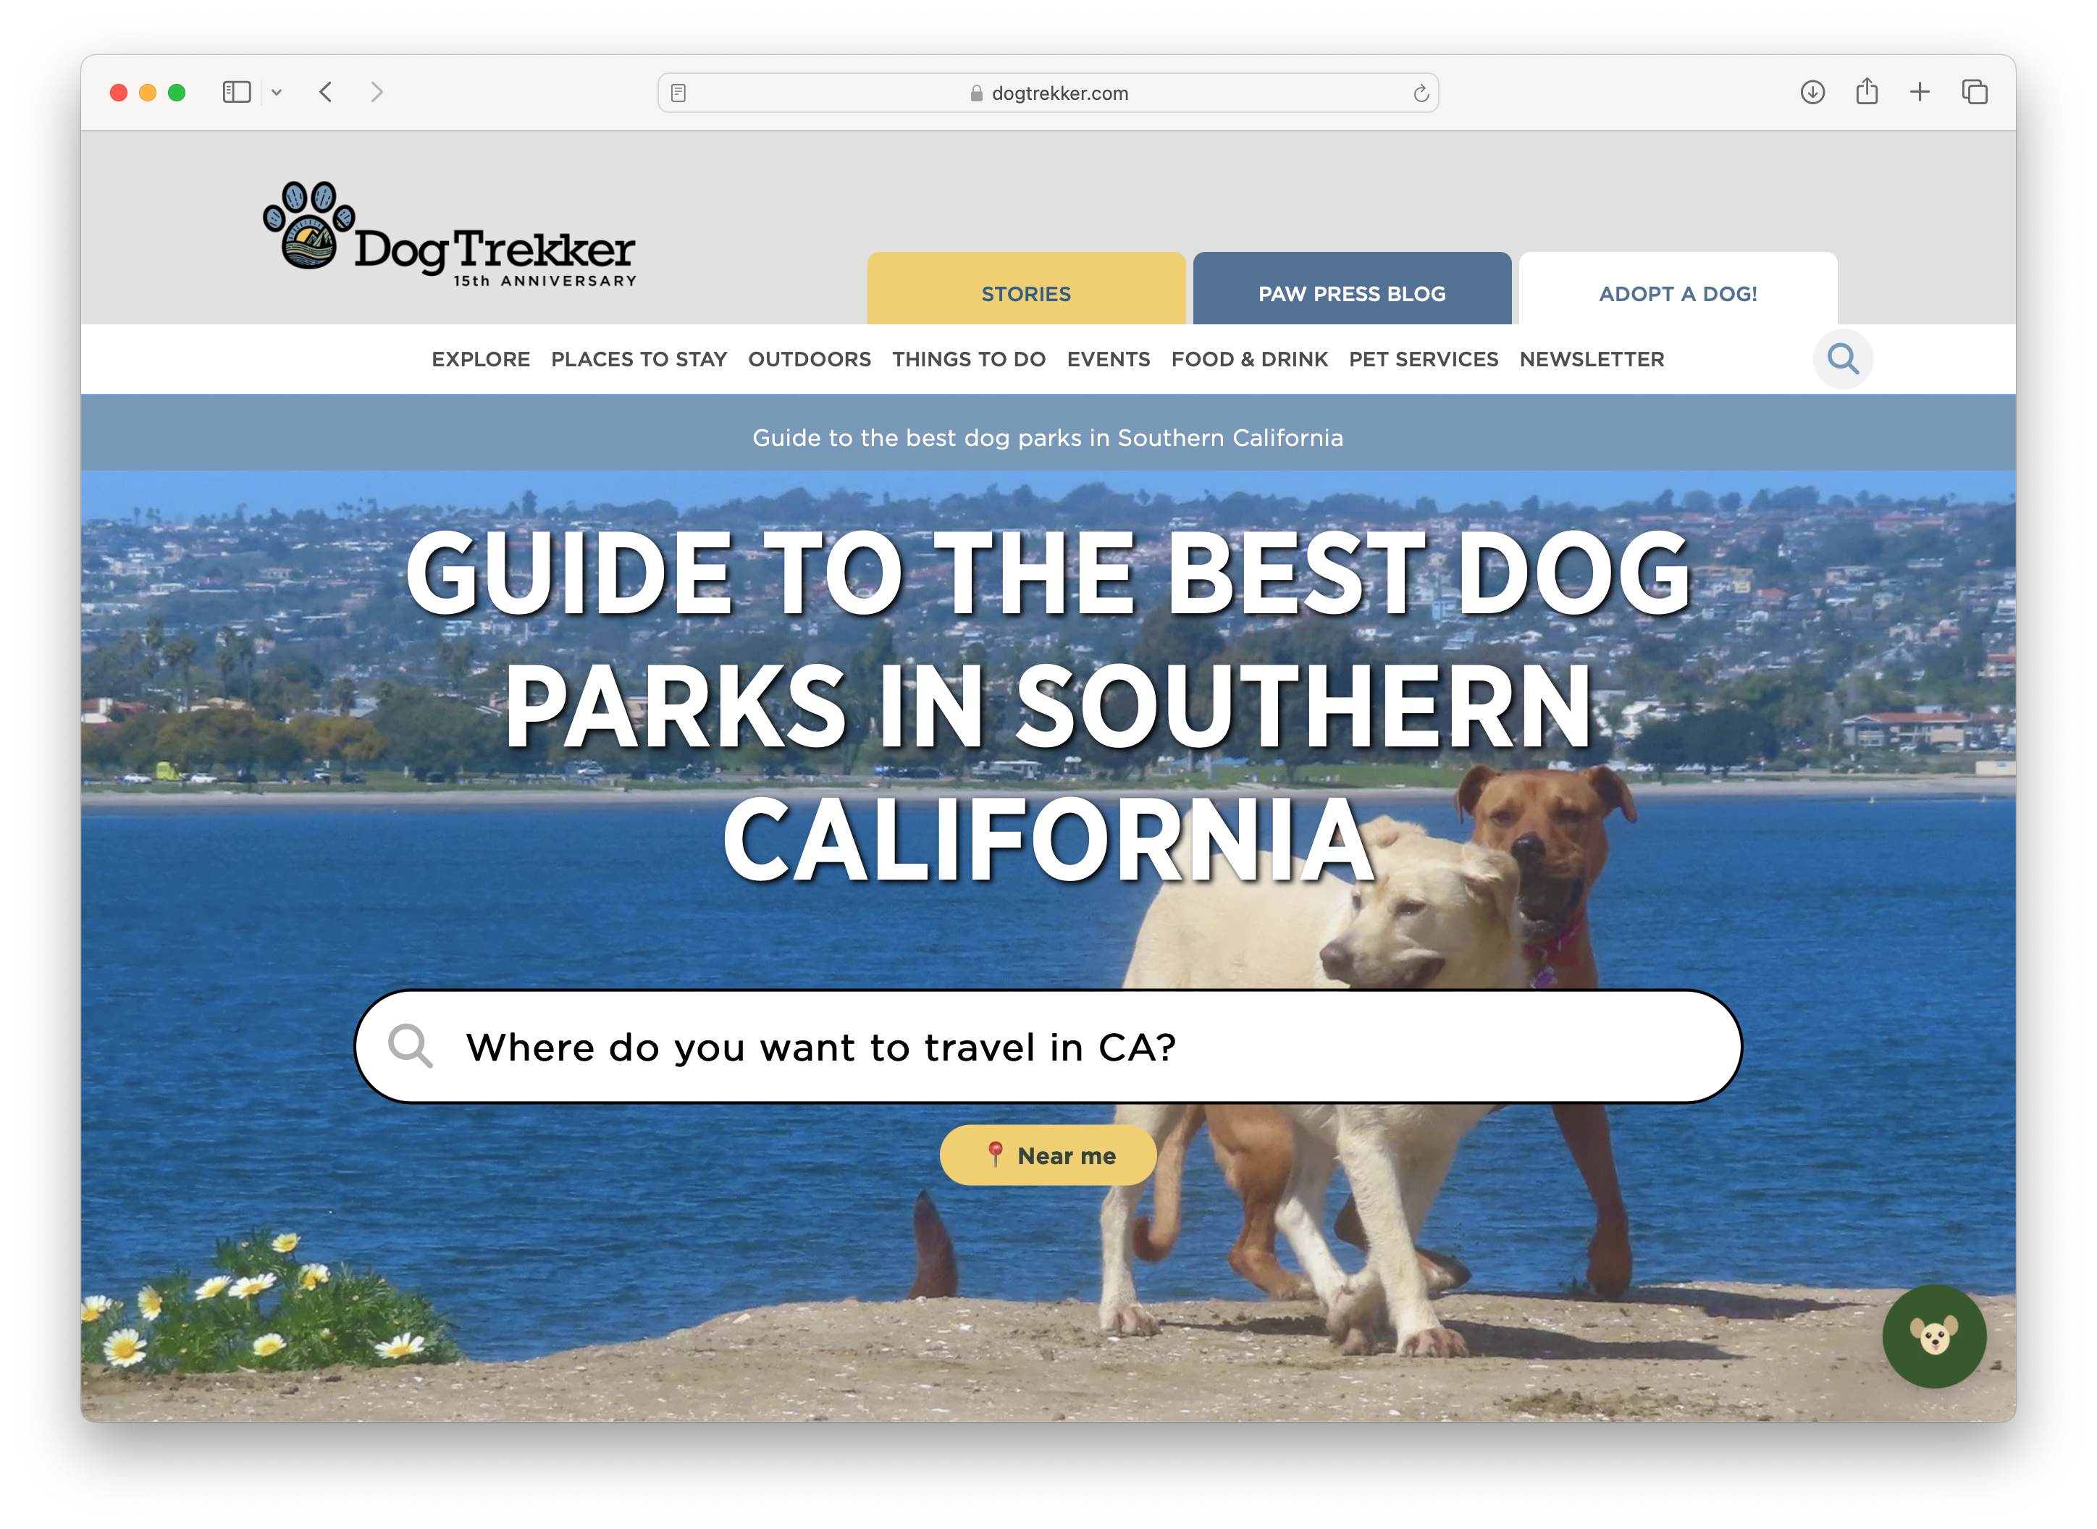
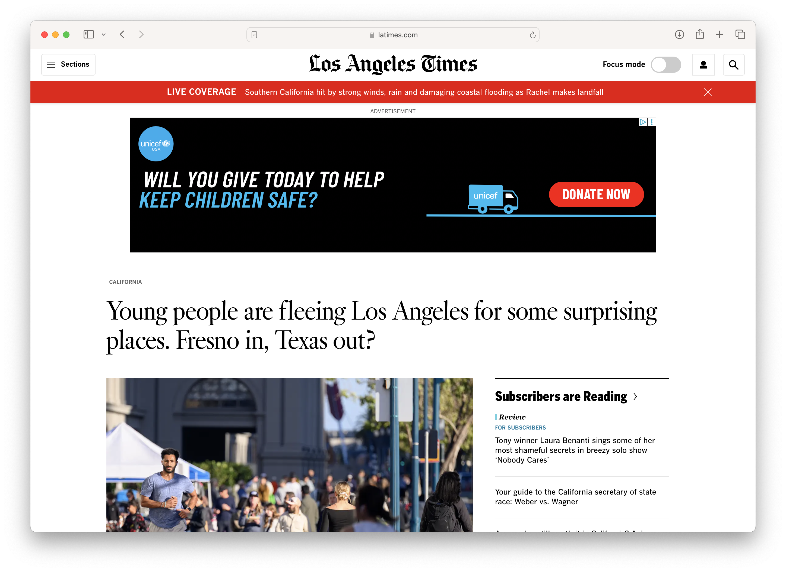
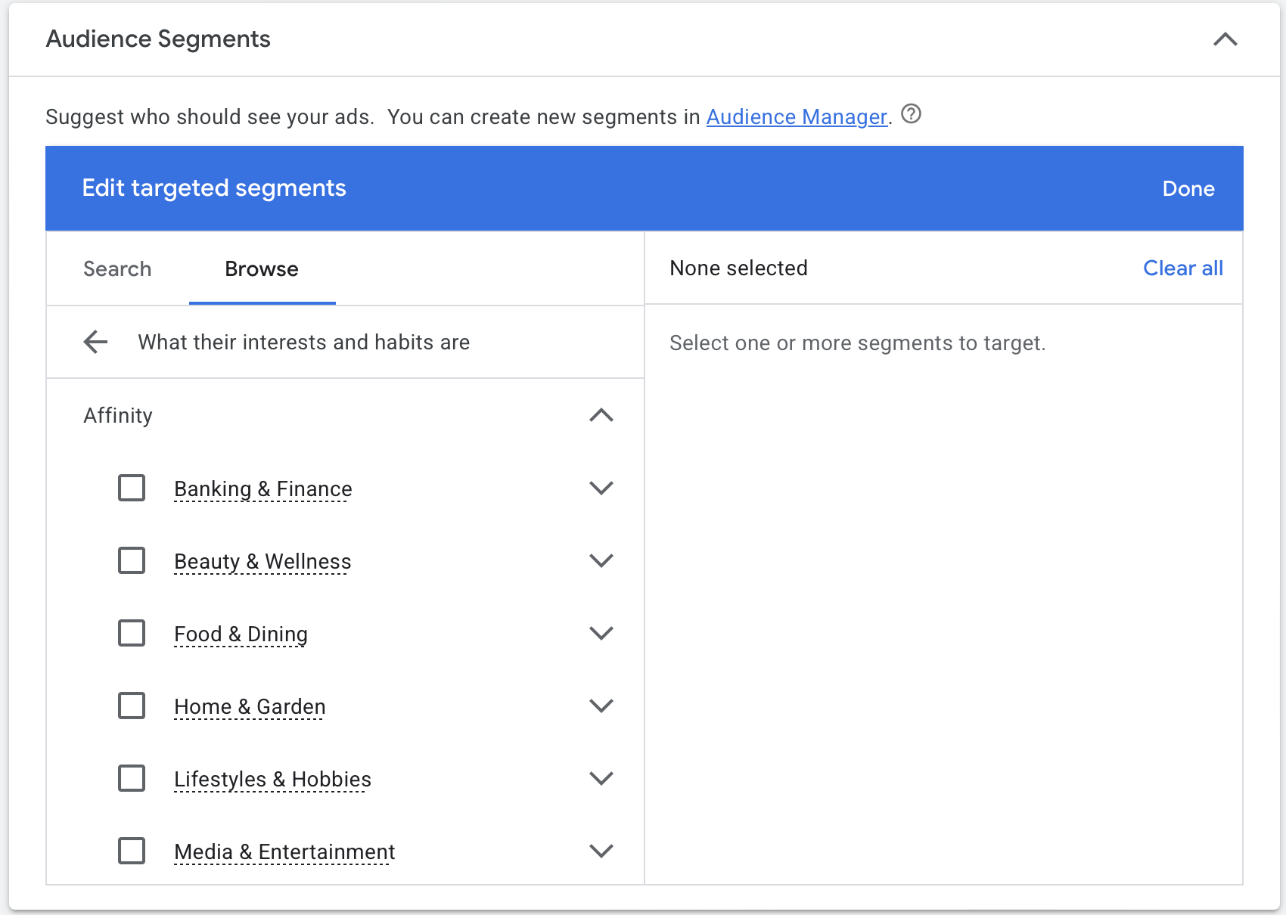

Review: Targeted Advertising

Slide 5
Review: Concerns about Tracking and Ads
privacy
discrimination
other bad societal impact

Slide 6
California Consumer Privacy Act
Goal: Give users more control over their personal information.
Introduced four key rights:
  The right to know
  The right to delete
  The right to opt-out of sale
  The right to non-discrimination
Signed: June 28, 2018
Enforced: July 1, 2020
The right to opt-out of sale

Slide 7
The Right to Opt-out of Sale
Users have the right to opt-out of the sale of their personal information.
Personal information is “information that identifies, relates to, or could reasonably be linked with you or your household.”
name, SSN, email
geolocation information
records of products purchased, internet browsing history
inferences from other personal info that could create preference profile
Sale includes selling or sharing personal information, specifically including “sharing for cross-context behavioral advertising”
Businesses must provide a "a clear and conspicuous link" on the homepage of their website
entitled "Do Not Sell My Personal Information".
Allowed language now “Do Not Sell or Share My Personal Information,” “Your Privacy Choices,” or “Your California Privacy Choices.”

Slide 8

How usable are CCPA opt-outs?
Consumer Reports study (May 2021)
identified 234 California data brokers
randomly assigned people to opt-out of sale on websites
403 participants
analyzed 3 requests each to 214 data brokers
Notes:
https://advocacy.consumerreports.org/wp-content/uploads/2021/05/CR_CCPA-Are-Consumers-Digital-Rights-Protected_092020_vf2.pdf

Slide 9
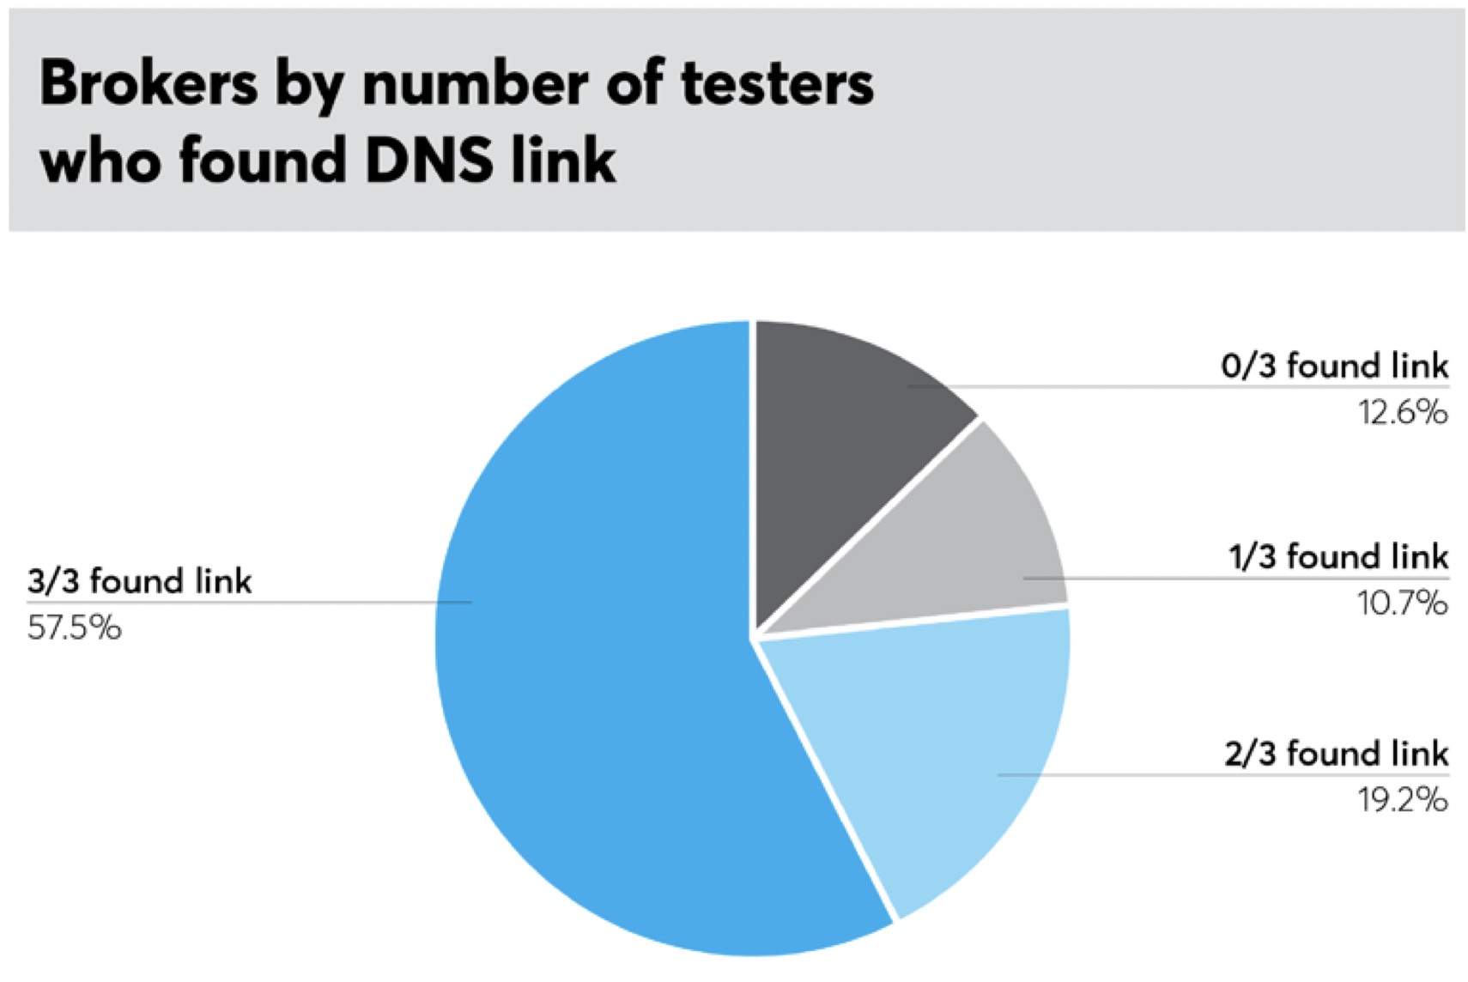
How usable are CCPA opt-outs?

Slide 10
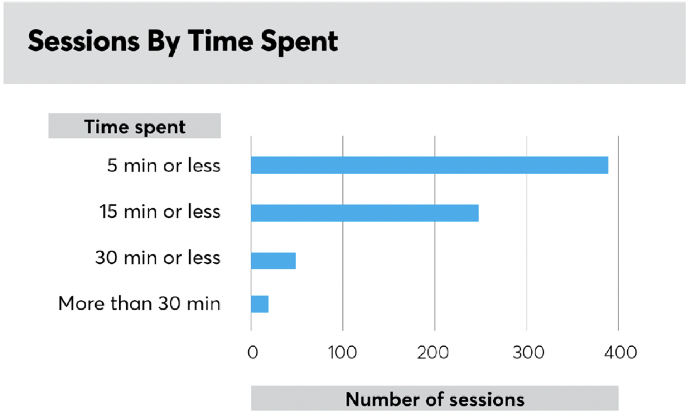
How usable are CCPA opt-outs?
Notes:
46% of the time, people were unsure whether their request had succeeded.

Slide 11
Exercise: Figure out how to opt-out
Example 1: https://www.theguardian.com/
Example 2: https://weather.com/
Example 3: https://www.espn.com
Example 4: https://www.buzzfeed.com

Slide 12
Measurement study
Top 500 websites
Conducted manually July 2020-July 2021

Slide 13
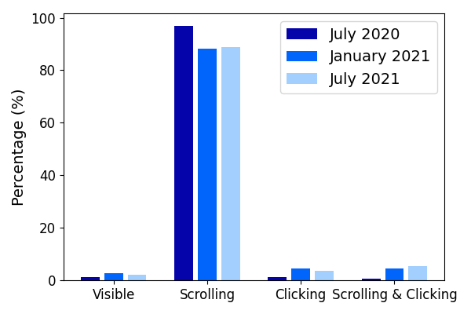
Link Accessibility (Top 500 U.S.)

Slide 14
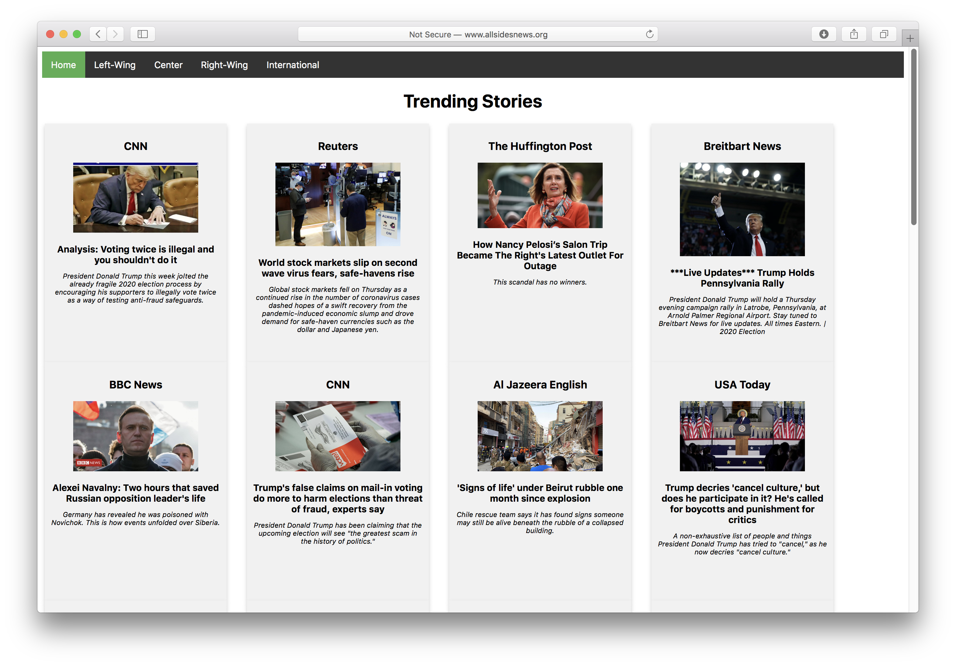
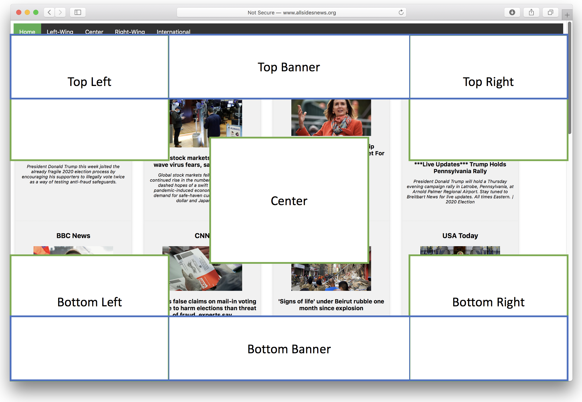
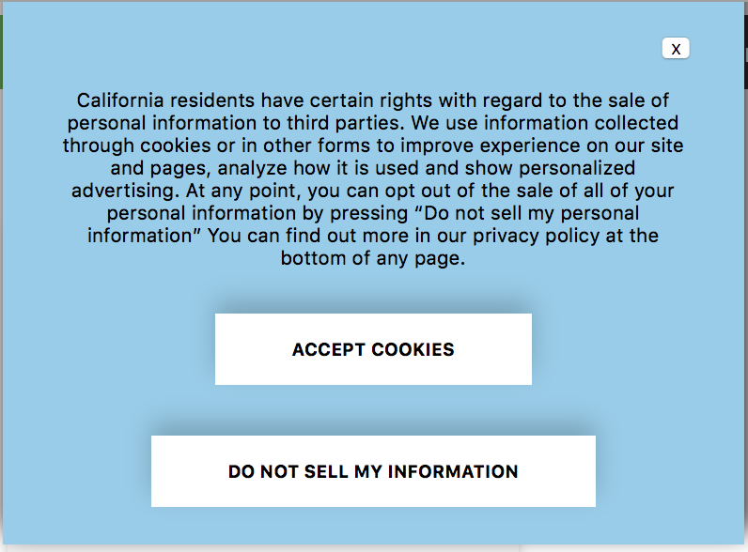
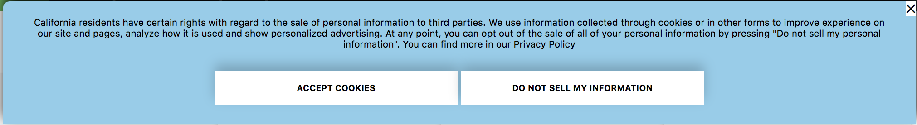
User Study: Link vs. Banners

Slide 15
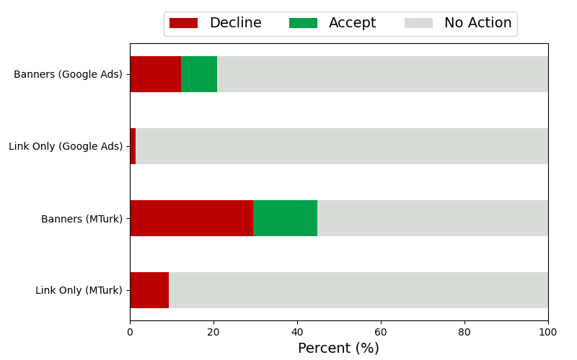
User Study: Link vs. Banners

Slide 16
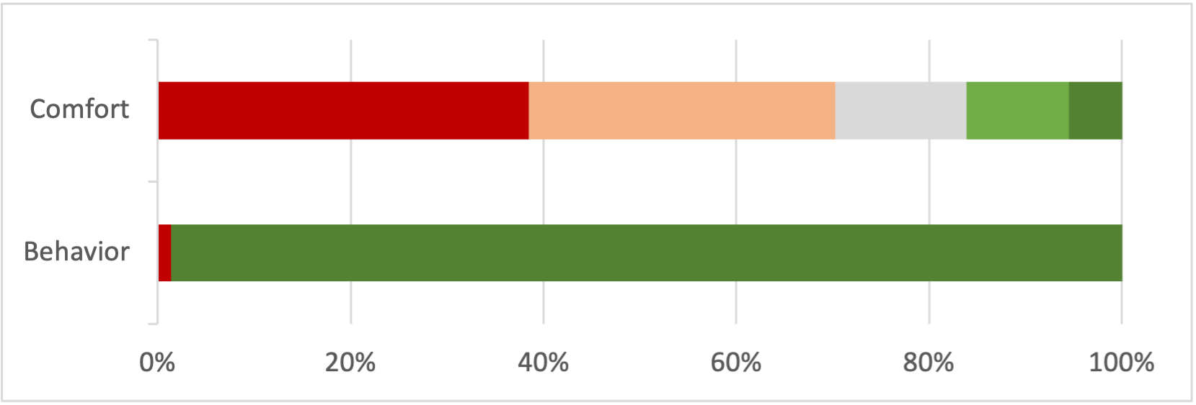
Follow-up Questions
45.5%
Notes:
45.5% of users who saw link-only version were not aware that they had the right to opt out of sale (compared to 28.9% of users in banner conditions, p=.019)

Slide 17
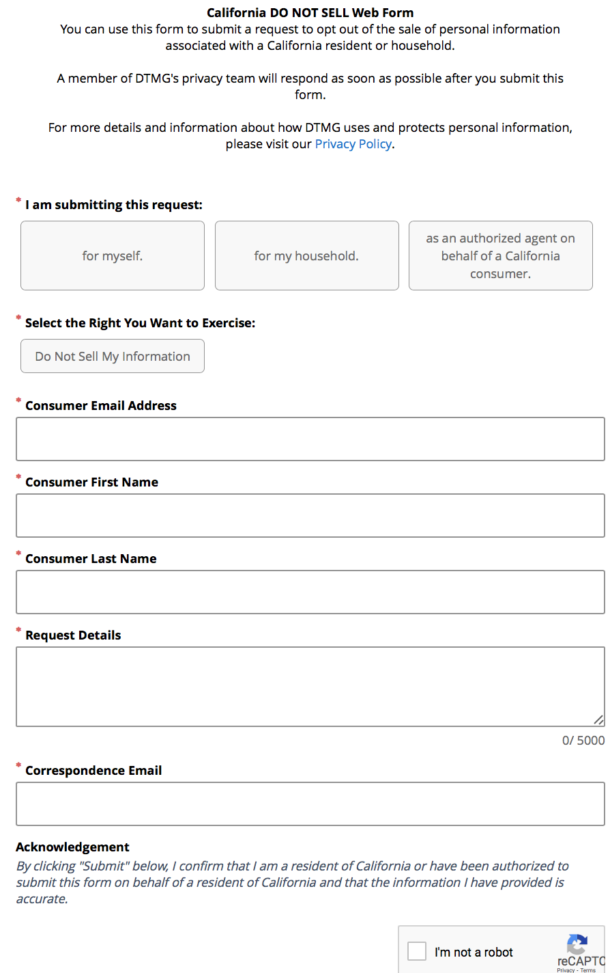
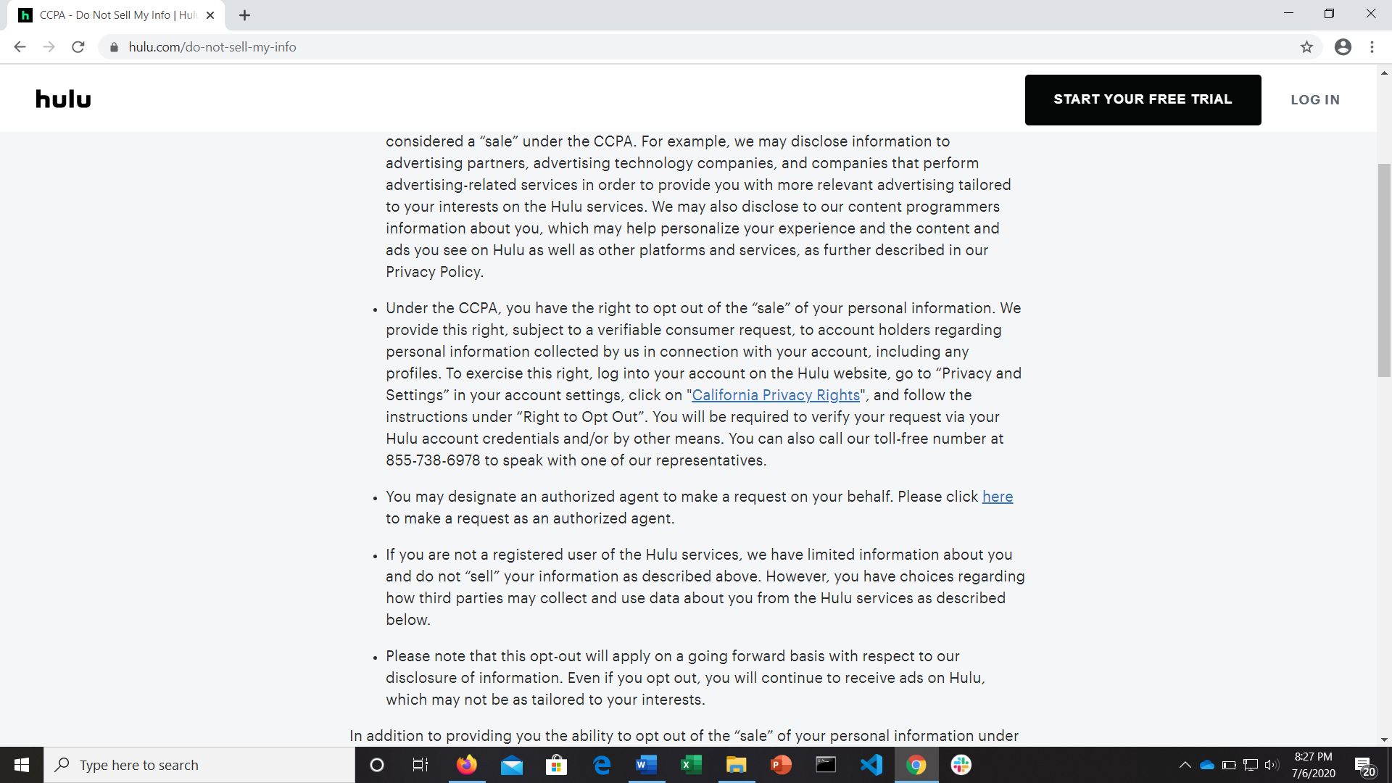
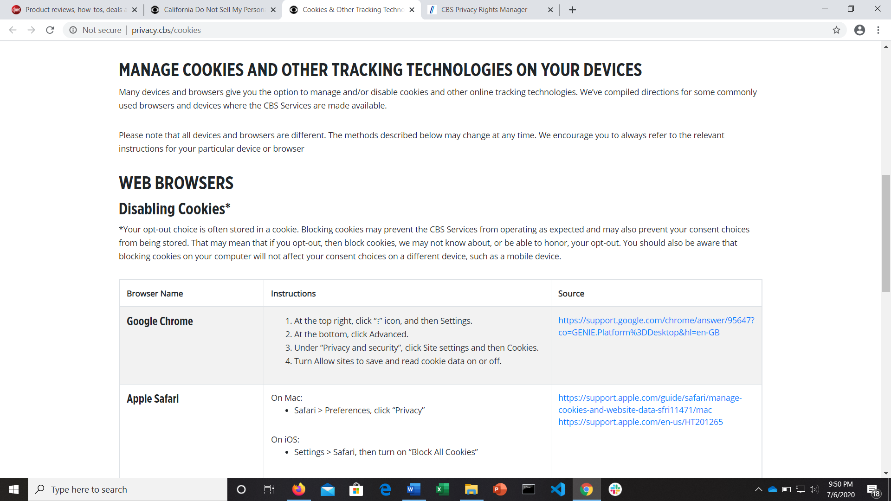
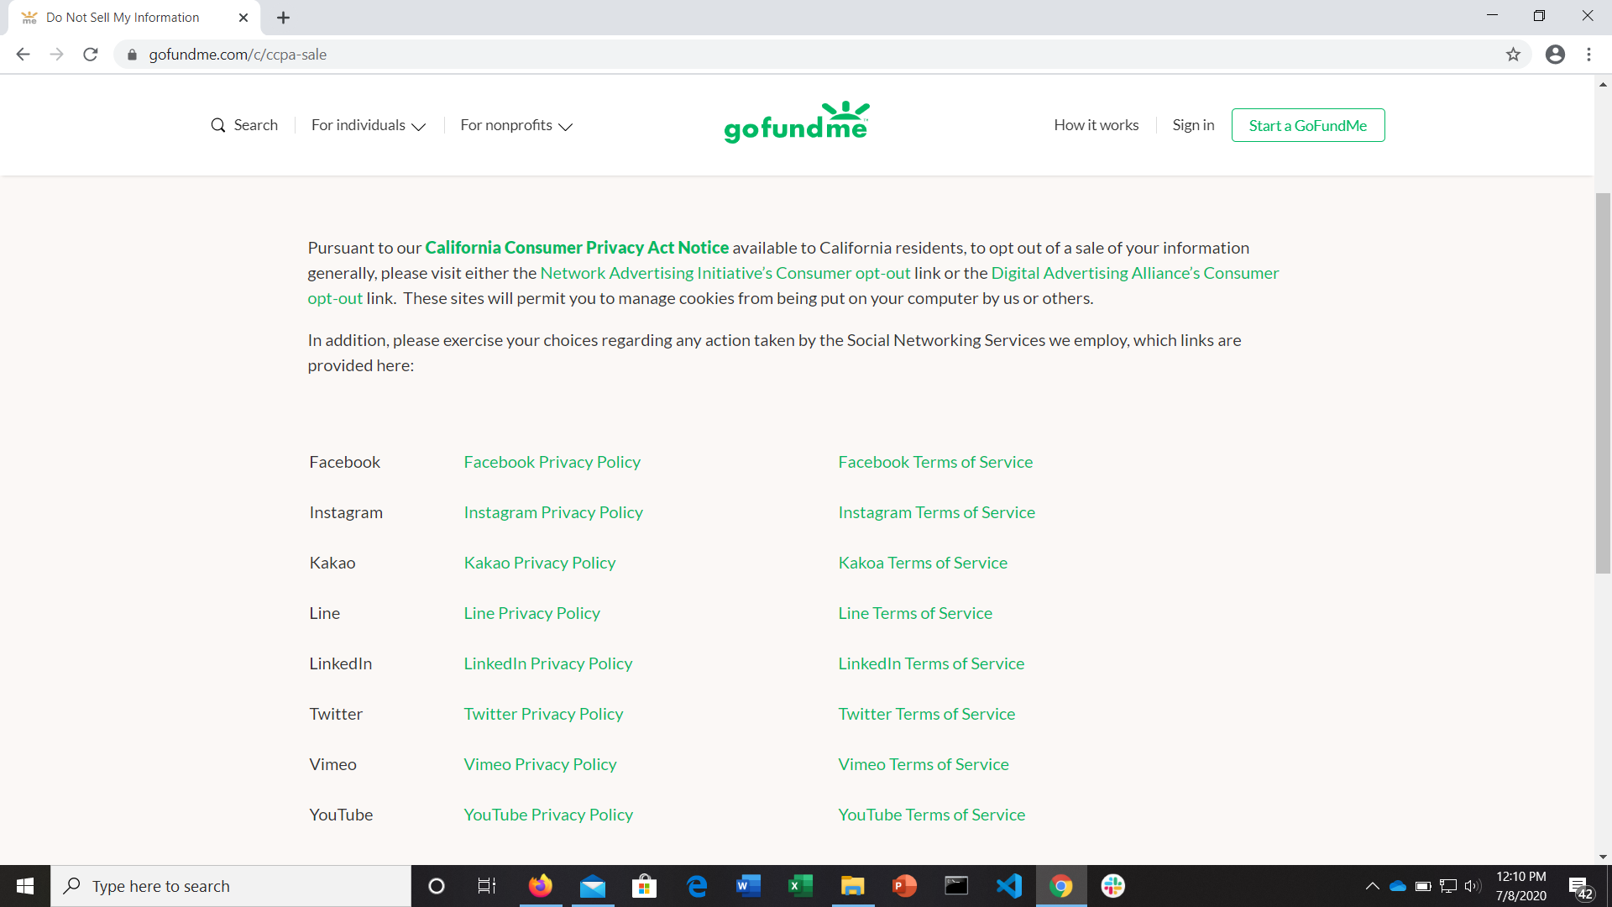
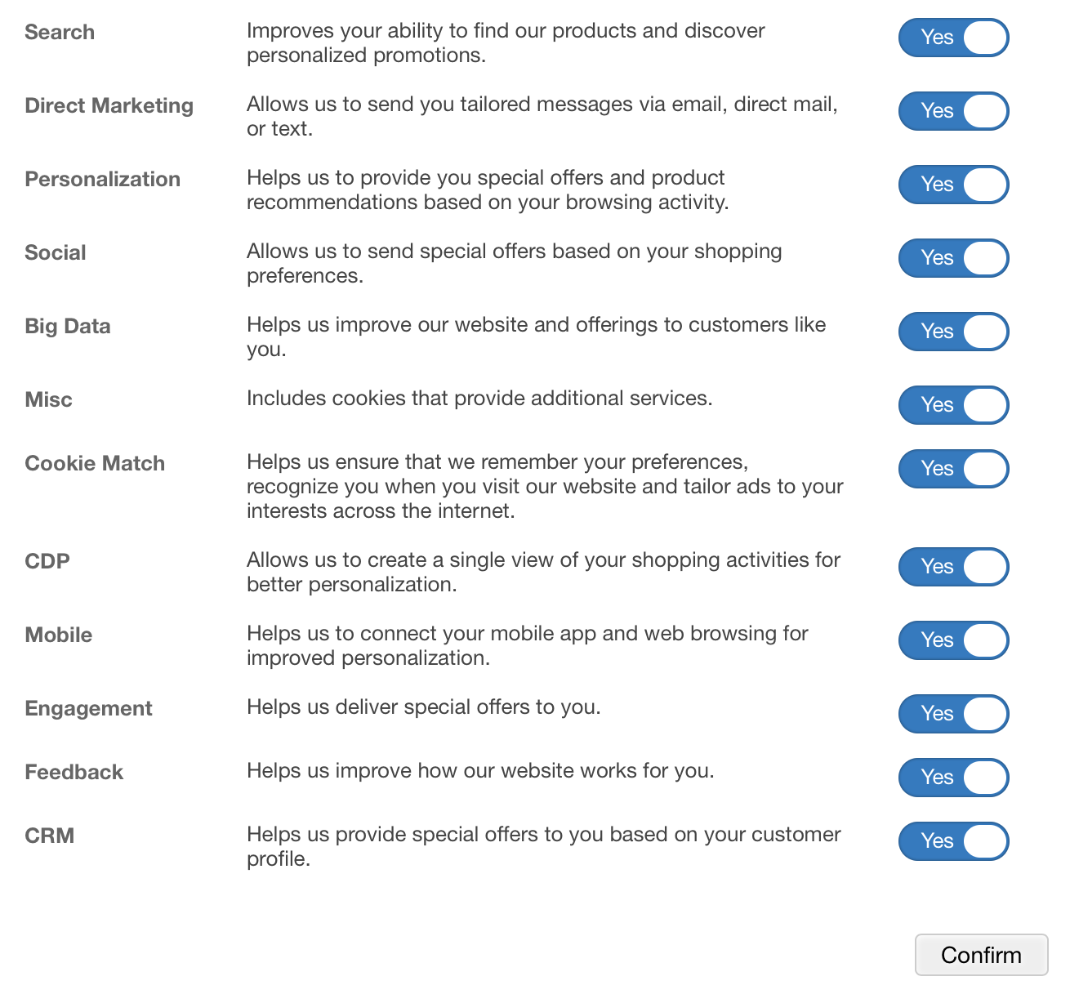
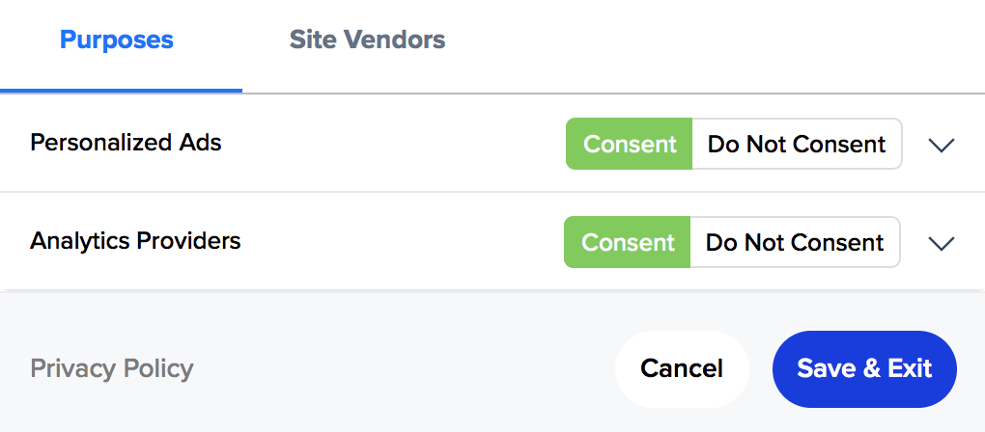
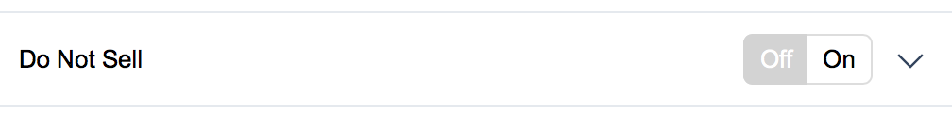
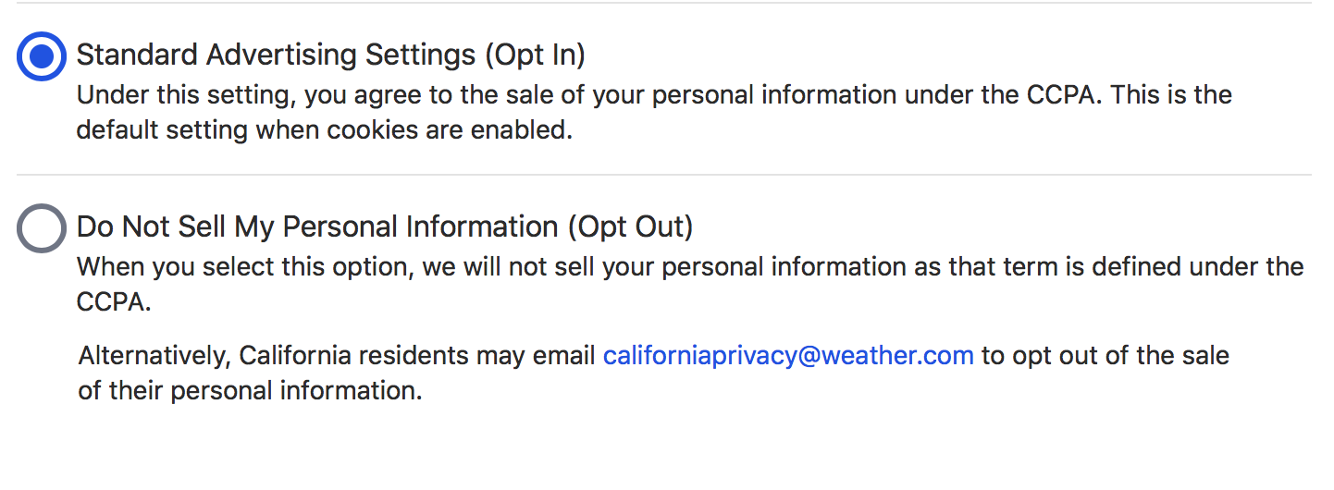
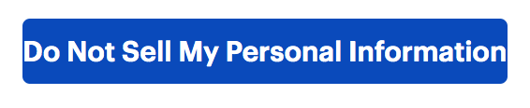
Opt-out mechanisms
Notes:
one button: bestbuy.com (requires second click to confirm)
two button (slider): Bloomberg
two button: weather.com
multi-option: insider.com
multi-option (lots): gap.com
form: digitaltrends.com

Slide 18
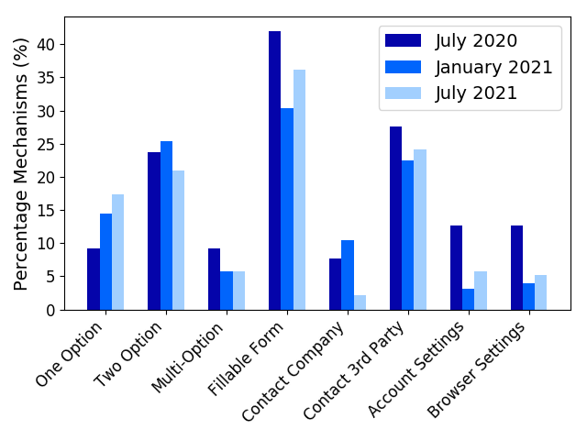
Opt-out Mechanisms

Slide 19
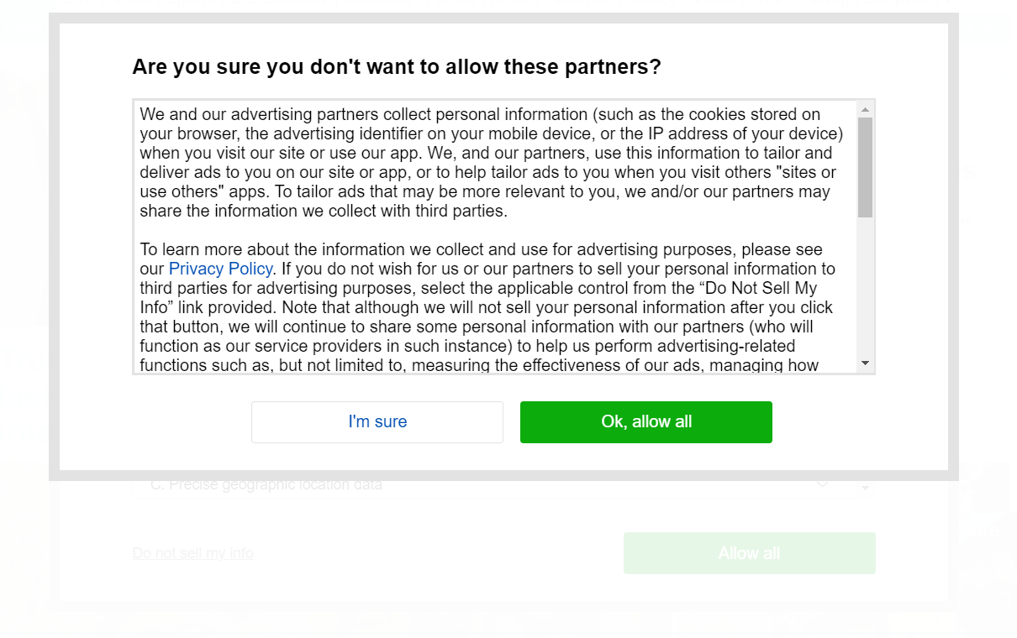
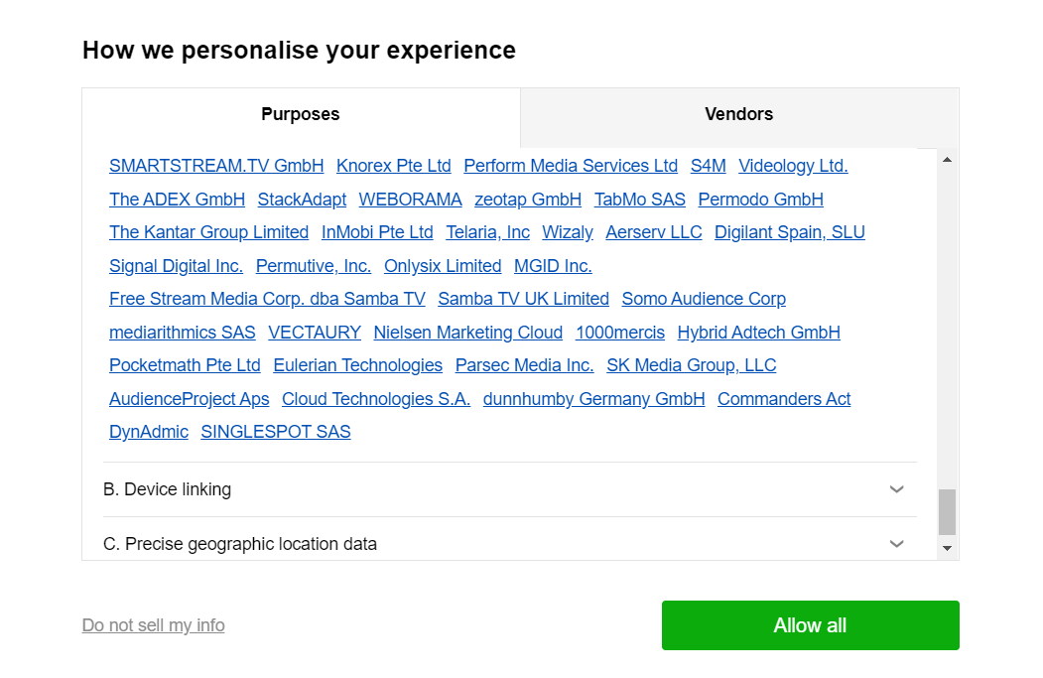
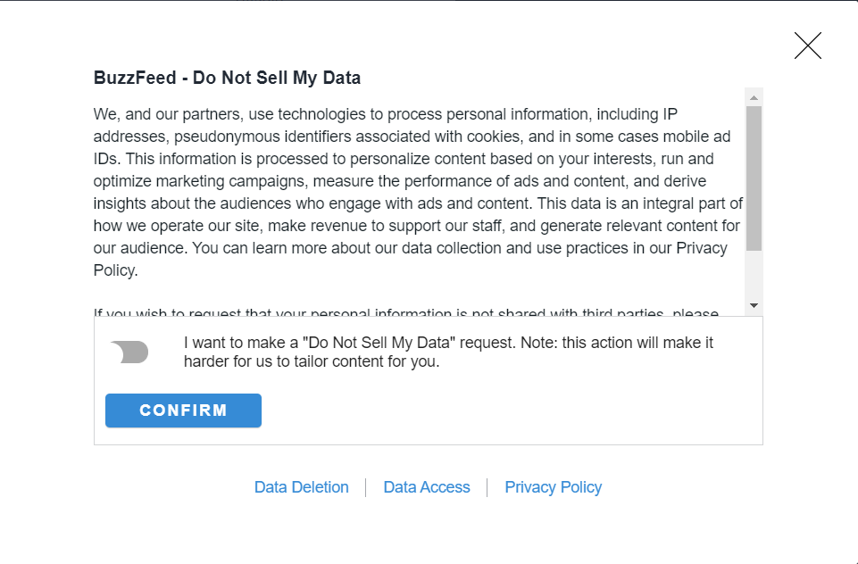
Nudging

Slide 20
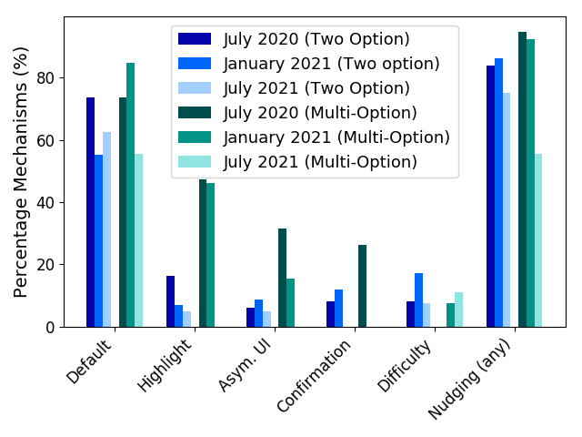
Nudging

Slide 21
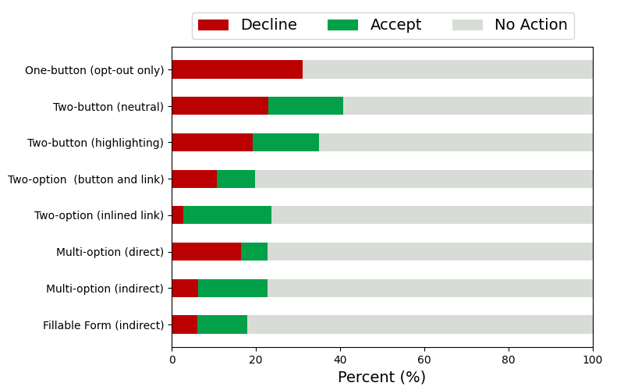
User Study: Nudging and Inconvenience

Slide 22
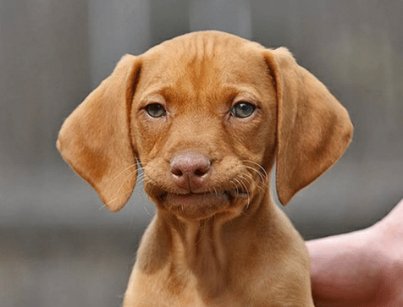
DISAPPOINTED
BUT NOT SURPRISED

Slide 23
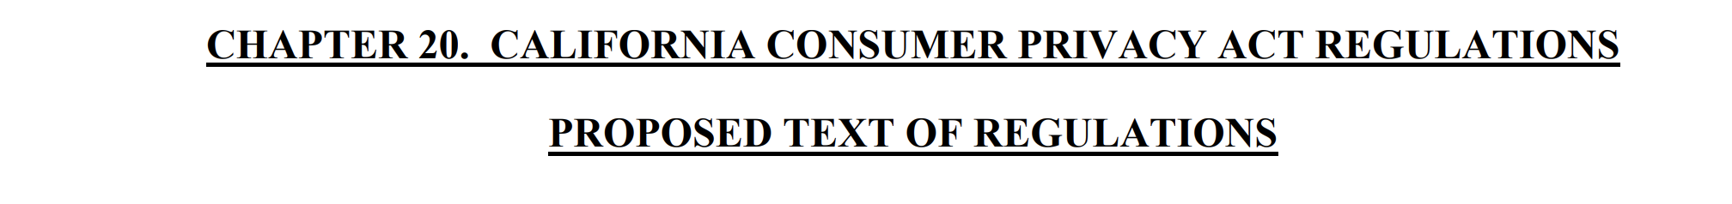
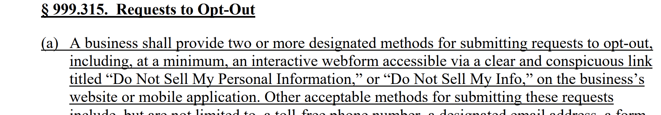
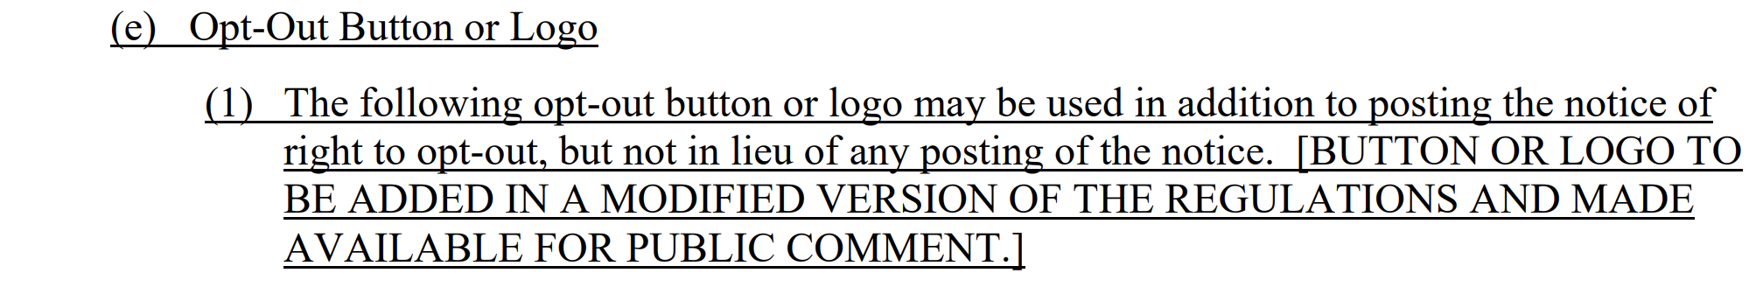
Idea 1: Improve Recognizability

Slide 24
Exercise: Opt-out of Sale Icon
Design an standardized icon that you think users would recognize as an option to opt-out of sale of personal information

Slide 25
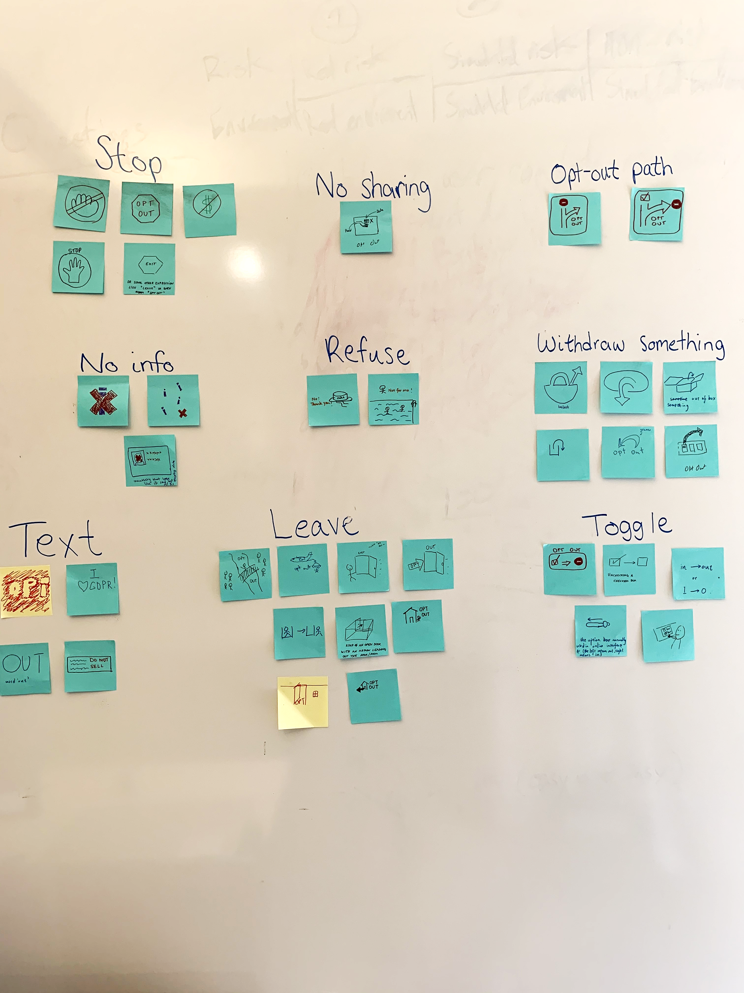
Icon ideation focused on 3 concepts
Choice/consent
Opting out
Do-not-sell

Slide 26












Preliminary icon Designs
Choice/consent
Opting out
Do not sell (personal info)
DAA Privacy
Rights

Slide 27
First icon evaluation
240 Mturk participants
Tested 12 icons with and without
“Do Not Sell My Personal Information” tagline
Displayed 1 icon
  Asked what the icon means and what would happen if you click on it
Displayed all 12 icons
  Asked which best conveyed Do Not Sell and Privacy Choices concepts

Slide 28
Icons difficult to interpret without words
best conveys choices about personal info
best conveys do not sell my personal info, but also conveys payments
Choice/consent
Opting out
Do not sell (personal info)
mostly confusing
people didn’t recognize stop sign

Slide 29
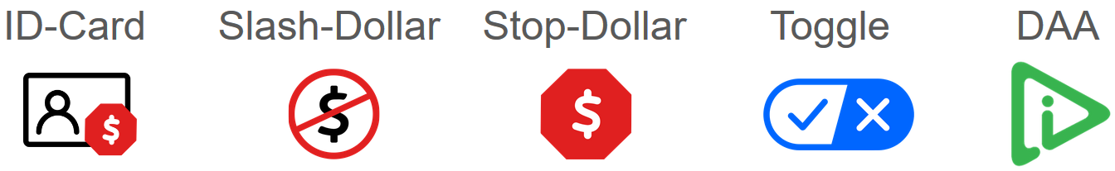
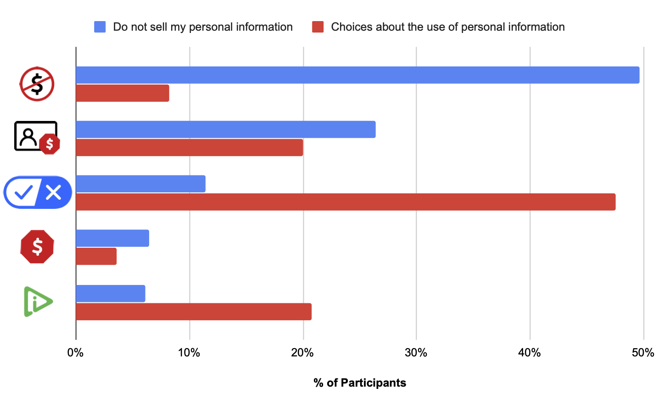
Refined icons for evaluation
Best conveys do not sell my personal information
Best conveys choices about the use of personal info

Slide 30


Icon | Common Interpretations without tagline (# of participants)
Toggle | accept/decline something (11) activate/deactivate something (5) okay/exit options (4) mark as true/false (4)
DAA | get more information (15) start audio/video content (7) denotes website is safe or private (3) move forward or next (2) something about ads (0)
Slash-dollar | something is free or requires no money (12) cash/dollars not accepted (7) money (4) does not sell data opt-out of sale (1)
17
10
4
2
3
4
7
2
correct interpretation
misconception

Slide 31
Recommendations to OAG
Privacy Options
  This allows consumers to look for one button
  Prevent the proliferation of buttons
Do Not Sell My Personal Information
  Complies with CCPA as written

Slide 32
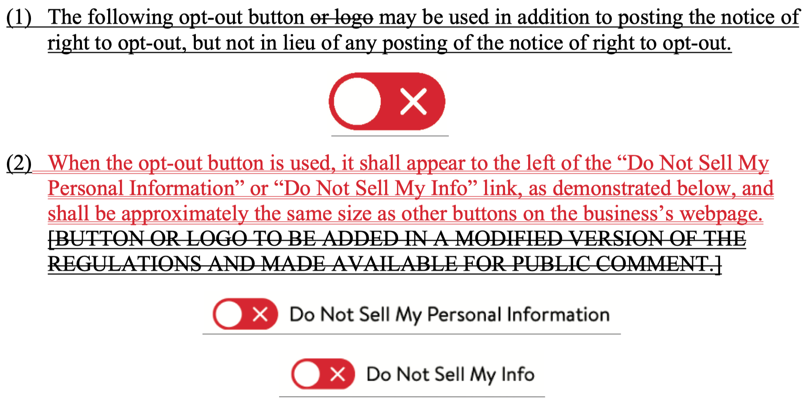
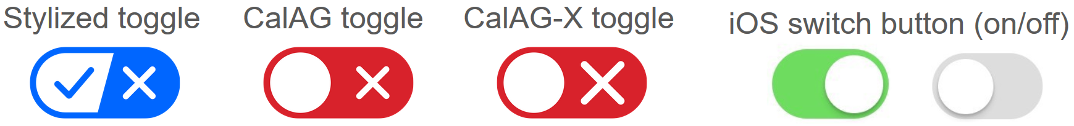
OAG’s revised proposed regulations
Recommended icon
iOS toggle switch

Slide 33

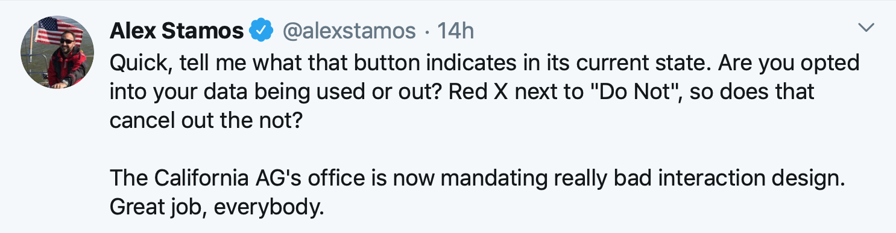
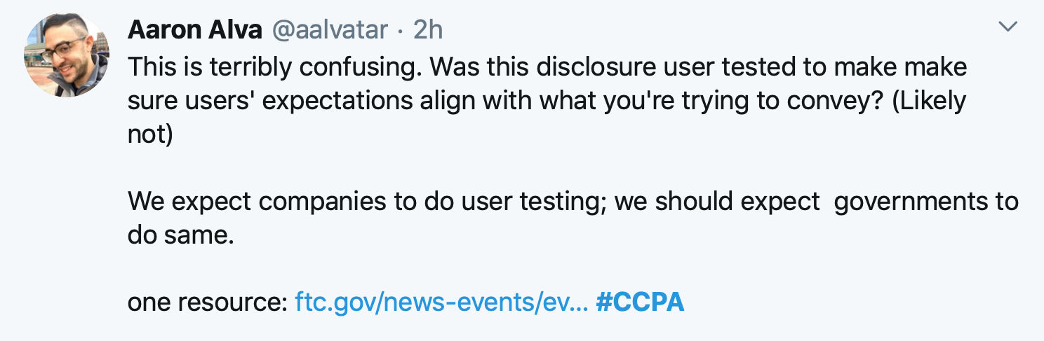
Twitter responds

Slide 34
So they ran another study
swapped colors
Insignificant difference between the big and small X
Small differences based on color
Big differences between the CalAG icon and recommended icon
CalAG icon more likely to be misinterpreted as actual toggle
Some small changes can sometimes make a big difference and you won’t know unless you test with users

Slide 35
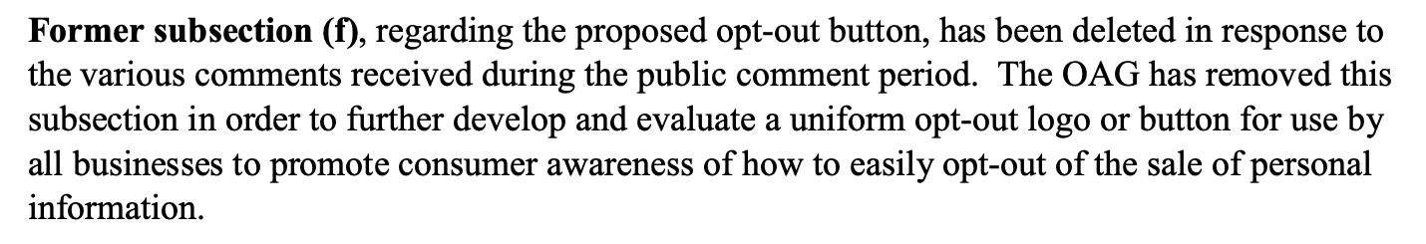
Then the OAG removed the icon
Icon completely removed from regulation
OAG will design a uniform and recognizable opt-out button in the future

Slide 36






Then they tested more icons from the OAG!
Which of these icons, paired with the “Do Not Sell My Personal Information” link text performs best
  standing out to users on a website?
  communicating the presence of a do-not-sell choice?
  motivating users to click?
… and only recruit participants from CA

Slide 37
tl;dr; None of the icons were very effective
Showing the link text without any icon resulted in the highest percentage (64%) of correct expectations
Adding any of these icons to the link text introduced misconceptions
Adding an icon made users more likely to notice link (increased from 31% to 38% - 52%) but did not create a significantly higher intention to click

Slide 38
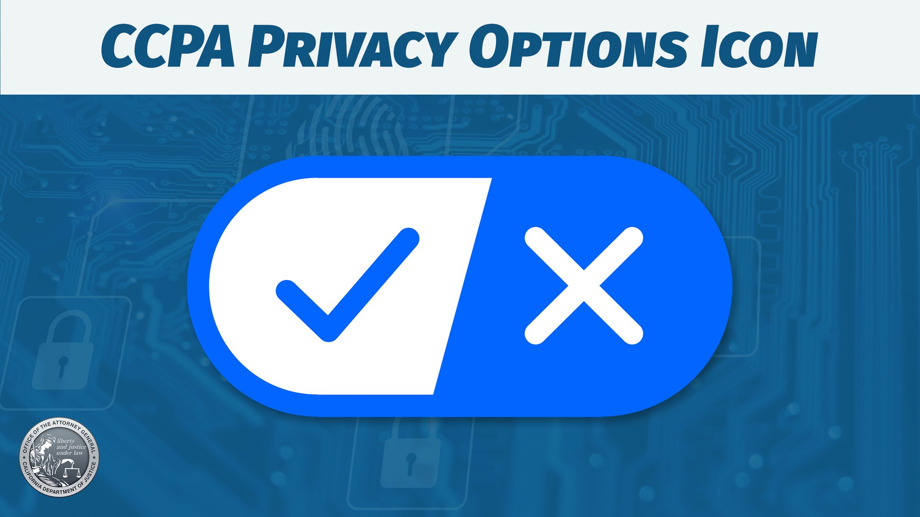

Slide 39
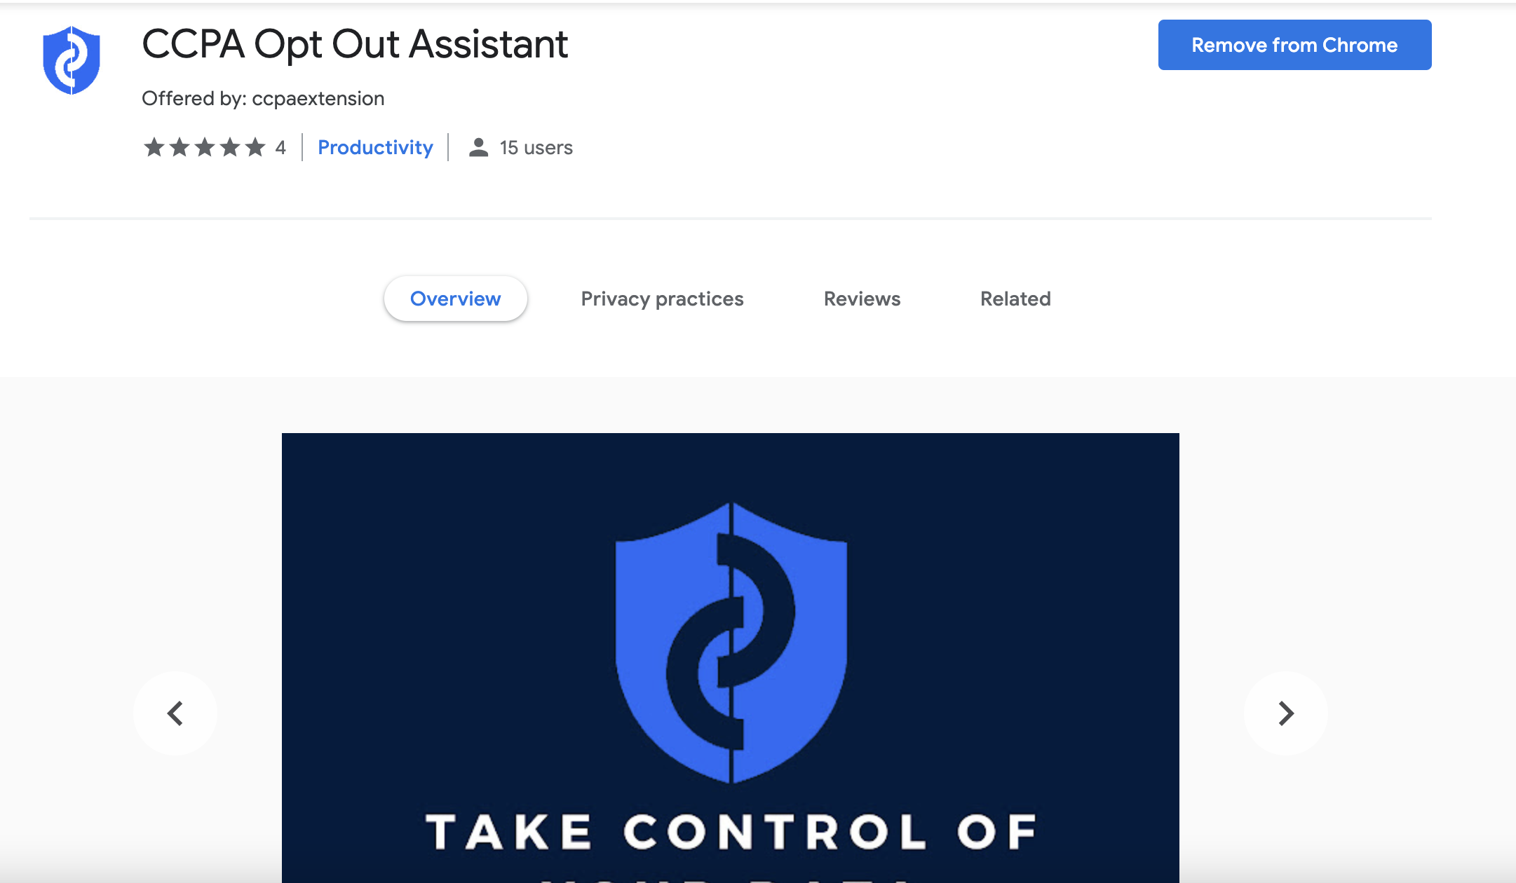
Idea 2: Improve Visibility

Slide 40
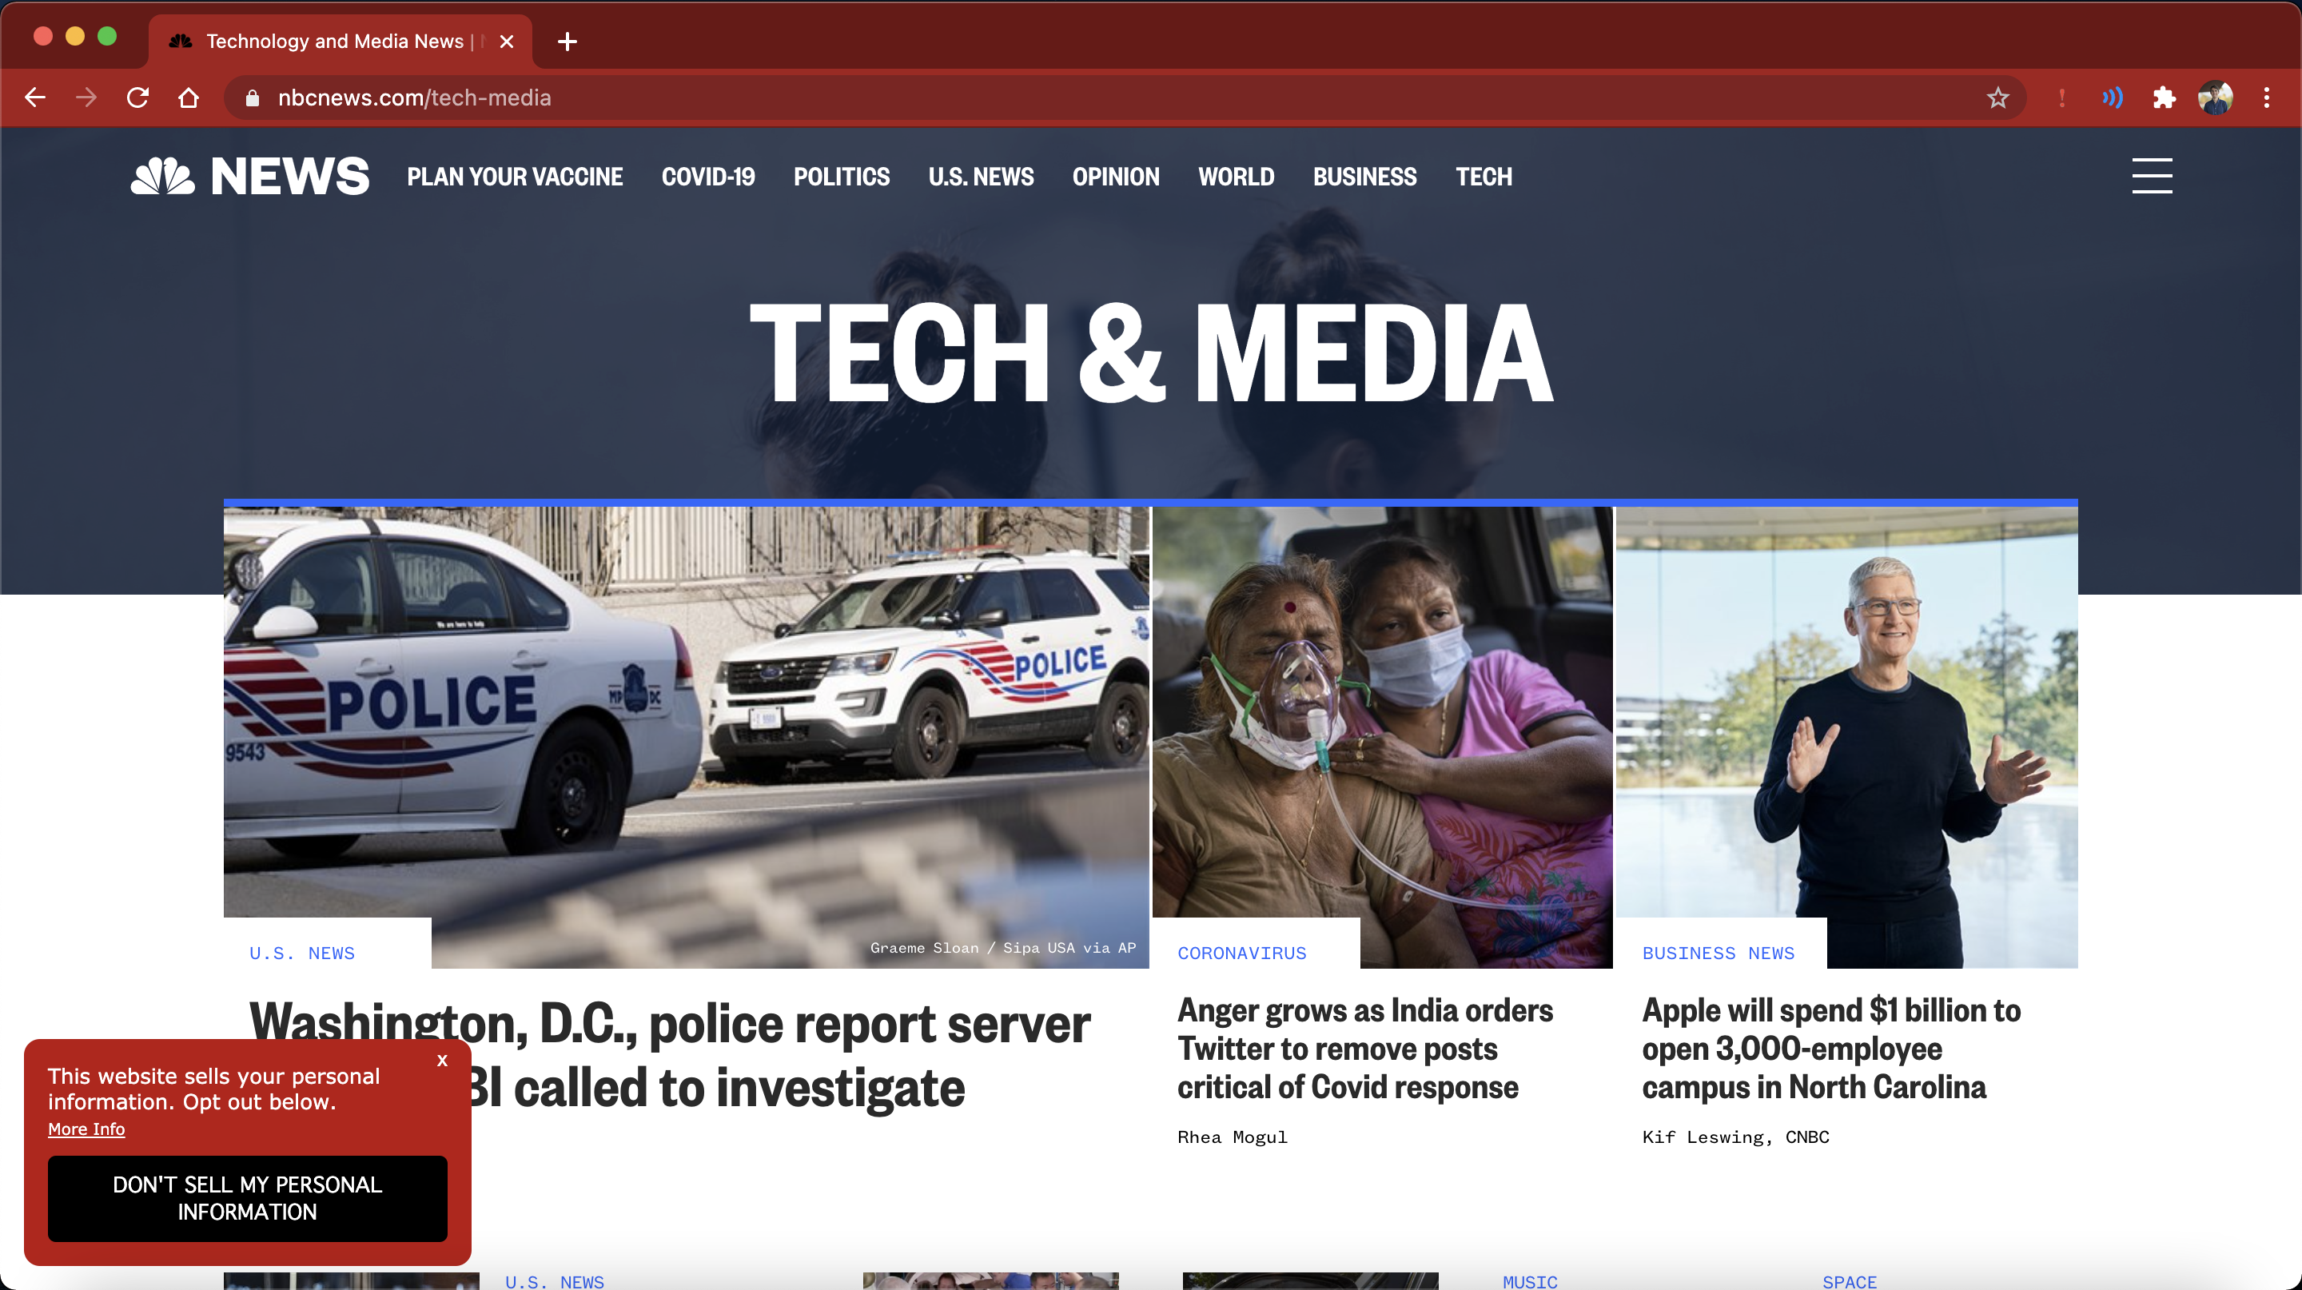
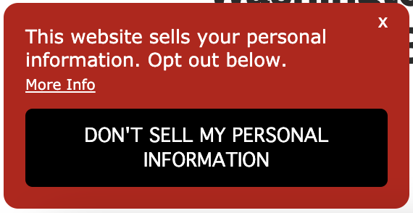
CCPA Opt-out Assistant

Slide 41
User Study: Extension
54 users recruited on MTurk
52 users recruited through Google Ads
Asked to install and use extension for 1 week
  32 MTurkers installed CCPA Opt-out Assistant
  22 MTurkers installed control extension
Logged user behavior
  hash of website visited
  whether website had valid (or ambiguous) opt-out of sale link
  if and how user invoked right to opt-out
Accepted all participants who used kept extension installed for at least 24 hours

Slide 42
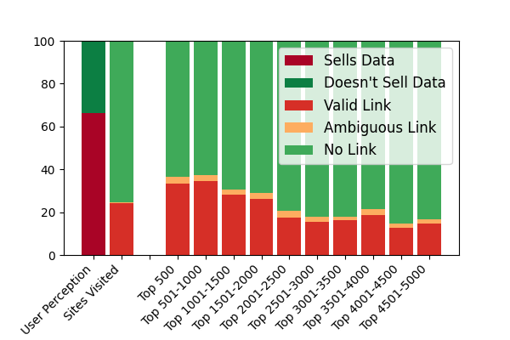
Sale of Personal Information

Slide 43


Opt-out Rates
MTurk Users
Native Chrome Downloads
Notes:
opt-out in the wild: 8.8\% of sites with link

Slide 44


User Experience
Difficulty
Satisfaction

Slide 45

Idea 3: Automate Opt-outs
Global Privacy Control (GPC)
browser signal that indicates desire to opt-out of sale on all websites
Currently available in Firefox, Brave, DuckDuckGo, etc.
Also available as a Chrome extension
legally considered a valid signal under California law

Slide 46
Measurement Study
Jan Charatan and Eleanor Birrell. Two Steps Forward and One Step Back: The Right to Opt-out of Sale under CPRA . PETS 2024.
Crawled 25,000 websites from Tranco top website list
Recorded:
  Response to GPC signal
    US Privacy String when GPC is not enabled
    US Privacy String when GPC is enabled
  Presence/absence of CCPA opt-out of sale link on homepage
  Privacy policy language
  Presence/absence of /.well-know/gpc.json file
Conducted monthly crawls between November 2022 and November 2023
U.S. Privacy String:
IAB specification
4-character string 1YNN
sent to 3rd parties
accessible through API
supported until 1/1/2024
Data Collection
CCPA
CPRA
2019
2020
2021
2022
2023
2024

Slide 47


Response to GPC Signals

Slide 48

Prevalence of Opt-out of Sale Mechanisms

Slide 49

Websites that had opt-out links in Nov. 2022

Slide 50

Additional Limitations of GPC
Market Penetration
User Awareness
All browsers will be required to support GPC starting in January 2027
Notes:
https://gs.statcounter.com/browser-market-share
42% of users are not aware of the right to opt-out of sale (Jan 2022)
https://consumerfed.org/wp-content/uploads/2022/01/CCPA-Privacy-Rights-Survey.pdf

Slide 51

Additional Limitations of GPC

Slide 52



A Possible Future…

Slide 53

CCPA Opt-out of Sale

