Slide 1
Lecture 10: Online Advertising
CS 181E Fall 2026

Slide 2
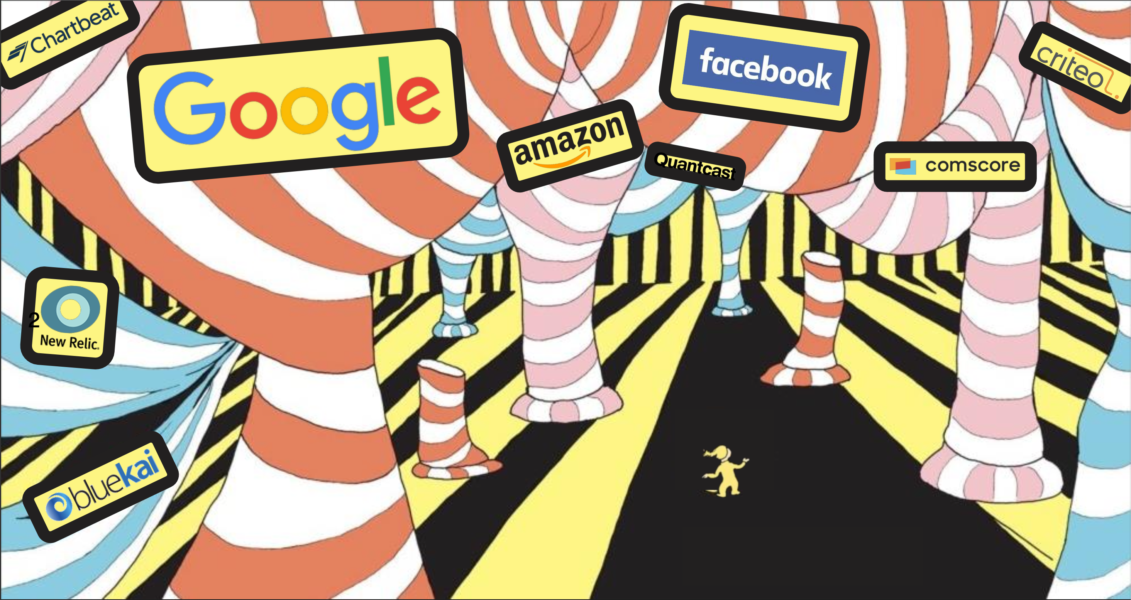
Review: Online Tracking

Slide 3
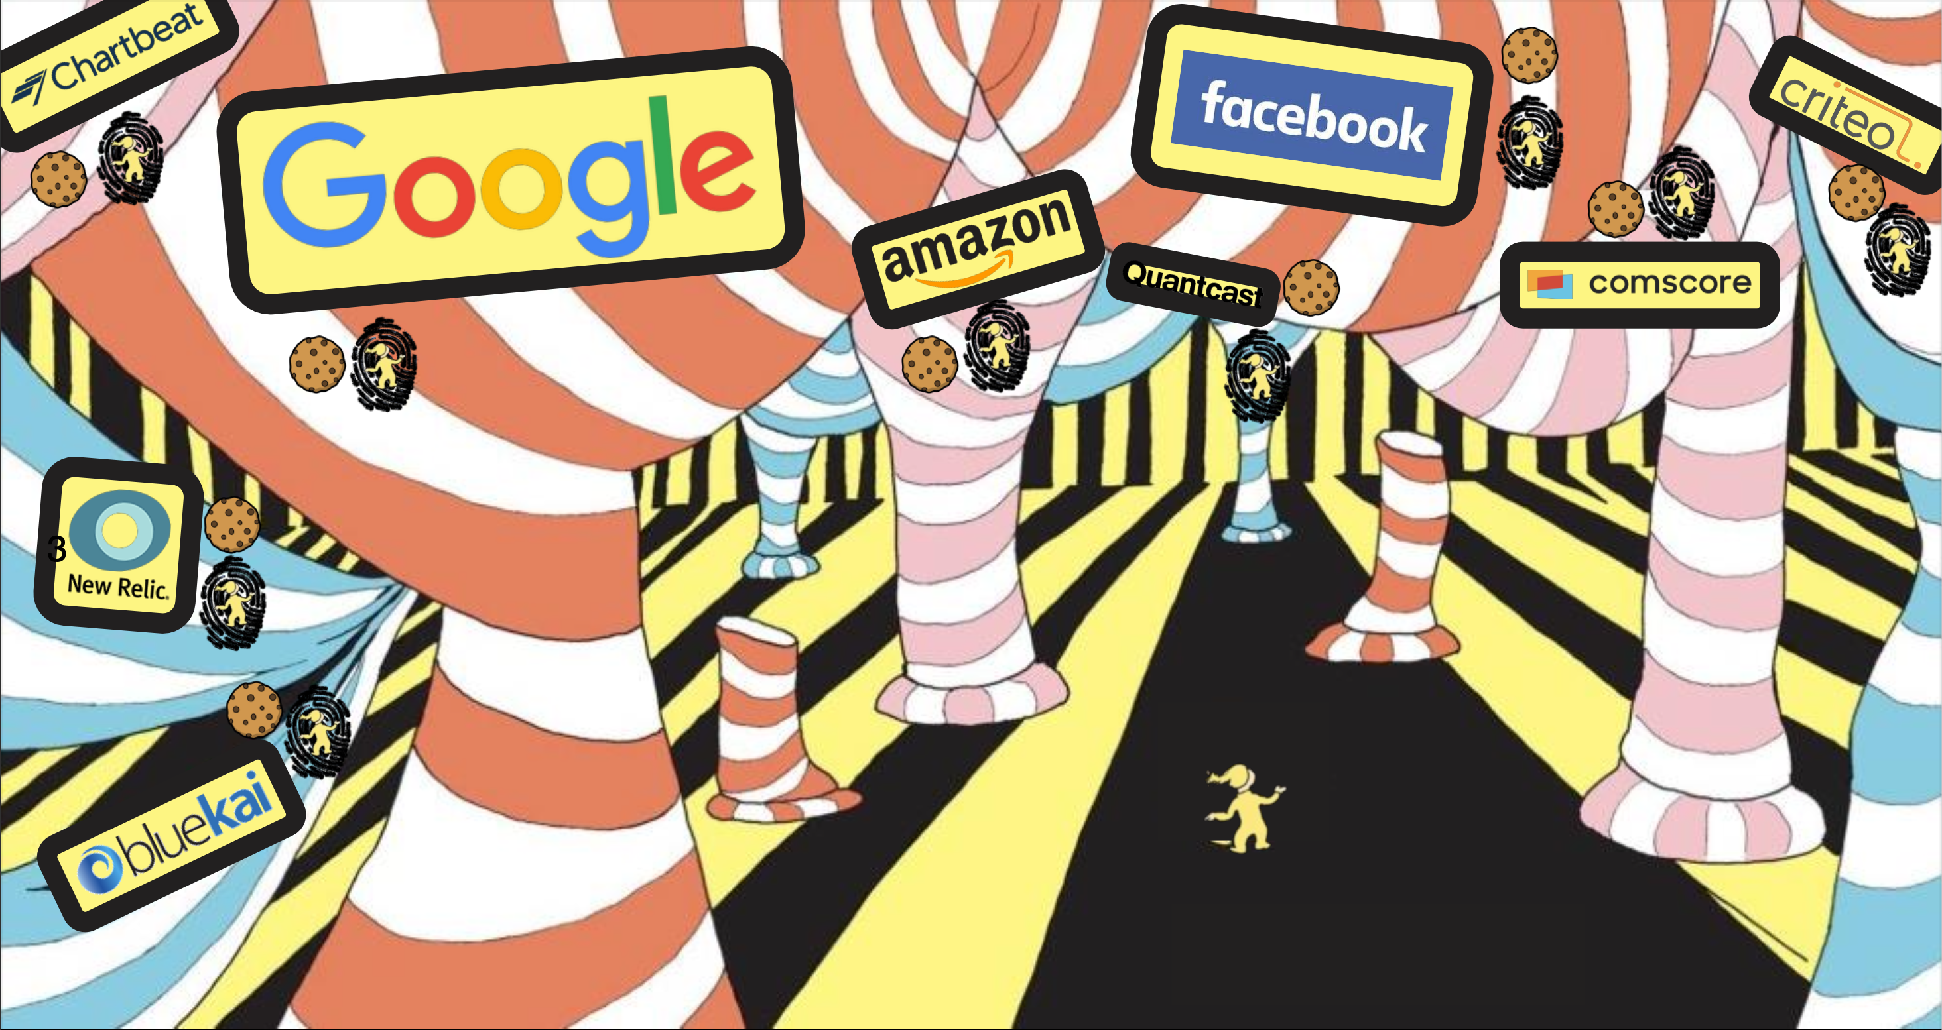
Review: Online Tracking

Slide 4


Review: Cookies
Client
Server
GET http://www.example.com/ HTTP/1.1
HTTP/1.1 200 OK
Set-Cookie: session-id=12345
GET http://www.example.com/ HTTP/1.1
Cookie: session-id=12345

Slide 5
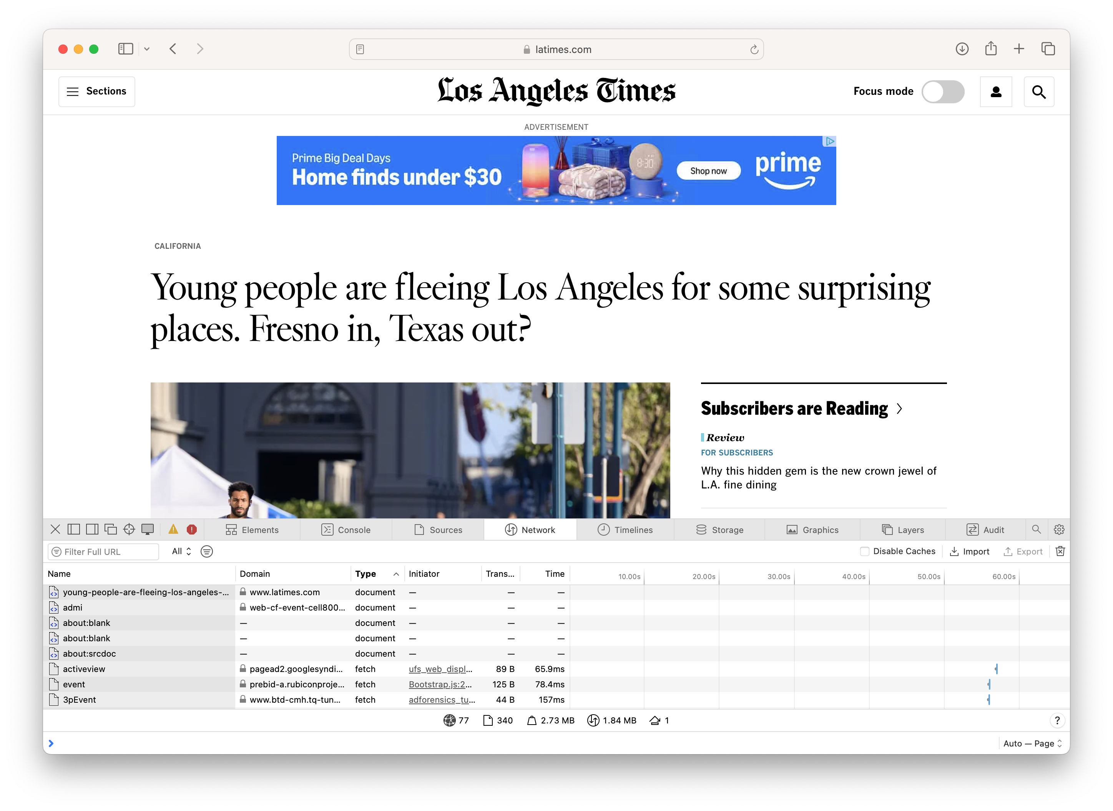
Review: Third-Party Tracking Cookies
Notes:
Demo: show latimes page in Chrome, click through all the images received over the network on preview mode, then click through images in preview mode and look at cookies for advertisers

Slide 6
Review: Trackers and Advertisers
trackers observe user behavior across one or (usually) many sites
use ML to make inferences about user demographics and interests
advertisers serve ads on first or third party sites
get paid by companies that place ads
can choose which ads to place based on context or user attributes
Some trackers are also advertisers (e.g., Google, Meta)
Some trackers are data brokers who sell collected and inferred information to other third parties

Slide 7
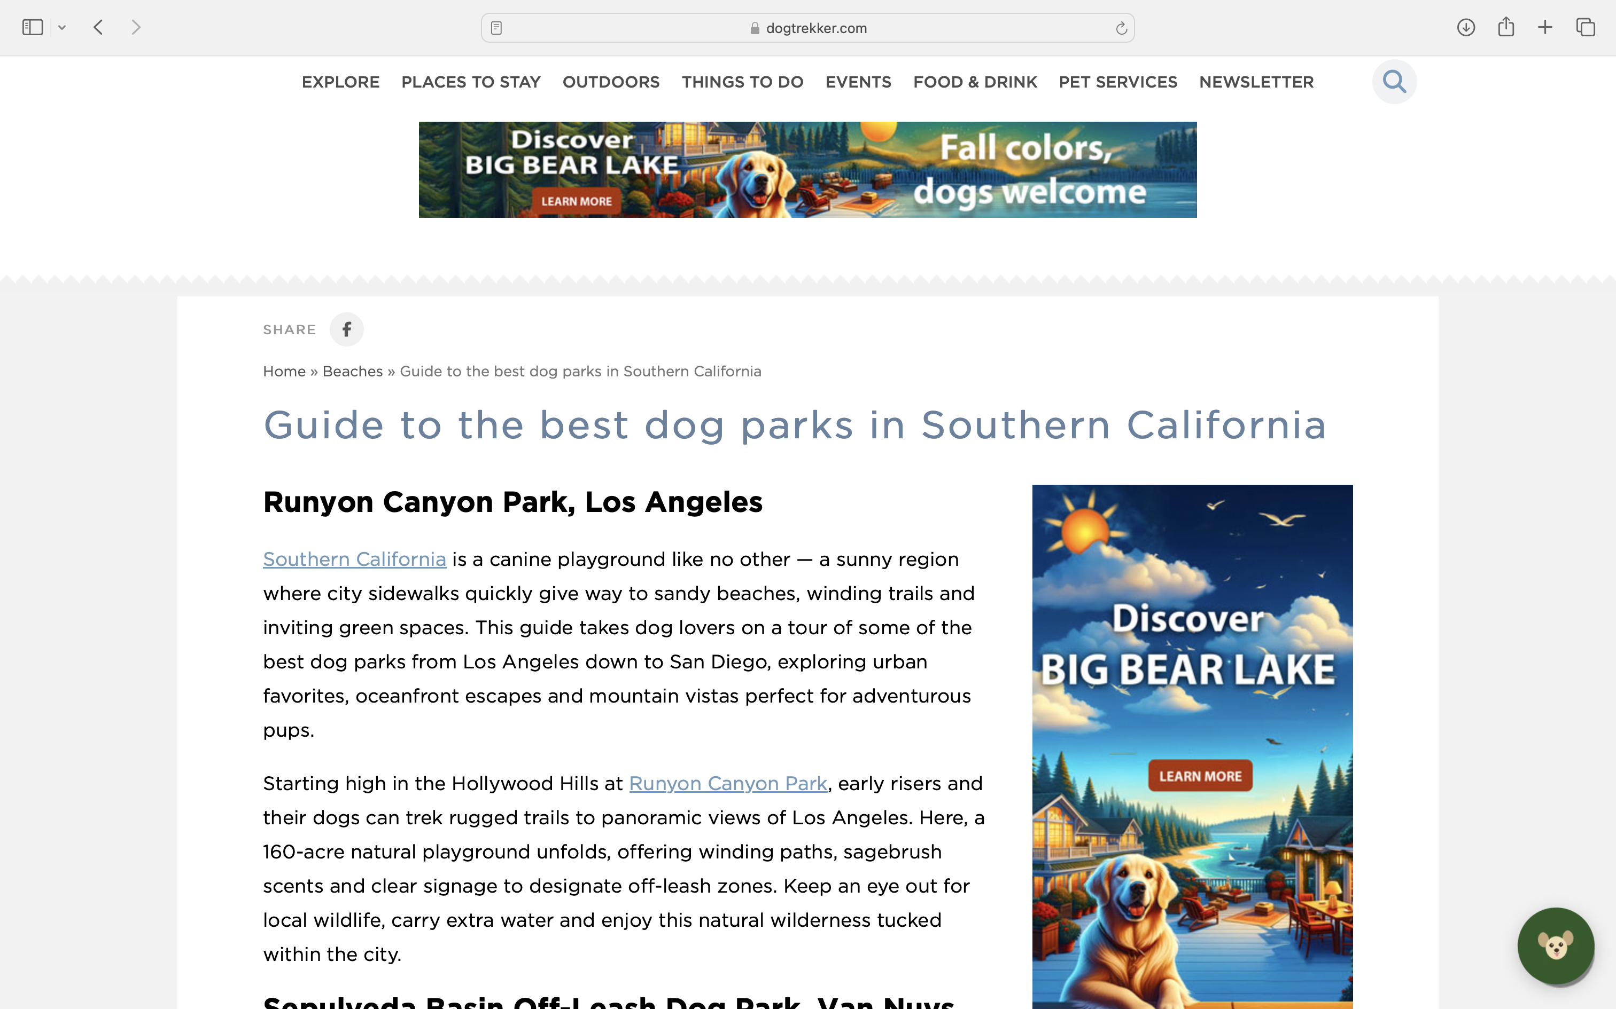
Contextual Advertising

Slide 8
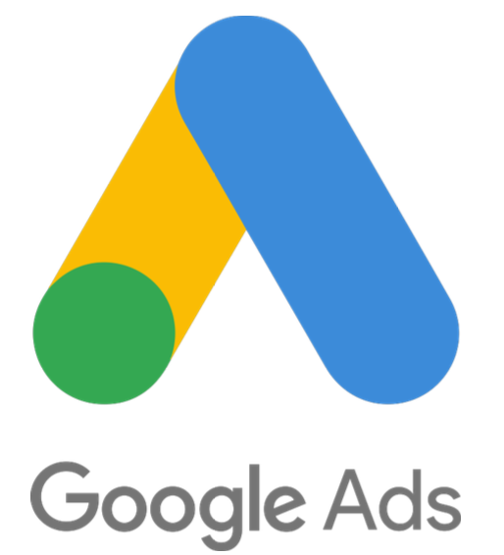
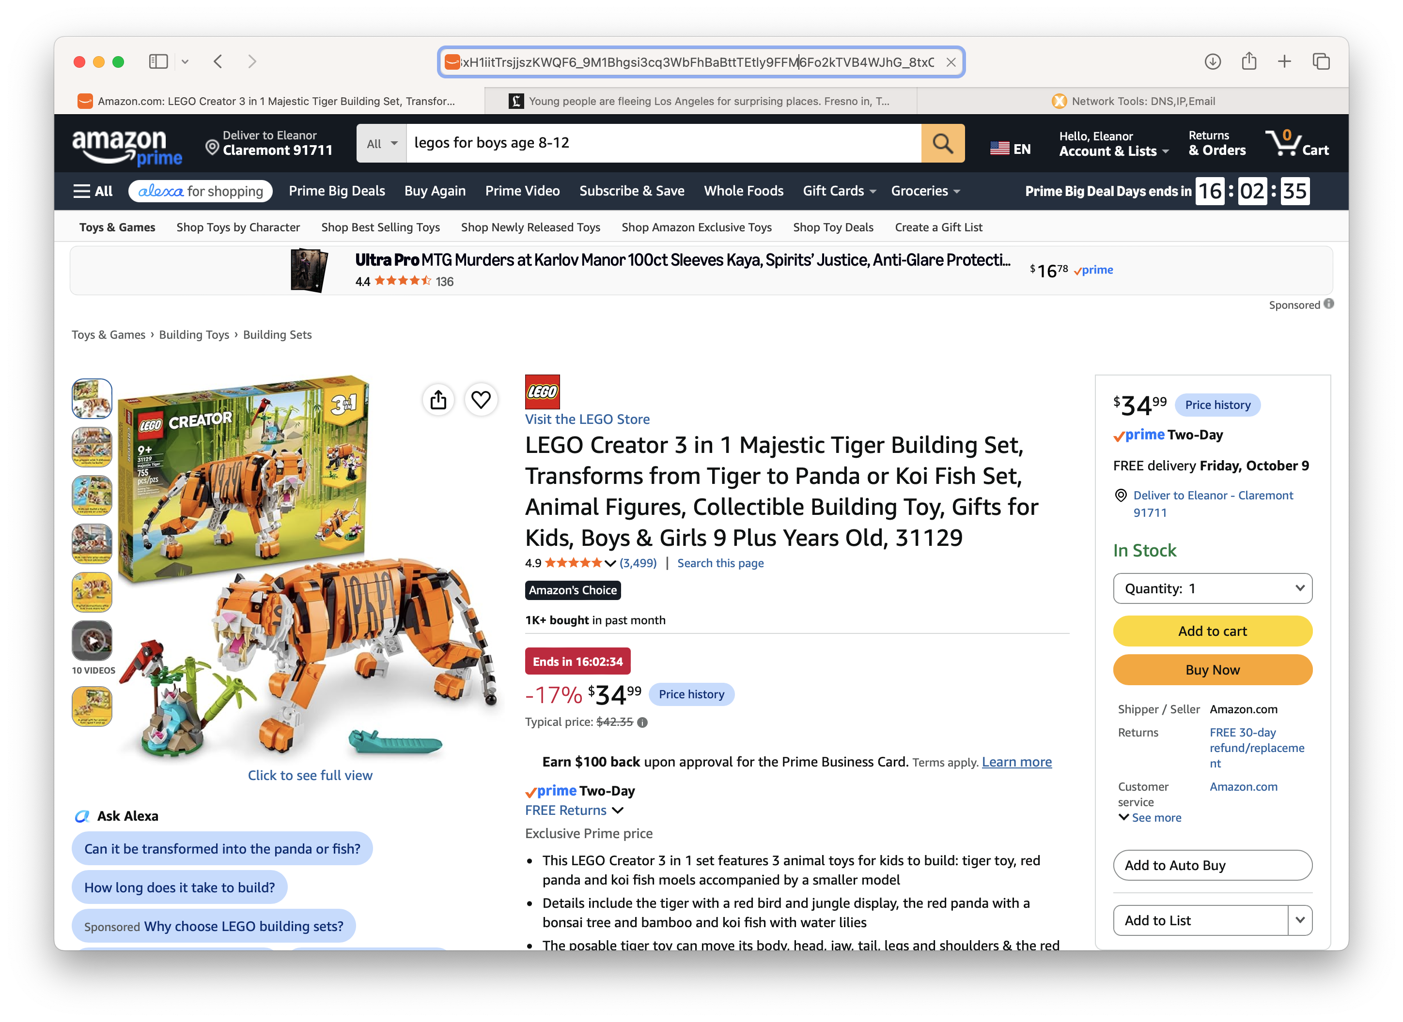
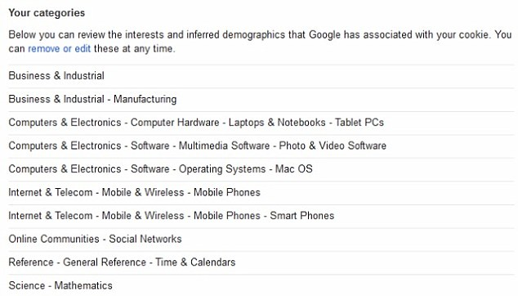
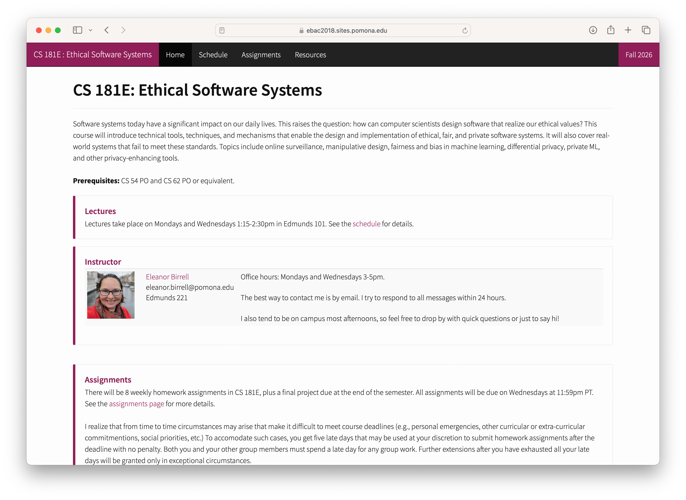
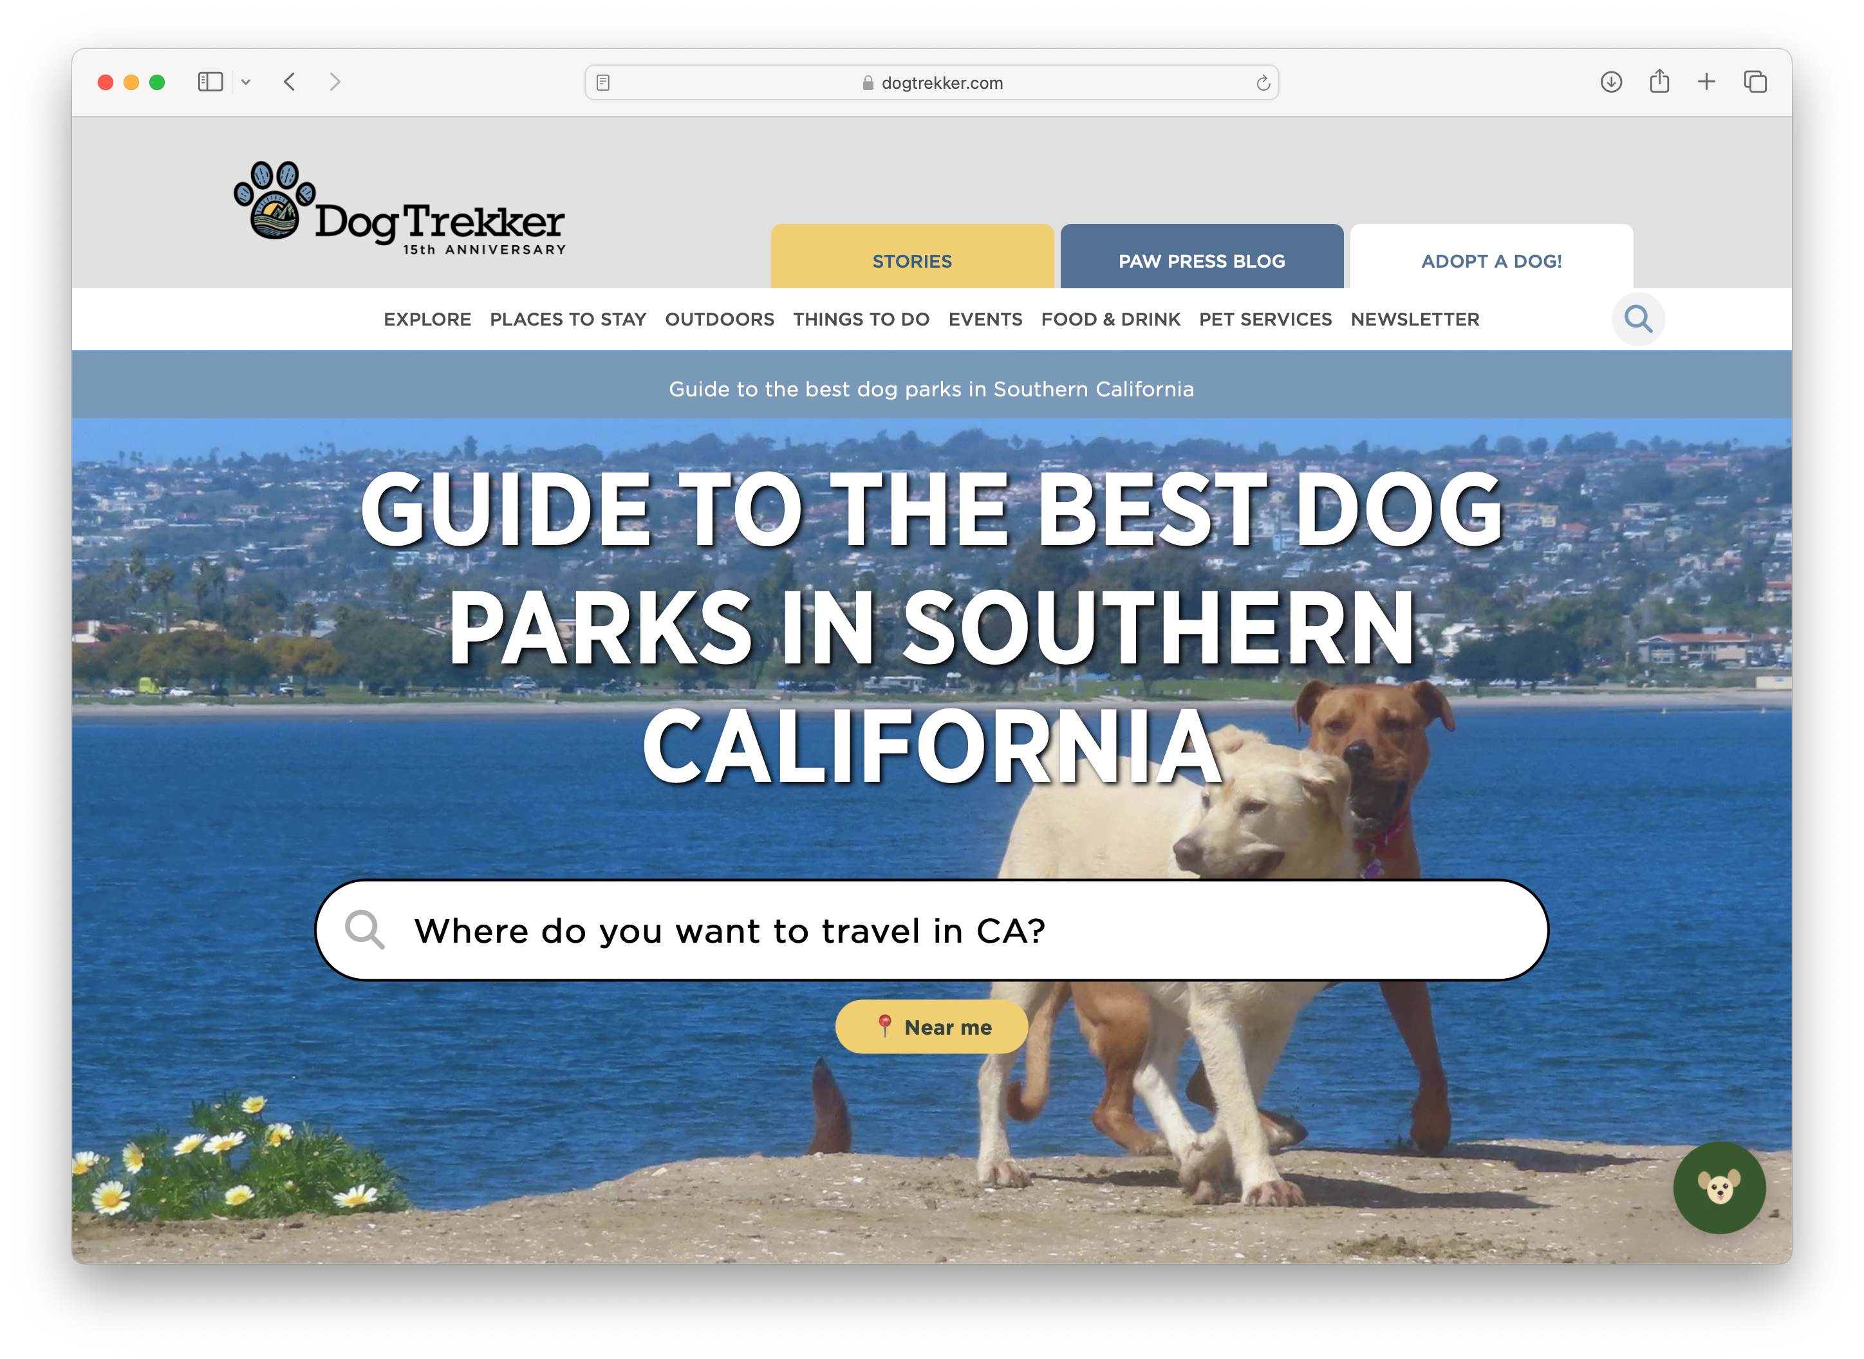
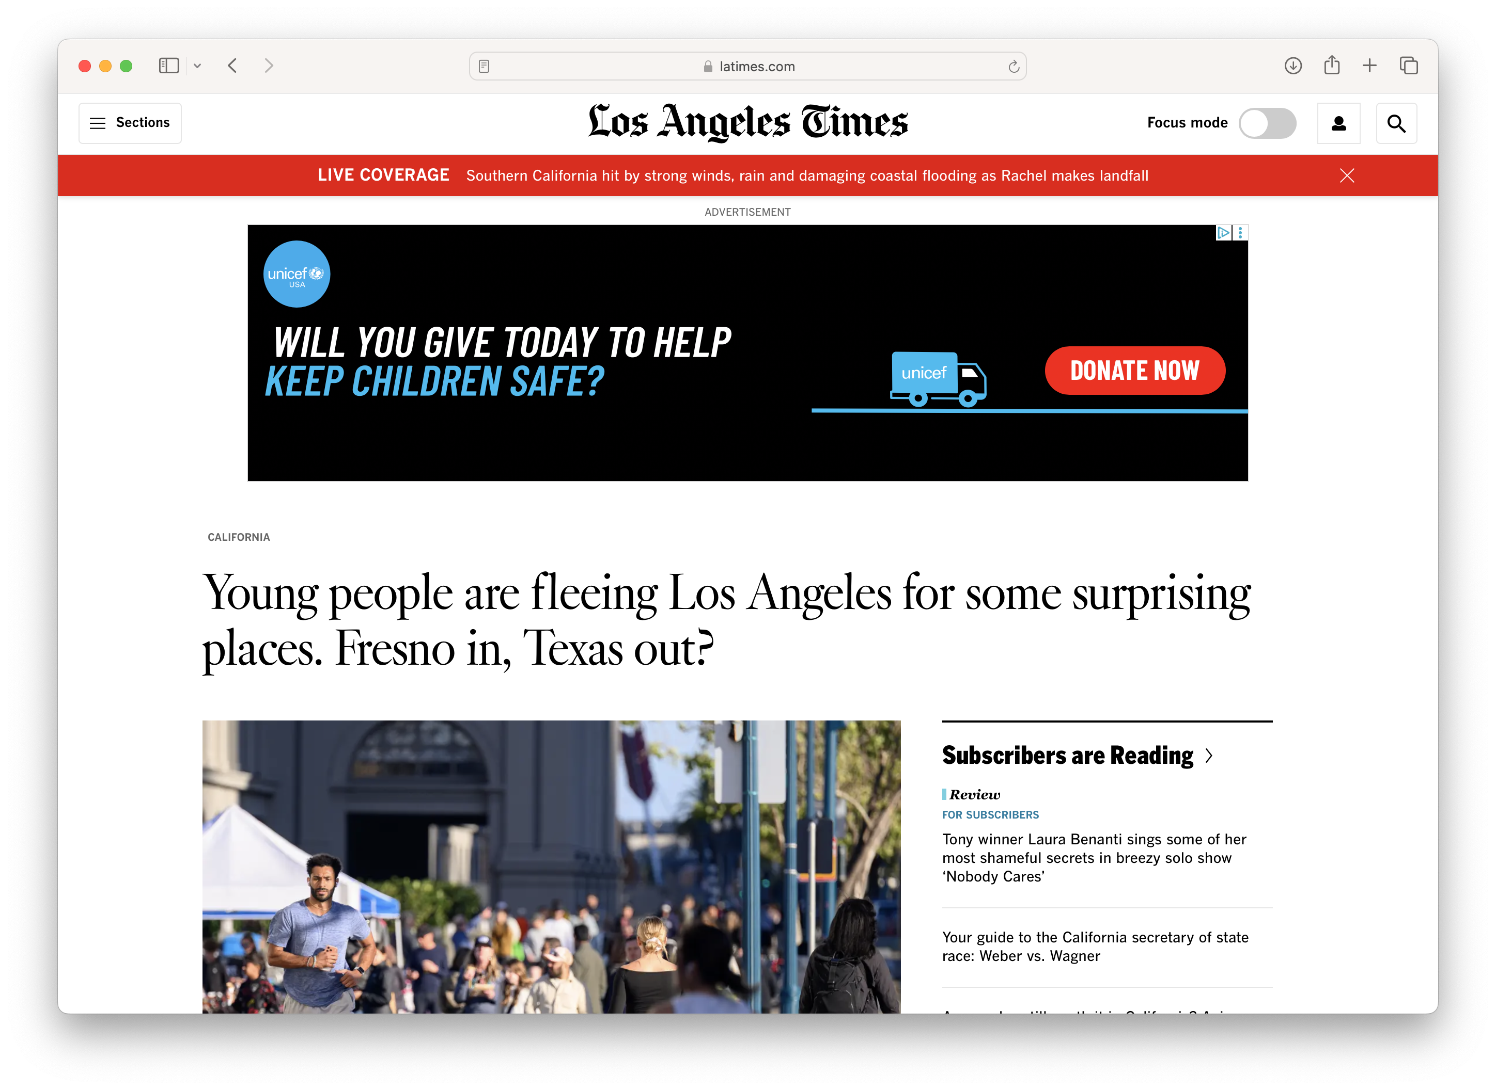
Targeted Advertising
ML

Slide 9
Exercise: Targeted Ads
Go to Google’s Ad Center: https://myadcenter.google.com/controls
  What demographic info are they using to target ads to you?
  What categories are they using to target ads to you?
  What activity are they using to target ads to you?
Go to Meta’s Privacy Center: https://accountscenter.instagram.com/ads/
  What categories are they using to target ads to you?
  Are the using activity info from 3rd parties?

Slide 10
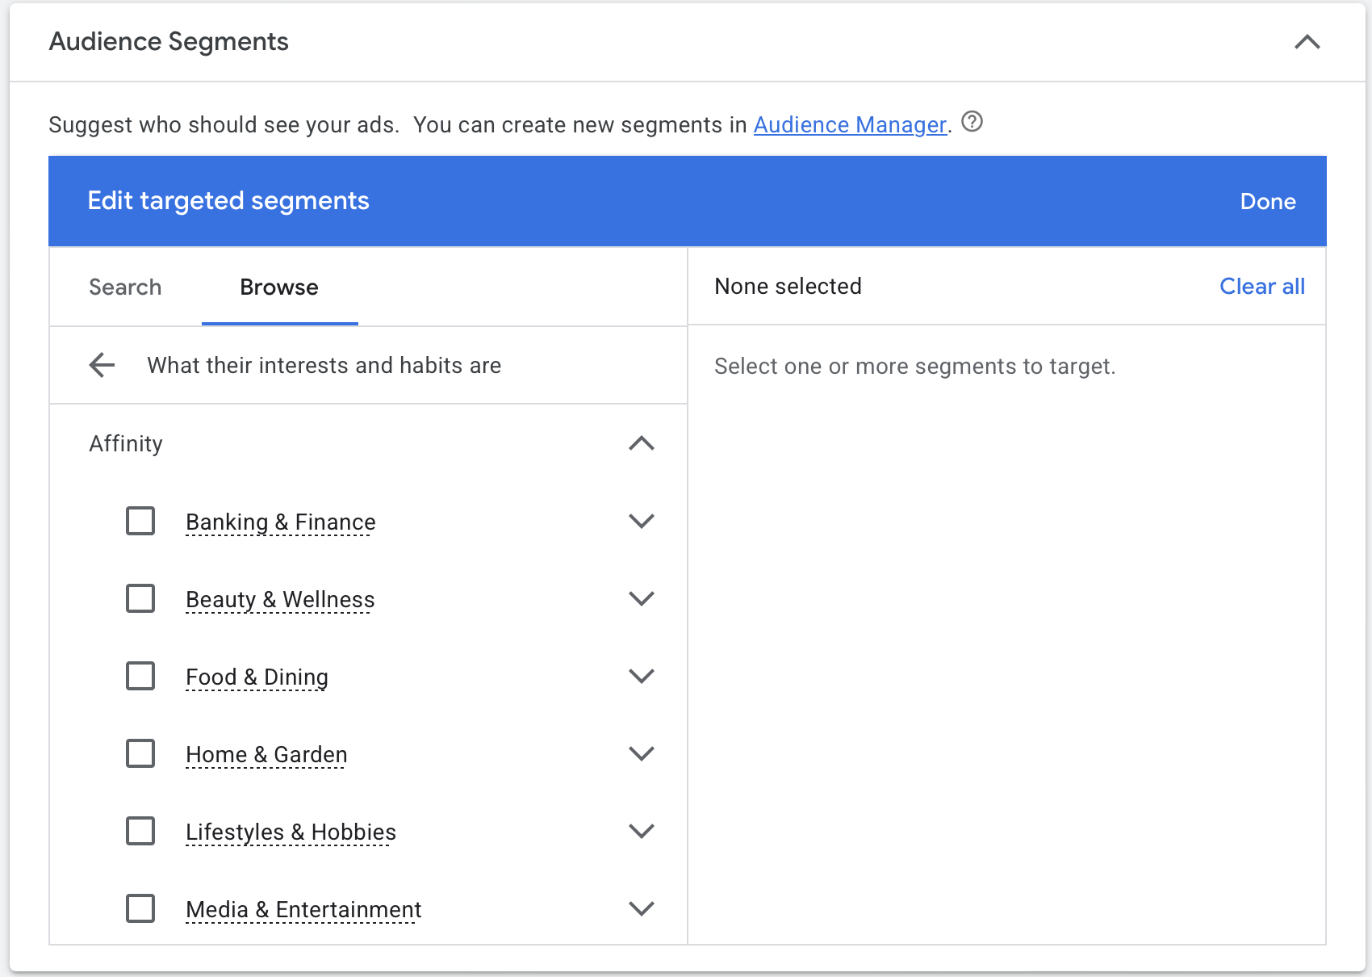

Targeted Advertising
ML

Slide 11
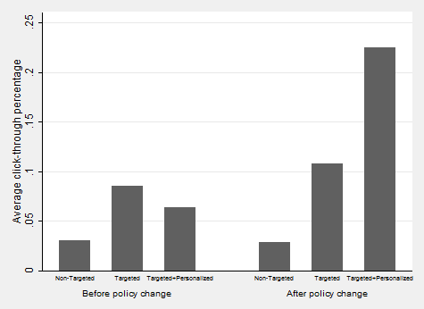
Behavioral Advertising
.25
.20
.15
Average Click-Through Rate (%)
.10
.05
.00
Non-Targeted
Targeted
Targeted+Personalized
Notes:
I used this data in a talk about obliviad years ago, but I can’t find the source so didn’t include in the presentation

Slide 12
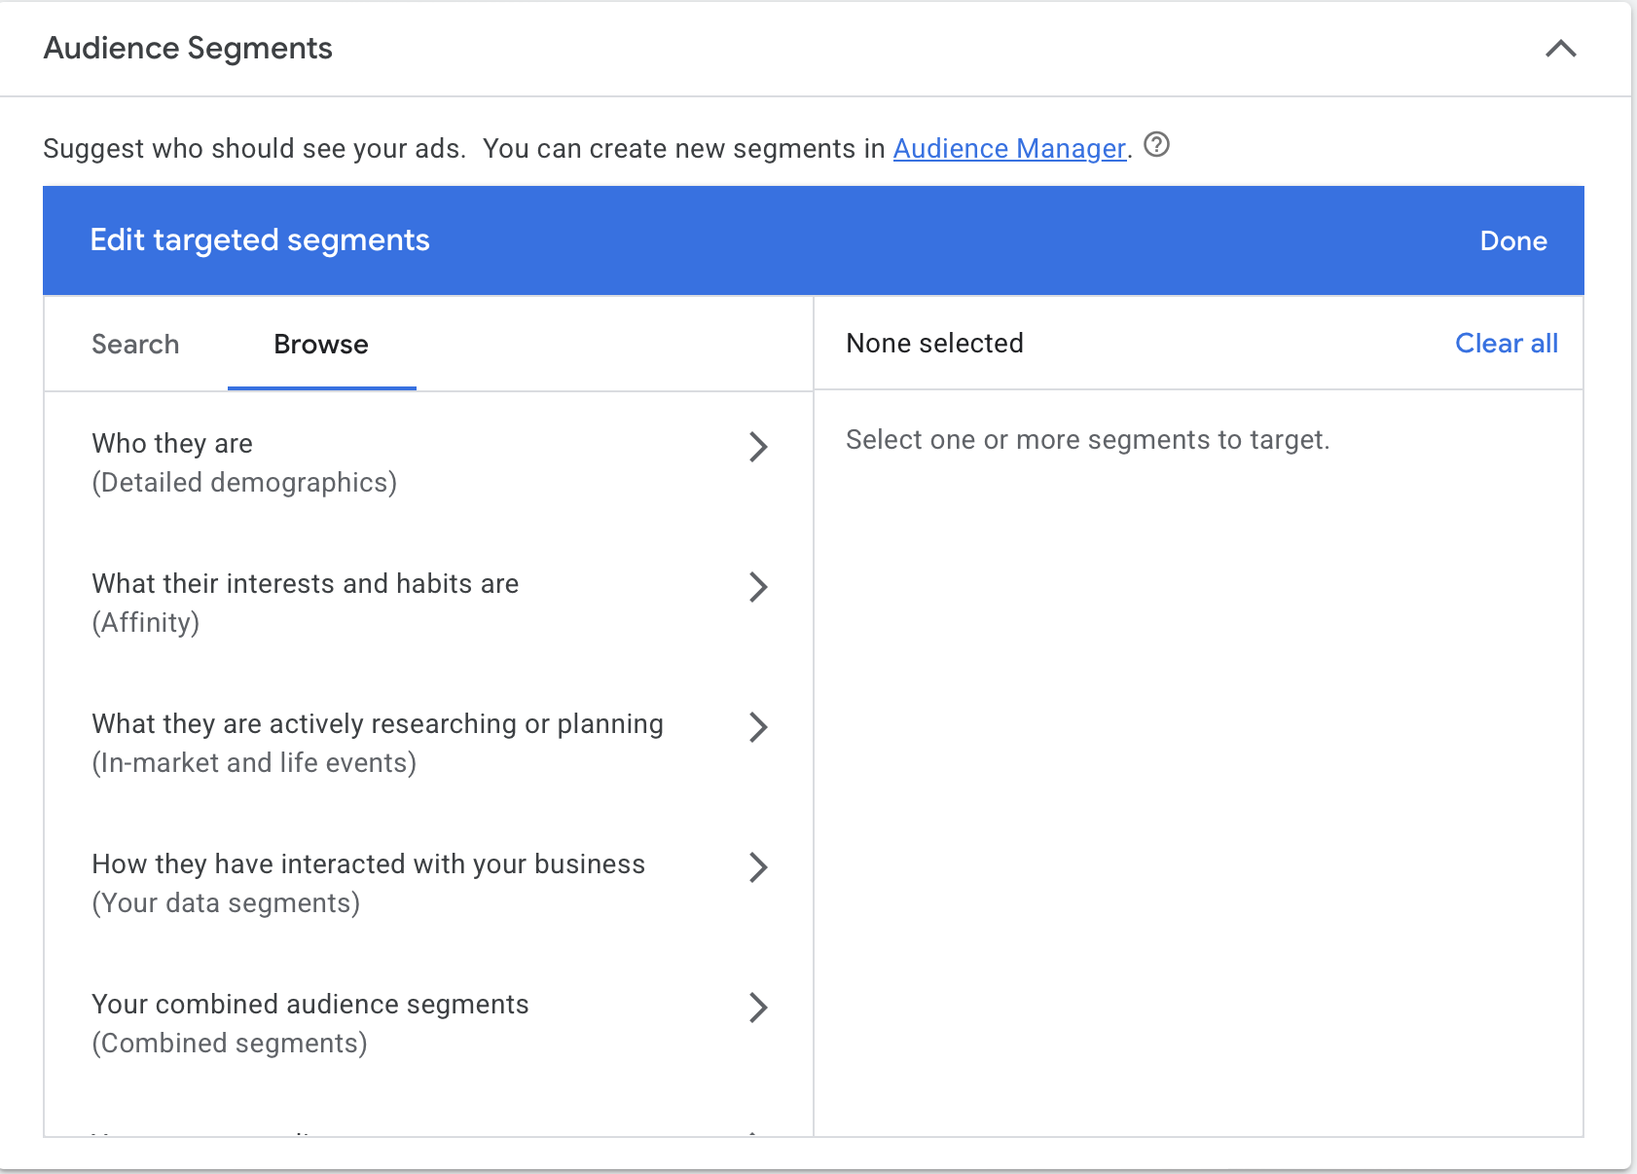
Advertising Targets
Notes:
https://ads.google.com/aw/campaigns/new/display

Slide 13
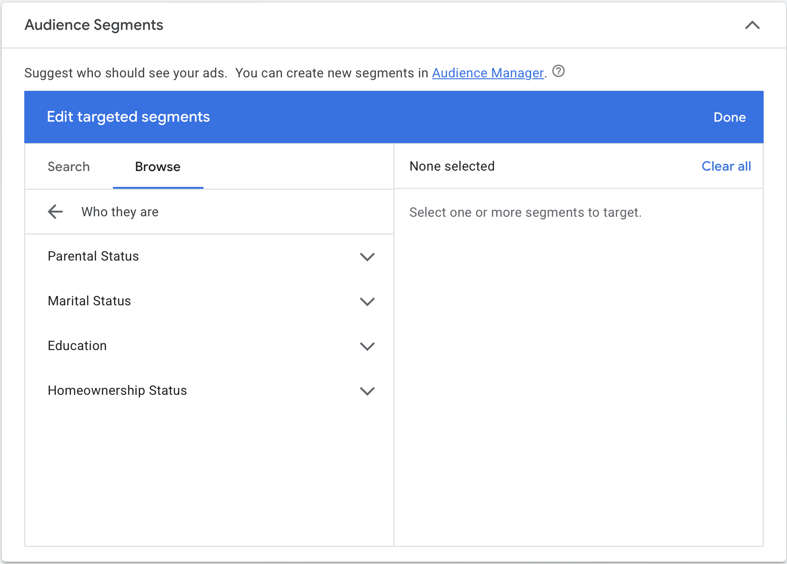
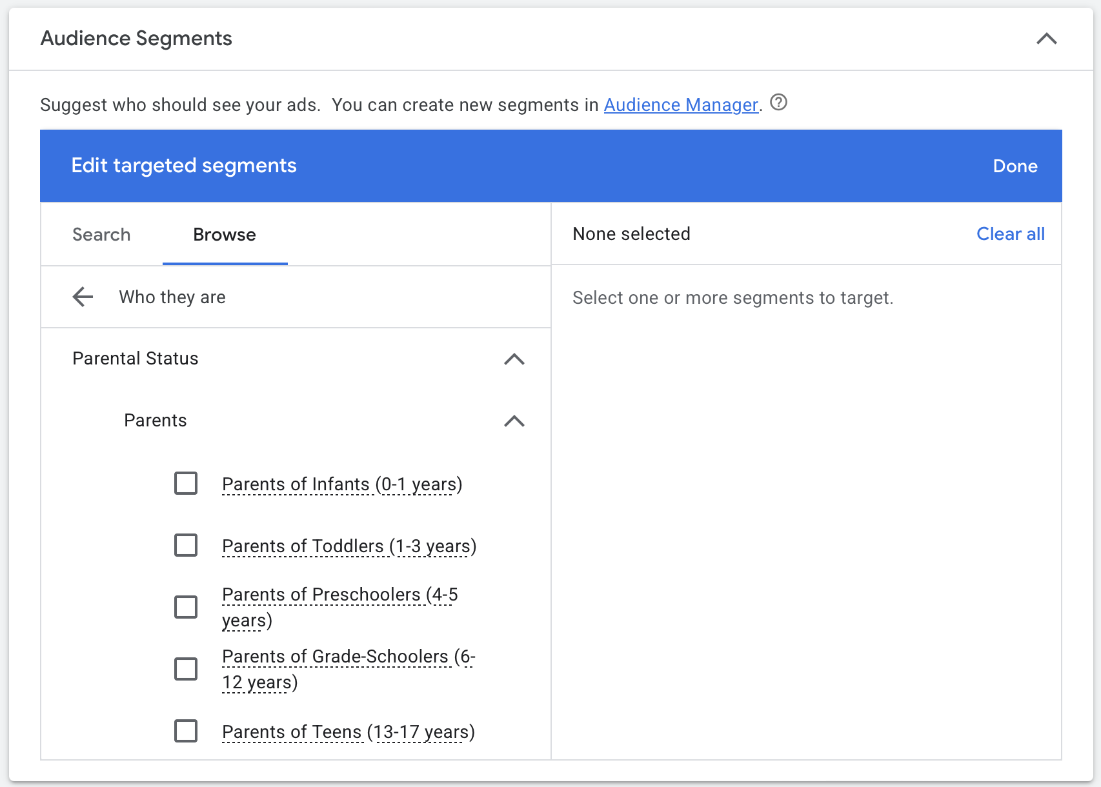
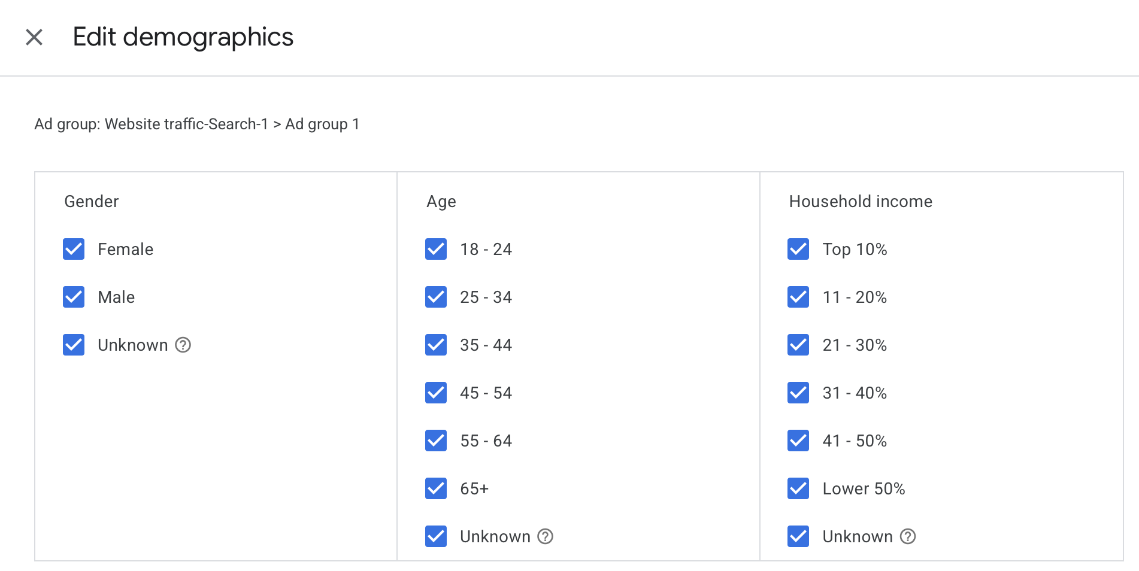
Demographic Targeting

Slide 14
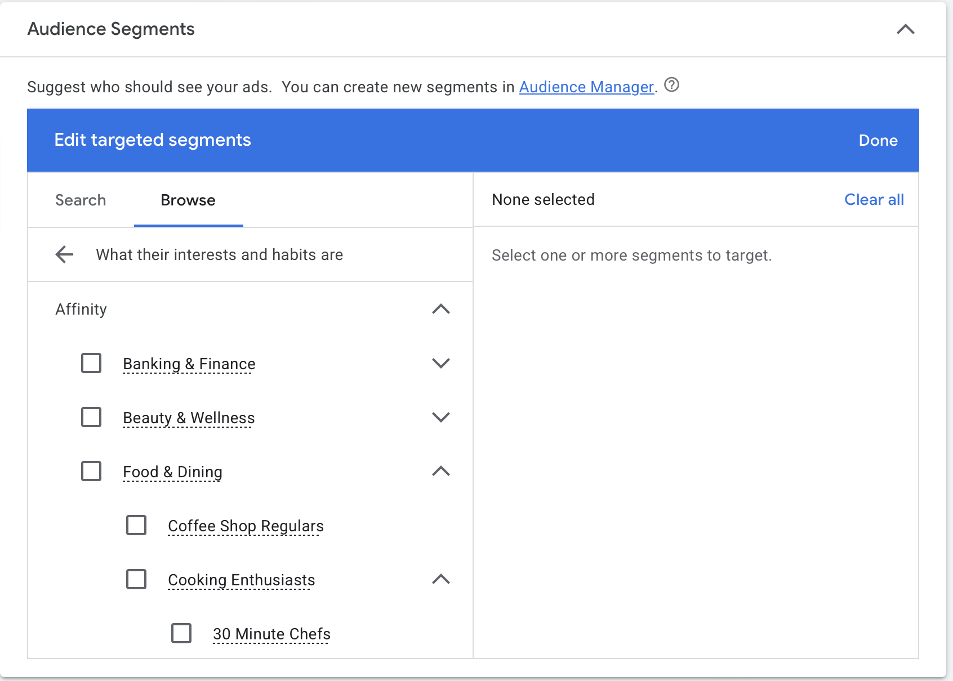
Interest Targeting

Slide 15
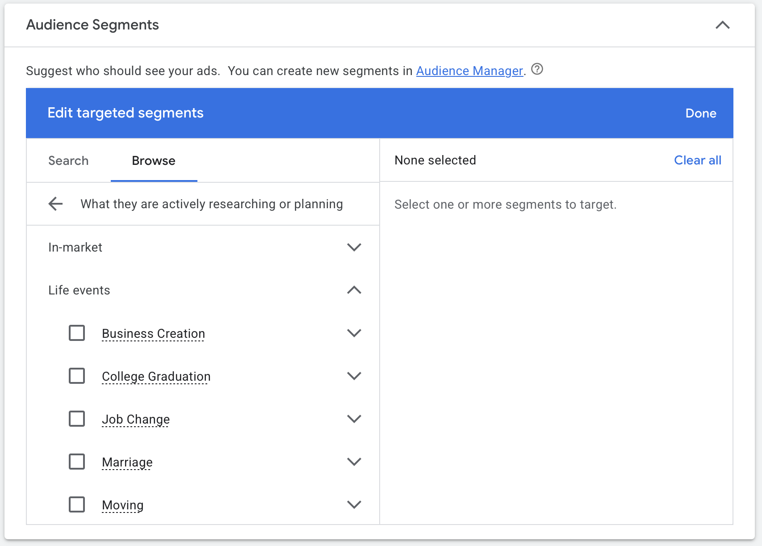
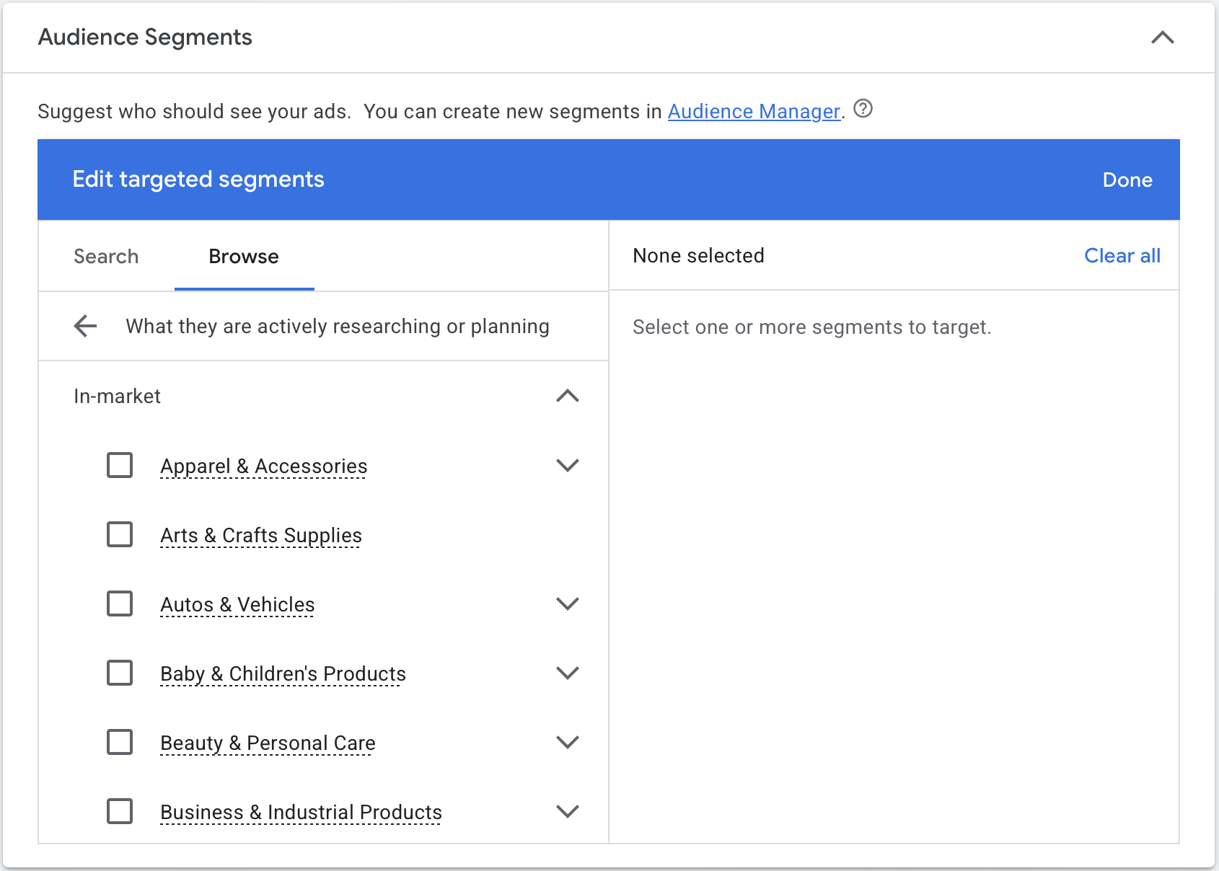
Recent History Targeting

Slide 16
Exercise: Problematic Targeting
What are examples where targeting particular ads at particular people might be problematic?

Slide 17

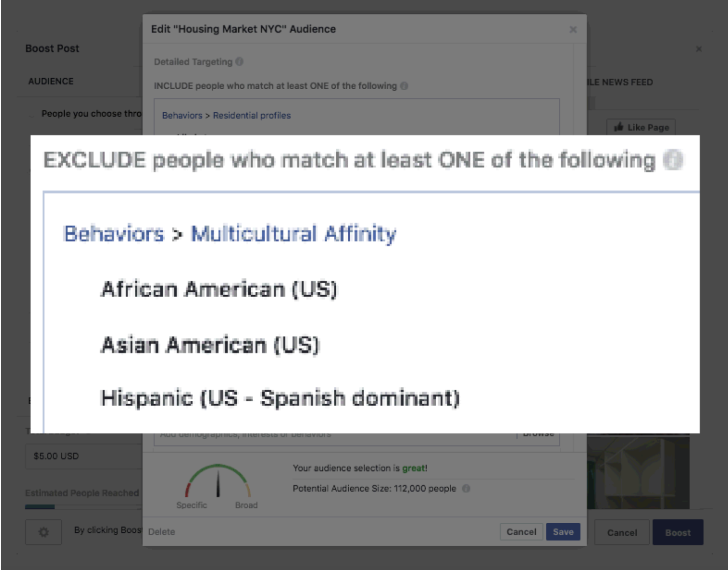
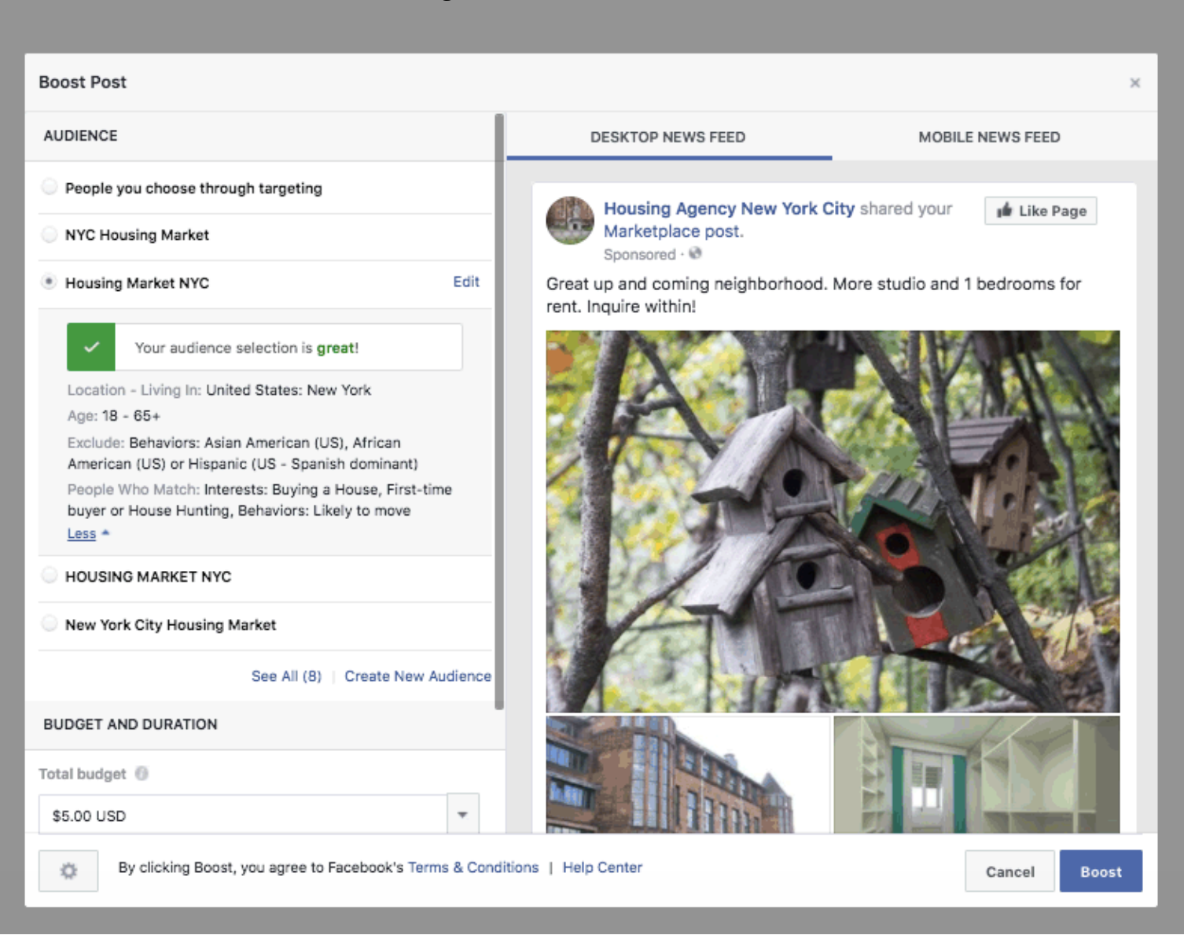
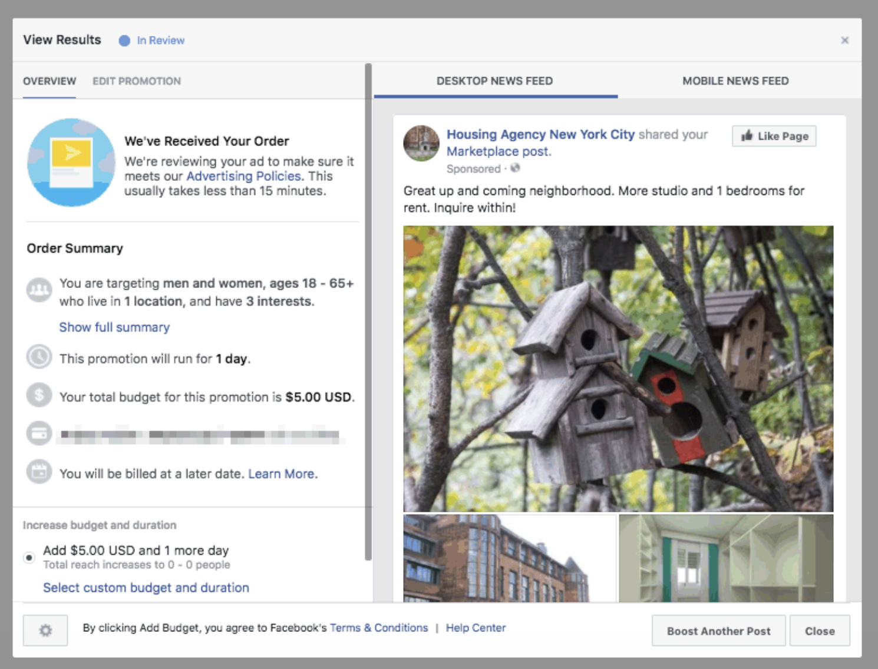
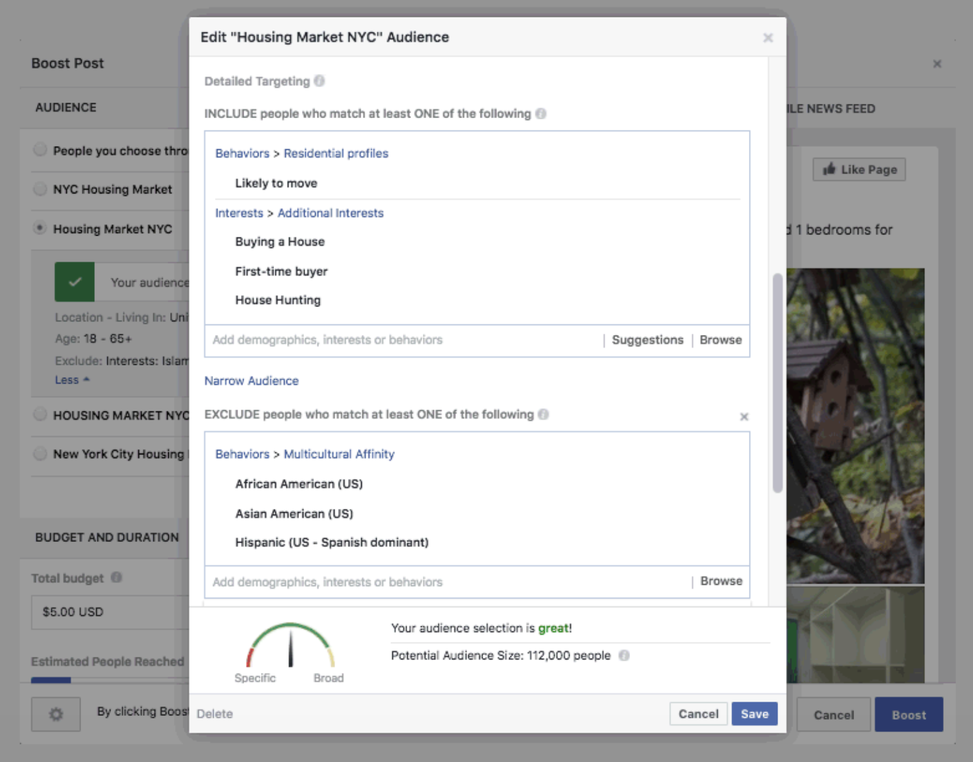
Targeting Housing Ads (2016)
Notes:
https://www.propublica.org/article/facebook-lets-advertisers-exclude-users-by-race
https://www.propublica.org/article/facebook-advertising-discrimination-housing-race-sex-national-origin (2017)
Violation of federal Fair Housing Act (1968)

Slide 18
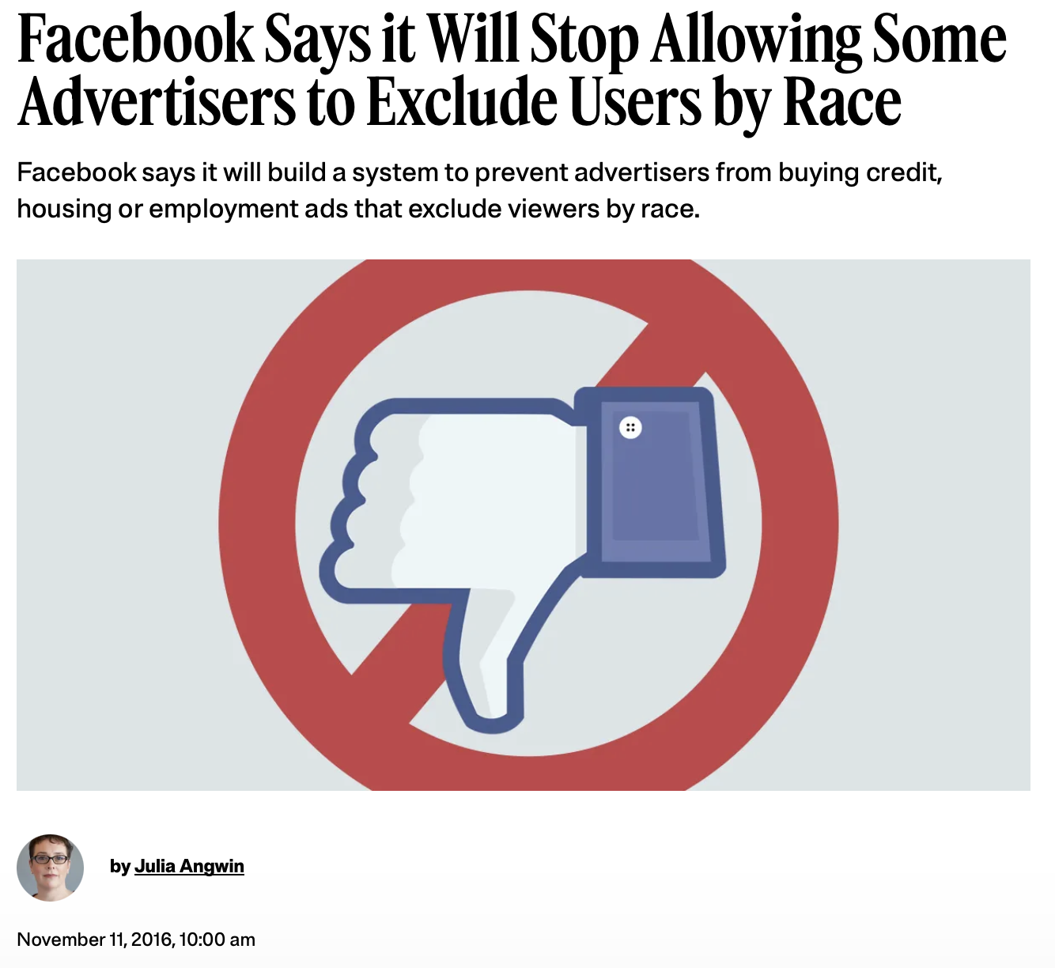
Facebook Response
Notes:
housing, employment, credit

Slide 19
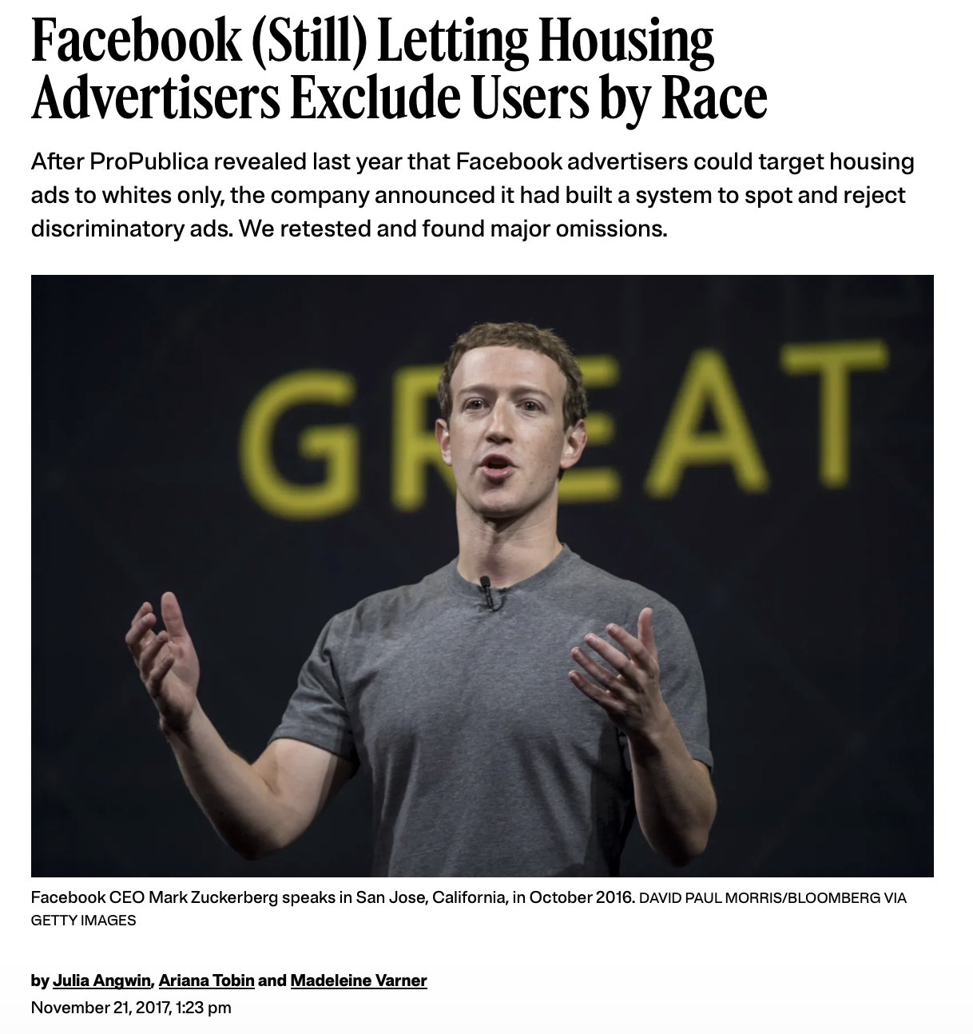
2017 Update

Slide 20
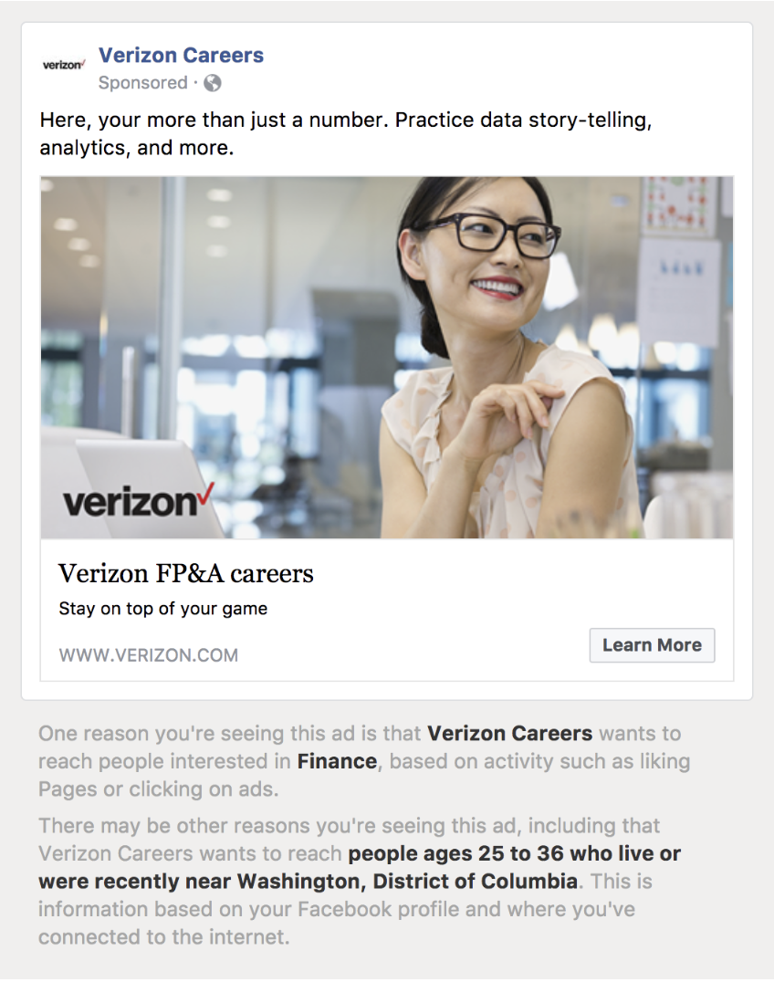
Job Ads (2017)
identified dozens of employers targeting ads at young adults
Verizon, Amazon, Goldman Sachs, Target, Facebook
likely violation of federal law
Notes:
https://www.propublica.org/article/facebook-ads-age-discrimination-targeting

Slide 21
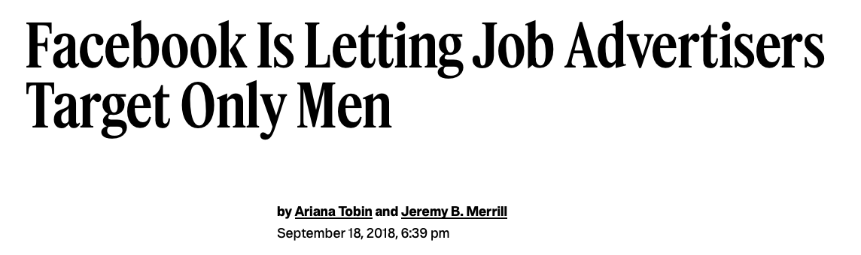
Job Ads (2018)

Slide 22
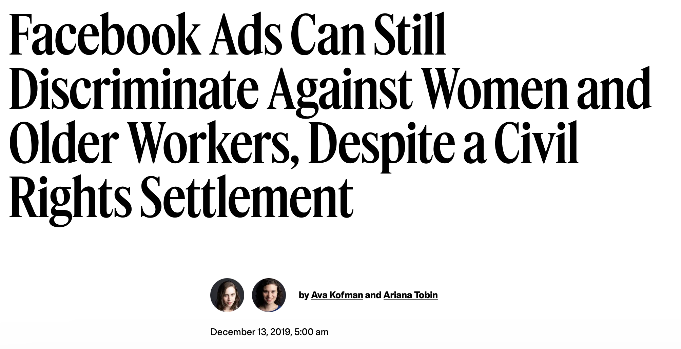
2019 Update

Slide 23
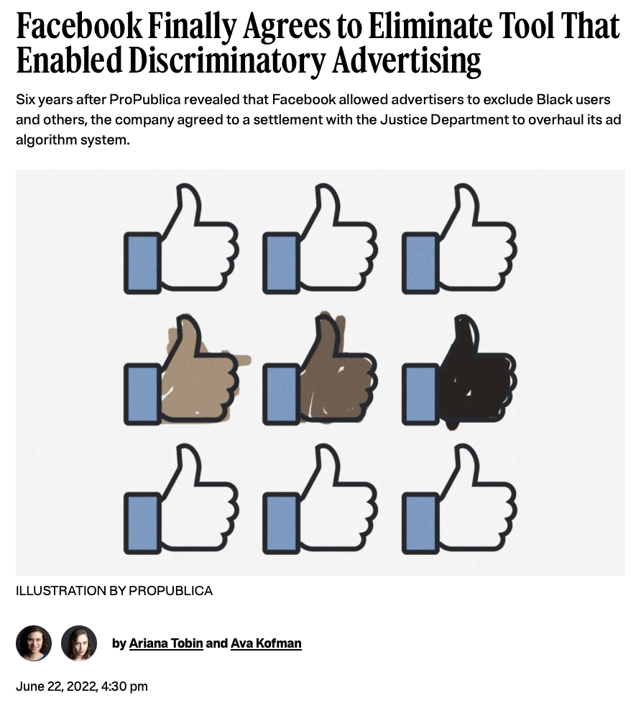
Federal Settlement (2022)

Slide 24
Exercise: Problematic Targeting
How might an advertiser target ads in a problematic way if they’re not allowed to target protected attributes?

Slide 25
Disparate Impact
Defining advertising discrimination:
  Intent: the advertiser is trying to benefit one group over another
  Process: the advertiser targets or excludes specific groups
  Outcome: different groups are more or less likely to see the ad
Speicher et al. Potential for Discrimination in Online Targeted Advertising. FAccT 2018.
Notes:
http://proceedings.mlr.press/v81/speicher18a/speicher18a.pdf

Slide 26
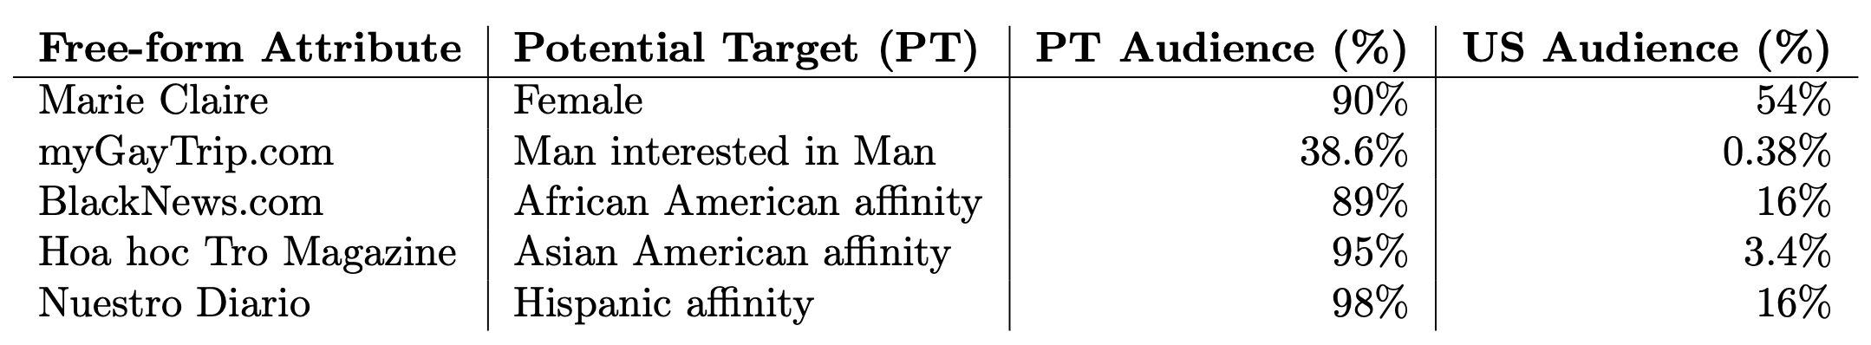
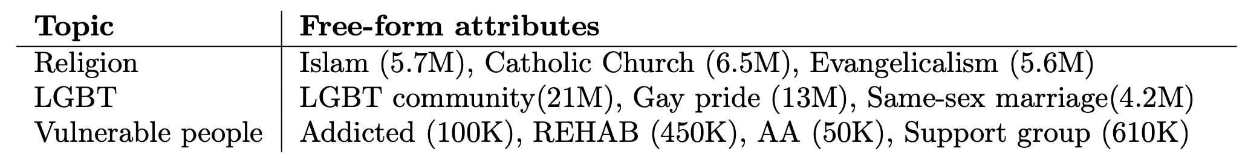
Attribute-Based Targeting
advertisers select specific demographics or interests
can select other attributes that correlate
Speicher et al. Potential for Discrimination in Online Targeted Advertising. FAccT 2018.

Slide 27
Custom Audience Targeting
advertisers can specify target individuals by phone number or email address
advertising platforms do not audit lists for shared protected attributes
voter registration records include age (38 states), gender (34 states), race (8 states)
these attributes can also be inferred
  gender from name ~96% accurate
  race from name ~91% accurate
Speicher et al. Potential for Discrimination in Online Targeted Advertising. FAccT 2018.

Slide 28
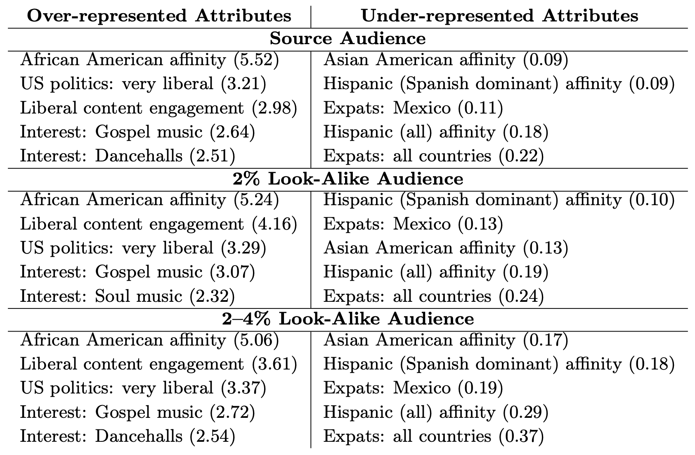
Look-Alike Targeting
advertisers can target people who are similar to existing set of customers (defined by PII)
biases in source audience extend to look-alike audience
Speicher et al. Potential for Discrimination in Online Targeted Advertising. FAccT 2018.

Slide 29
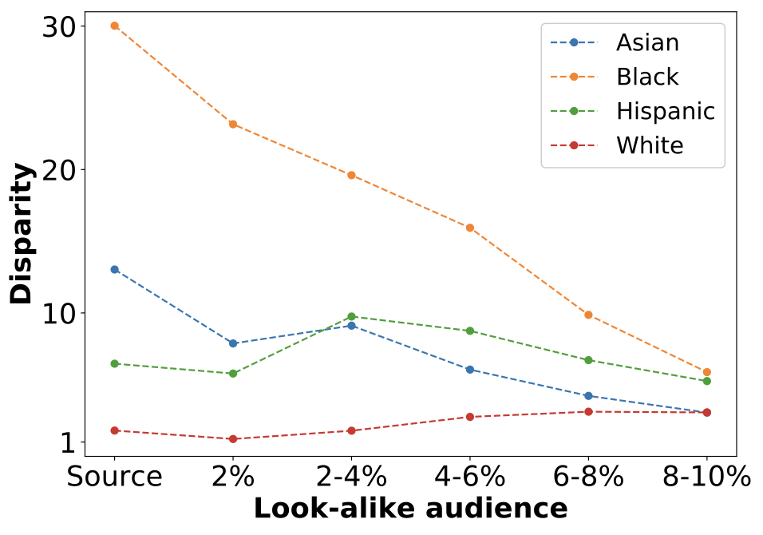
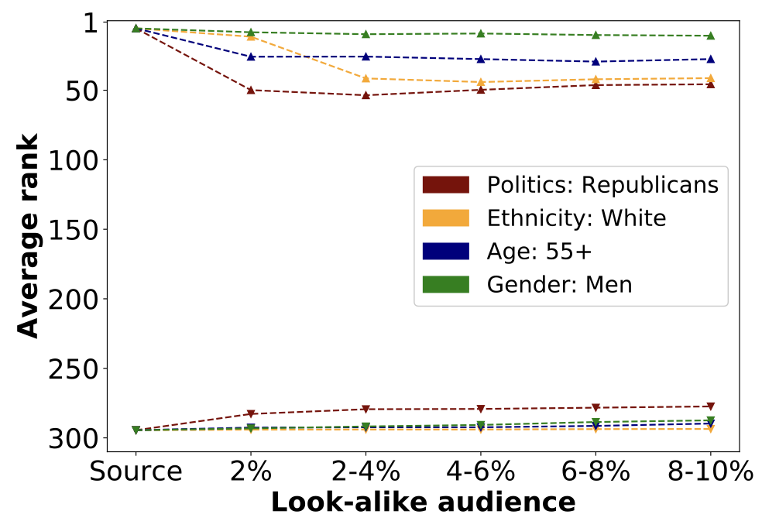
Look-Alike Targeting
advertisers can target people who are similar to existing set of customers (defined by PII)
biases in source audience extend to look-alike audience
Speicher et al. Potential for Discrimination in Online Targeted Advertising. FAccT 2018.

Slide 30
What if the advertiser isn’t trying to discriminate?

Slide 31
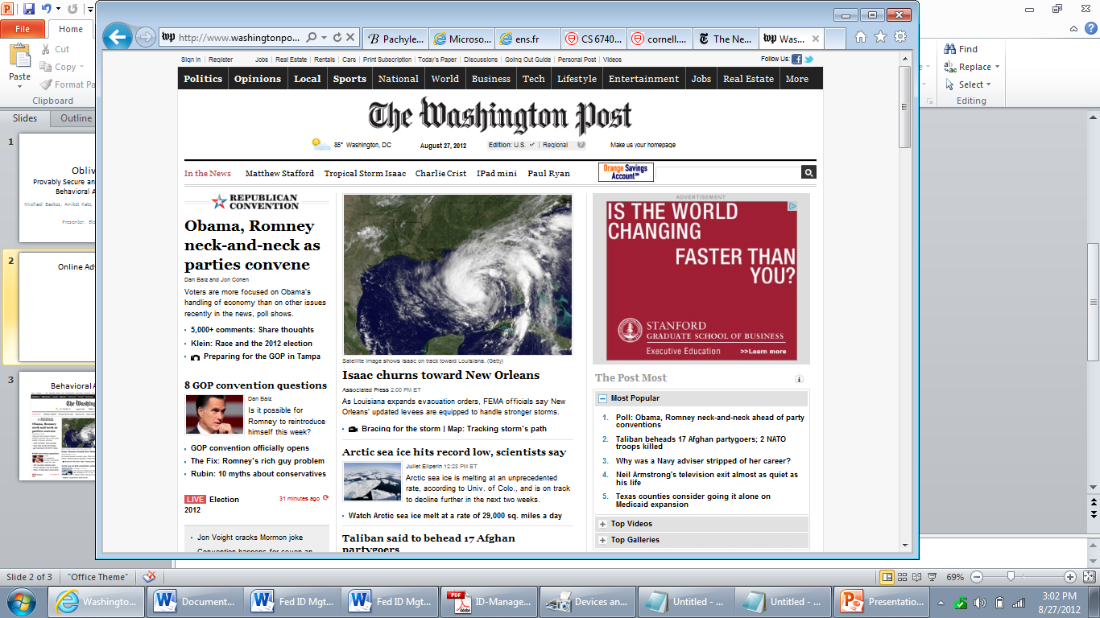
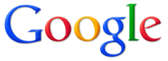

Online Advertising
4. Get Ads
Broker
8. Collect Payment
Advertiser
3. HTTP Request
7. Report Click
5. Ads
9. Redirect
Client
Publisher
1. HTTP Request
2. Content
6. Click

Slide 32
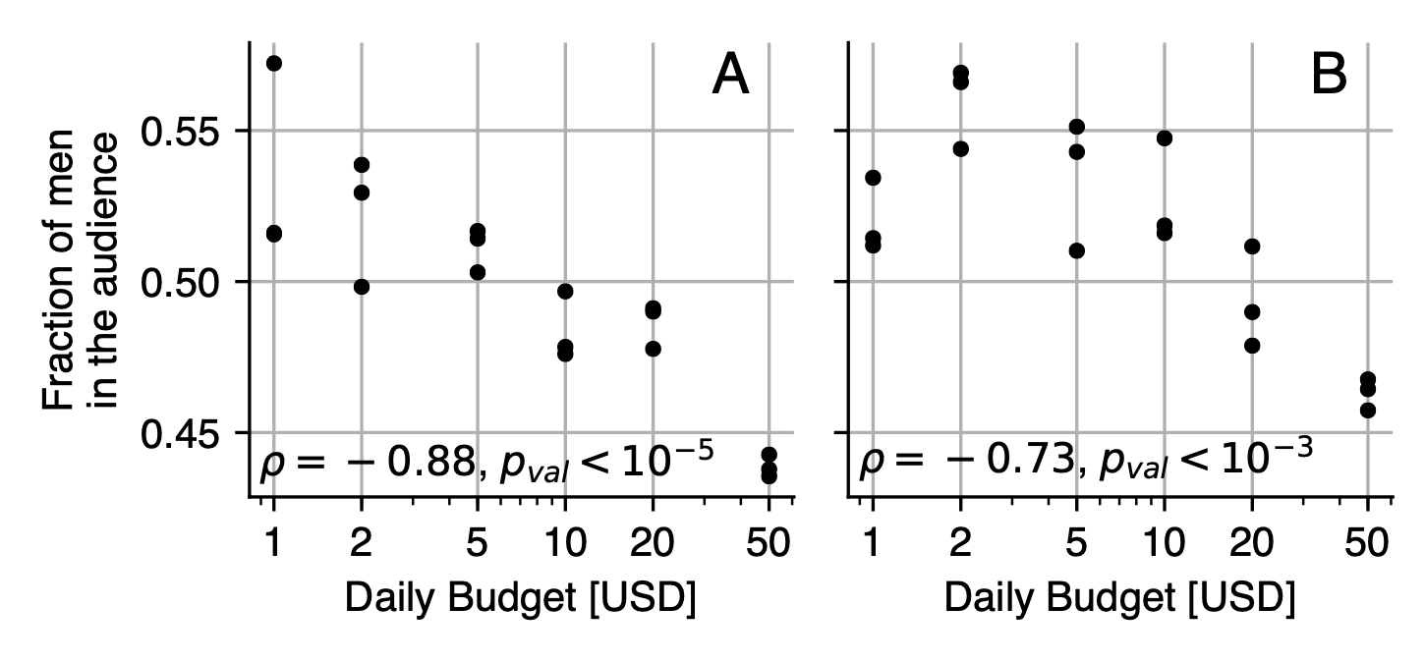
The Effect of Market Effects
Ad placement determined by auction
General Audience
Custom Audience
Ali et al. Discrimination through Optimization: How Facebook’s Ad Delivery Can Lead to Biased Outcomes. CSCW 2019.

Slide 33
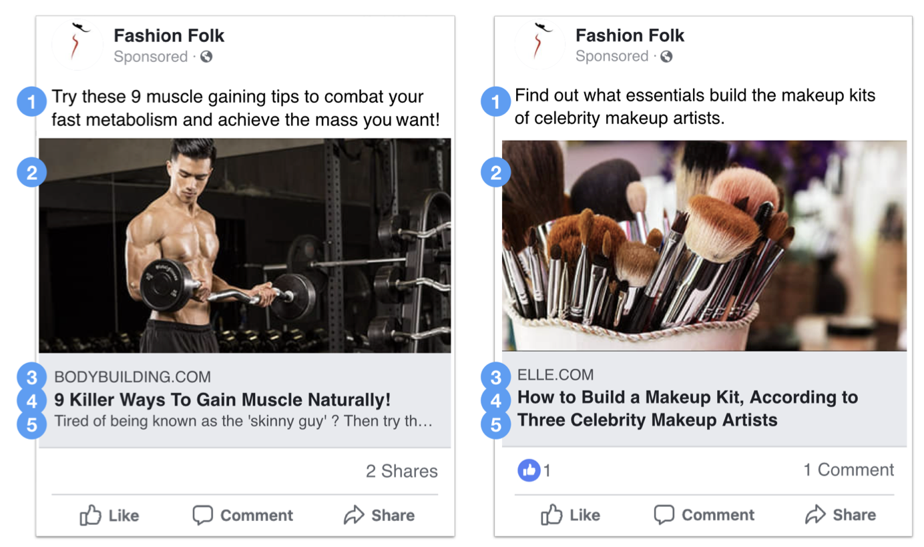
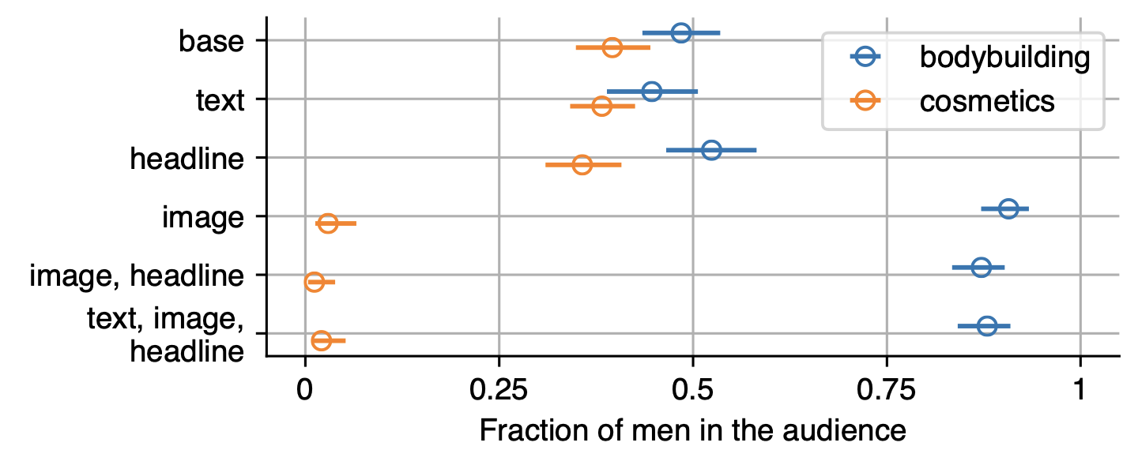
The Effect of Ad Content
1
text
2
image
3
base url
4
headline
Ali et al. Discrimination through Optimization: How Facebook’s Ad Delivery Can Lead to Biased Outcomes. CSCW 2019.

Slide 34
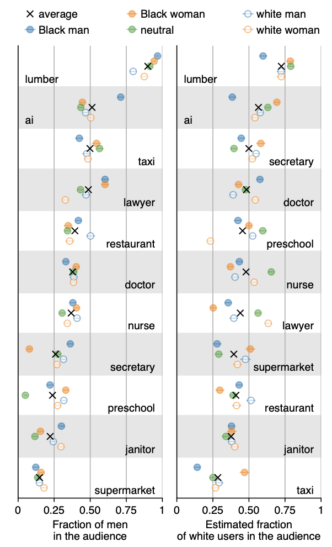
Real-world Effects
different jobs end up with different audience demographics
in some cases, image significantly affects audience
Ali et al. Discrimination through Optimization: How Facebook’s Ad Delivery Can Lead to Biased Outcomes. CSCW 2019.

Slide 35
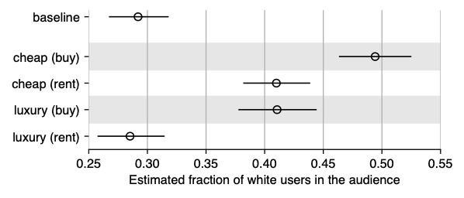
Real-world Effects
different housing ads end up with different audience demographics
Ali et al. Discrimination through Optimization: How Facebook’s Ad Delivery Can Lead to Biased Outcomes. CSCW 2019.
Notes:
Note: in North Carolina

Slide 36
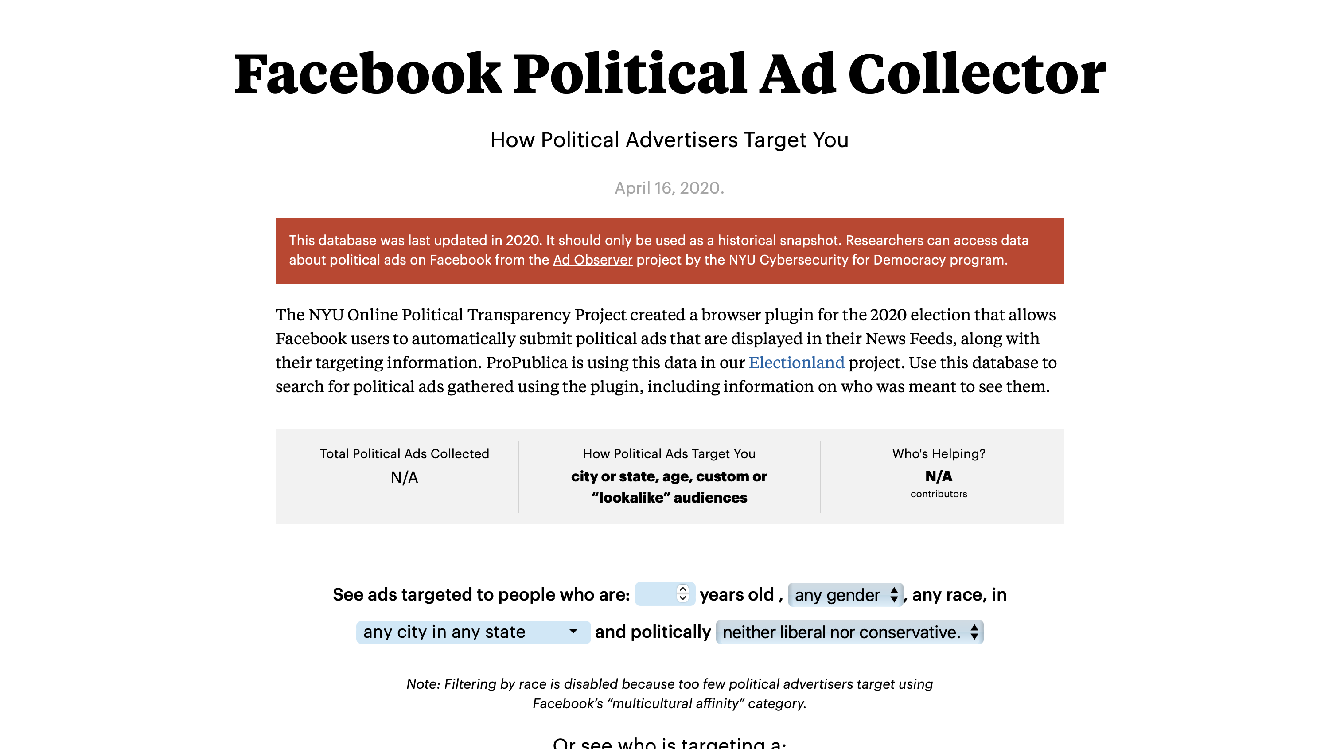
What about political ads?
https://projects.propublica.org/facebook-ads/

Slide 37
Alternatives: PrivAd

Slide 38
Alternatives: Google FLoC

Slide 39
Alternatives: Google’s Topics API

