Slide 1
Lecture 9: Online Tracking
CS 181E Fall 2026

Slide 2
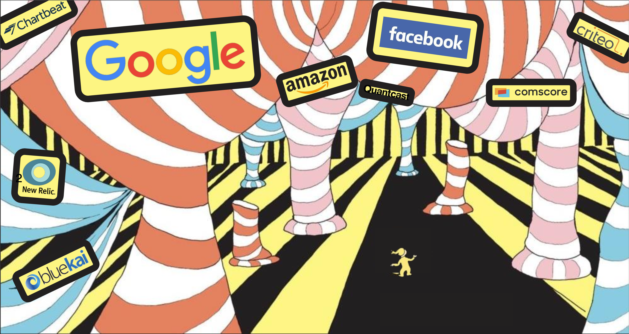
Online Tracking

Slide 3
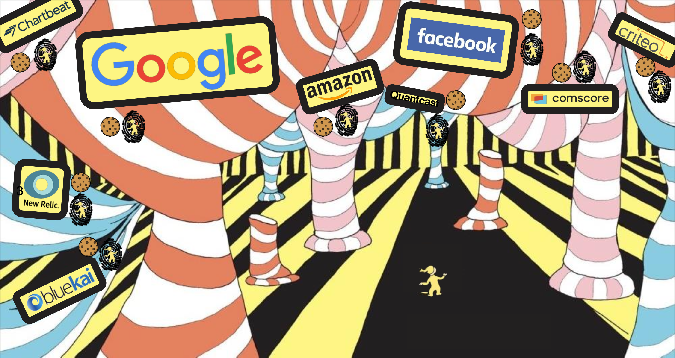
Online Tracking

Slide 4


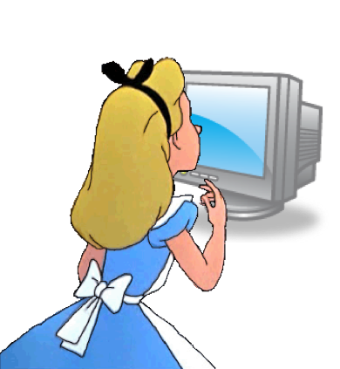


Review: Networked Systems
Server
Server
Server

Slide 5
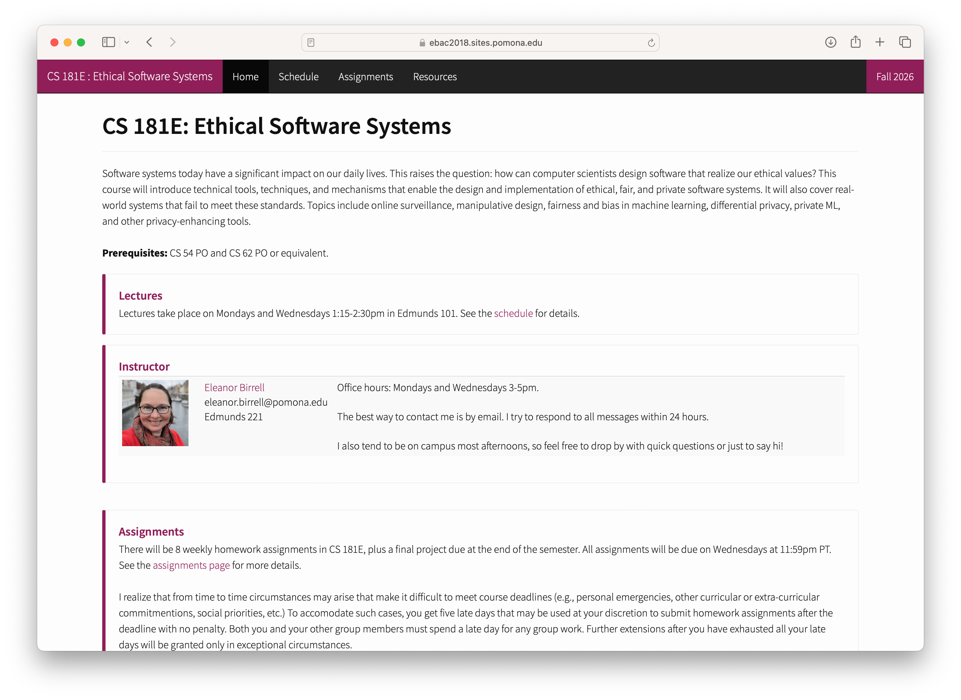
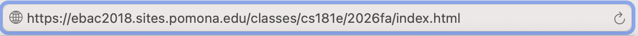
The web

Slide 6
URLs
Unique name for a file: URL (Universal Resource Locator)
Example URL:
Clients use prefix (http://www.cs.pomona.edu) to infer:
  What kind (protocol) of server to contact (HTTP)
  Where the server is (www.cs.pomona.edu)
Servers use suffix (/classes/cs181e/index.html) to:
  Specify what content they want
http://www.cs.pomona.edu:/classes/cs181e/index.html
prefix
suffix

Slide 7
HTTP Requests
HTTP request is a request line, followed by zero or more request headers
Request line: <method> <uri> <version>
  <method> is one of GET, POST, OPTIONS, HEAD, PUT, DELETE, or TRACE
  <uri> is typically URL for proxies, URL suffix for servers
    A URL is a type of URI (Uniform Resource Identifier)
    See http://www.ietf.org/rfc/rfc2396.txt
  <version> is HTTP version of request (HTTP/1.1 or HTTP/2.0)
Request headers: <header name>: <header data>
  Provide additional information to the server

Slide 8
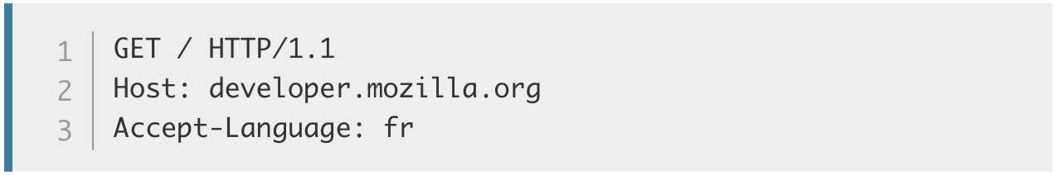
HTTP Example
HTTP Request:
Request Method
Path
Protocol Version
Headers (optional)
Notes:
Demo: course website w/ web inspector + wireshark

Slide 9
HTTP Responses
HTTP response is a response line followed by zero or more response headers, possibly followed by content
  a blank line (“\r\n”) separates headers from content.
Response line: <version> <status code> <status msg>
  <version> is HTTP version of the response
  <status code> is numeric status
  <status msg> is corresponding English text
    200 OK Request was handled without error
    301 Moved Provide alternate URL
    404 Not found Server couldn’t find the file
Response headers: <header name>: <header data>
  Provide additional information about response
  Content-Type: MIME type of content in response body
  Content-Length: Length of content in response body

Slide 10
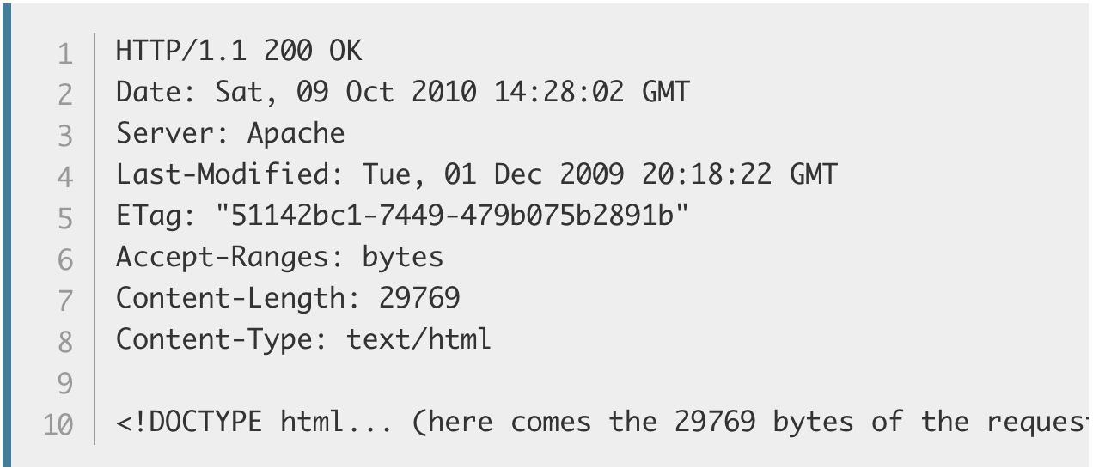
HTTP Example
HTTP Request:
HTTP Response:
Protocol Version
Status Code
Status Msg
Headers (optional)
Body
Notes:
Demo: course website w/ web inspector + wireshark

Slide 11
Web Content
Web servers return content to clients
  content: a sequence of bytes with an associated MIME (Multipurpose Internet Mail Extensions) type
Example MIME types
  text/html HTML document
  text/plain Unformatted text
  image/gif Binary image encoded in GIF format
  image/png Binar image encoded in PNG format
  image/jpeg Binary image encoded in JPEG format
You can find the complete list of MIME types at:
http://www.iana.org/assignments/media-types/media-types.xhtml

Slide 12
HTML
Key Observation: All of this is deterministic
<!DOCTYPE html>
<html>
<head>
<meta charset="utf-8">
<title>CS 181E - Fall 2026</title>
<link href='https://fonts.googleapis.com/css?family=Source+Sans+Pro:300,300i,600,700,700i' rel='stylesheet' type='text/css'>
<link href='https://fonts.googleapis.com/css?family=Inconsolata:400,700,700i' rel='stylesheet' type='text/css'>
<link href="resources/css/bootstrap.min.css" rel="stylesheet">
<link rel="stylesheet" href="resources/css/main.css">
</head>
<body>
<header class="site-header">
<div class="navbar navbar-inverse navbar-fixed-top">
<div class="container-fluid">
<div class="navbar-header">
<button type="button" class="navbar-toggle" data-toggle="collapse" data-target=".navbar-collapse">
<span class="sr-only">Toggle navigation</span>
<span class="icon-bar"></span>
<span class="icon-bar"></span>
<span class="icon-bar"></span>
</button>
<a class="navbar-brand"> CS 181E
<span class="hidden-xs hidden-sm">: Computer Systems</span>
<span class="hidden-md hidden-lg"> - Fall 2026</span>
</a>
</div>
Notes:
demo this with tiny (show file on server side, show file source in browser, show how it renders in browser

Slide 13
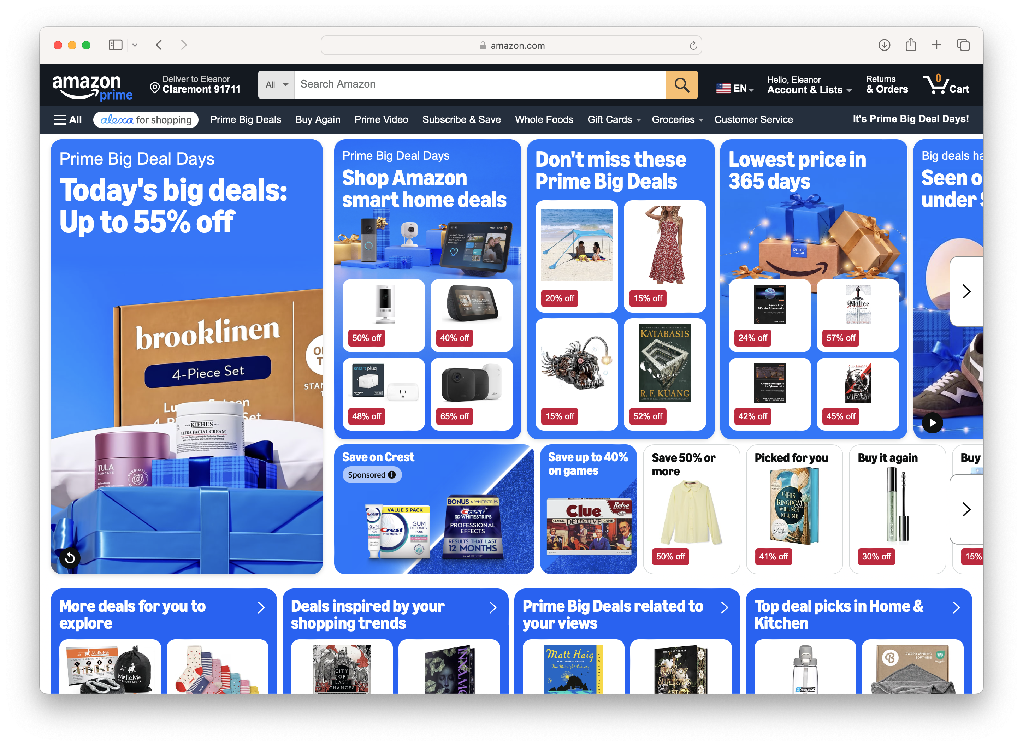
Dynamically-Generated Content
Notes:
discuss differences pages per person
discuss retaining authentication/web cart/etc

Slide 14
Static and Dynamic Content
The content returned in HTTP responses can be either static or dynamic
  Static content: content stored in files and retrieved in response to an HTTP request
    Examples: HTML files, images, audio clips
    Request identifies which content file
  Dynamic content: content produced on-the-fly in response to an HTTP request
    Example: content produced by a program executed by the server on behalf of the client
    Request identifies file containing executable code
Bottom line: Web content is associated with a file that is managed by the server

Slide 15
Dynamic Web Pages
Server-Side
Client-Side
PHP
Ruby
Python
Java
Go
Javascript
Key Observation: All of this is still stateless
Notes:
Demo: minesweeper in javascript

Slide 16
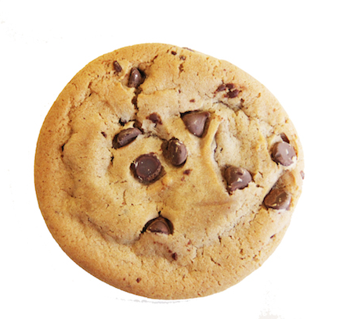
Cookies
Cookies are small blocks of data stored locally by the web browser
Cookie is sent with every request to that domain
Can be used to keep track of whether a user has authenticated (as which user)
And also other things…
Can be set by third parties
Notes:
-standard cookies, third party cookies

Slide 17
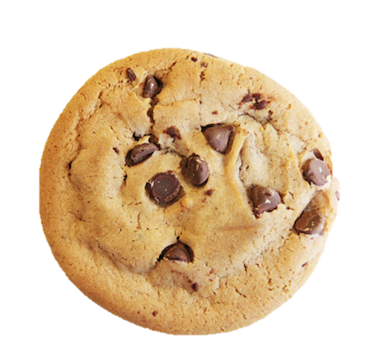

Cookies
Client
Server
GET http://www.example.com/ HTTP/1.1
HTTP/1.1 200 OK
Set-Cookie: session-id=12345
GET http://www.example.com/ HTTP/1.1
Cookie: session-id=12345

Slide 18
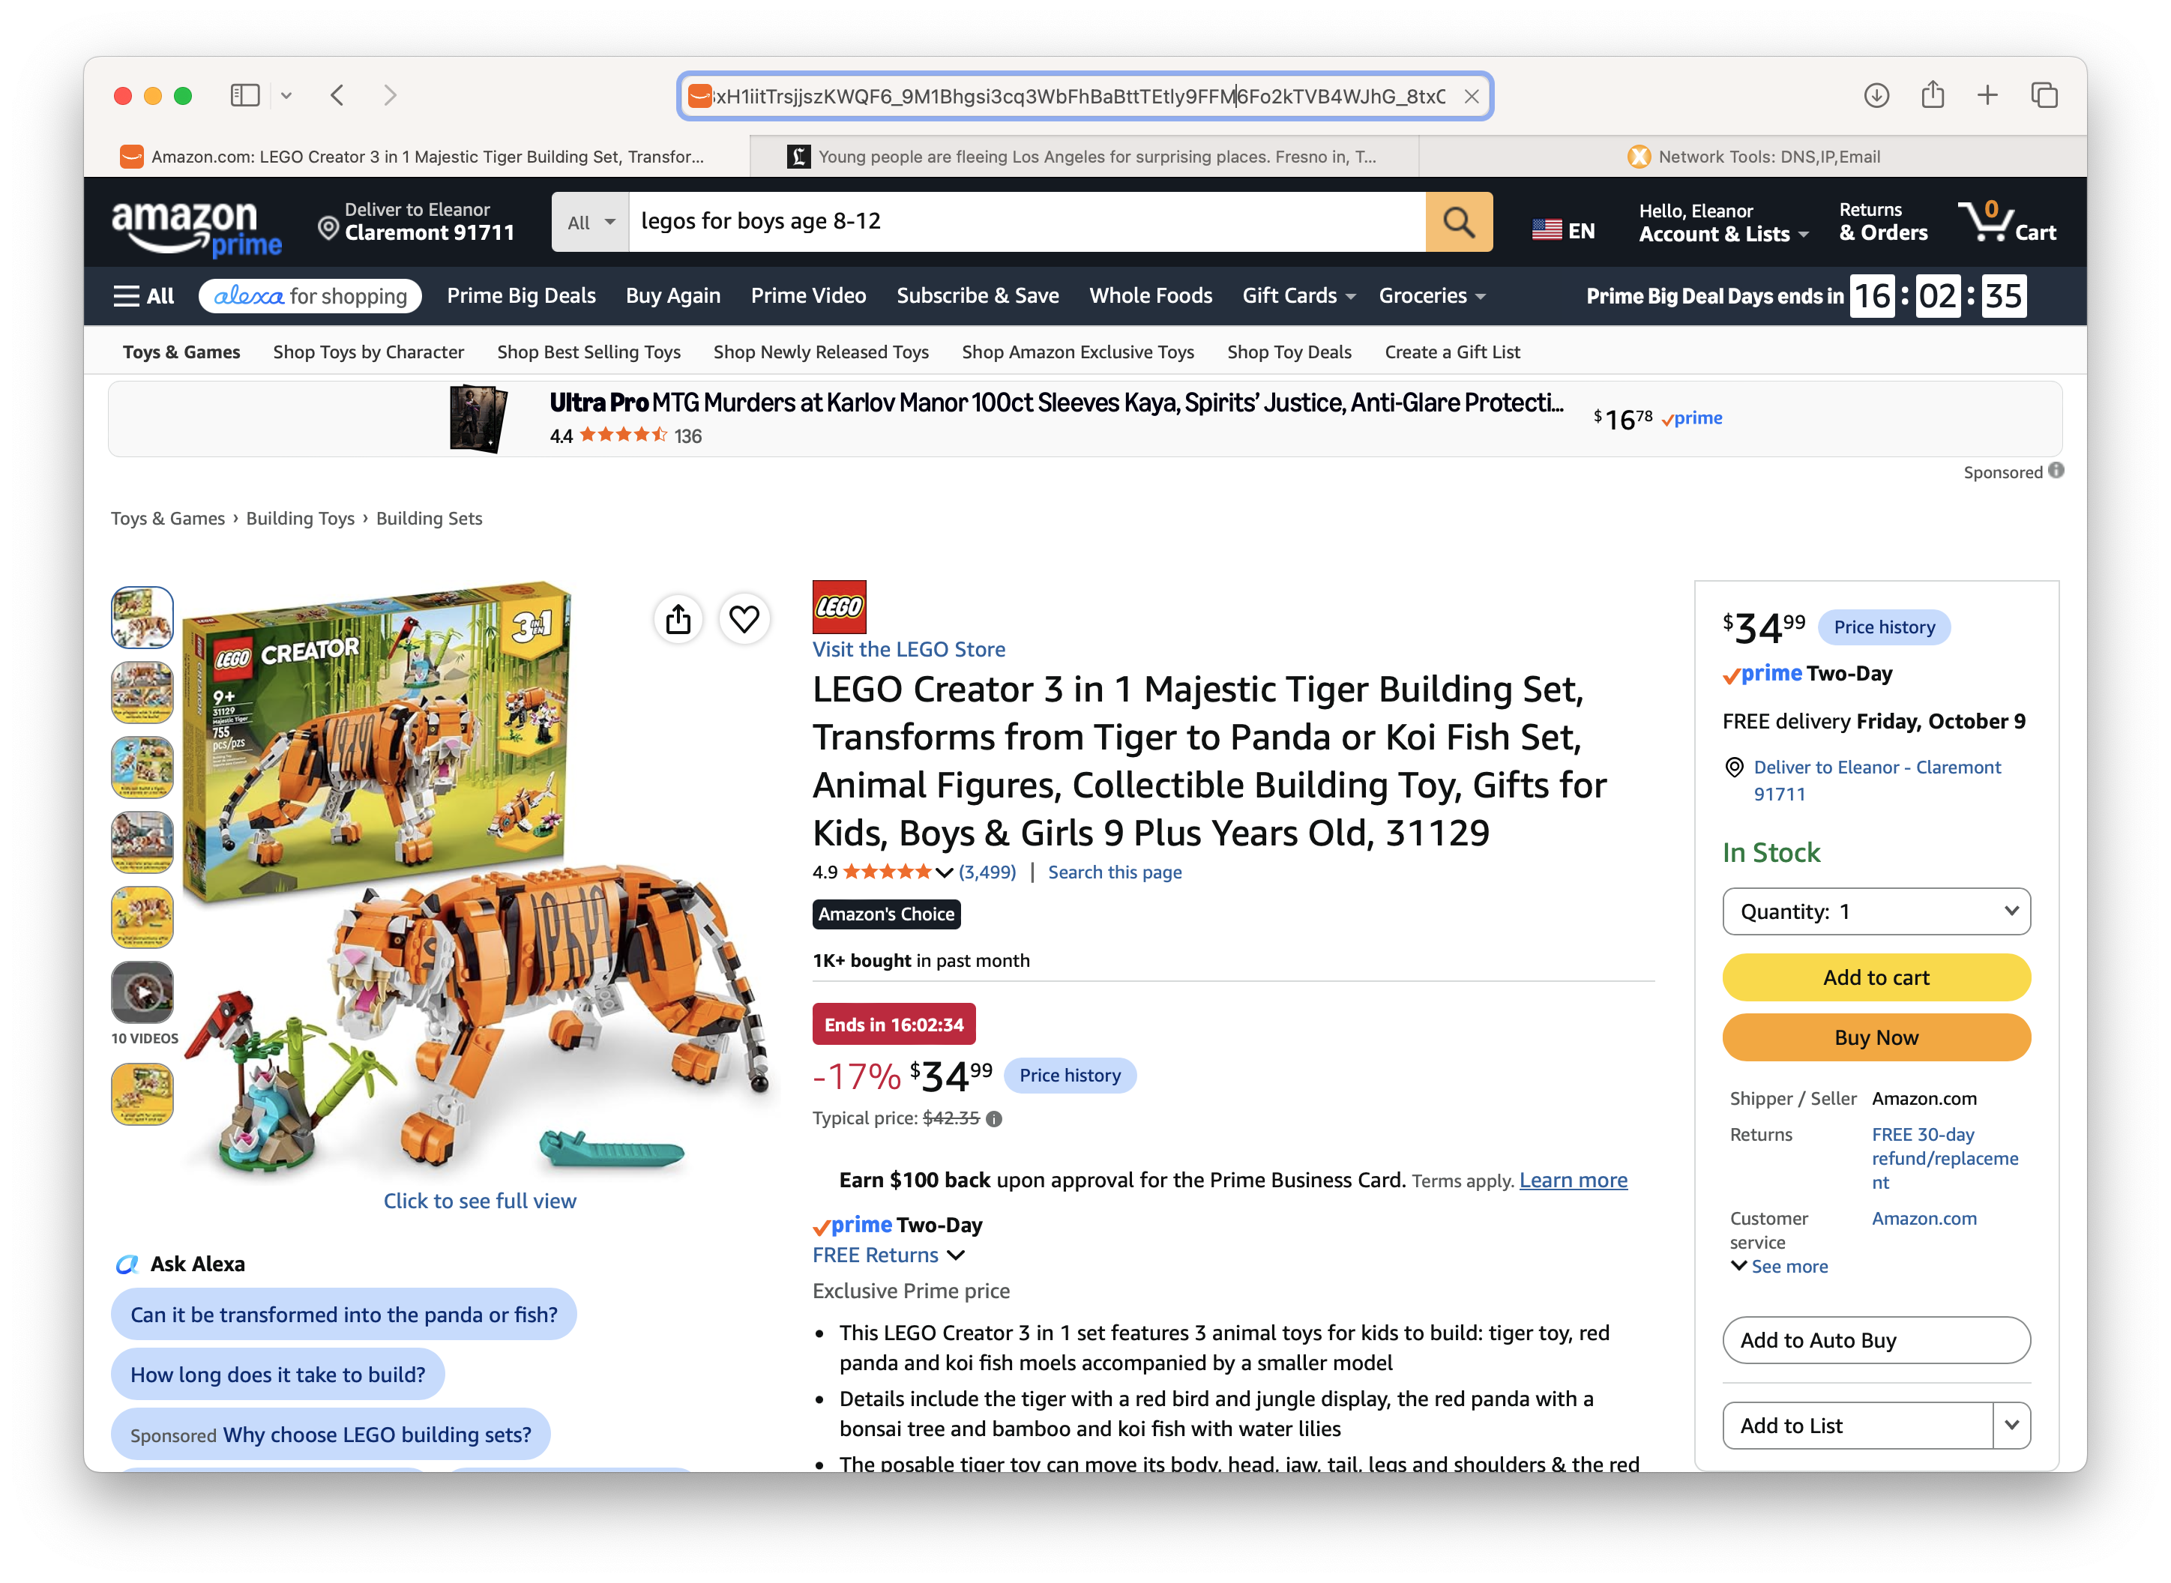
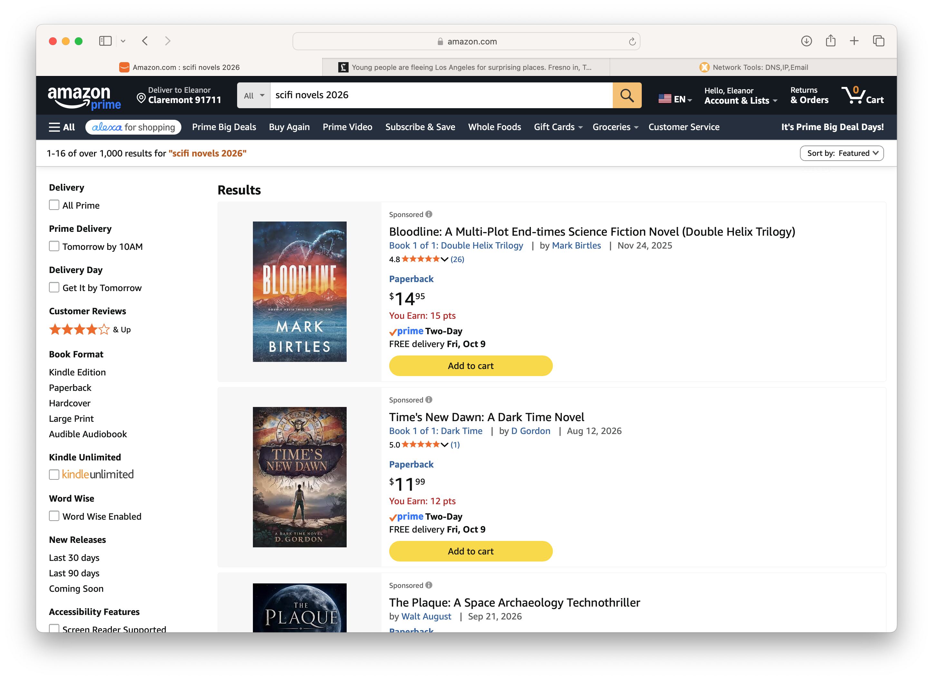
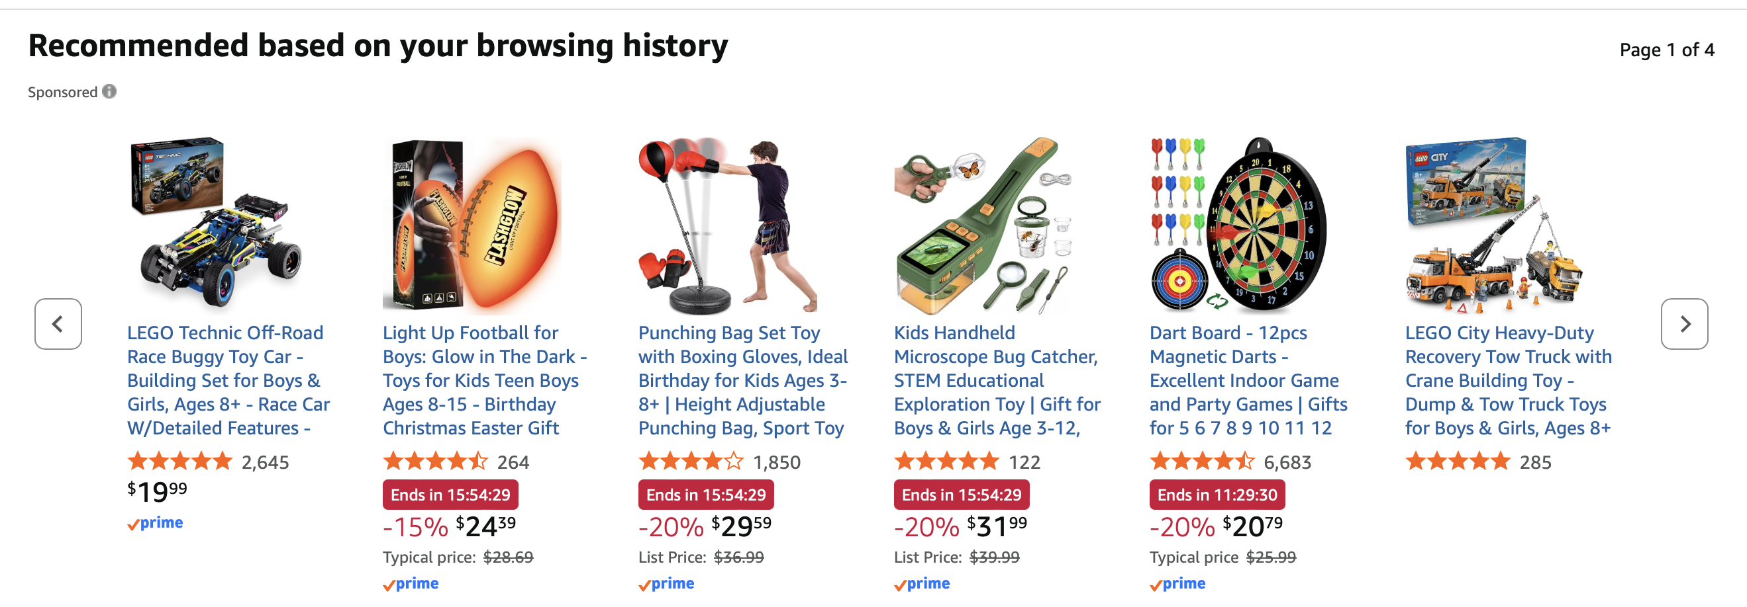
First party tracking
uses cookies, javascript, and url parameters to track behavior on site
https://www.amazon.com/LEGO-Majestic-Building-Featuring-Imaginati ve/dp/B09FM57L7B/ref=sr_1_1_sspa?crid=28QO8CV6XVUJO&dib=eyJ2IjoiMSJ9.CgmS_iNoAEFAyxySR6sPRkK0HLeFtyw9AMIqzNQCK8xH1iitTrsjjszKWQF6_9M1Bhgsi3cq3WbFhBaBttTEtly9FFM6Fo2kTVB4WJhG_8txOOexcH89mgxN6yBIl8jg0rByrljMtk-JpW1P5GVsEUQ2Il-jX I6ZSPk01uwAjpg-JJ2smfK0pgay8DV-6xafyDF0vHKQI4eDIlwzquEix5 GpkZopJrTvZml56pqgrN59fSzZ kDT1-xIe6m0VJ81KbBEeNXX3afC7Y r-X2Z_Ke0UZAp92bfn7QFVAZ8UAcIA.KgOBGNSmCjKO_6yt5cXP8T P8H0ty6SXgkSkxFwWuL6I&dib_tag=se&keywords=legos+for+boys+age+8-12&qid=1791384961&sprefix=legos+for+%2Caps%2C221&sr=8-1-spons&sp_csd=d2lkZ2V0TmFtZT1zcF9hdGY&psc=1

Slide 19
HTML DOM
<!DOCTYPE html>
<html>
<head>
<title>CS 181E - Fall 2026</title>
<link href='https://fonts.googleapis.com/css?family=Source+Sans+Pro:300,300i,600,700,700i' rel='stylesheet' type='text/css'>
<link href='https://fonts.googleapis.com/css?family=Inconsolata:400,700,700i' rel='stylesheet' type='text/css'>
<link href="resources/css/bootstrap.min.css" rel="stylesheet">
<link rel="stylesheet" href="resources/css/main.css">
</head>
<body>
<header class="site-header">
<div class="navbar navbar-inverse navbar-fixed-top">
<div class="container-fluid">
<div class="navbar-header">
<a class="navbar-brand" href="">CS 181E <span class="hidden-xs hidden-sm">: Ethical Software Systems</span> <span class="hidden-md hidden-lg"> - Fall 2026</span> </a>
</div>
<div class="collapse navbar-collapse">
<ul class="nav navbar-nav">
<li class="active”><a href="index.html">Home</a></li>
<li><a href="schedule.html">Schedule</a></li>
<li><a href="assignments.html">Assignments</a></li>
<li><a href="resources.html">Resources</a></li>
</ul>
<ul class="nav navbar-nav navbar-right hidden-xs hidden-sm"><li><a>Fall 2026</a></li></ul>
</div><!-- /.nav-collapse -->
</div><!-- /.container -->
</div><!-- /.navbar -->
</header>
<div class="container">
<div class="page-header"><h1>CS 181E: Ethical Software Systems</h1></div>
<p>Software systems today have a significant impact on our daily lives. This raises the question: how can computer scientists design software that realize our ethical values? This course will introduce technical tools, techniques, and mechanisms that enable the design and implementation of ethical, fair, and private software systems. It will also cover real-world systems that fail to meet these standards. Topics include online surveillance, manipulative design, fairness and bias in machine learning, differential privacy, private ML, and other privacy-enhancing tools. <br/><br/><b>Prerequisites:</b> CS 54 PO and CS 62 PO or equivalent. </p>
<div class="bs-callout bs-callout-class"><h4>Lectures</h4>
<div><p>Lectures take place on Mondays and Wednesdays 1:15-2:30pm in Edmunds 101. See the <a href="schedule.html">schedule</a> for details. </p></div>
</div>
<div class="bs-callout bs-callout-class"><h4>Instructor</h4><div>
<table><tbody>
<tr class="row1">
<td><img src="images/birrell.jpg" alt="Eleanor Birrell" width="100"></td>
<td valign="top" width="200">
<a href="http://www.cs.pomona.edu/~ebirrell">Eleanor Birrell</a><br/>
eleanor.birrell@pomona.edu<br/>
Edmunds 221 <br/>
</td>
<td valign="top">Office hours: Mondays and Wednesdays 3-5pm.
<br/><br/>
The best way to contact me is by email. I try to respond
to all messages within 24 hours.
<br/><br/>
I also tend to be on campus most afternoons, so feel free to drop by
with quick questions or just to say hi!
</td>
</tr>
</tbody>
</table>
</div>
</div>
Notes:
show sequence of requests in tiny (logs requests/responses to console on server side)

Slide 20
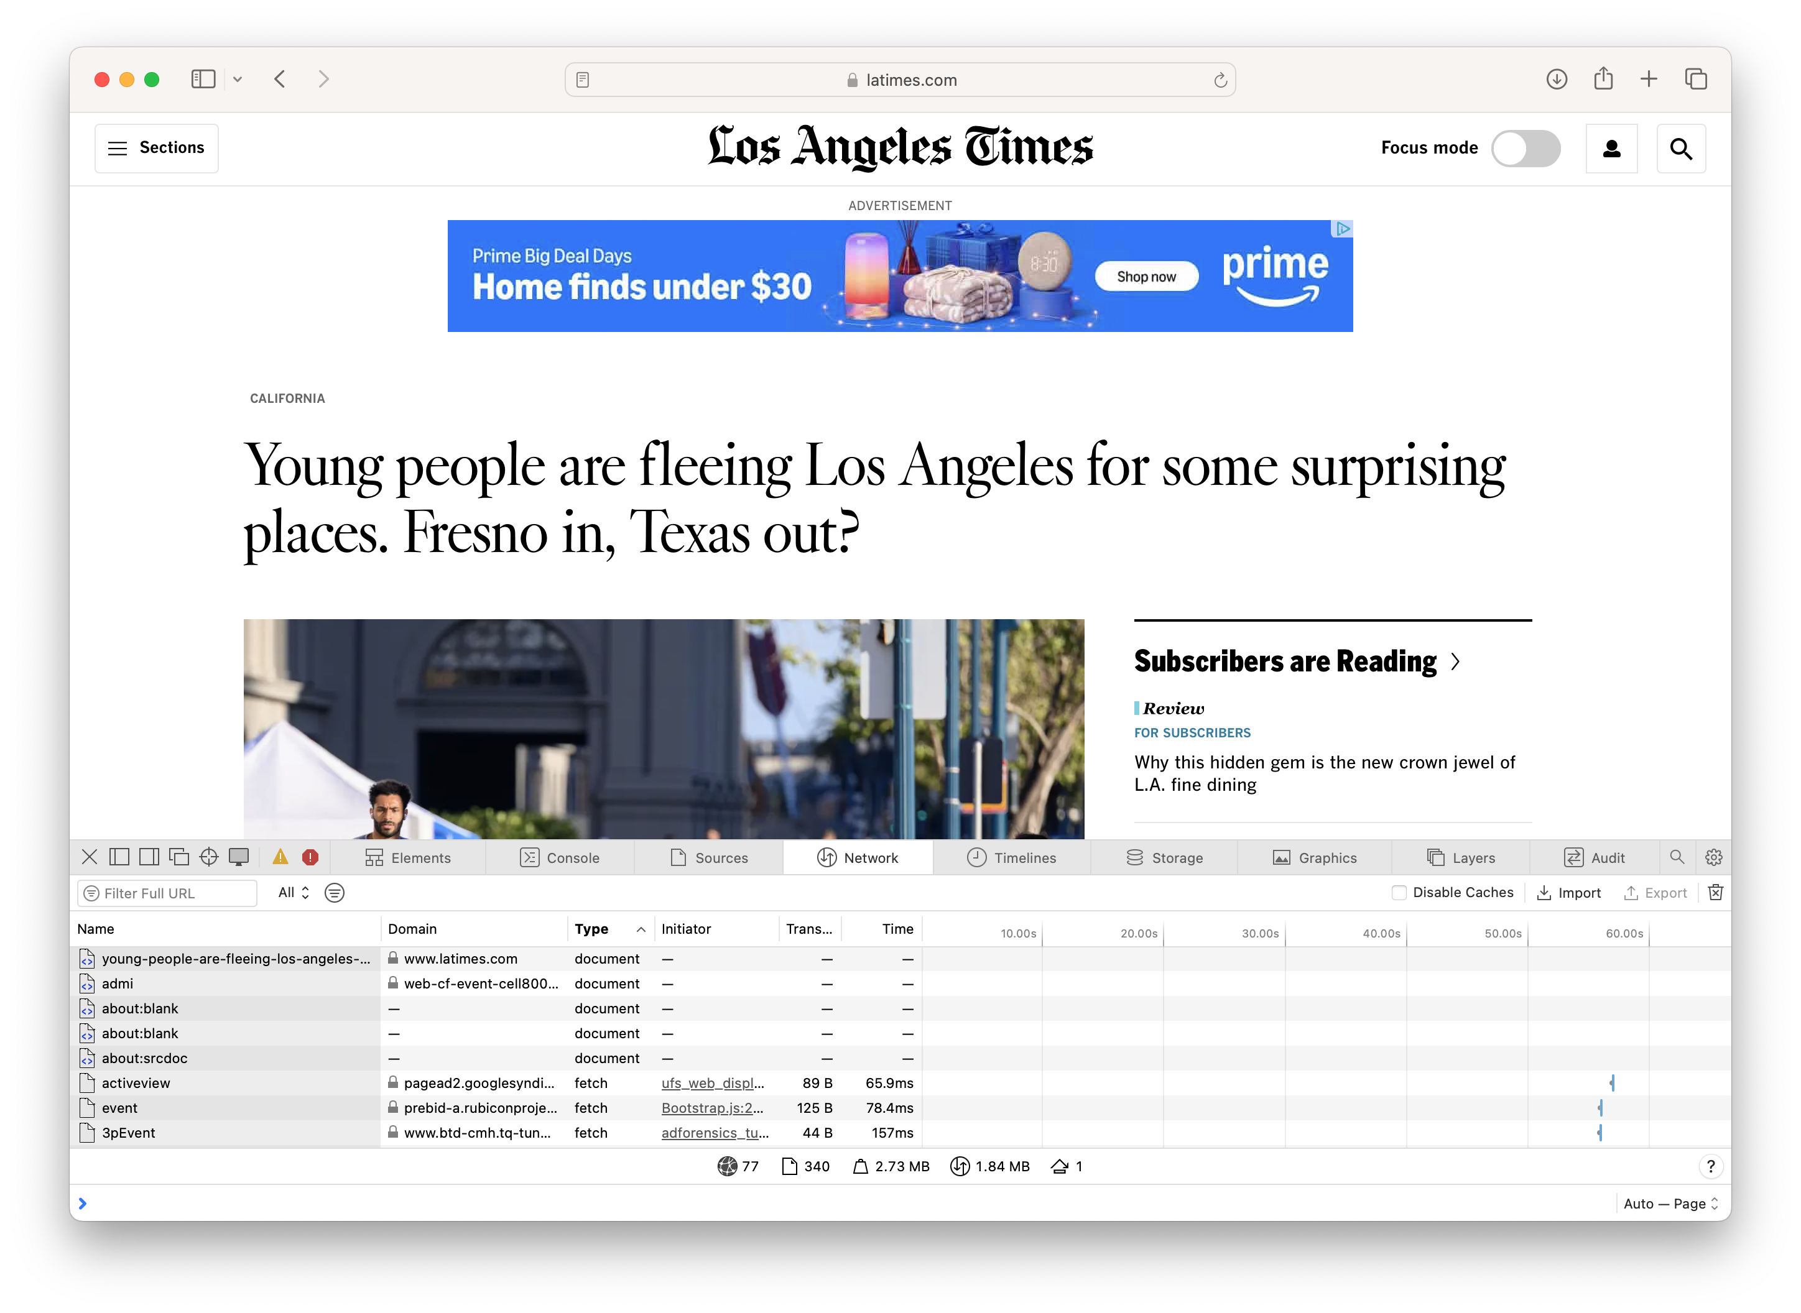
Third-Party Tracking Cookies
Notes:
Demo: show latimes page in Chrome, click through all the images received over the network on preview mode, then click through images in preview mode and look at cookies for advertisers

Slide 21
Exercise: Tracking Cookies
Go to Chrome and turn on developer tools (find a partner with a laptop + Chrome installed if you don’t)
Pick a website that you use regularly
Try to identify what requests it sends with cookies. Look up what these are.
How many known companies did you find? How many other trackers/advertisers did you find?

Slide 22
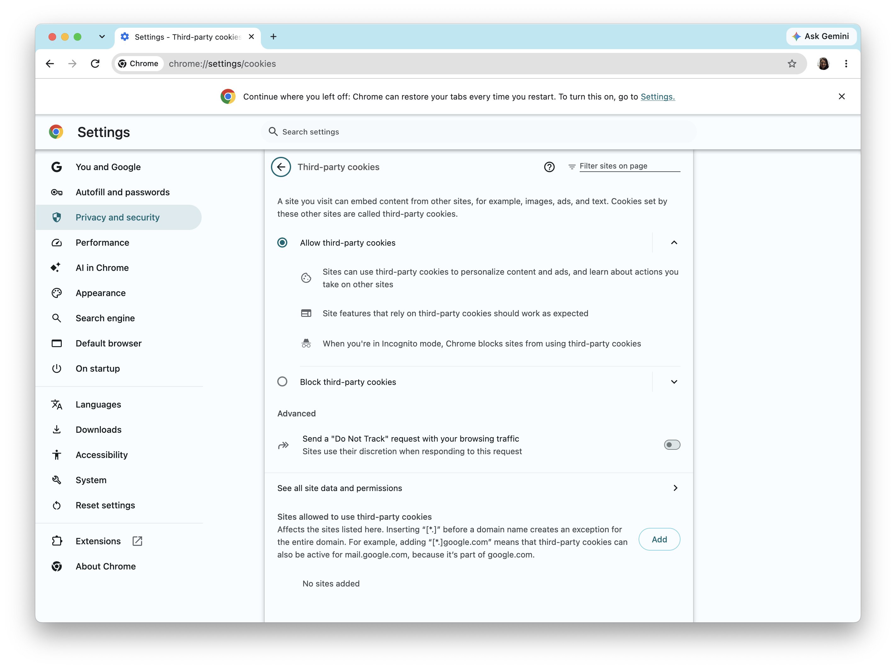
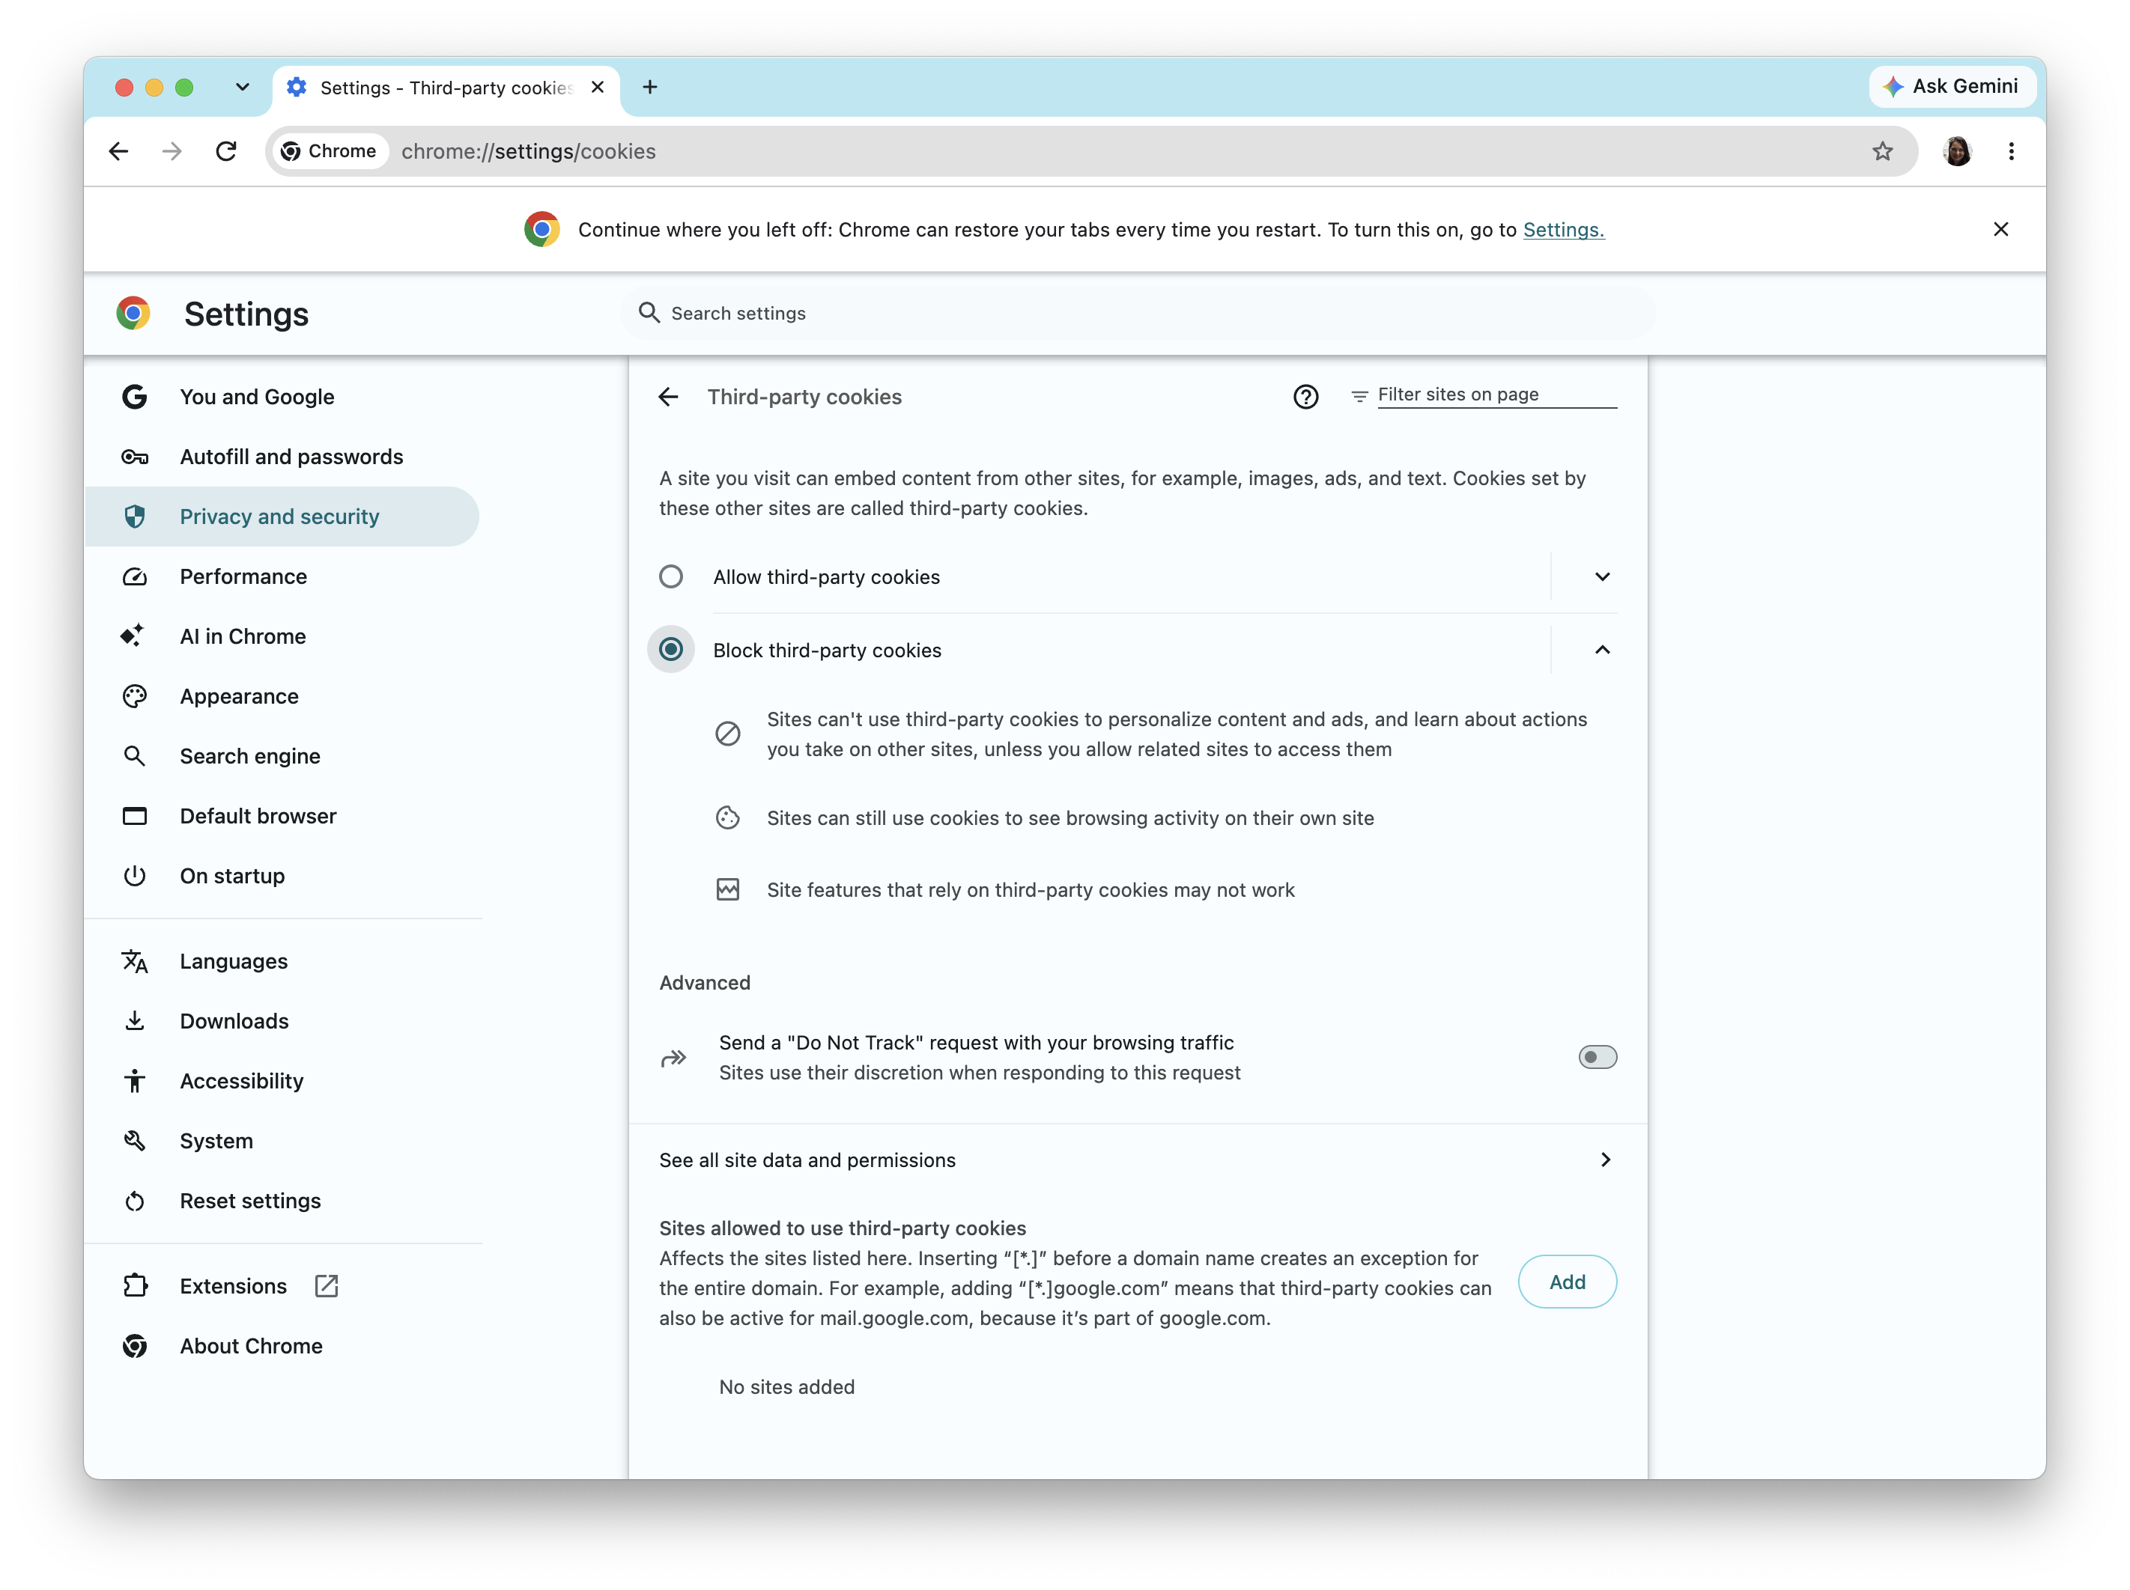
Disabling 3rd-party cookies
Most modern browsers (except Chrome) disable third-party cookies by default
(Safari, Firefox, Brave, DuckDuckGo, etc.)
Increasing rates of user rejection (decline cookie in banner, enable GPC, use ad blocker, etc.)

Slide 23
CNAME Cloaking
Domain Name Service (DNS)
CNAME
Maps domain name (e.g., www.cs.pomona.edu) to IP address
DNS A record
IP address is then used at the network level to send request to the right server
alternate type of DNS record
redirects from domain name to another domain
can be used to make 3rd party domains look like 1st party (e.g., redirect from tracker.pomona.edu to tracker.com

Slide 24
URL Parameters
Unique name for a file: URL (Universal Resource Locator)
Example URL:
Clients use prefix (http://www.cs.pomona.edu) to infer:
  What kind (protocol) of server to contact (HTTP)
  Where the server is (www.cs.pomona.edu)
Servers use suffix (/classes/cs105/index.html) to:
  Specify what content they want
Parameters are key-value pairs passed from client to server
  usually used for internal information
  can also pass tracking ID to third-parties
http://www.cs.pomona.edu/classes/cs181e/index.html?id=1234&a=True
prefix
suffix
parameters

Slide 25
Browser Fingerprinting
Key Idea: many features of the browser that are relatively unique to your machine
  Fonts
  GPU model anti-aliasing (Canvas fingerprinting)
  User-agent string
Use combination of device features as an identifier

Slide 26
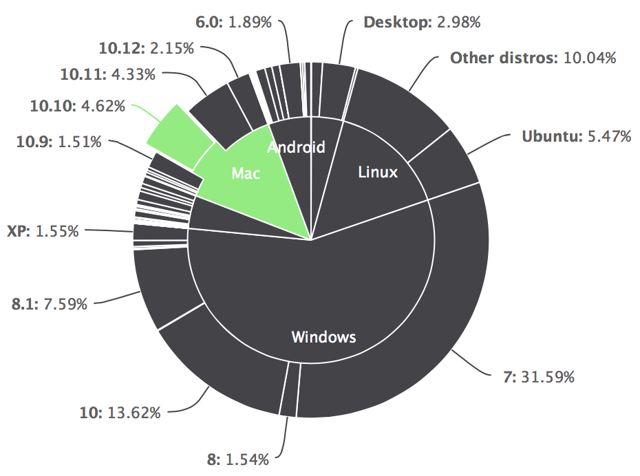
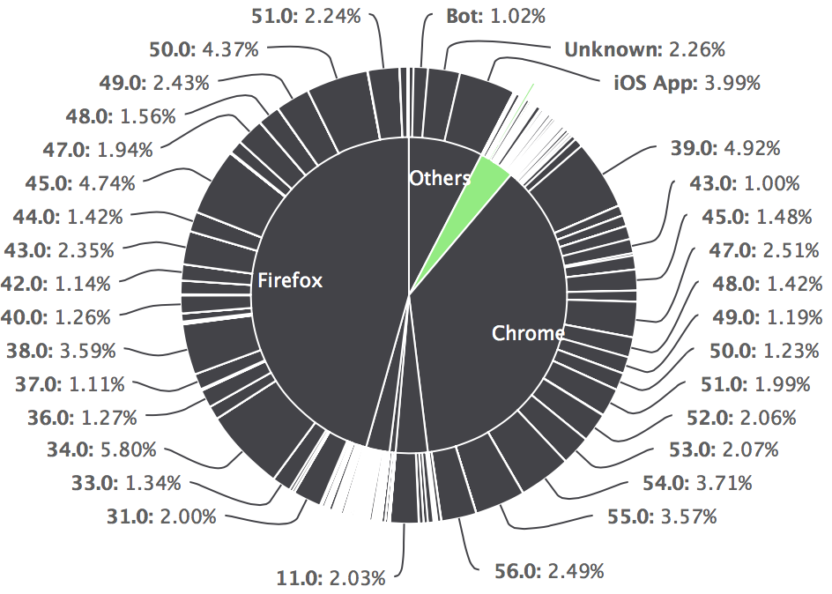
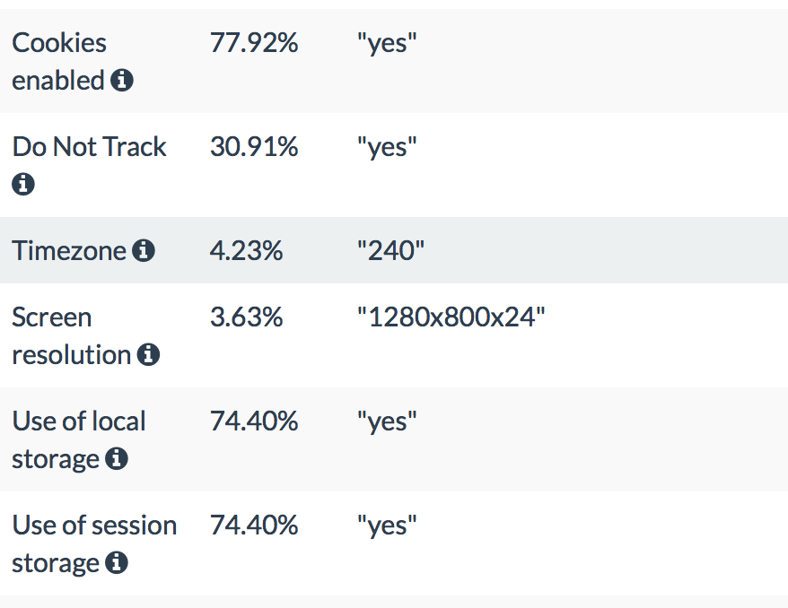
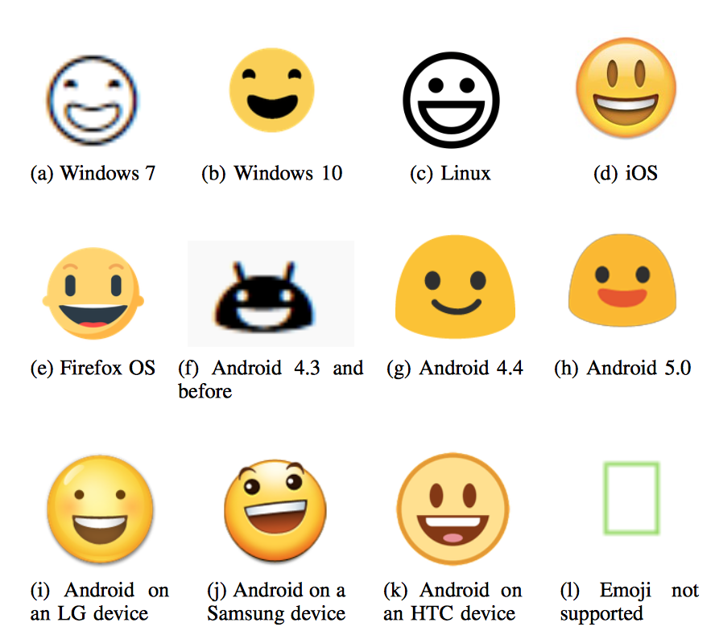
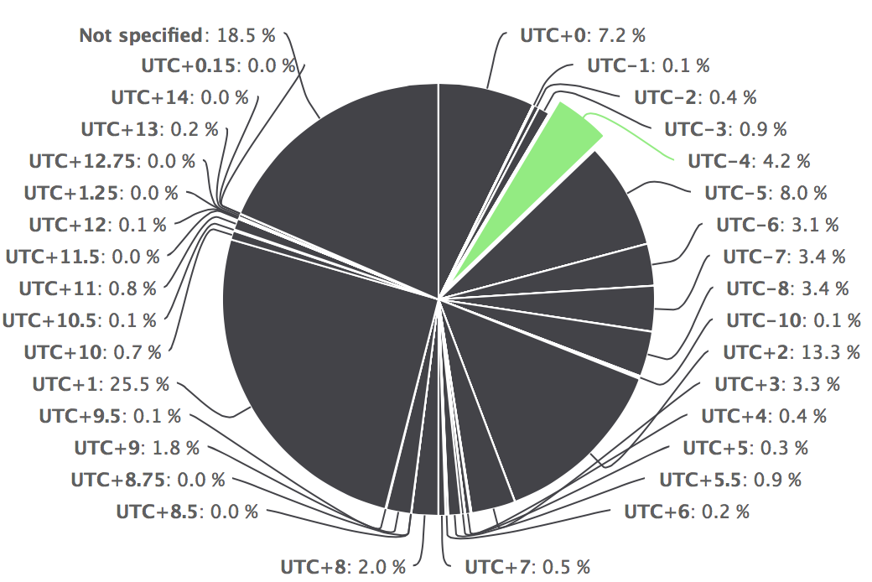
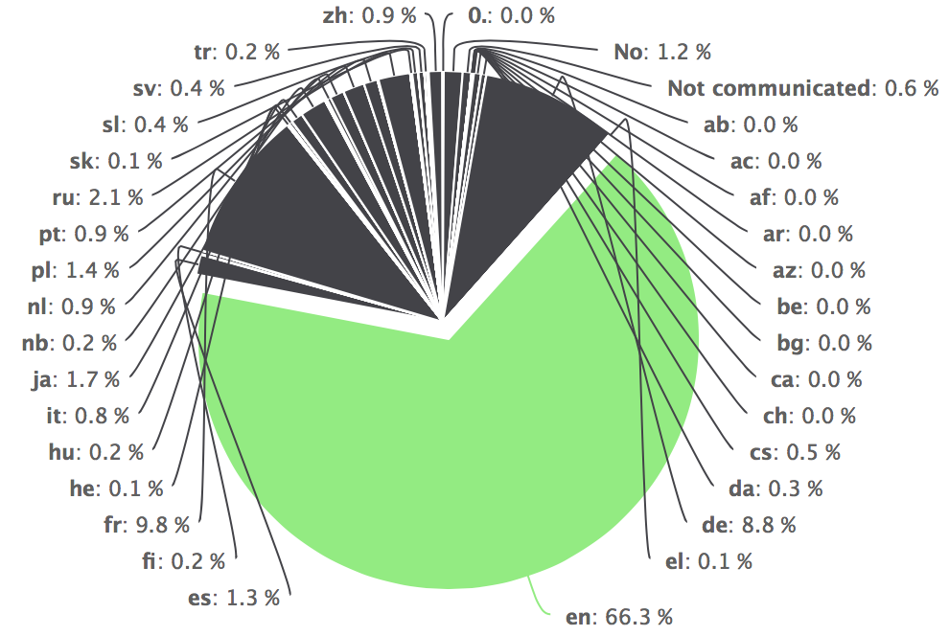
Browser Fingerprinting
Operating System
Browser
Settings
Time Zone
Language
Canvas

Slide 27
Exercise: Browser Fingerprinting
The EFF runs a project that lets you test how unique your browser configuration is: https://coveryourtracks.eff.org/
Go there, test your browser, and read through the results
How unique is your browser?
What types of info were used to fingerprint you? Are any of them surprising?

Slide 28
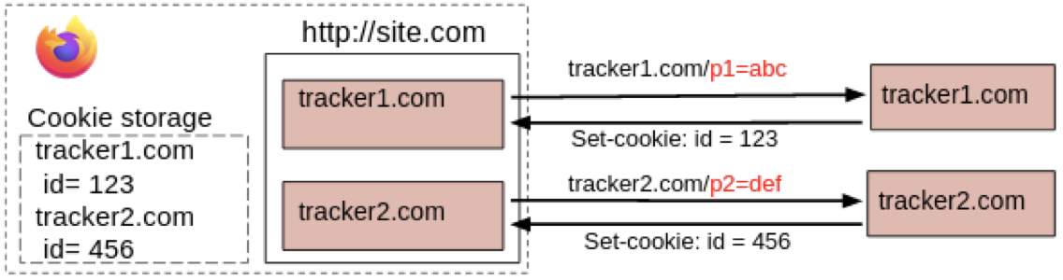
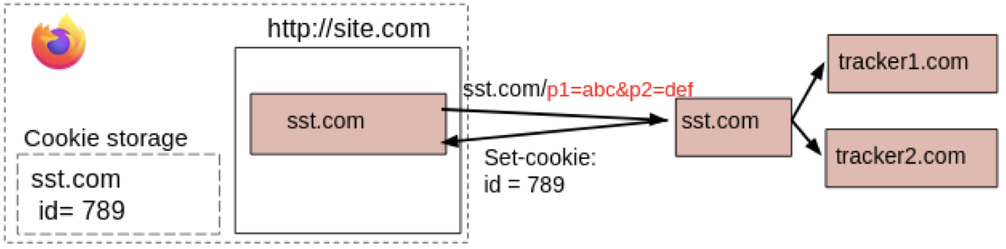
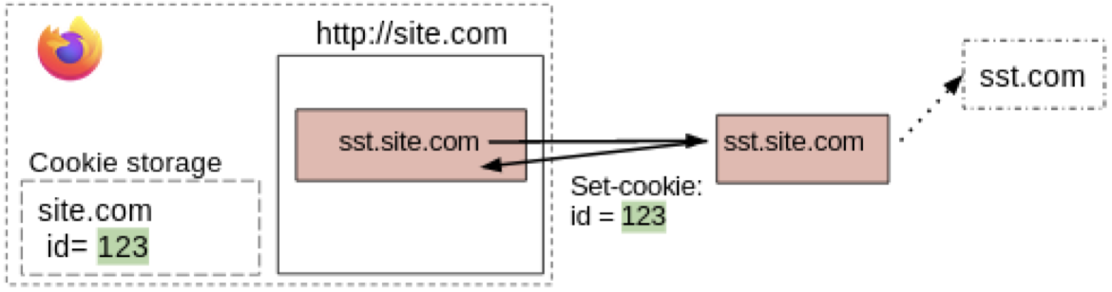
Server-side Tracking
Key idea: instead of browser sending info to third-parties, company collects data and then shares with third-parties on the backend/server side
introduced by Google in 2020
Notes:
Figures from Fouad et al. (PETS 2024): https://petsymposium.org/popets/2024/popets-2024-0125.pdf

Slide 29
Trackers and Advertisers
trackers observe user behavior across one or (usually) many sites
use ML to make inferences about user demographics and interests
advertisers serve ads on first or third party sites
get paid by companies that place ads
can choose which ads to place based on context or user attributes
Some trackers are also advertisers (e.g., Google, Meta)
Some trackers are data brokers who sell collected and inferred information to other third parties

Slide 30
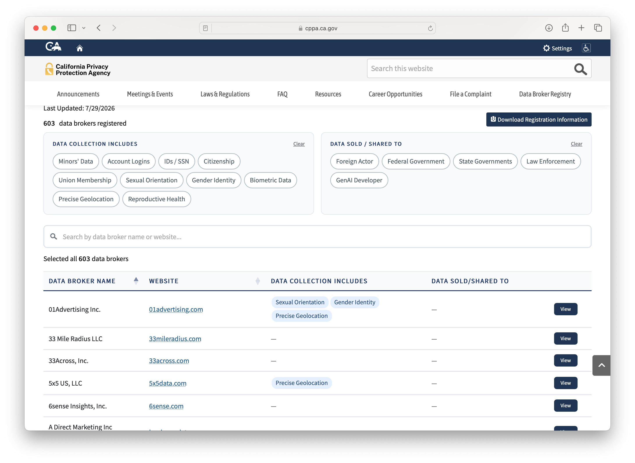
California Data Broker Registry
Notes:
currently 603 companies in registry

