Slide 1
Lecture 8: Client-Side Scanning
CS 181E Fall 2026

Slide 2






Review: Computer Systems
Server
Server
Server

Slide 3

Review: Point-to-Point Encryption
pk_server =
Server
Server
Server

Slide 4
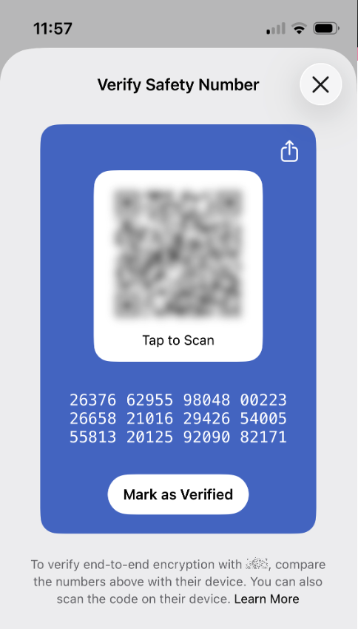
Review: End-to-End Encryption
pk_server =
Server
Server
Server
Examples:
Signal
Telegram
WhatsApp
iMessages
Notes:
Signal: on install, local app generates key pair(s), signal servers store this info and provide key bundles

Slide 5
Review: The Debate over E2E encryption
Pros
Cons
Good for privacy
Don’t have to trust server
Important for journalists/ protesters, esp. in suppressive regimes
Can’t monitor for bad content
  violations of T&C
  illegal content
Gov can’t subpoena data

Slide 6
Client-Side Scanning

Slide 7
High-level Idea
content is only accessible on the client
run monitoring code on the client to detect known bad stuff
to handle large-scale data, uses hash functions

Slide 8
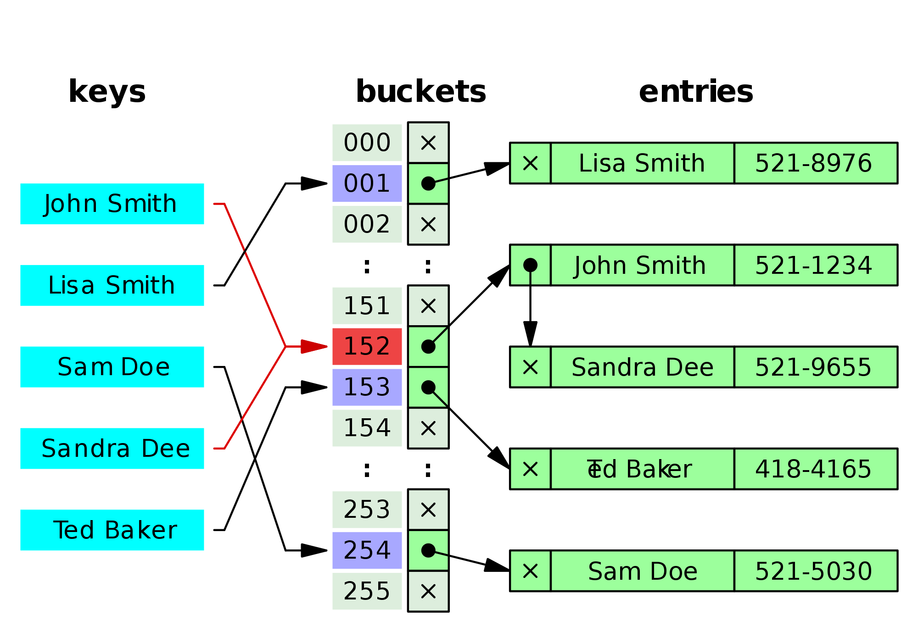
Hash functions
Input: arbitrary size bit string
Output: fixed size bit string
  efficient: easy/fast to compute
  deterministic: if you compute the output twice, you get the same answer
  compression: size of the output is smaller than the input
  diffusion: minimize collisions (and clustering)

Slide 9
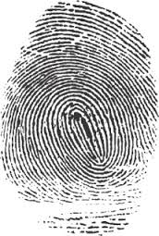
Cryptographic hash functions
Input: arbitrary size bit string
Output: fixed size bit string
  efficient: easy/fast to compute
  deterministic: if you compute the output twice, you get the same answer
  compression: size of the output is smaller than the input
  diffusion: minimize collisions (and clustering)
  collision-resistant: hard to find to inputs with the same output
  one-way: given an output y, hard to find any x such that h(x) = y

Slide 10


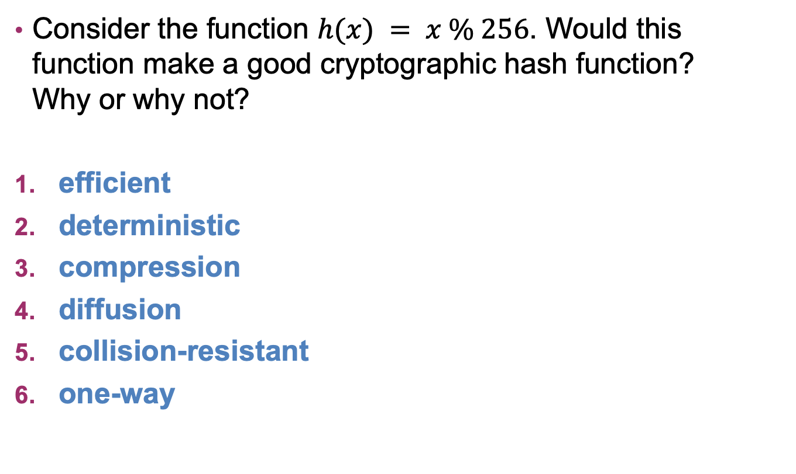
Exercise: Hash Functions
Consider the function $h(x) = x \% 256$. Would this function make a good cryptographic hash function? Why or why not?
efficient
deterministic
compression
diffusion
collision-resistant
one-way

Slide 11
Real world hash functions
SHA-2: NSA (2001)
  Family of algorithms with output sizes {224, 256, 385, 512}
  In principle, could one day be vulnerable to similar attacks to earlier hash functions that are no longer secure
SHA-3: public competition (won in 2012, standardized by NIST in 2015)
  Same output sizes as SHA-2
  Plus a variable-length output option called SHAKE

Slide 12

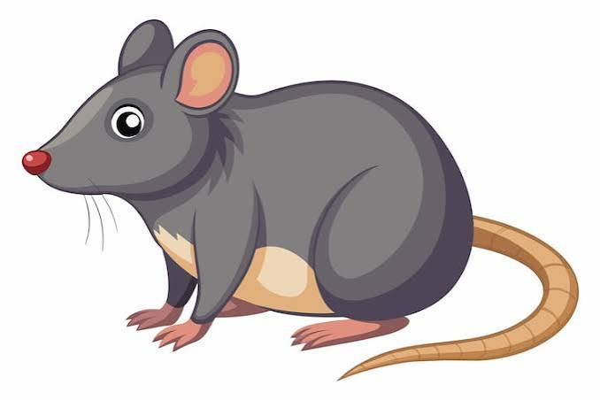



Hash-Based Monitoring
h( ) = 1047
1047
9201
2558
3038
h( ) = 9201
h( ) = 2558
h( ) = 2558
h( ) = 3290
h( ) = 1047

Slide 13
However…
h( ) = 1047
h( ) = 8343
minor changes to input generate completely different outputs
can bypass detection by modifying image slightly

Slide 14


Perceptual Hashing
Step 1: Simplify the image to 32x32 black-and-white
Step 2: Apply Discrete Cosine Transform (DCT)
Notes:
various different versions of this for different types of data, including images, video, audio, etc

Slide 15
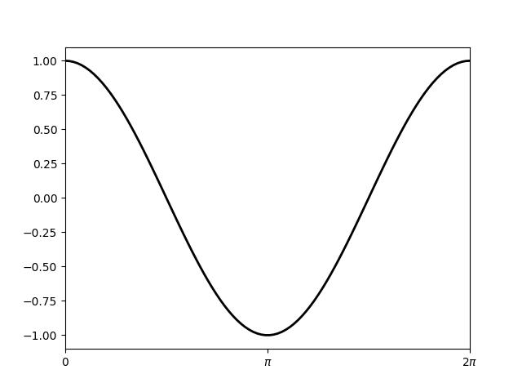
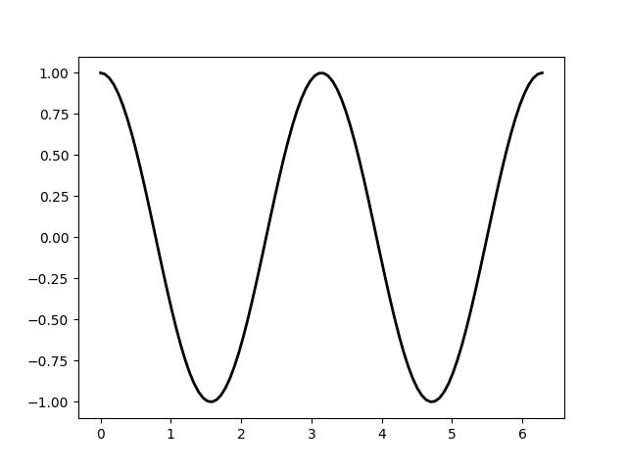
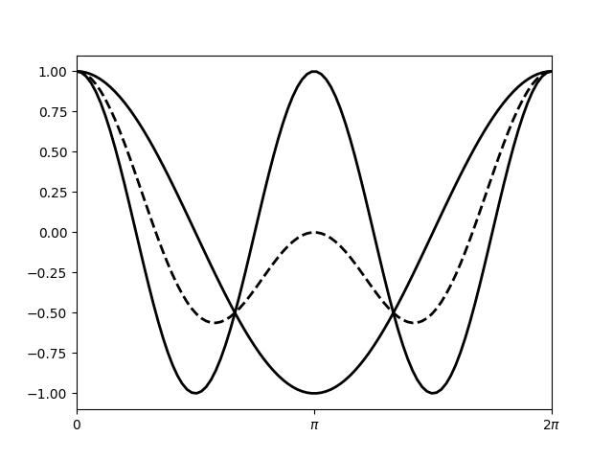
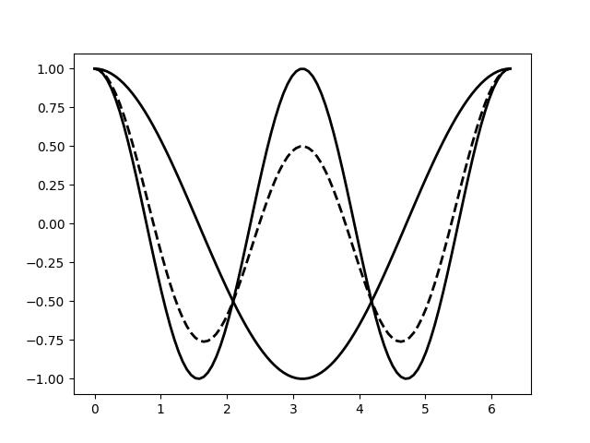
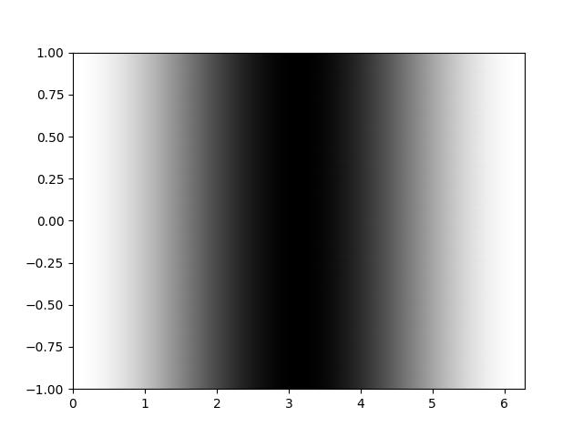
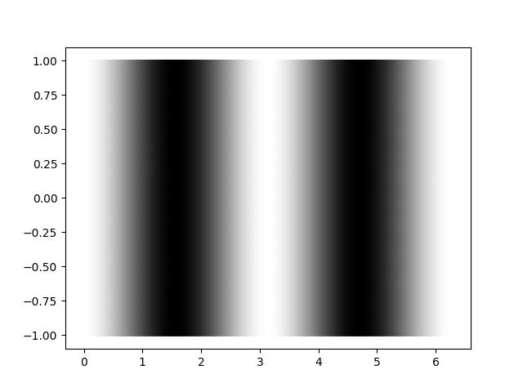
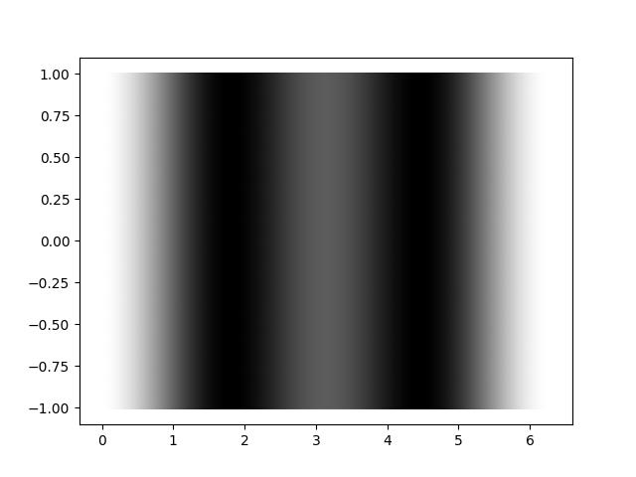


Discrete Cosine Transform (DCT)
(.5, .5)
(.25, .75)
DCT: curve $→$ vector of weights

Slide 16
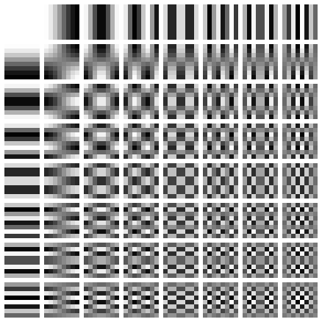
Perceptual Hashing
Step 1: Simplify the image to 32x32 black-and-white
Step 2: Apply Discrete Cosine Transform (DCT)
Step 3: Round
…
(.1, 0, .01, .06, .02, .01, .07, .09,…)
Note: keep only 8x8 low-frequency coefficients
…
64-bit hash value
(.1, 0, .01, .06, .02, .01, .07, .09,…)
10010011….
Notes:
various different versions of this for different types of data, including images, video, audio, etc

Slide 17
PhotoDNA
developed by Microsoft research ~2009
widely used for detecting CSAM in cloud storage
  also used to detect non-consensual imagery and extremist content
confirmed use by Microsoft, Google, Meta, and others
similar ideas are used for Google’s image search and (allegedly) Youtube’s copyright infringement detection
in 2021, Apple announced plan to use similar techniques to scan content stored on devices
Notes:
https://transparencyreport.google.com/child-sexual-abuse-material/reporting?lu=total_cybertipline_reports&total_cybertipline_reports=product:GOOGLE;period:2026H1&hl=en

Slide 18
Client-Side Scanning
“close” is defined by Hamming distance, i.e. how many bits are different
11101000
10101100
00010100
10101100
10111100
h( ) = 10101100
h( ) = 10111100
Question: Should companies be allowed to implement client-side scanning?
Should companies be required to implement client-side scanning?

Slide 19
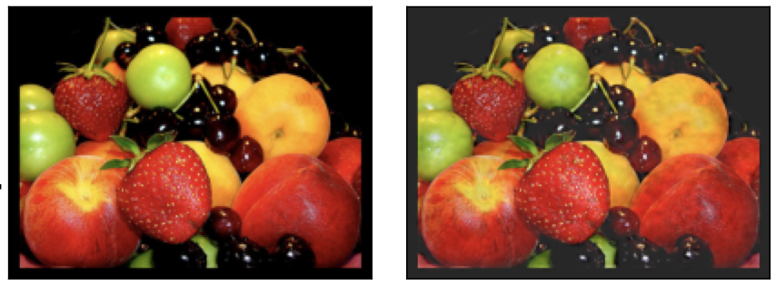
Problem 1: Can bypass detection
Original Image
Manipulated Image
Notes:
https://www.usenix.org/system/files/sec22-jain.pdf

Slide 20
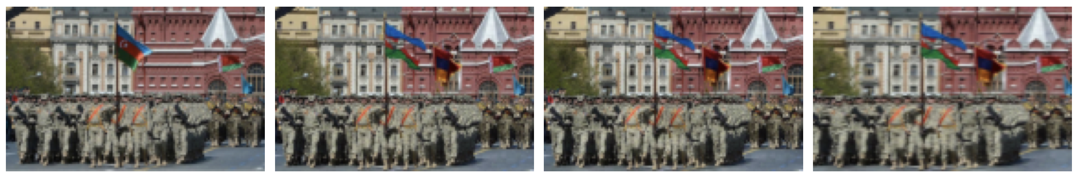
Can also be used for misinformation
Original Image
Manipulated Image
(flagged as similar)
Manipulated Image
(not flagged)
Notes:
Note: original is flag is Azerbaijan
Note: image known because Azerbaijan published version with Armenian flag removed from background

Slide 21
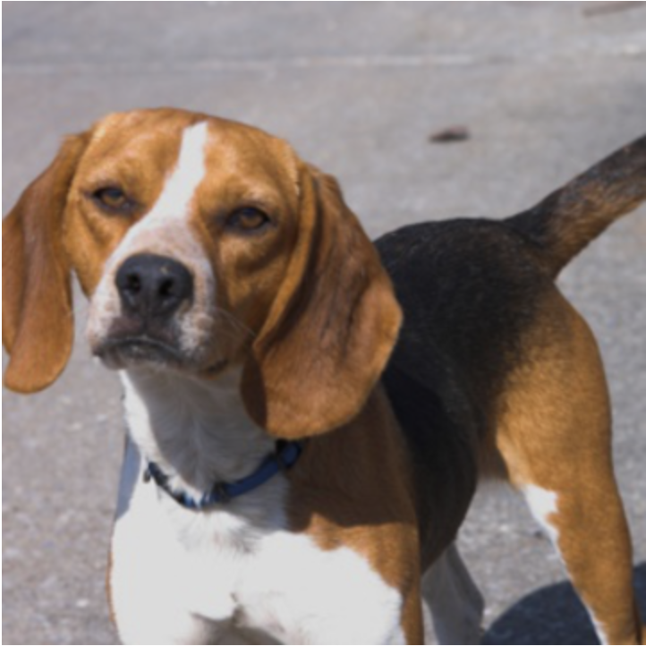
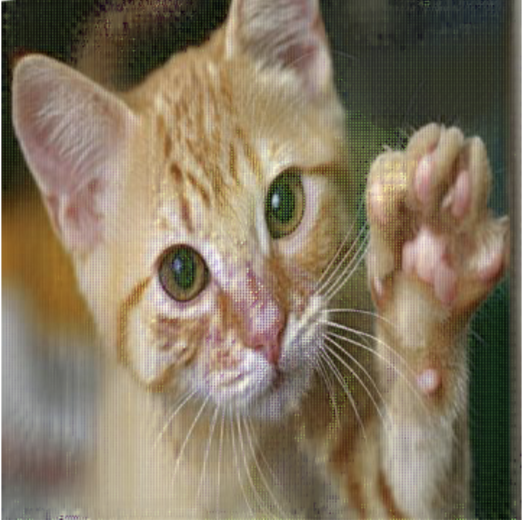
Problem #2: Accidental Collisions
Notes:
accidental hash collision in Apple’s perception hash algorithm NeuralHash. https://github.com/anishathalye/neural-hash-collider

Slide 22
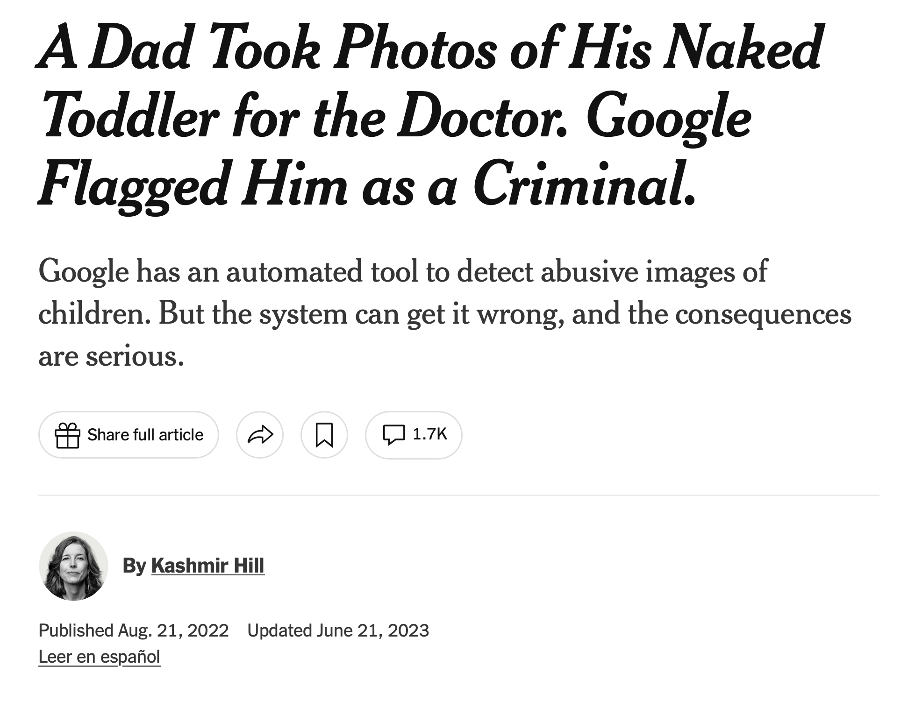
Hamming Distance ignores context
Notes:
https://transparencyreport.google.com/child-sexual-abuse-material/reporting?lu=total_cybertipline_reports&total_cybertipline_reports=product:GOOGLE;period:2026H1&hl=en

Slide 23
Problem #3: Can be used for surveillance
Who defines list of target hashes?
How much do you trust them?
Since hashes are one-way, can’t be verified…

Slide 24
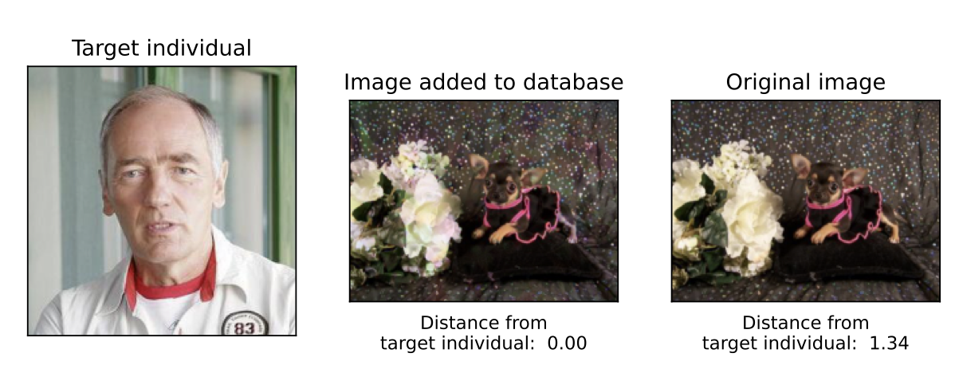
Targeted Facial Recognition
Original Image
Target
Manipulated Image
Notes:
Jain et al. Deep perceptual hashing algorithms with hidden dual purpose: when client-side scanning does facial recognition. Oakland 2023.
Image of target gets flagged as similar to manipulated image

Slide 25
Discussion
Should companies be allowed to use client-side scanning?
Should companies be required to use client-side scanning?
Does it matter if checks are done locally vs sending hash to server?
Does it matter whether they use perceptual hashing vs modern AI moderating?

Slide 26
Client-Side Scanning
in 2021, Apple announced plan to use client-side scanning to scan content stored on devices
  huge backlash, Apple backed off
periodic efforts by governments (e.g. EU) to require

Slide 27
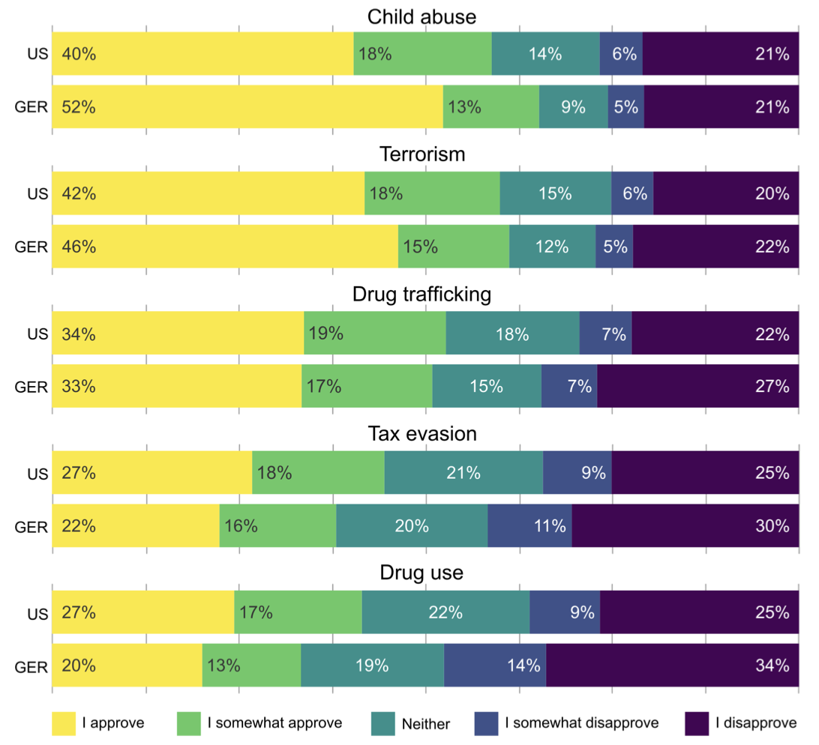
Current Attitudes
Strong correlation between attitudes and trust in governments/law enforcement/companies

