Slide 1
Lecture 7: Encrypted Systems
CS 181E Fall 2026

Slide 2






Review: Computer Systems
Server
Server
Server

Slide 3



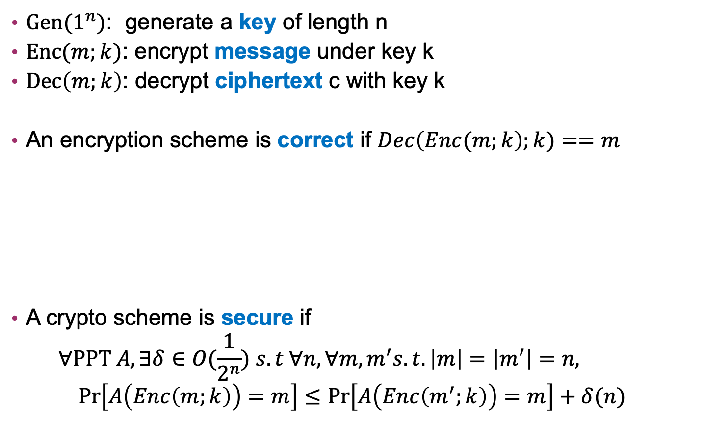
Review: (Symmetric) Encryption
$Gen(1^{n})$: generate a key of length n
$Enc(m;k)$: encrypt message under key k
$Dec\left(m;k\right)$: decrypt ciphertext c with key k
An encryption scheme is correct if $Dec\left(Enc(m;k\right);k)==m$
A crypto scheme is secure if
$$∀PPT A, ∃δ∈O(\frac{1}{2^{n}}) s.t ∀n, ∀m,m^{′}s.t. \left|m\right|=\left|m^{′}\right|=n, \operatorname{Pr}\left[A\left(Enc\left(m;k\right)\right)=m\right]≤\operatorname{Pr}\left[A\left(Enc\left(m^{′};k\right)\right)=m\right]+δ(n)$$
Enc
Dec

Slide 4
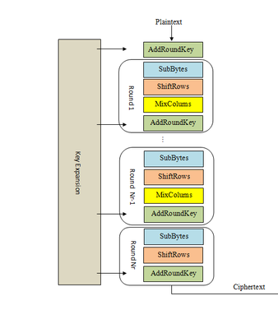
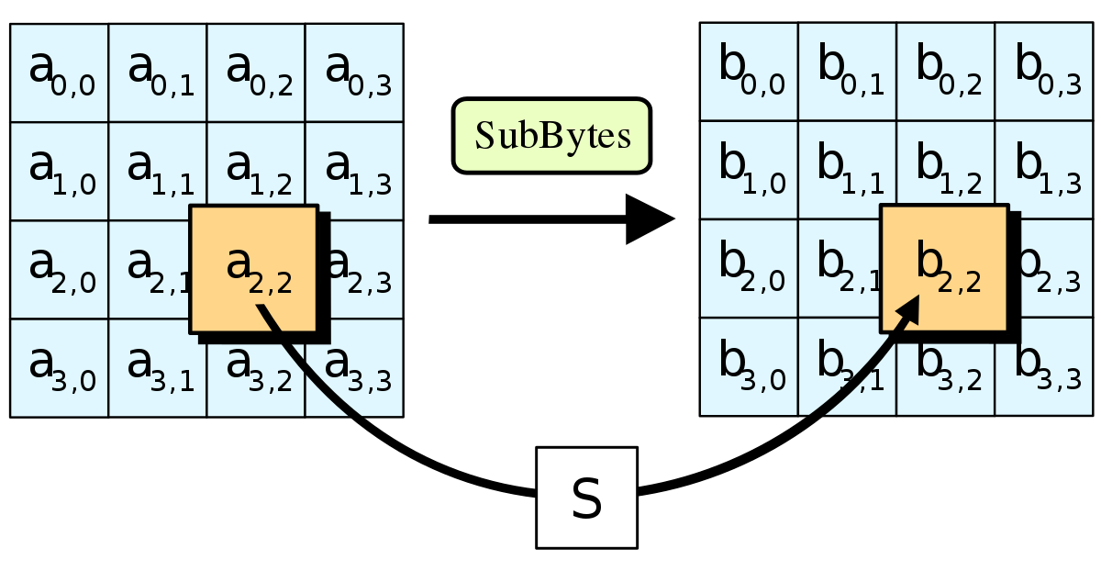
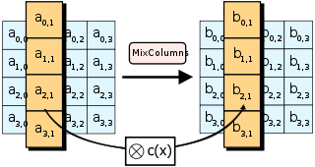
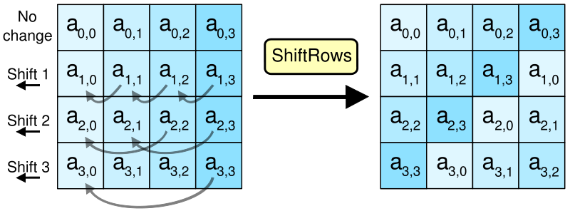
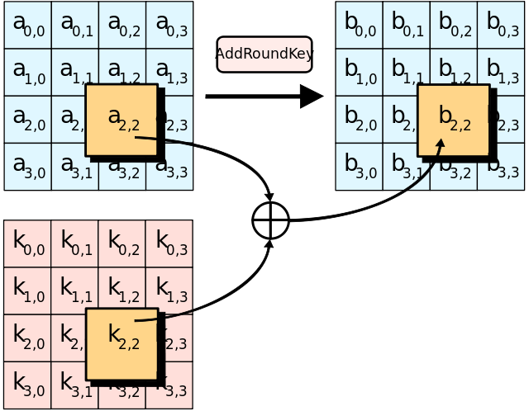
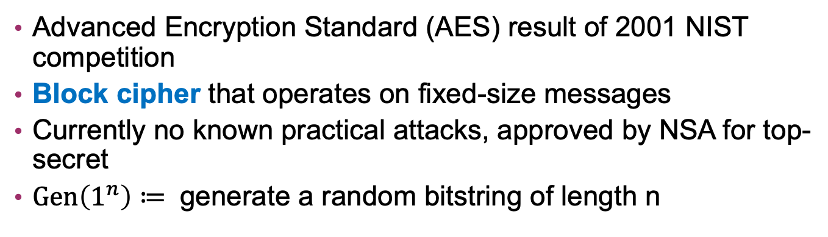
Example: AES
Advanced Encryption Standard (AES) result of 2001 NIST competition
Block cipher that operates on fixed-size messages
Currently no known practical attacks, approved by NSA for top-secret
$Gen\left(1^{n}\right)≔$ generate a random bitstring of length n

Slide 5
Review: Encryption for Privacy
people with sk can read data (correctness)
people without sk can’t read data (security)
so can control access by controlling who gets sk
to distribute keys, we can use more crypto!

Slide 6
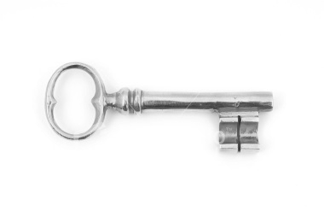
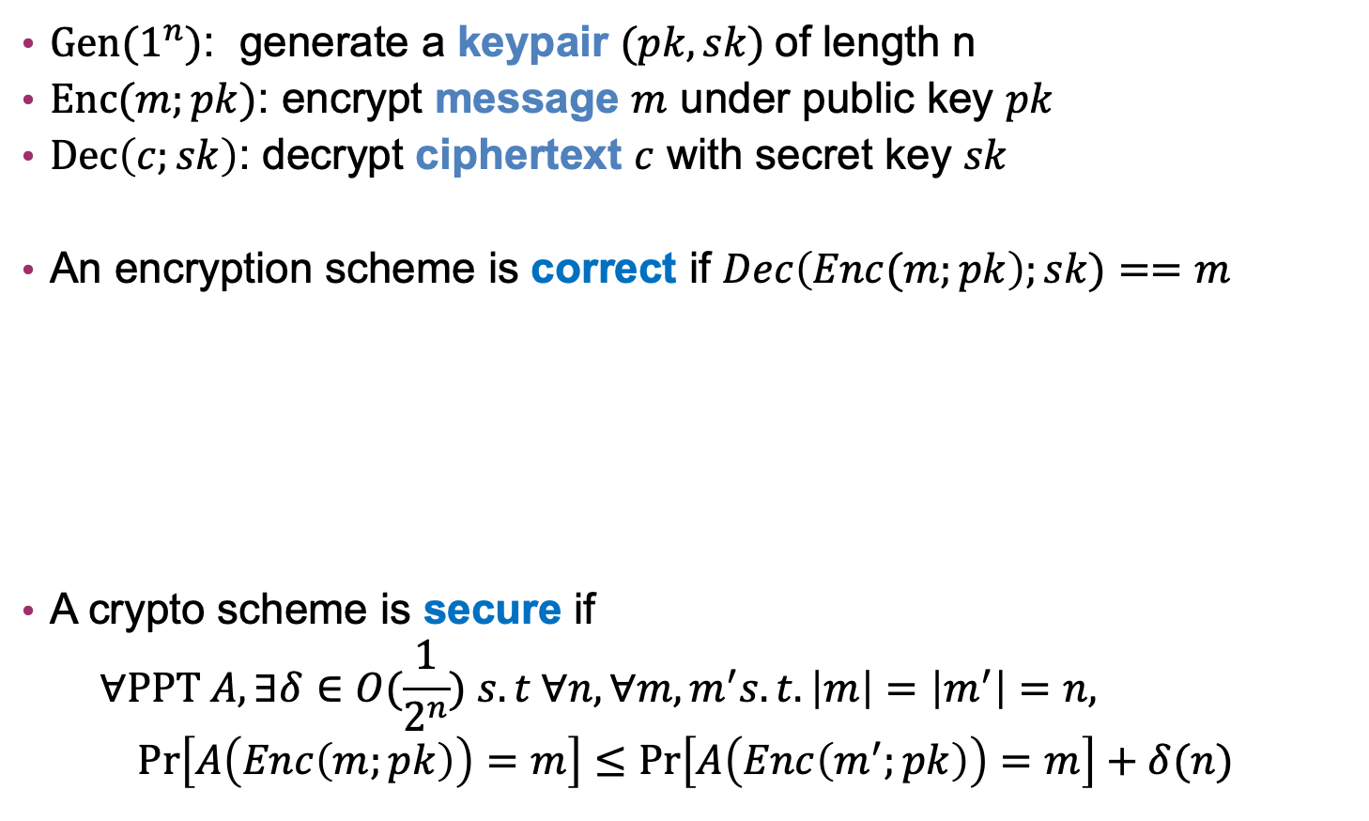
(Public-Key) Encryption algorithms
$Gen(1^{n})$: generate a keypair $(pk, sk)$of length n
$Enc(m;pk)$: encrypt message $m$ under public key $pk$
$Dec\left(c;sk\right)$: decrypt ciphertext $c$ with secret key $sk$
An encryption scheme is correct if $Dec\left(Enc(m;pk\right);sk)==m$
A crypto scheme is secure if
$$∀PPT A, ∃δ∈O(\frac{1}{2^{n}}) s.t ∀n, ∀m,m^{′}s.t. \left|m\right|=\left|m^{′}\right|=n, \operatorname{Pr}\left[A\left(Enc\left(m;pk\right)\right)=m\right]≤\operatorname{Pr}\left[A\left(Enc\left(m^{′};pk\right)\right)=m\right]+δ(n)$$
Enc
Dec

Slide 7
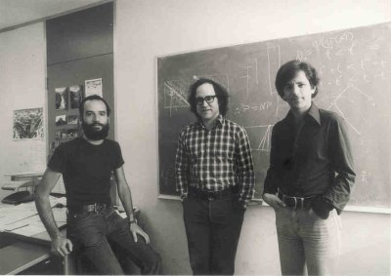
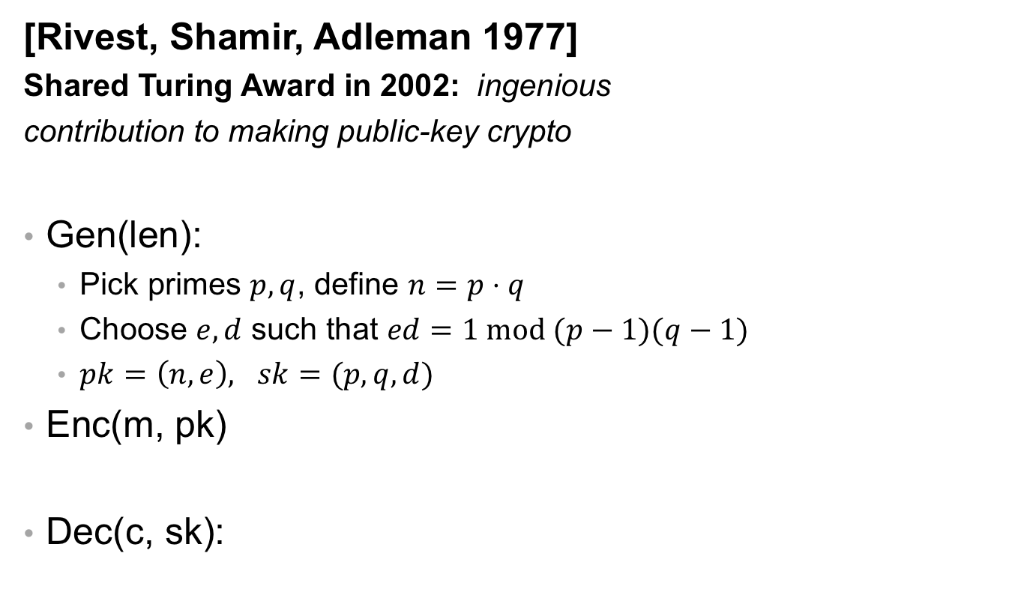


RSA
[Rivest, Shamir, Adleman 1977]
Shared Turing Award in 2002: ingenious
contribution to making public-key crypto
Gen(len):
  Pick primes $p,q$, define $n=p⋅q$
  Choose $e,d$ such that $ed=1 mod (p−1)(q−1)$
  $pk=\left(n, e\right), sk=(p,q, d)$
Enc(m, pk)
Dec(c, sk):
$$c=m^{e} mod n$$
$$m=c^{d} mod n$$
Notes:
size of modulus bounds size of keys and methods: usually 2048 bit (note: much bigger than AES keys!!!)
recommendations for strength summarized at https://www.keylength.com/en/
factoring n would break RSA (assumed to be hard) Largest challenge broken so far is 768-bit modulus [2010]
Shor's algorithm factors in polynomial time on a quantum computer: largest factorization so far is of the number 56153 (i.e., 16 bits); motivates work on post-quantum cryptography

Slide 8
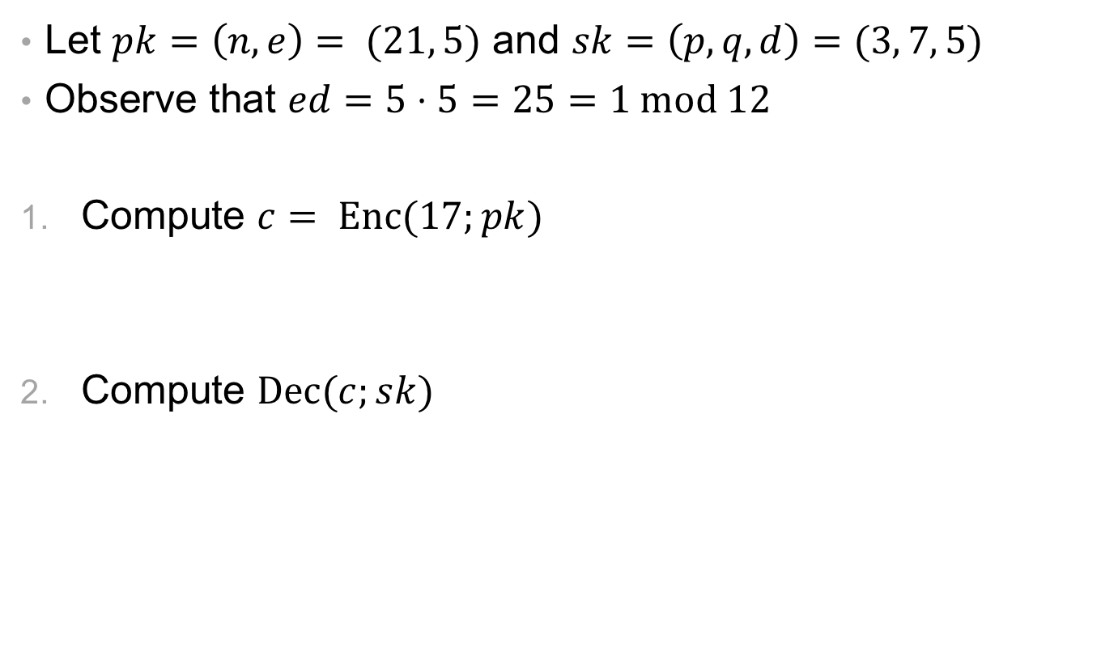
Exercise: RSA
Let $pk=\left(n,e\right)= (21, 5)$ and $sk=\left(p, q, d\right)=(3, 7, 5)$
Observe that $ed=5⋅5=25=1 mod 12$
Compute $c= Enc(17;pk)$
Compute $Dec(c;sk)$
$$c= Enc\left(17;\left(21, 5\right)\right)={17}^{5} mod 21=1419857 mod 21=5$$
$$Dec\left(c;sk\right)= Dec\left(5;\left(3,7,5\right)\right)=5^{5} mod 21=3125 mod 21= 17$$

Slide 9


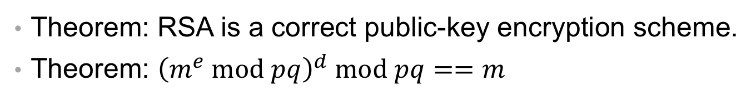











RSA is correct
Theorem: RSA is a correct public-key encryption scheme.
Theorem: ${\left(m^{e} mod pq\right)}^{d} mod pq==m$
$${Dec\left(Enc\left(m;pk\right);sk\right)= \left(m^{e} mod pq\right)}^{d} mod pq$$
$${= \left(m^{e}\right)}^{d} mod pq$$
$$={ m}^{ed} mod pq$$
$$=m mod pq$$
$$m^{ed} mod p=m^{1+k(p−1)(q−1)} mod p$$
$$m^{ed} mod q=m^{1+k(p−1)(q−1)} mod q$$
$$={ m^{1}⋅(m}^{p−1}) ^{k(q−1)} mod p$$
$$={ m^{1}⋅(m}^{q−1}) ^{k(p−1)} mod q$$
$$={ m⋅(m}^{p−1} mod p) ^{k(q−1)} mod p$$
$$={ m⋅(m}^{q−1} mod p) ^{k(p−1)} mod q$$
$$=m⋅\left(1\right) ^{k\left(q−1\right)} mod p$$
$$=m⋅\left(1\right) ^{k\left(p−1\right)} mod q$$
$$=m mod p$$
$$=m mod q$$
Notes:
8. Fermat's Little Theorem (Pierre de Fermat asserted, 1640, proof by Gottfried Leibniz, 1683, published by Leonhard Euler, 1736)
- note: technically this assumes that m is not a multiple of p or q, but if it is, both sides are 0
11. Chinese Remainder Theorem (Sun-tzu, 3rd century AD)

Slide 10
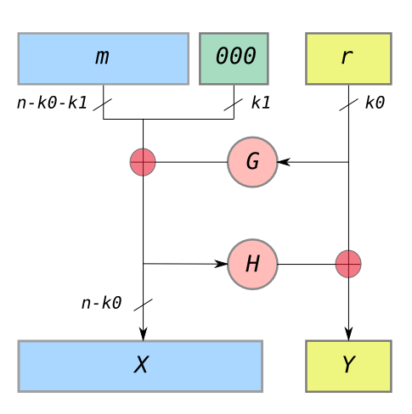
Problems with Textbook RSA
Insecure keys: There are known efficient attacks for some choices of e, d, p, q
  use good crypto library, never implement yourself
Deterministic: given same plaintext and key, always produces the same ciphertext
  OAEP (Optimal Asymmetric Encryption Padding)
Inefficient: computing modular arithmetic with large numbers is very slow
  only use pke to share/agree on key

Slide 11

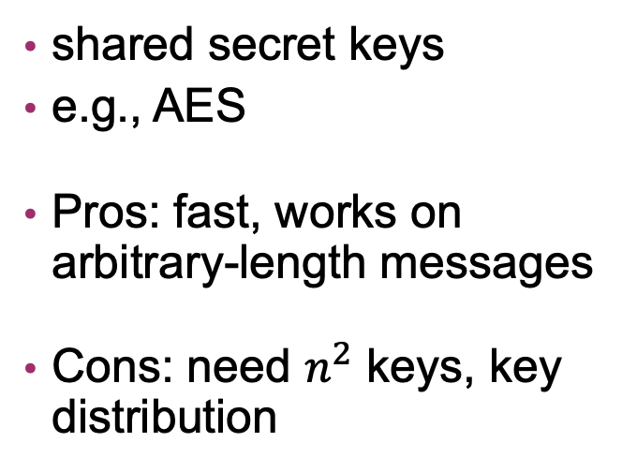
Option 1: Hybrid Encryption
Symmetric Encryption
Public-key Encryption
shared secret keys
e.g., AES
Pros: fast, works on arbitrary-length messages
Cons: need $n^{2}$ keys, key distribution
keypair (sk, pk) per person
e.g., RSA
Pros: don’t need secret enc
Cons: (very!) slow, key authentication
Hybrid Encryption: generate fresh AES key each time,
use other person's public key to encrypt AES session key
and send it to them

Slide 12


Option 1: Hybrid Encryption
m
0. B: (pk_B, sk_B) = Gen_PKE(len_PKE)
publish (B, pk_B)
1. A: k_s = Gen_SKE(len_SKE)
c1 = Enc_PKE(k_s; pk_B)
c2 = Enc_SKE(m; k_s)
2. A -> B: c1, c2
3. B: k_s = Dec_PKE(c1; sk_B)
m = Dec_SKE(c2; k_s)

Slide 13
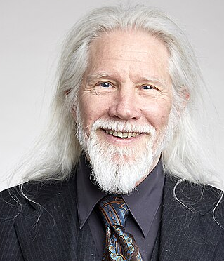
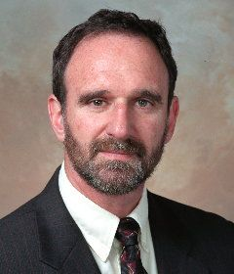
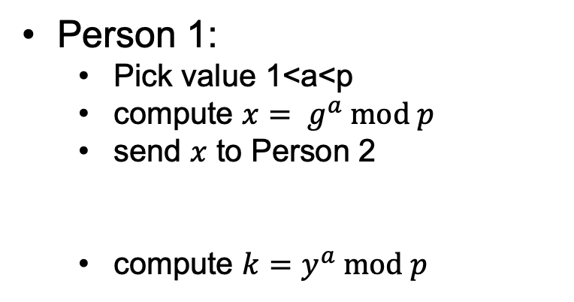
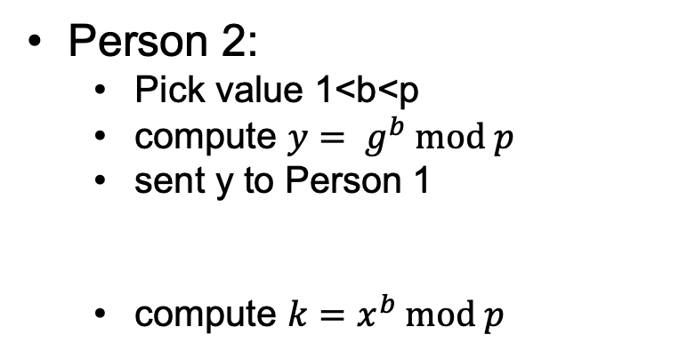
Option 2: Key Agreement
[Diffie and Hellman, 1976]
Shared Turing Award in 2015: fundamental contributions to modern cryptography
Gen(len):
  Agree on integer n, finite cyclic group G of order n, and generator g
  Agree a prime p and value 1<g<p
Person 1:
  Pick value 1<a<p
  compute ${x= g}^{a} mod p$
  send $x$ to Person 2
  compute $k=y^{a} mod p$
Person 2:
  Pick value 1<b<p
  compute ${y= g}^{b} mod p$
  sent y to Person 1
  compute ${k=x}^{b} mod p$
Notes:
size of modulus bounds size of keys and methods: usually 2048 bit (note: much bigger than AES keys!!!)
recommendations for strength summarized at https://www.keylength.com/en/
factoring n would break RSA (assumed to be hard) Largest challenge broken so far is 768-bit modulus [2010]
Shor's algorithm factors in polynomial time on a quantum computer: largest factorization so far is of the number 56153 (i.e., 16 bits); motivates work on post-quantum cryptography

Slide 14
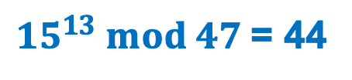
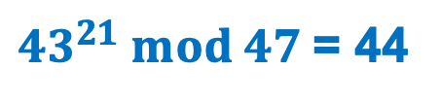
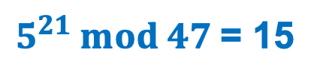
Exercise: DH Key Agreement
Assume g=4 and p = 47
Assume Alice chooses a=13 and sends x=43 to Bob
Assume that Bob then chooses b=21
What value y will Bob send to Alice?
What secret key will be generated by Bob?
What secret key will be generated by Alice?
$5^{21} mod 47$= 15
$43^{21} mod 47$= 44
${15}^{13} mod 47$= 44

Slide 15








DH is Correct
Theorem: Diffie-Hellman key-agreement always results in Alice and Bob ending up with the same key.
  $$k_{Alice}=y^{a} mod p$$
  $={(g^{b} mod p)}^{a} mod p$
  $$={(g^{b} )}^{a} mod p$$
  $$=g^{b⋅a} mod p$$
  $$={(g^{a} )}^{b} mod p$$
  $$={(g^{a} mod p)}^{b} mod p$$
  $$=x^{b} mod p$$
  $${=k}_{Bob}$$

Slide 16
Option 2: Key Agreement
m
0. B: pick p,g, y = g^b mod p
publish (g,p,y)
1. A: pick a, x = g^a mod p
k_s = y^a mod p
c = Enc_SKE(m; k_s)
2. A -> B: x, c
3. B: k_s = x^b mod p
m = Dec_SKE(c; k_s)

Slide 17
Problem: Key Authentication
Hybrid Encryption
Encryption w/ KA
0. B: (pk_B, sk_B) = Gen_PK
publish (B, pk_B)
1. A: k_s = Gen_SK
c1 = Enc_PKE(k_s; pk_B)
c2 = Enc_SKE(m; k_s)
2. A -> B: c1, c2
3. B: k_s = Dec_PKE(c1; sk_B)
m = Dec_SKE(c2; k_s)
0. B: pick p,g,
y = g^b mod p
publish (g,p,y)
1. A: pick a,
x = g^a mod p
k_s = y^a mod p
c = Enc_SKE(m; k_s)
2. A -> B: x, c
3. B: k_s = x^b mod p
m = Dec_SKE(c; k_s)

Slide 18
Public Key Infrastructure
X.509 Certificates
Certificate Authorities (CAs)
Digital certificate is a document binding together:
  identity of principal
  public key of that principal (might be RSA pk or DH info)
binding together = signed
standard: X.509 certs
responsible for verifying identity and signing certs
Can also sign certs saying they trust other CAs
You decide which root CAs you trust
more precisely, this is defined in a file on your computer
Notes:
Example Certs:
https://www.google.com
https://www.cs.pomona.edu
Currently to view certs in Safari: Click on the lock symbol->click Show Certificate->open Details
To see root certs: /System/Library/Keychains/SystemRootCertificates.keychain

Slide 19

HTTPS
pk_server =
Server
Server
Server

Slide 20
Cloud storage
pk_server =
Server
Server
Server

Slide 21
Point-to-Point Encryption
pk_server =
Server
Server
Server

Slide 22
Implications
All messages/content is encrypted in transit
All messages/content is encrypted when stored
Server can decrypt all messages/content

Slide 23
Client-Side encryption
pk_server =
Can store encrypted files locally
  iOS does by default when enable passcode
Can backup encrypted files in cloud
  Example: iOS Advanced Data Protection
  Sometimes called E2E
key often generated from password
can also be chosen at random
Server
Server
Server

Slide 24
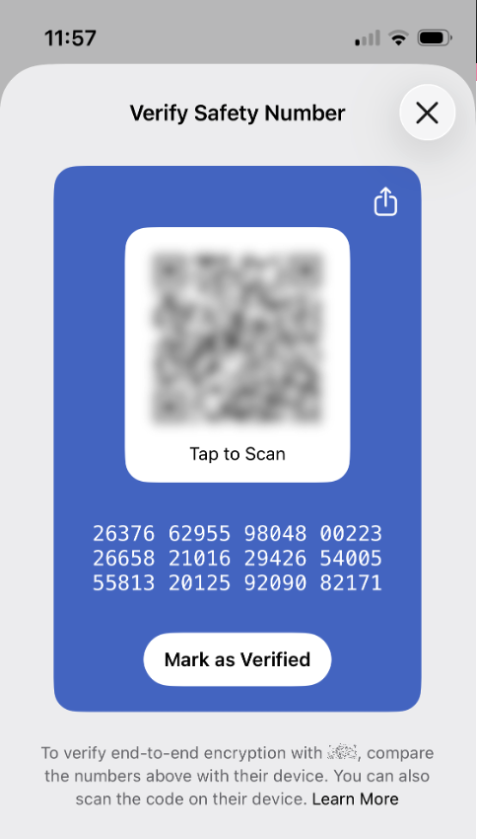
End-to-End Encryption
pk_server =
Server
Server
Server
Examples:
Signal
Telegram
iMessages
Notes:
Signal: on install, local app generates key pair(s), signal servers store this info and provide key bundles

Slide 25
The Debate over E2E encryption
Pros
Cons
Good for privacy
Don’t have to trust server
Important for journalists/ protesters, esp. in suppressive regimes
Can’t monitor for bad content
  violations of T&C
  illegal content
Gov can’t subpoena data

