Slide 1
Lecture 6: Cryptography
CS 181E Fall 2026

Slide 2






Computer Systems
The Model Thus Far
Reality
Server
Server
Server
DB

Slide 3
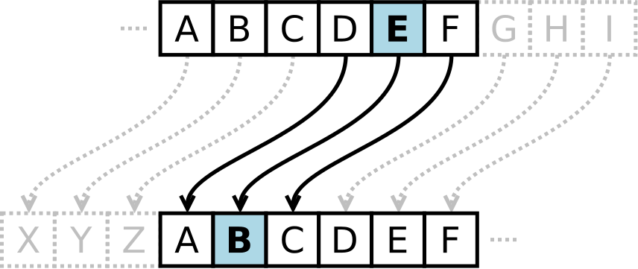
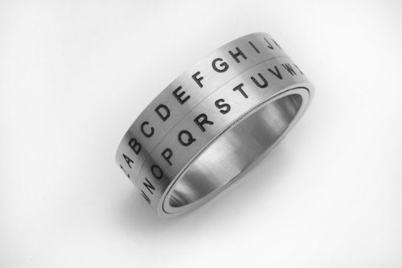
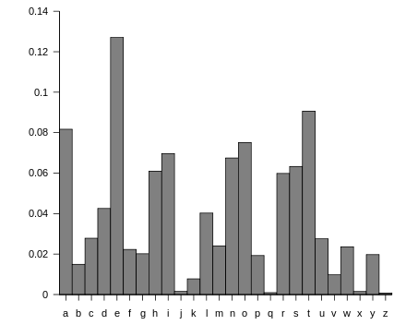
Classical Crypto: Substitution Ciphers
WKLV LV QRW VR VHFXUH
THIS IS NOT SO SECURE
Notes:
Caesar Cipher:
simple substitution cipher
first recorded use: caesar used shift of 3 to record military secrets
no real security now
Classical vs modern:
Enigma machine from WW2
RSA algorithm for encryption
Latex source:
\begin{tabular}{c}
$P$ and $Q$ prime \\
$N = PQ$ \\
$ED \equiv 1 \mod (P-1)(Q-1)$ \\
$C = M^E \mod N$ \\
$M = C^D \mod N$
\end{tabular}

Slide 4
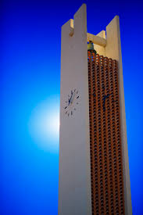

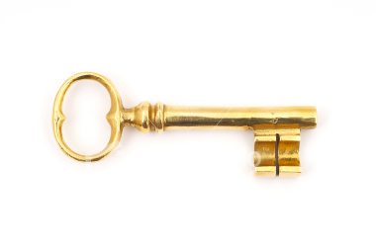
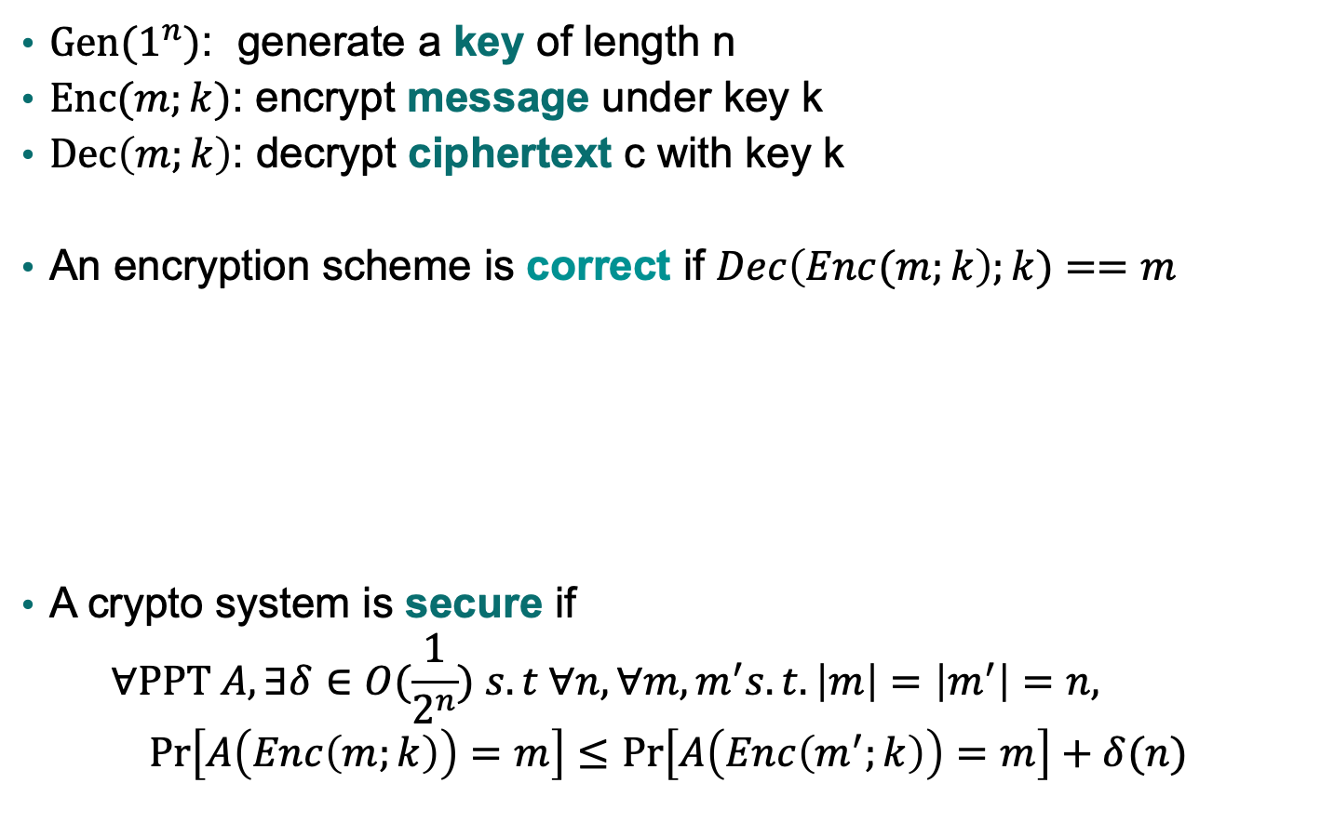
(Symmetric) Encryption
$Gen(1^{n})$: generate a key of length n
$Enc(m;k)$: encrypt message under key k
$Dec\left(m;k\right)$: decrypt ciphertext c with key k
An encryption scheme is correct if $Dec\left(Enc(m;k\right);k)==m$
A crypto system is secure if
$$∀PPT A, ∃δ∈O(\frac{1}{2^{n}}) s.t ∀n, ∀m,m^{′}s.t. \left|m\right|=\left|m^{′}\right|=n, \operatorname{Pr}\left[A\left(Enc\left(m;k\right)\right)=m\right]≤\operatorname{Pr}\left[A\left(Enc\left(m^{′};k\right)\right)=m\right]+δ(n)$$
Enc
Dec

Slide 5
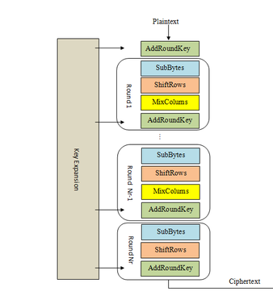
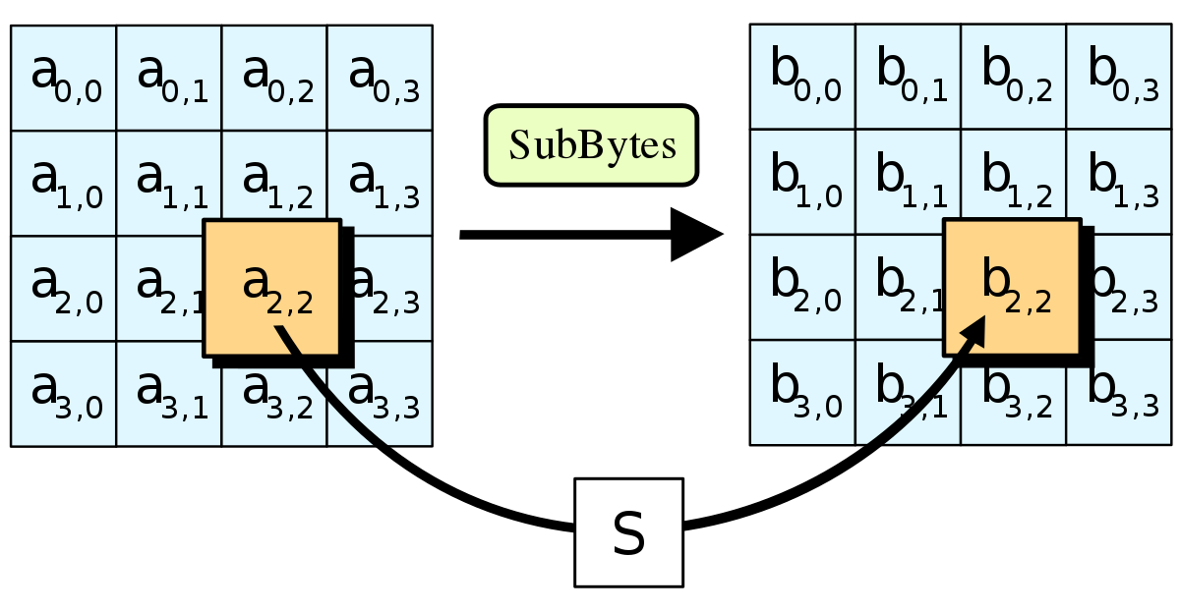
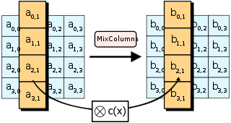
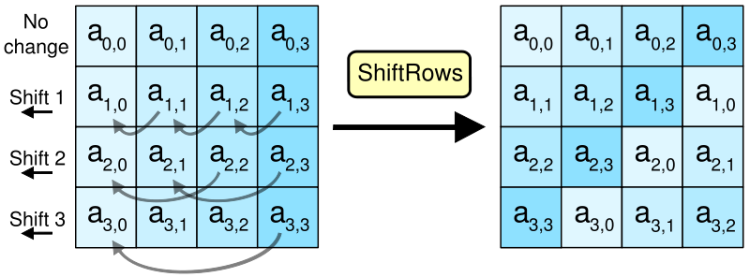
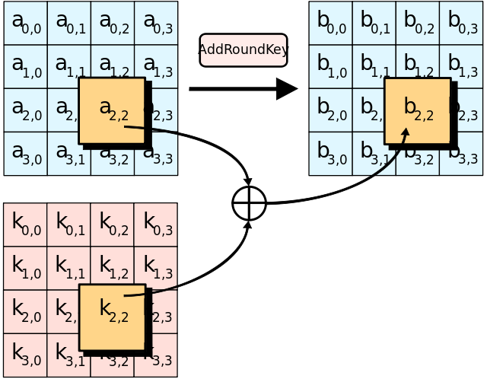
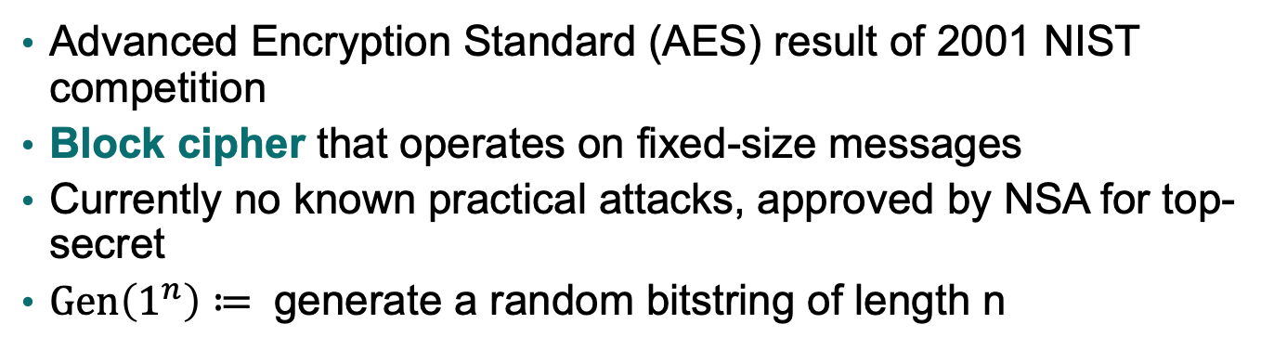
Example: AES
Advanced Encryption Standard (AES) result of 2001 NIST competition
Block cipher that operates on fixed-size messages
Currently no known practical attacks, approved by NSA for top-secret
$Gen\left(1^{n}\right)≔$ generate a random bitstring of length n

Slide 6
AES: Pre-processing
Step into the scene, you won't catch an eye
0 1 2 3 4 5 6 7 8 9 10 11 12 13 14 15
Step into the scene, you won’t catch an eye
TODO: Generate ASCII encoding of each of these bytes
Char | Hex | Binary
space | 20 | 00100000
! | 21 | 00100001
" | 22 | 00100010
# | 23 | 00100011
$ | 24 | 00100100
% | 25 | 00100101
& | 26 | 00100110
' | 27 | 00100111
( | 28 | 00101000
) | 29 | 00101001
* | 2a | 00101010
+ | 2b | 00101011
, | 2c | 00101100
Char | Hex | Binary
P | 50 | 01010000
Q | 51 | 01010001
R | 52 | 01010010
S | 53 | 01010011
T | 54 | 01010100
U | 55 | 01010101
V | 56 | 01010110
W | 57 | 01010111
X | 58 | 01011000
Y | 59 | 01011001
Z | 5a | 01011010
[ | 5b | 01011011
\ | 5c | 01011100
Char | Hex | Binary
] | 5d | 01011101
^ | 5e | 01011110
_ | 5f | 01011111
` | 60 | 01100000
a | 61 | 01100001
b | 62 | 01100010
c | 63 | 01100011
d | 64 | 01100100
e | 65 | 01100101
f | 66 | 01100110
g | 67 | 01100111
h | 68 | 01101000
i | 69 | 01101001
Char | Hex | Binary
j | 6a | 01101010
k | 6b | 01101011
l | 6c | 01101100
m | 6d | 01101101
n | 6e | 01101110
o | 6f | 01101111
p | 70 | 01110000
q | 71 | 01110001
r | 72 | 01110010
s | 73 | 01110011
t | 74 | 01110100
u | 75 | 01110101
v | 76 | 01110110
…
…
…

Slide 7
AES: Step 0 (Expand key)
a3d39ac91855c571b1ebe3894d5c4f47d7b8f762493f052d97f7ce8aeaf4c438
AES key: random 256-bits
Expand key to 240 bytes (1920 bits)
Hex | Bin
0 | 0000
1 | 0001
2 | 0010
3 | 0011
4 | 0100
5 | 0101
6 | 0110
7 | 0111
8 | 1000
9 | 1001
a | 1010
b | 1011
c | 1100
d | 1101
e | 1110
f | 1110
void expand_key(unsigned char *in) {
unsigned char t[4];
unsigned char c = 32;
unsigned char i = 1;
unsigned char a;
while(c < 240) {
for(a = 0; a < 4; a++) /* Copy the temporary variable over */
t[a] = in[a + c - 4];
if(c % 32 == 0) {/* Every eight sets, do a complex calculation */
schedule_core(t,i);
i++; }
if(c % 32 == 16) {
for(a = 0; a < 4; a++)
t[a] = sbox(t[a]); }
for(a = 0; a < 4; a++) {
in[c] = in[c - 32] ^ t[a];
c++;
}
}
}

Slide 8
AES: Step 0 (Add round key)
XOR 128 bits of message with first 128 bits of expanded key
Hex | Bin
0 | 0000
1 | 0001
2 | 0010
3 | 0011
4 | 0100
5 | 0101
6 | 0110
7 | 0111
8 | 1000
9 | 1001
a | 1010
b | 1011
c | 1100
d | 1101
e | 1110
f | 1110
0 1 2 3 4 5 6 7 8 9 10 11 12 13 14 15
a3 d3 9a c9 18 55 c5 71 b1 eb e3 89 4d 5c 4f 47

Slide 9
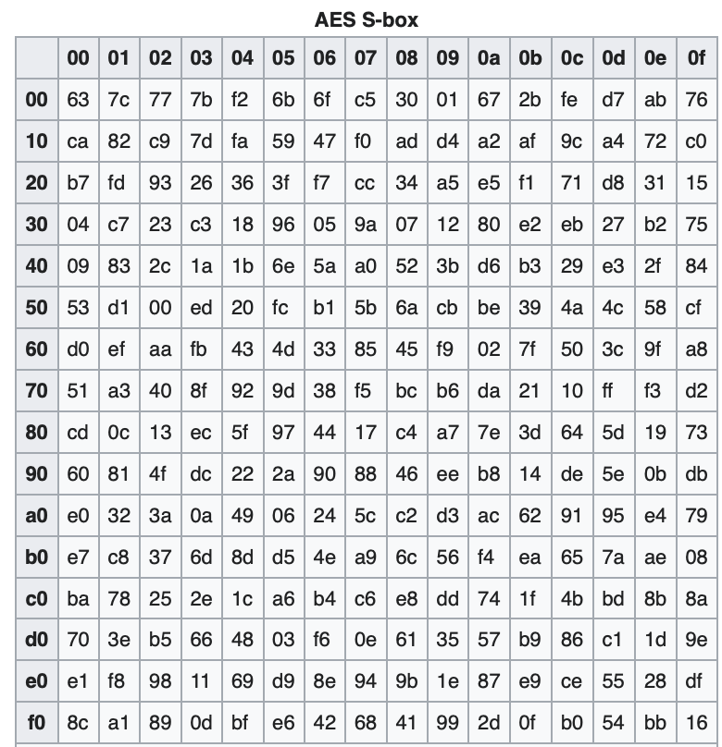
AES: Step 1 (Substitute Bytes)
Hex | Bin
0 | 0000
1 | 0001
2 | 0010
3 | 0011
4 | 0100
5 | 0101
6 | 0110
7 | 0111
8 | 1000
9 | 1001
a | 1010
b | 1011
c | 1100
d | 1101
e | 1110
f | 1110
For example, 0x9a substitutes to 0xb8

Slide 10
AES: Step 2 (Shift rows)
First row unchanged
Second row shifts left by 1
Third row shifts left by 2
Fourth row shifts left by 3

Slide 11
AES: Step 3 (Mix Columns)
Each 4-element column is mixed
void mix_columns(unsigned char *r) { /* input is array of 4 bytes = 1 column */
unsigned char a[4];
unsigned char b[4];
for (unsigned char c = 0; c < 4; c++) {
a[c] = r[c]; /* copy of input */
b[c] = r[c] << 1; /* e.g., 01101010 becomes 11010100*/
unsigned char h = r[c] >> 7; /* h left bit of r[c], either 1 or 0 */
b[c] = b[c] ^ (h * 0x1B); /* Rijndael's Galois field, 0x1B is 00011011 */
}
r[0] = b[0] ^ a[3] ^ a[2] ^ b[1] ^ a[1]; /* 2 * a0 + a3 + a2 + 3 * a1 */
r[1] = b[1] ^ a[0] ^ a[3] ^ b[2] ^ a[2]; /* 2 * a1 + a0 + a3 + 3 * a2 */
r[2] = b[2] ^ a[1] ^ a[0] ^ b[3] ^ a[3]; /* 2 * a2 + a1 + a0 + 3 * a3 */
r[3] = b[3] ^ a[2] ^ a[1] ^ b[0] ^ a[0]; /* 2 * a3 + a2 + a1 + 3 * a0 */
}

Slide 12
AES: Step 4 (Add round key)
XOR 128 bits of message with next 128 bits of expanded key
Hex | Bin
0 | 0000
1 | 0001
2 | 0010
3 | 0011
4 | 0100
5 | 0101
6 | 0110
7 | 0111
8 | 1000
9 | 1001
a | 1010
b | 1011
c | 1100
d | 1101
e | 1110
f | 1110
0 1 2 3 4 5 6 7 8 9 10 11 12 13 14 15
d7 b8 f7 62 49 3f 05 2d 97 f7 ce 8a ea f4 c4 38

Slide 13
AES: Repeat Rounds
Repeat Steps 1-4 14 total times
Except skip Mix columns in last round

Slide 14



Handling arbitrary length data
The obvious idea (Called electronic code book (ECB) mode)
  Divide long message into short chunks, each the size of a block
  Encrypt each block with the block cipher
ECB is insecure
m1
m2
m3
m4
m5
m
$$Enc(m ; k)$$
c1
c2
c3
c4
c5
Enc-ECB(Tux; k)

Slide 15
One more problem…
Problem: block ciphers are deterministic: inter-message repetition is visible to attacker (violates security)
Solution: incorporate a fresh random number every time
  Enc(m, r; k)
  Dec(c, r; k)
Choosing a different random number each time makes each encryption different than others

Slide 16
Yet another problem…
Problem: AES only gives us confidentiality (other people can’t understand our messages)
  bad guys can still change the message and we would never know
Solution: add some extra information that you can use to check whether the message is still the same as it was when it was encrypted

Slide 17
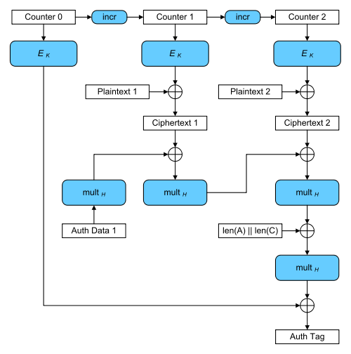
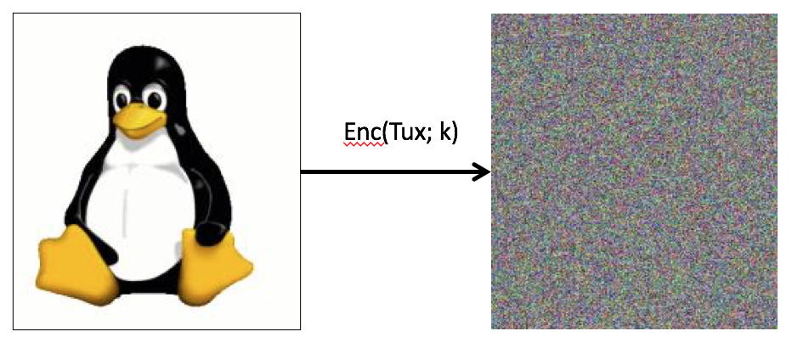
Galois Counter Mode (GCM)

Slide 18
Padding
What if the message length isn't exactly a multiple of block length? End up with final block that isn't full:
Non-solution: pad out final block with 0's (not reversible)
Solution: Let B be the number of bytes that need to be added to final plaintext block to reach block length. Pad with B copies of the byte representing B. Called PKCS #5 or #7 padding.
m
Notes:
Don’t spend too much time on PKCS#5!

Slide 19
Encryption for Privacy
people with sk can read data (correctness)
people without sk can’t read data (security)
so can control access by controlling who gets sk
to distribute keys, we can use more crypto!

