Slide 1
Lecture 5: Differential Privacy (cont’d)
CS 181E Fall 2026

Slide 2
Review: Anonymization is hard
Personal data showing up in unexpected places
Errors suppressing data
Thinking only about personal data / PII is not sufficient
It’s hard to reason about what is/is not identifiable
Availability of auxiliary information
  Extremely hard to control

Slide 3

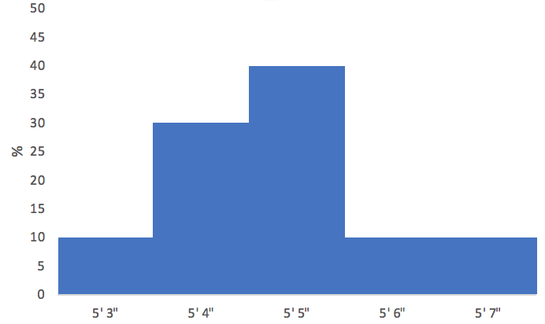
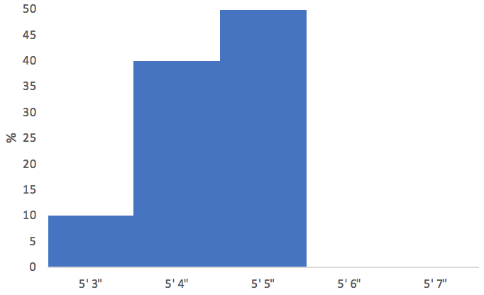


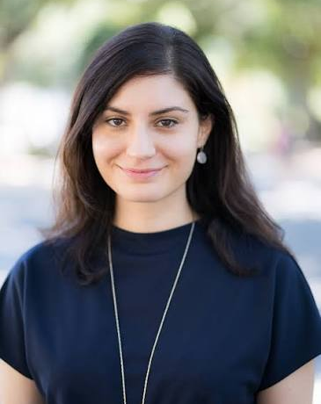

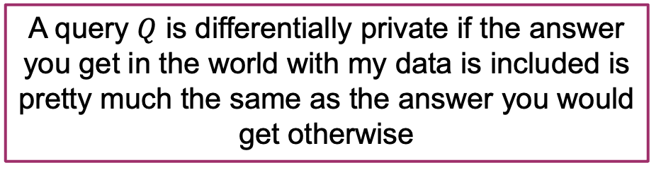
Review: Differential Privacy
World 1
World 2
DB
DB
A query $Q$ is differentially private if the answer you get in the world with my data is included is pretty much the same as the answer you would get otherwise

Slide 4
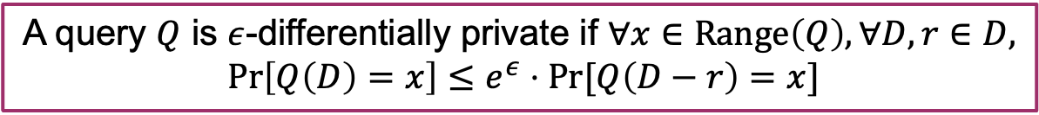
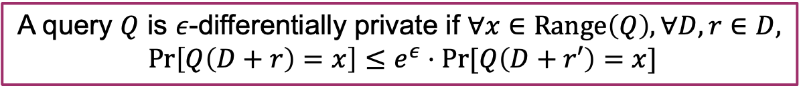
Review: Differential Privacy
World 1
World 2
DB
DB
A query $Q$ is $ε$-differentially private if $∀x∈Range\left(Q\right), ∀D,r∈D,$
$$\operatorname{Pr}\left[Q\left(D\right)=x\right]≤e^{ε}⋅Pr⁡[Q\left(D−r\right)=x]$$
A query $Q$ is $ε$-differentially private if $∀x∈Range\left(Q\right), ∀D,r∈D,$
$$\operatorname{Pr}\left[Q\left(D+r\right)=x\right]≤e^{ε}⋅Pr⁡[Q\left(D+r′\right)=x]$$

Slide 5
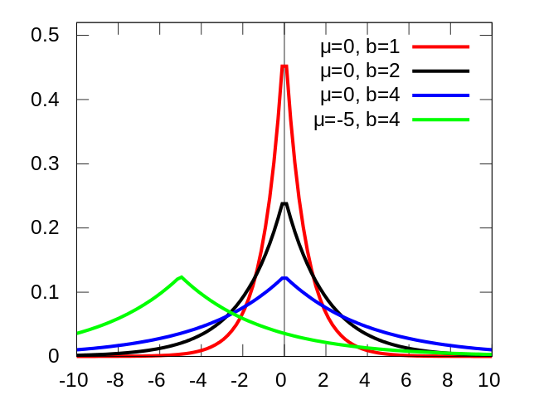
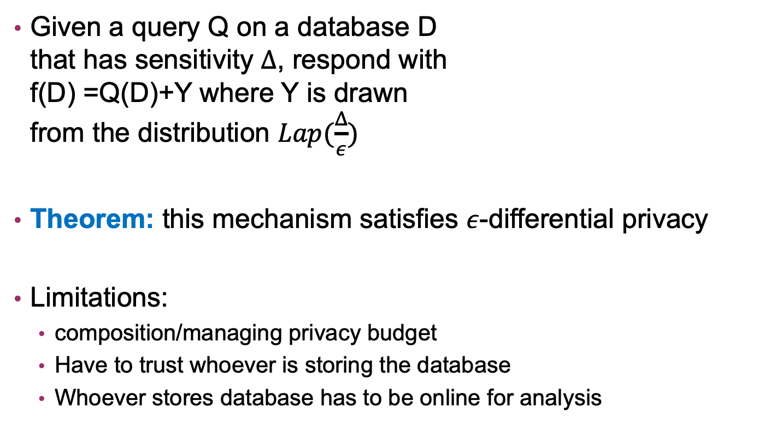
Review: Laplacian Mechanism
Given a query Q on a database D that has sensitivity $Δ$, respond with f(D) =Q(D)+Y where Y is drawn from the distribution $Lap(\frac{Δ}{ε})$
Theorem: this mechanism satisfies $ε$-differential privacy
Limitations:
  composition/managing privacy budget
  Have to trust whoever is storing the database
  Whoever stores database has to be online for analysis

Slide 6

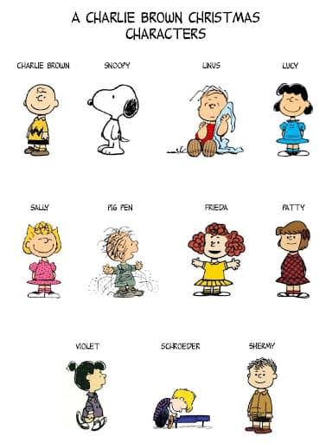
Models of Differential Privacy
Central DP
Local DP
DB
DB

Slide 7
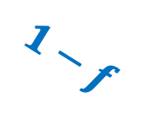


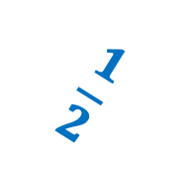
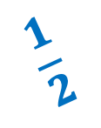
Randomized Response
Respond truthfully
$$f$$
$$\frac{1}{2}$$
"yes"
$$1−f$$
flip a coin
$$\frac{1}{2}$$
"no"
$$⟨Y,N,Y,Y,Y,N,…,Y,N⟩$$

Slide 8
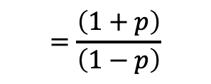

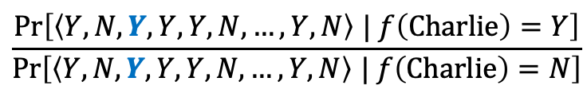
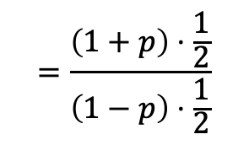

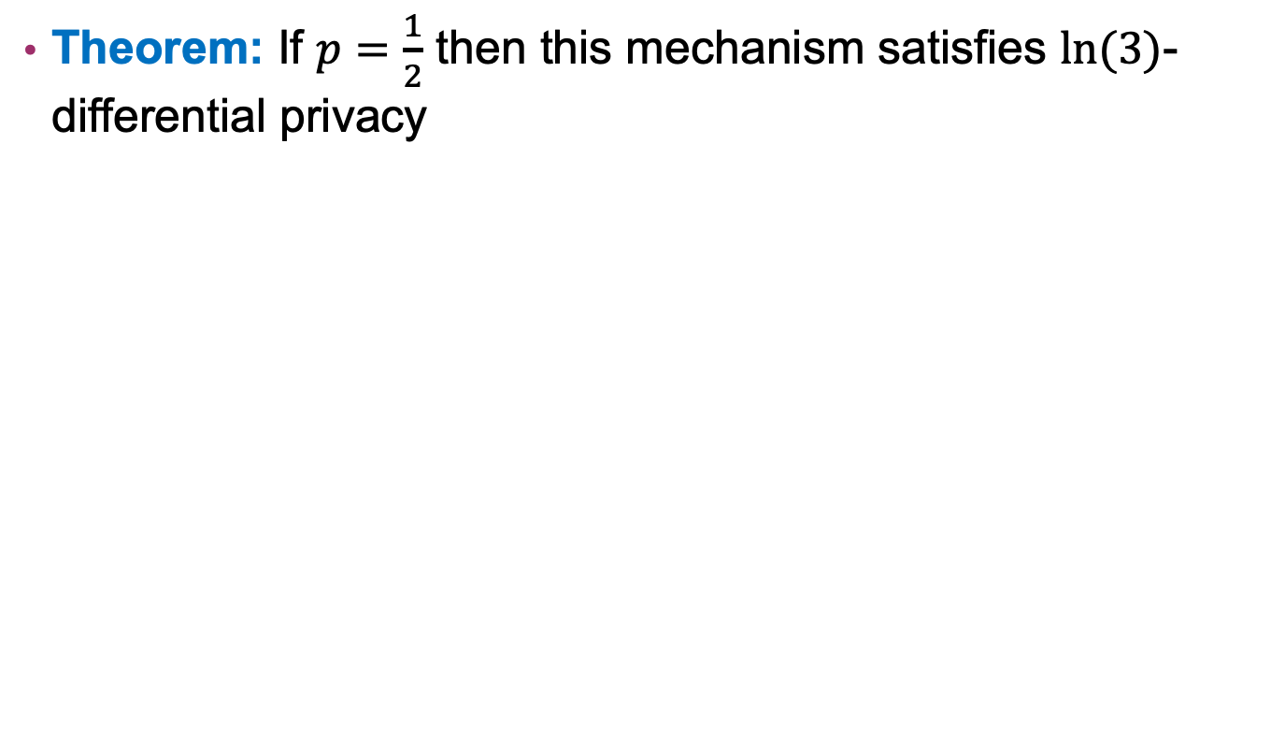
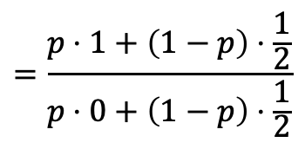
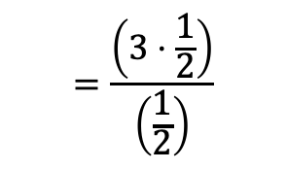
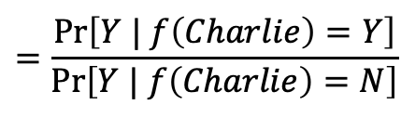
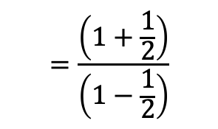
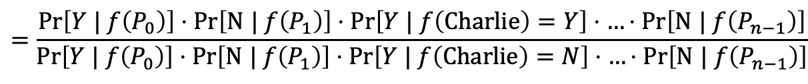


Randomized Response
Theorem: If $p=\frac{1}{2}$ then this mechanism satisfies $ln⁡(3)$-differential privacy
$$\frac{Pr\left[\left\langle Y,N,Y,Y,Y,N,…,Y,N\right\rangle | f\left(Charlie\right)=Y\right]}{Pr\left[\left\langle Y,N,Y,Y,Y,N,…,Y,N\right\rangle | f\left(Charlie\right)=N\right]}$$
$$=\frac{Pr\left[Y | f\left(P_{0}\right)\right]⋅Pr\left[\text{N} | f\left(P_{1}\right)\right]⋅Pr\left[Y | f\left(Charlie\right)=Y\right]⋅…⋅Pr\left[\text{N} | f\left(P_{n−1}\right)\right]}{Pr\left[Y | f\left(P_{0}\right)\right]⋅Pr\left[\text{N} | f\left(P_{1}\right)\right]⋅Pr\left[Y | f\left(Charlie\right)=N\right]⋅…⋅Pr\left[\text{N} | f\left(P_{n−1}\right)\right]}$$
$$=\frac{Pr\left[Y | f\left(Charlie\right)=Y\right]}{Pr\left[Y | f\left(Charlie\right)=N\right]}$$
$$=\frac{p⋅1+\left(1−p\right)⋅\frac{1}{2}}{p⋅0+\left(1−p\right)⋅\frac{1}{2}}$$
$$=\frac{\left(1+p\right)⋅\frac{1}{2}}{\left(1−p\right)⋅\frac{1}{2}}$$
$$=\frac{\left(1+p\right)}{\left(1−p\right)}$$
$$=\frac{\left(1+\frac{1}{2}\right)}{\left(1−\frac{1}{2}\right)}$$
$$=\frac{\left(3⋅\frac{1}{2}\right)}{\left(\frac{1}{2}\right)}$$
$$=3$$
$$=e^{\ln{(3)}}$$
$⇒$ $ln\left(3\right)$-differentially private
$$≈e^{1.1}$$

Slide 9

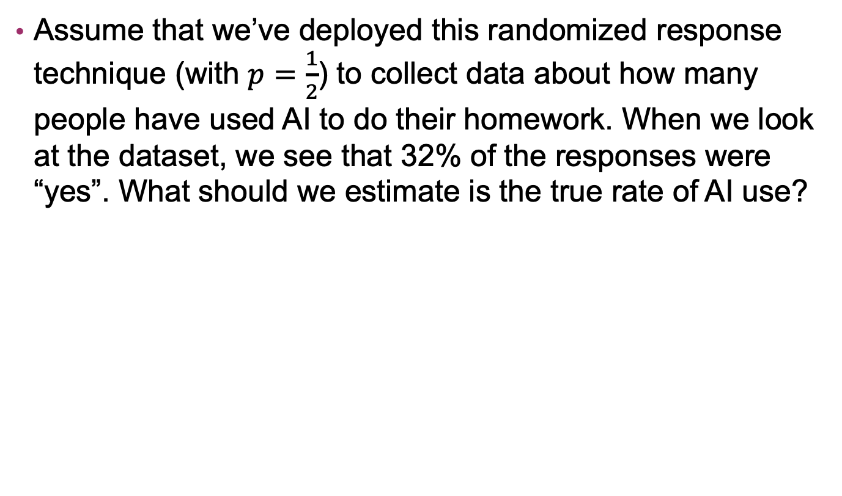


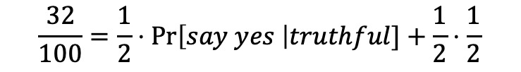
Exercise: Randomized Response
Assume that we’ve deployed this randomized response technique (with $p=\frac{1}{2}$) to collect data about how many people have used AI to do their homework. When we look at the dataset, we see that 32% of the responses were “yes”. What should we estimate is the true rate of AI use?
$$\frac{32}{100}=Pr\left[truthful\right]⋅Pr\left[say yes \right|truthful] + Pr[flip again]⋅Pr\left[say yes \right|flip again]$$
$$\frac{32}{100}=\frac{1}{2}⋅Pr\left[say yes \right|truthful]+\frac{1}{2}⋅\frac{1}{2}$$
$$\frac{32}{100}=\frac{1}{2}⋅Pr[true yes] +\frac{1}{4}$$
$$\frac{32}{100}−\frac{1}{4}=\frac{1}{2}⋅Pr[true yes]$$
$$\frac{7}{100}=\frac{1}{2}⋅Pr[true yes]$$
$$Pr\left[true yes\right]=14\%$$

Slide 10
Limitations
Limitation #1: This only works for binary responses

Slide 11



Handling Ordinal Data
“Hot-one encoding” – store data as an array of k bits, each bit encodes whether one possible attribute applies
Human | Black Hair | Blond Hair | Brown Hair | Female
$$B_{Lucy}=$$
1 | 1 | 0 | 0 | 1
$$B_{Charlie}=$$
1 | 0 | 0 | 0 | 0
$$B_{Snoopy}=$$
0 | 0 | 0 | 0 | 0

Slide 12
Handling Arbitrary Bit-strings
just use the string
  not private: length can leak info
hash the string
  risk of collisions when deployed at scale
use some other fancy data structure
  Bloom filters!

Slide 13
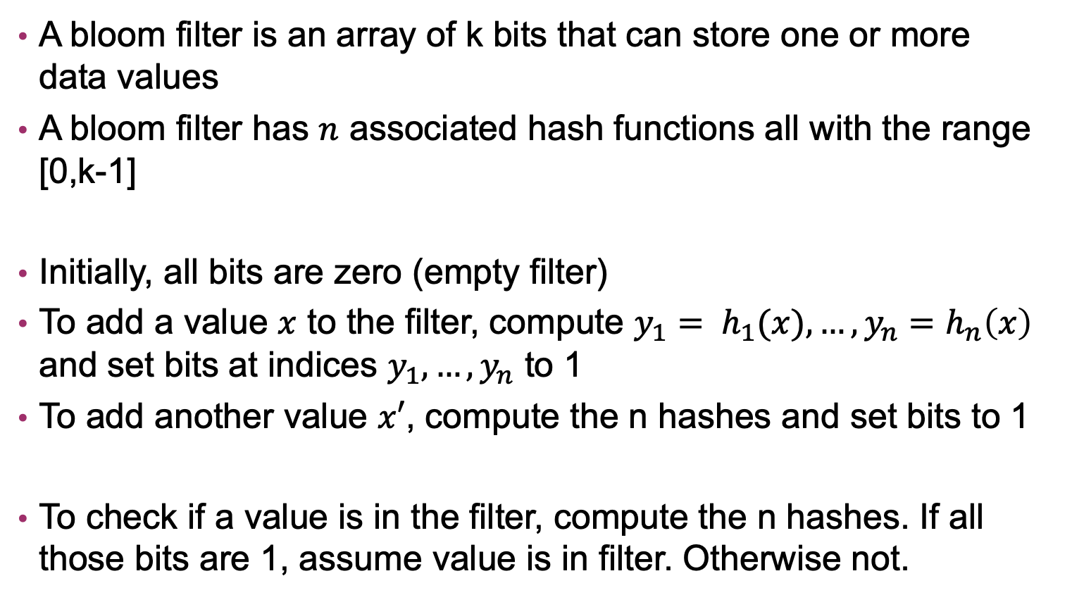
Bloom Filters
A bloom filter is an array of k bits that can store one or more data values
A bloom filter has $n$ associated hash functions all with the range [0,k-1]
Initially, all bits are zero (empty filter)
To add a value $x$ to the filter, compute ${y_{1}= h}_{1}(x), …,{y_{n}=h}_{n}\left(x\right)$ and set bits at indices $y_{1},…,y_{n}$ to 1
To add another value $x′$, compute the n hashes and set bits to 1
To check if a value is in the filter, compute the n hashes. If all those bits are 1, assume value is in filter. Otherwise not.
0 | 0 | 0 | 0 | 0
0 | 1 | 0 | 0 | 1
0 | 1 | 1 | 0 | 1

Slide 14


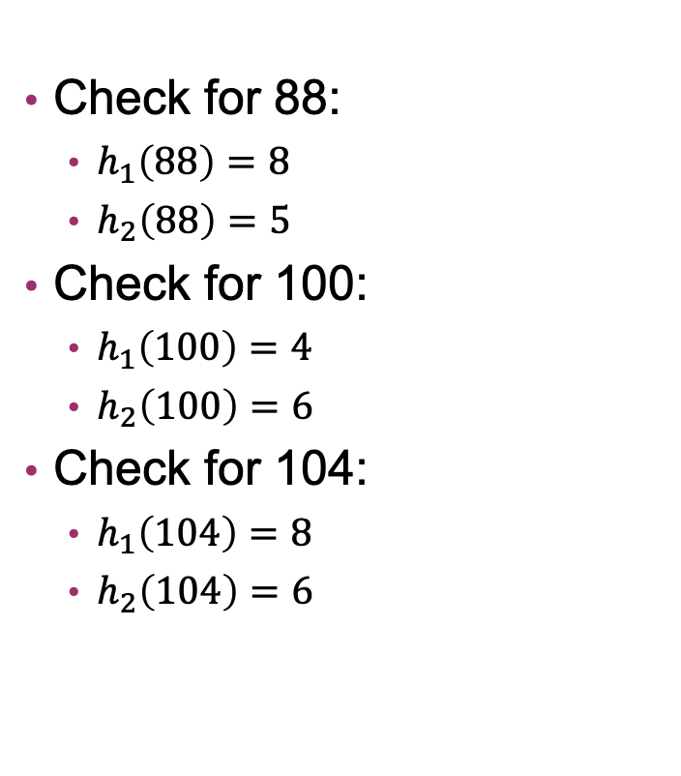
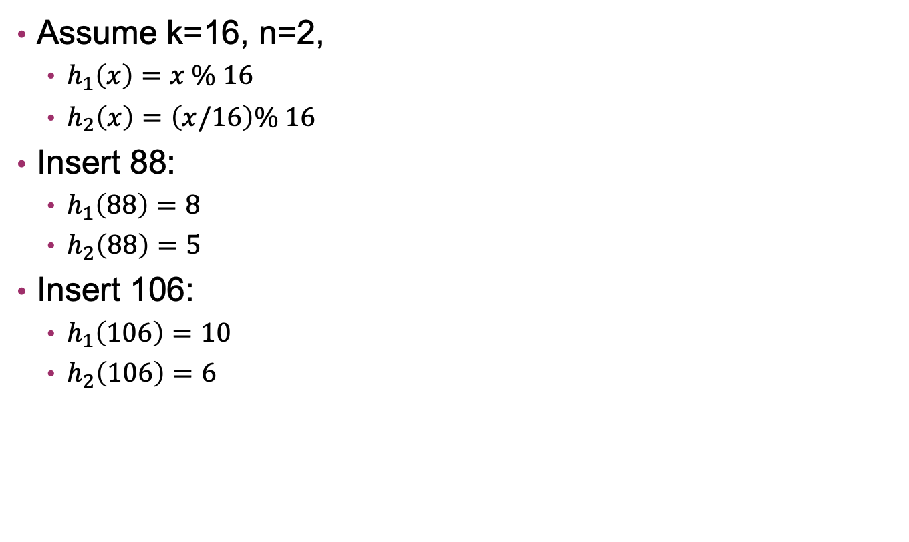
Example: Bloom Filters
Check for 88:
  $h_{1}\left(88\right)=8$
  $h_{2}\left(88\right)=5$
Check for 100:
  $h_{1}\left(100\right)=4$
  $h_{2}\left(100\right)=6$
Check for 104:
  $h_{1}\left(104\right)=8$
  $h_{2}\left(104\right)=6$
Assume k=16, n=2,
  $h_{1}\left(x\right)=x \% 16$
  $h_{2}\left(x\right)=\left(x/16\right)\% 16$
Insert 88:
  $h_{1}\left(88\right)=8$
  $h_{2}\left(88\right)=5$
Insert 106:
  $h_{1}\left(106\right)=10$
  $h_{2}\left(106\right)=6$
0
1
2
3
4
5
6
7
8
9
10
11
12
13
14
15
0 | 0 | 0 | 0 | 0 | 0 | 0 | 0 | 0 | 0 | 0 | 0 | 0 | 0 | 0 | 0
0 | 0 | 0 | 0 | 0 | 1 | 1 | 0 | 1 | 0 | 1 | 0 | 0 | 0 | 0 | 0
0 | 0 | 0 | 0 | 0 | 1 | 0 | 0 | 1 | 0 | 0 | 0 | 0 | 0 | 0 | 0
No false negatives, but can get false positives!

Slide 15

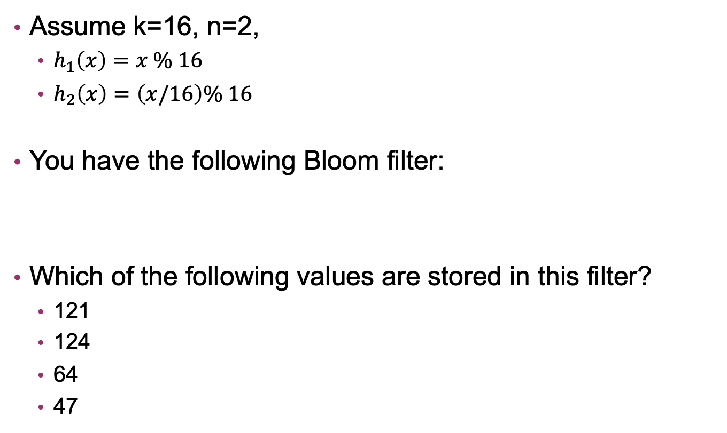



Exercise: Bloom Filters
Assume k=16, n=2,
  $h_{1}\left(x\right)=x \% 16$
  $h_{2}\left(x\right)=\left(x/16\right)\% 16$
You have the following Bloom filter:
Which of the following values are stored in this filter?
  121
  124
  64
  47
0
1
2
3
4
5
6
7
8
9
10
11
12
13
14
15
1 | 0 | 0 | 0 | 1 | 0 | 1 | 1 | 0 | 0 | 0 | 0 | 1 | 1 | 0 | 0
$$h_{1}\left(121\right)=9, h_{2}\left(121\right)=7$$
$$h_{1}\left(124\right)=12, h_{2}\left(121\right)=7$$
$$h_{1}\left(64\right)=0, h_{2}\left(64\right)=4$$
$$h_{1}\left(47\right)=15, h_{2}\left(47\right)=2$$

Slide 16
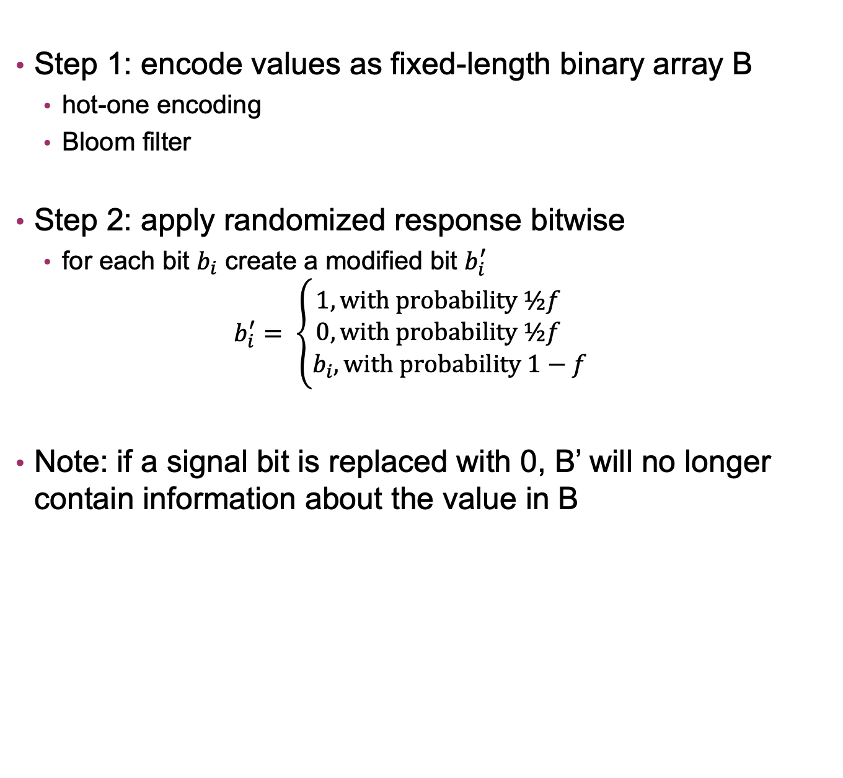
Adding Differential Privacy
Step 1: encode values as fixed-length binary array B
  hot-one encoding
  Bloom filter
Step 2: apply randomized response bitwise
  for each bit $b_{i}$ create a modified bit $b_{i}^{′}$
  $$b_{i}^{′}= \left\{\begin{aligned}1, with probability ½f \\ 0, with probability ½f \\ b_{i}, with probability 1−f\end{aligned}\right.$$
Note: if a signal bit is replaced with 0, B’ will no longer contain information about the value in B

Slide 17
Limitations
Limitation #1: This only works for binary responses
Limitation #2: Repeated answers degrade privacy

Slide 18
Memoization
Permanently associated a fixed random response with the real value B
If you needed again, used the stored B’
Never generate a fresh random B’ for the same value
Permanent randomized response

Slide 19
Limitations
Limitation #1: This only works for binary responses
Limitation #2: Repeated answers degrade privacy
Limitation #3: Memoized repeated responses are linkable

Slide 20
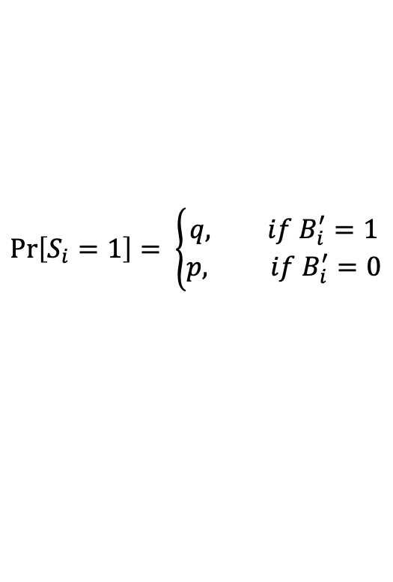
Add a second layer of Privacy
Instantaneous randomized response
Create new array using bitwise randomized response
Send this new array S to the server
$$\operatorname{Pr}\left[S_{i}=1\right]= \left\{\begin{aligned}q, if B_{i}^{′}=1 \\ p, if B_{i}^{′}=0\end{aligned}\right.$$

Slide 21
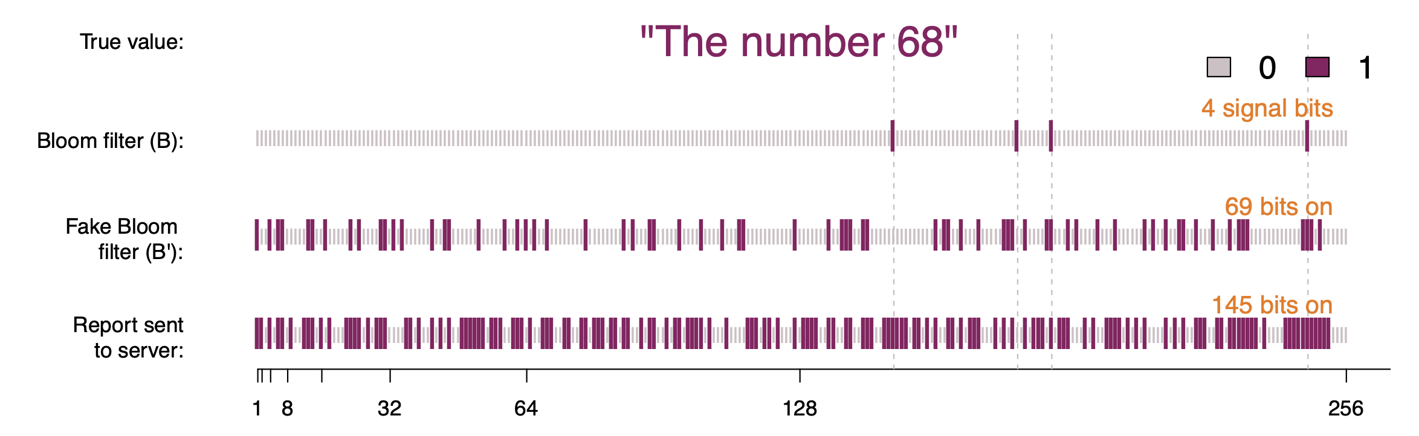
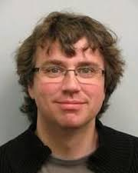
RAPPOR
n = 4
f = .5
q = .75
p = .5

Slide 22
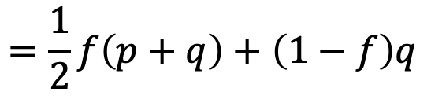
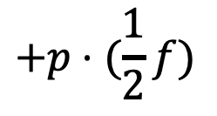
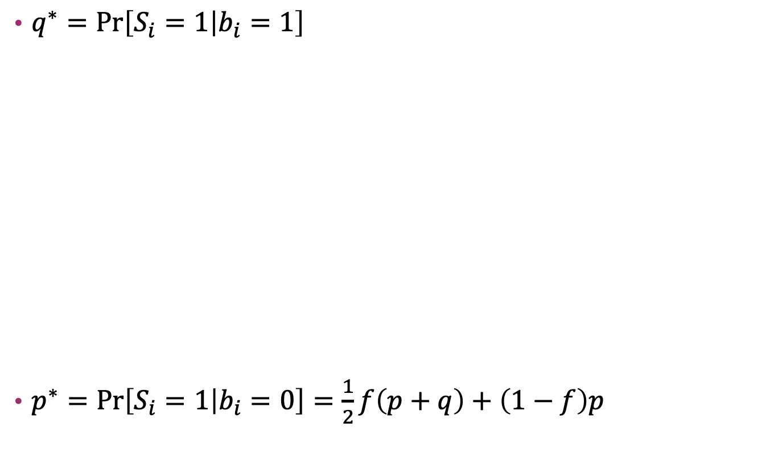
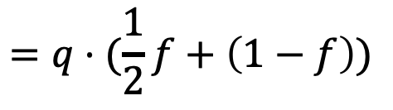
Privacy of RAPPOR
$q^{∗}=\operatorname{Pr}\left[S_{i}=1 | b_{i}=1\right]$
$p^{∗}=\operatorname{Pr}\left[S_{i}=1 | b_{i}=0\right]=\frac{1}{2}f\left(p+q\right)+\left(1−f\right)p$
$$=\operatorname{Pr}\left[S_{i}=1 and b_{i}^{′}=1 | b_{i}=1\right]+\operatorname{Pr}\left[S_{i}=0 and b_{i}^{′}=0 \right|b_{i}=1]$$
$$=\operatorname{Pr}\left[S_{i}=1 \right|b_{i}^{′}=1 and b_{i}=1]⋅\operatorname{Pr}\left[b_{i}^{′}=1 | b_{i}=1\right]$$
$$+\operatorname{Pr}\left[S_{i}=1 \right|b_{i}^{′}=0 and b_{i}=1]⋅\operatorname{Pr}\left[b_{i}^{′}=0 | b_{i}=1\right]$$
$$=q⋅(\frac{1}{2}f+\left(1−f\right))$$
$$+p⋅(\frac{1}{2}f)$$
$$=\frac{1}{2}f\left(p+q\right)+\left(1−f\right)q$$

Slide 23
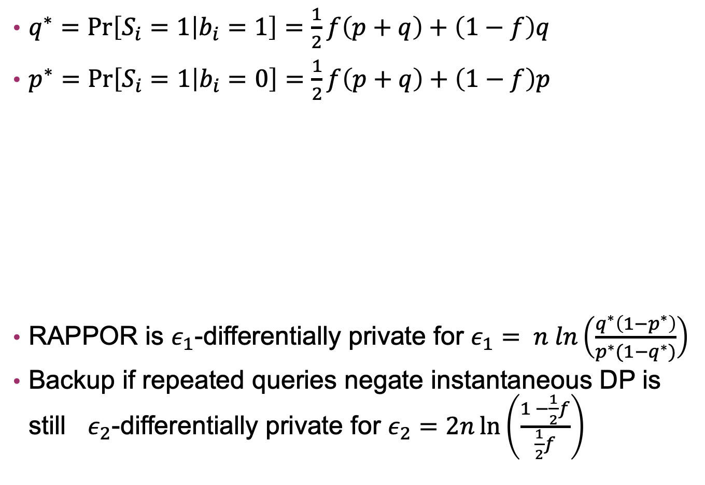
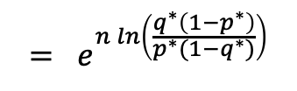
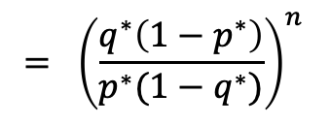
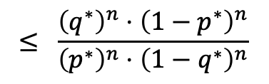
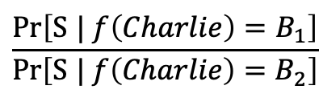
Privacy of RAPPOR
$q^{∗}=\operatorname{Pr}\left[S_{i}=1 | b_{i}=1\right]=\frac{1}{2}f\left(p+q\right)+\left(1−f\right)q$
$p^{∗}=\operatorname{Pr}\left[S_{i}=1 | b_{i}=0\right]=\frac{1}{2}f\left(p+q\right)+\left(1−f\right)p$
RAPPOR is $ε_{1}$-differentially private for $ε_{1}= n ln\left(\frac{q^{∗}\left(1−p^{∗}\right)}{p^{∗}(1−q^{∗})}\right)$
Backup if repeated queries negate instantaneous DP is still $ε_{2}$-differentially private for $ε_{2}=2n\ln\left(\frac{1 −\frac{1}{2}f}{\frac{1}{2}f}\right)$
$$\frac{Pr\left[\text{S} | f\left(Charlie\right)=B_{1}\right]}{Pr\left[\text{S} | f\left(Charlie\right)=B_{2}\right]}$$
$$≤ \frac{{\left(q^{∗}\right)}^{n}⋅{\left(1−p^{∗}\right)}^{n}}{{\left(p^{∗}\right)}^{n}⋅{\left(1−q^{∗}\right)}^{n}}$$
$$= {\left(\frac{q^{∗}\left(1−p^{∗}\right)}{p^{∗}(1−q^{∗})}\right)}^{n}$$
$$= e^{n ln\left(\frac{q^{∗}\left(1−p^{∗}\right)}{p^{∗}(1−q^{∗})}\right)}$$
Notes:
B1 and B2 differ in at most 2n positions (n 1s and n 0s flip). Worst case: S matchs B1 in all 2n and B2 in none
(Pr 1 and correct)^n x (Pr 0 and correct)^n / (Pr 1 and wrong)^n x (Pr 0 and wrong)

Slide 24
Utility of RAPPOR
Calculate estimate of number of times each bit is truly set in B
Use regression model to select candidate strings to consider
Use least-squares regression to estimate counts for candidate strings
filter out ones with insignificant p-values

Slide 25
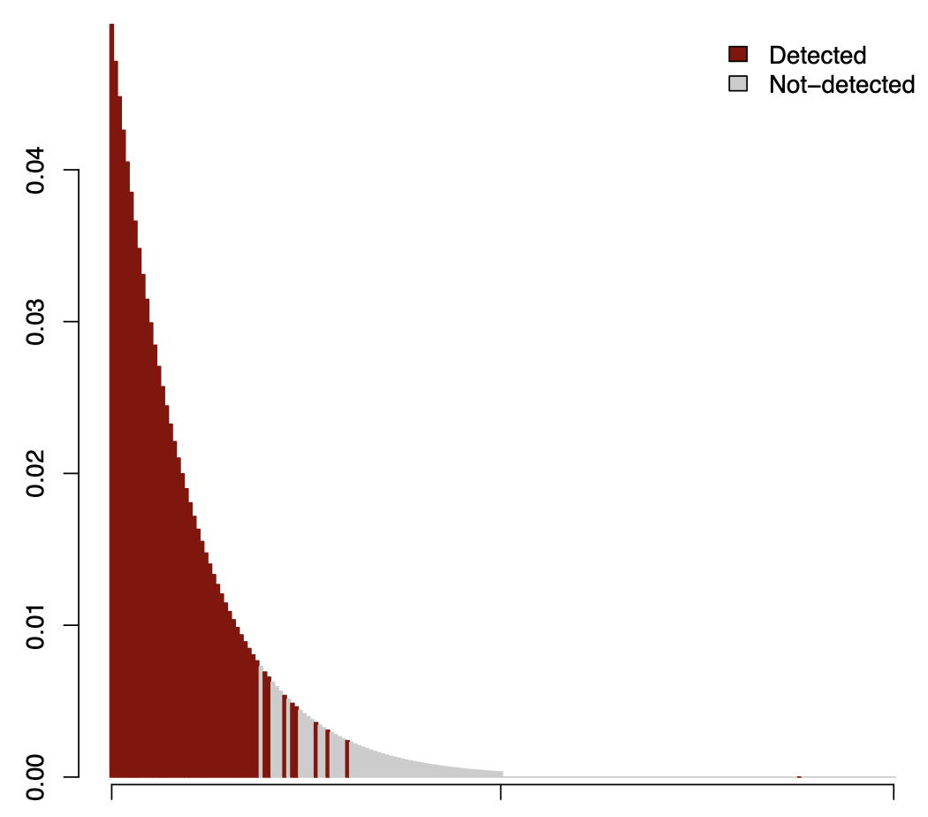
Utility of RAPPOR
String | Est | Truth
V_1 | 48803 | 49884
V_2 | 47388 | 47026
V_3 | 39509 | 44642
V_4 | 40420 | 42747
V_5 | 41490 | 40077
V_10 | 34196 | 31234
V_19 | 23860 | 20057
V_20 | 20159 | 19110
Experiments run with k=128,n=2, f=.5, q=.75, p=.5

Slide 26
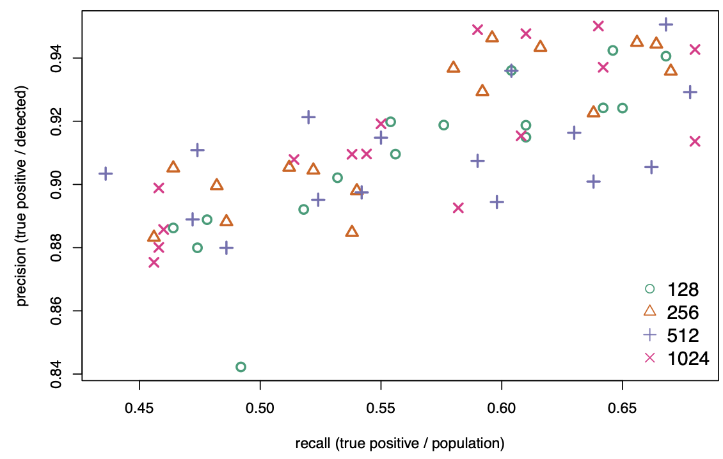
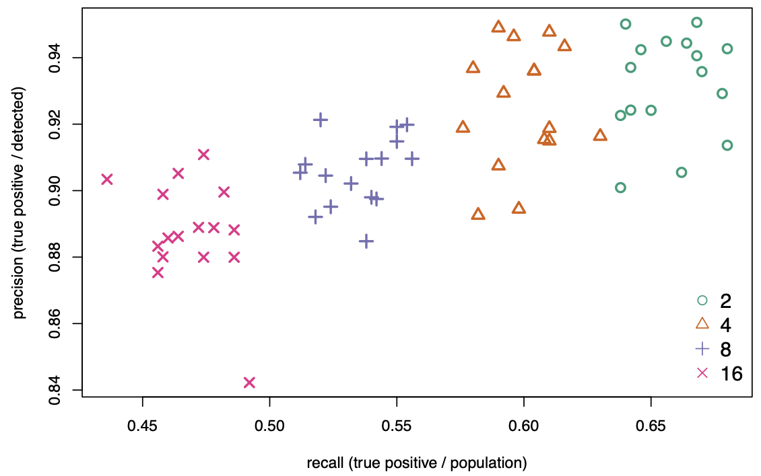
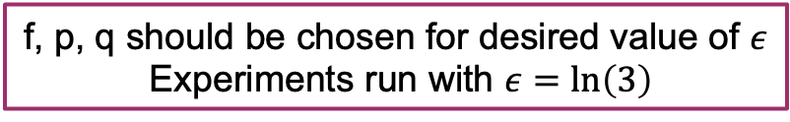
Choosing Parameters
Bloom Filter Size
Number of Hash functions (n)
f, p, q should be chosen for desired value of $ε$
Experiments run with $ε=\ln\left(3\right)$

Slide 27
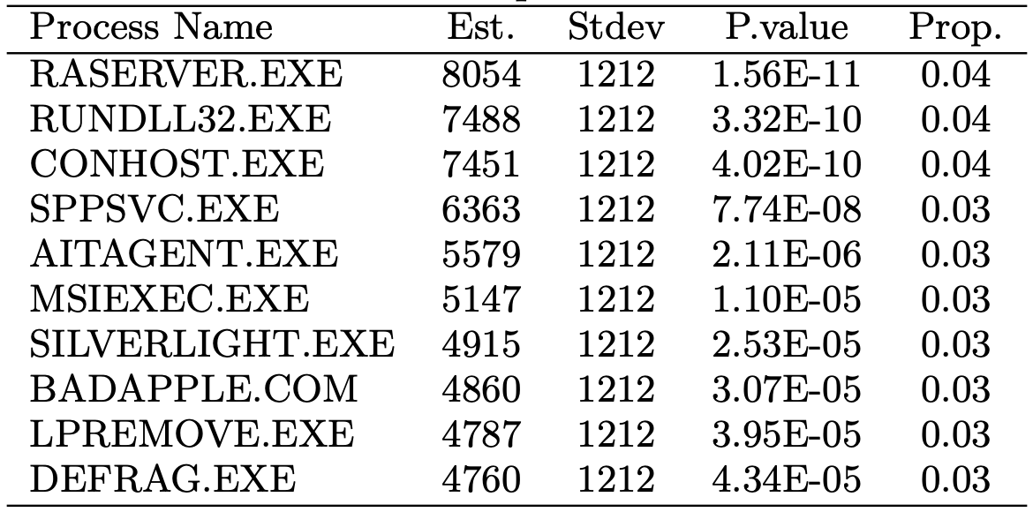
Estimating Malware Prevalence
186,792 reports from 10,133 Windows computers
sampled actively running processes (~18 process names per machine)
Goal: estimate frequency of malware “BADAPPLE.COM”

Slide 28

RAPPOR in the real world
used in Chromium for error reporting and other data collection for ~10 years
more recently, mostly replaced by private ML
Notes:
https://www.accessnow.org/differential-privacy-part-3-extraordinary-claims-require-extraordinary-scrutiny/
Normal reports: 2.04 (single report) 4.39 (total privacy budget) 107 (num metrics)
Low privacy reports: 3.15 (single report) 7.78 (total privacy budget) 28 (num metrics)

Slide 29

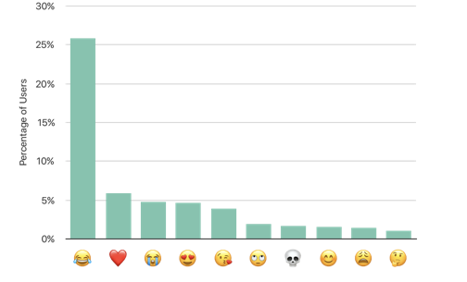
Local DP on iPhones
Apple uses a form of local differential privacy known as Private Count Mean Sketch to collect data iOS users
identifying websites with high memory or energy usage
discovering new words
identifying popular emojis
Notes:
https://machinelearning.apple.com/research/learning-with-privacy-at-scale
emoji data from 2017

Slide 30

Local DP on Windows Devices
first deployed in some versions of Windows 10
collects time user spends on a particular app (6 hour intervals)
Notes:
https://proceedings.neurips.cc/paper_files/paper/2017/file/253614bbac999b38b5b60cae531c4969-Paper.pdf

Slide 31

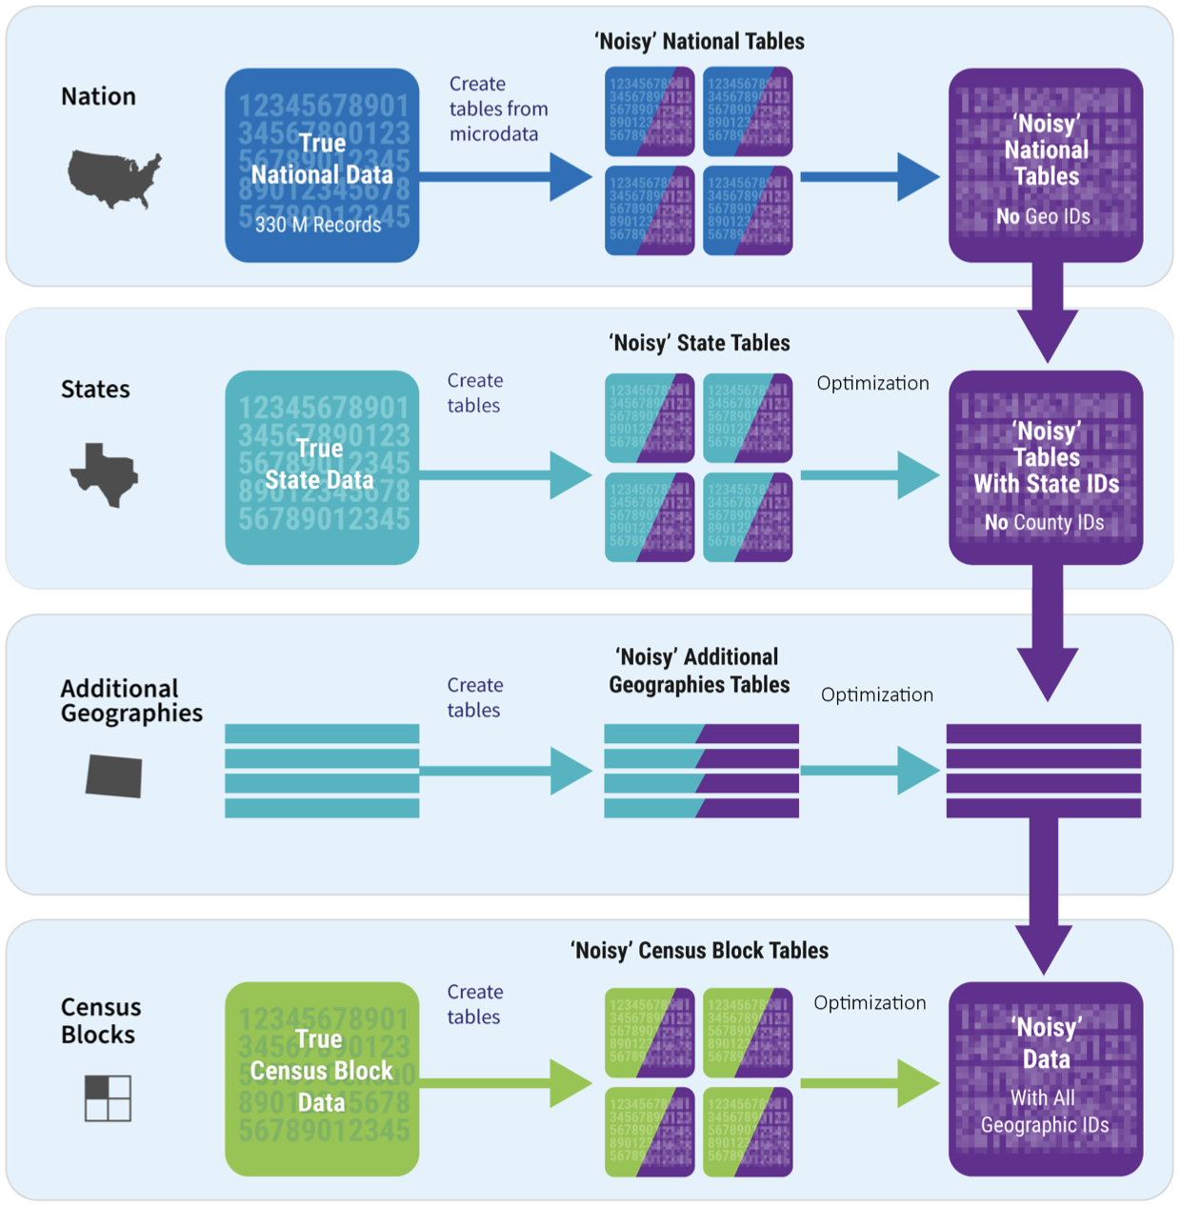
Census Data
U.S. federal government use differential privacy to protect data released about the 2020 census
cool application of differential privacy at scale
lots of controversy about this at the policy level

