Slide 1
Lecture 3: Anonymization
CS 181E Fall 2026

Slide 2
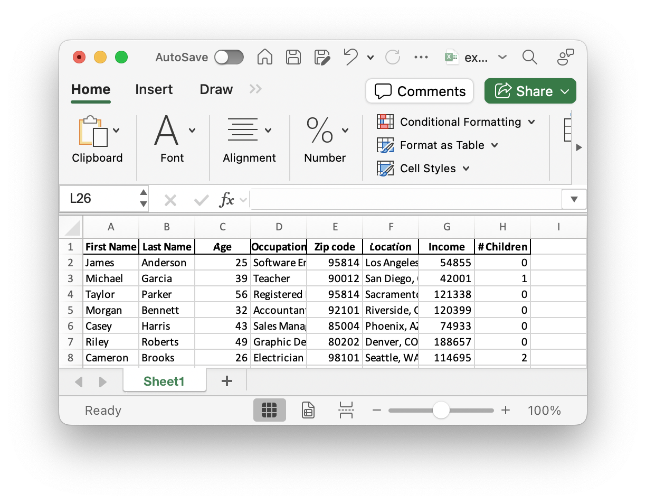
Example: Releasing a Dataset
Question: Would it be okay to publish this dataset?

Slide 3
Personally-Idenfiable Data (PII)
anonymization efforts generally try to remove any information that can uniquely identify an individual
exact definitions vary
CCPA:
  “Personal information” means information that identifies, relates to, describes, is reasonably capable of being associated with, or could reasonably be linked, directly or indirectly, with a particular consumer or household.
  “Personal information” does not include consumer information that is deidentified
  “Deidentified” means information that cannot reasonably be used to infer information about, or otherwise be linked to, a particular consumer

Slide 4
Exercise 1: Anonymizing a Dataset
What modifications would you make to this dataset to retain utility without compromising anyone’s privacy?

Slide 5
Technique #1: Pseudonymization
replacing identifying information (e.g., names) with unique identifiers
chronological
hashing
randomly generated

Slide 6
Technique #2: Suppression
delete particular columns or values
delete columns that are too sensitive
delete rare or sensitive values

Slide 7
Technique #3: Generalization
replace fine-grained values with course-grained values
Example:
  replace DOB with age
  replace age with age range
  replace GPS coordinates with city or state

Slide 8
Technique #4: Approximation
Add random noise to values
Potential concerns:
  how much noise?
  what distribution?
  does this make the data useless?

Slide 9
Technique #5: Aggregation
Instead of raw data, release summary statistics
Potential concerns:
  does this make the data useless?

Slide 10
What do people commonly do?
focus on particular attributes (e.g., age, gender, location)
mostly use suppression or generalization of entire values
remove distinctive values or combinations of values
informal and social processes for determining when done

Slide 11
Is this good enough?

Slide 12

Case Study: Massachusetts Health Data
Group Insurance Commission would release records with
100 attributes for every state employee’s hospital visits
Anonymized by removing any value that identified the individual (e.g., name, mailing address, insurance ID)
Researchers found quasi-identifiers that were unique for a lot of people
  87%: ZIP code + full Date of Birth + Sex
  53%: City + full Date of Birth + Sex
  18%: County + full Date of Birth + Sex
These same values are also in public records (e.g., voter registration)

Slide 13
k-Anonymity
Name | Pronouns | Grad | Grade
Alice | she/her | Spring 2028 | 95
Bob | he/him | Spring 2028 | 80
Charlie | they/them | Spring 2028 | 95
David | he/him | Spring 2028 | 60
Edward | he/him | Fall 2027 | 80
Flora | she/her | Spring 2027 | 99
Georgia | she/her | Spring 2027 | 60
Name | Pronouns | Grad | Grade
* | she/her | Spring 2028 | 95
* | he/him | Spring 2028 | 80
* | they/them | Spring 2028 | 95
* | he/him | Spring 2028 | 60
* | he/him | Fall 2027 | 80
* | she/her | Spring 2027 | 99
* | she/her | Spring 2027 | 60
Name | Pronouns | Grad | Grade
* | * | Spring 2028 | 95
* | he/him | Spring 2028 | 80
* | * | Spring 2028 | 95
* | he/him | Spring 2028 | 60
* | he/him | Fall 2027 | 80
* | she/her | Spring 2027 | 99
* | she/her | Spring 2027 | 60
Name | Pronouns | Grad | Grade
* | * | 2027-2028 | 95
* | he/him | 2027-2028 | 80
* | * | 2027-2028 | 95
* | he/him | 2027-2028 | 60
* | he/him | 2027-2028 | 80
* | she/her | Spring 2027 | 99
* | she/her | Spring 2027 | 60
Name | Pronouns | Grad | Grade
Alice | she/her | Spring 2028 | 95
Bob | he/him | Spring 2028 | 80
Charlie | they/them | Spring 2028 | 95
David | he/him | Spring 2028 | 60
Edward | he/him | Fall 2027 | 80
Flora | she/her | Spring 2027 | 99
Georgia | she/her | Spring 2027 | 60
Quasi-identifiers (QIs) are sets of attributes that can be exploited for linking
A database is k-anonymous if each QI maps to at least k different individuals
Techniques: suppression and generalization
Notes:
quasi-identifiers: (sets of) attributes that can be exploited for linking
k-anonymity: each quasi-identifier must be ambiguously mapped to at least k different individuals
Techniques: suppression and generalization
Problems: identifying QIs, homogenity attack, background knowledge attack
Refinement: \ell-diversity additionally requires \ell "well represented" values for each QI

Slide 14
Exercise 2: k-anonymity
Modify this dataset to make it 2-anonymous with respect to Zipcode/DOB/Sex
Zipcode | DOB | Gender | Marital Status | Health Issues
91711 | 9/27/00 | female | divorced | hypertension
91711 | 9/30/00 | female | divorced | obesity
91711 | 4/18/00 | male | married | chest pain
91711 | 4/15/00 | male | married | obesity
91767 | 3/13/99 | male | married | hypertension
91767 | 3/18/99 | male | married | shortness of breath
91767 | 9/13/00 | female | married | obesity
91767 | 9/07/00 | female | married | obesity
91101 | 5/14/01 | male | single | chest pain
91101 | 4/08/01 | male | single | obesity
91101 | 9/15/01 | female | married | shortness of breath
Zipcode | DOB | Gender | Marital Status | Health Issues
91711 | 9/00 | female | divorced | hypertension
91711 | 9/00 | female | divorced | obesity
91711 | 4/00 | male | married | chest pain
91711 | 4/00 | male | married | obesity
91767 | 3/99 | male | married | hypertension
91767 | 3/99 | male | married | shortness of breath
91767 | 9/00 | female | married | obesity
91767 | 9/00 | female | married | obesity
91101 | 2001 | * | single | chest pain
91101 | 2001 | * | single | obesity
91101 | 2001 | * | married | shortness of breath
Notes:
Problems: identifying QIs, homogeneity attack, background knowledge attack
Refinement: \ell-diversity additionally requires \ell "well represented" values for each QI

Slide 15
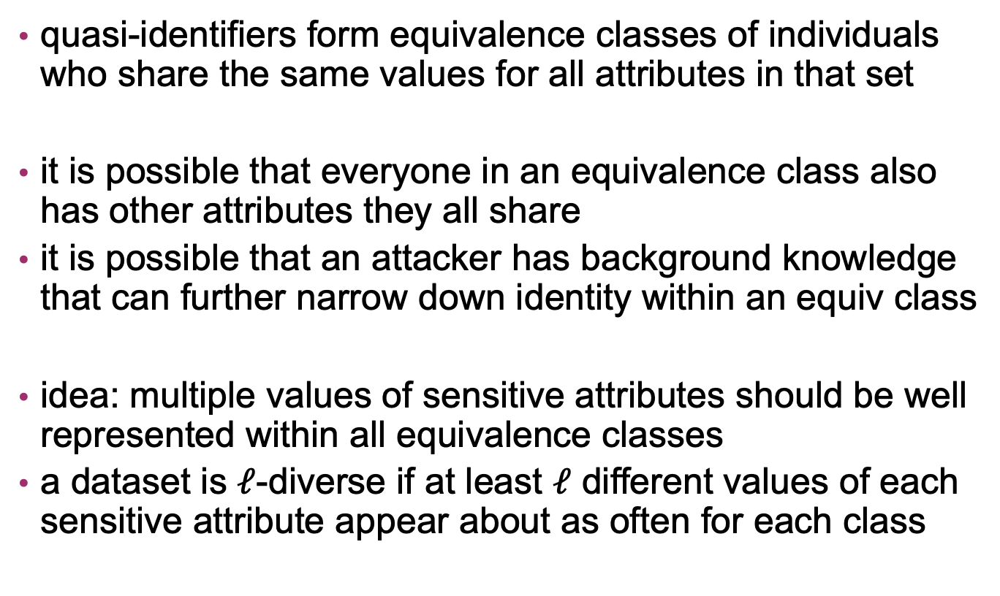
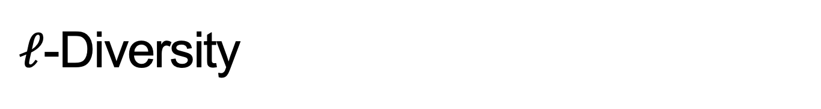
$ℓ$-Diversity
quasi-identifiers form equivalence classes of individuals who share the same values for all attributes in that set
it is possible that everyone in an equivalence class also has other attributes they all share
it is possible that an attacker has background knowledge that can further narrow down identity within an equiv class
idea: multiple values of sensitive attributes should be well represented within all equivalence classes
a dataset is $ℓ$-diverse if at least $ℓ$ different values of each sensitive attribute appear about as often for each class

Slide 16
Key assumption: You can correctly identify quasi-identifiers

Slide 17

Case Study: AOL Search Records
AOL Research released 20,000,000 search queries for 650,000 users of AOL’s search engine (3 months)
Suppressed AOL username and IP address
  Replaced them with unique, pseudonymous identifiers

Slide 18
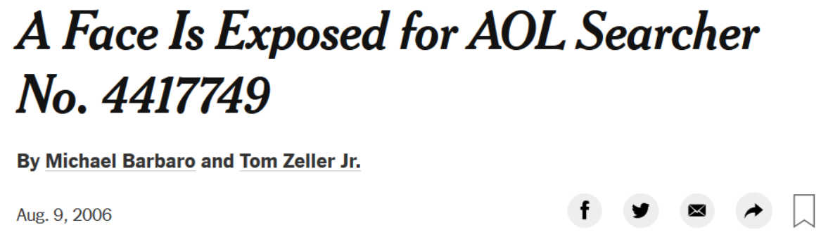
Case Study: AOL Search Records

Slide 19
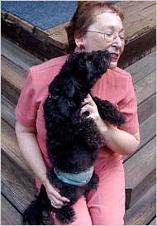
Case Study: AOL Search Records
User 4417749 example queries:
  ‘landscapers in Lilburn, Ga,’
  ‘homes sold in shadow lake subdivision gwinnett county georgia.’
  several people with the last name Arnold
Identified as Thelma Arnold, a 62-year-old from Lilburn, GA
Arnold acknowledged authoring the searches, including some “mildly embarrassing”
  ‘numb fingers,’
  ‘60 single men’
  ‘dog that urinates on everything’

Slide 20

Case Study: Netflix Prize Data
Netflix released 100,000,000 records from 500,000 users • December 1999 to December 2005
• Assigned a unique pseudonymous identifier to each user
Each record included the pseudonymous identifier, the movie watched, the rating (1-5 stars), and rating’s date

Slide 21
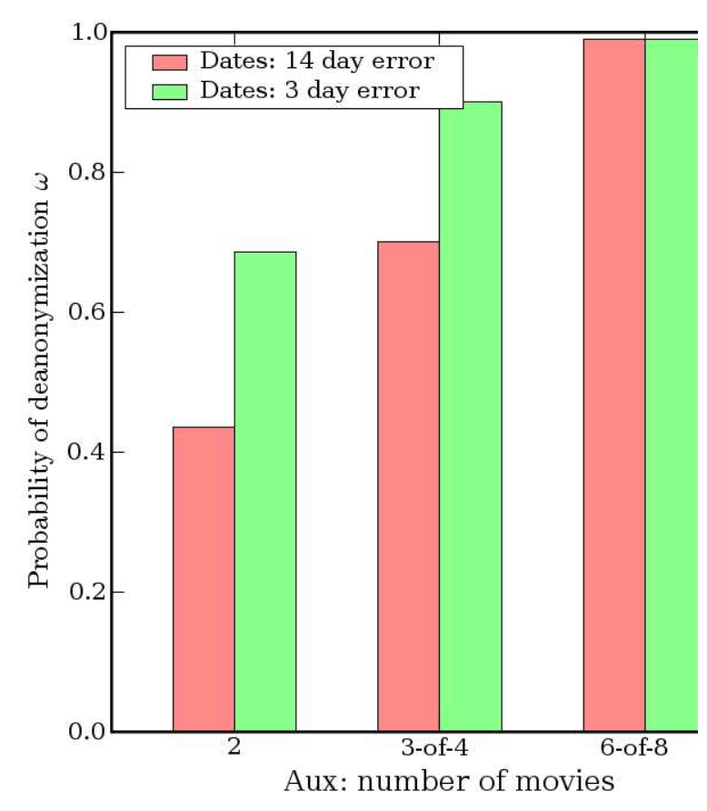
Case Study: Netflix Prize Data
used IMBD ratings as external information
defined two ratings to be similar if both the numeric rating and the date were within a threshold
quantified similarity between two records as the number of similar ratings divided by the total number of movies rated in the union of the two records

Slide 22
Why is anonymization so hard?
Personal data showing up in unexpected places
Errors suppressing data
Thinking only about personal data / PII is not sufficient
It’s hard to reason about what is/is not identifiable
Availability of auxiliary information
  Extremely hard to control

