Slide 1
Lecture 2: Intro to Privacy
CS 181E Fall 2026

Slide 2
What is Privacy?
Notes:
discuss
Privacy as confidentiality
Nissenbaum (contextual integrity)

Slide 3
Exercise: What does Privacy Mean to You?
Draw a picture that represent privacy to you
Or feel free to jot down some words, phrases, or a poem
Notes:
This activity + the example drawings & related slides (through the Westin quote) are based on Lorrie Cranor's UPS course from Spring 2022 (Lecture 3: Intro to Privacy).

Slide 4
http://cups.cs.cmu.edu/privacyillustrated/

Slide 5
Being left alone
“Being alone.”
– Shane, age 4
Privacy is being by myself.
– Emma, age 5
Privacy is the right to be by yourself. Privacy is isolation.
– Kevin, age 28
Notes:
houses, doors, bathrooms are common imagery

Slide 6
Personal Bubble
Privacy for me is like a place with a one-sided mirror. I can see outside but no one can see in unless I open the door. Also an extra wall on the outside just in case.
– Kim, age 21

Slide 7
Private Spaces
Your room is private.
– Alexia, age 11
No one come in when I am in the bathroom!
– Sydney, age 7

Slide 8
"The Right to Privacy" (1890)
Right to be left alone
Some data is private
Notes:
Louis Brandeis was an American lawyer and Supreme Court justice, also a leader of the progressive party
With his law partner Samual Warren, influential early writer on privacy law, including "The Right to Privacy" [Harvard Law Review, 1890], which developed the idea of a right to be left alone, and a right to control private data.
John Harlan (supreme court justice) outlined a two-prong test for a "reasonable expectation of privacy" in his concurrence to Katz v. United States (1967) to identify when laws or behaviors violated fourth amendment protections.
Update: Carpenter v. United States http://www.scotusblog.com/2018/06/opinion-analysis-court-holds-that-police-will-generally-need-a-warrant-for-cellphone-location-information/

Slide 9
Sensitive Data Today
GDPR
CCPA
“personally-identifiable data”
sensitive data is a specific set of “special categories”:
  Genetic data
  Political opinions
  Racial or ethnic origin
  Data concerning health
  Trade union membership
  Religious or philosophical beliefs
  Data concerning sex life or sexual orientation
  Biometric data
Extra restrictions on processing
“Personal information”
“Sensitive personal information” means:
  ID numbers (SSN, license number, etc)
  financial info or credentials.
  precise geolocation.
  racial or ethnic origin, citizenship or immigration status, religious or philosophical beliefs, or union membership.
  contents of mail, email, and text messages
  genetic data.
  neural data.
  biometric information
  health data
  data about sex life or sexual orientation.

Slide 10
Freedom from Surveillance
“To me privacy means being able to get away from unwanted eyes.”

Slide 11
Katz v. United States (1967)
“Because the Fourth Amendment protects people, rather than places, its reach cannot turn on the presence or absence of a physical intrusion into any given enclosure”
“reasonable expectation of privacy”

Slide 12
Exercise: Reasonable expectation of privacy
In-person conversations
Phone records (who you talk to, for how long, etc)
Phone conversations (actual content)
Emails/DMs
Bank Records
Things you put out in the trash/recycling
Your DNA
Your GPS location
Notes:
Informant wire: United States v. White (1971)
Wiretaps: Olmstead v. US (1928) -> Katz v US (1967)
Phone records: Smith v. Maryland (1979) -> “third party doctrine”
Emails: US v Warshak (2010), subsequent laws
Bank Records: US v Miller (1976) -> “third party doctrine”
Trash: California v Greenwood (1988) -> “discarded”
DNA: Lots of state cases, Minnesota v. Westrom (??)
GPS: Carpenter v. US (2018)

Slide 13
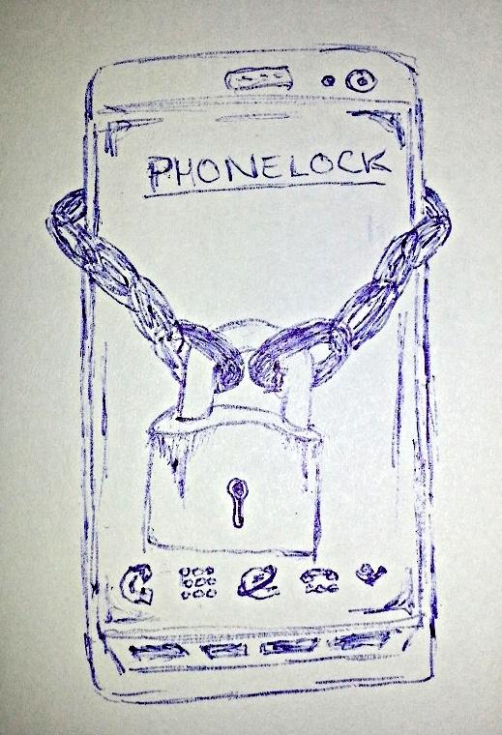
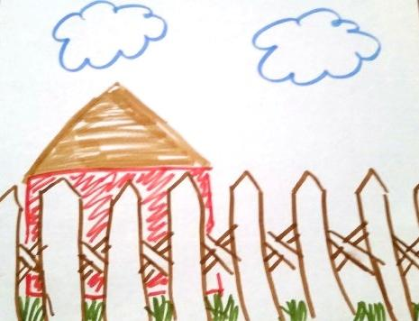
Locks and Barriers

Slide 14
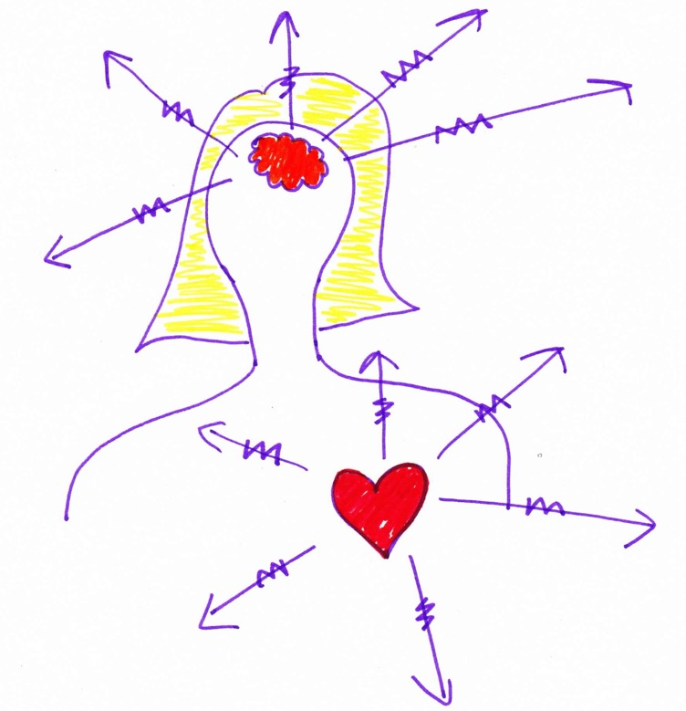
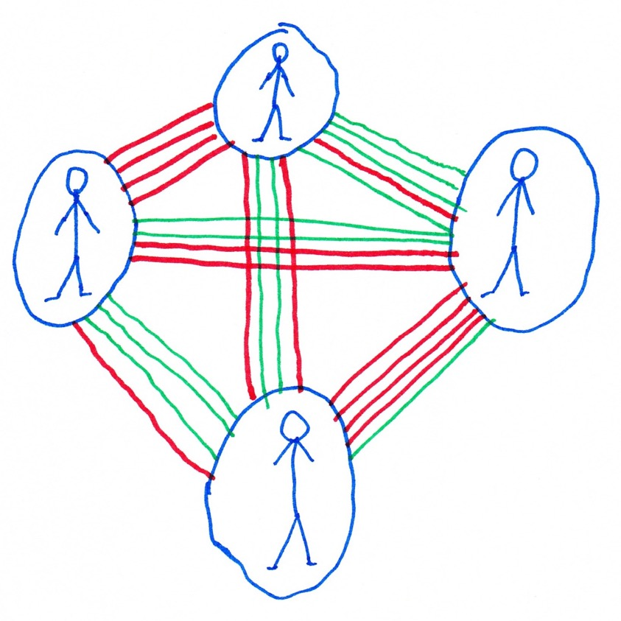
Privacy as Control
Privacy is about control – controlling what is shared about your thoughts and preferences, the things that make you you.
– KRB, age 39
Privacy is a network: I share what I want with whom I want and trust and what matches with those in the network….
Green = share.
Red = don't.

Slide 15
Privacy and Freedom (1967)
Privacy is the claim of individuals, groups or institutions to determine for themselves when, how, and to what extent information about them is communicated to others.
– Alan Westin
Notes:
Notice and consent

Slide 16
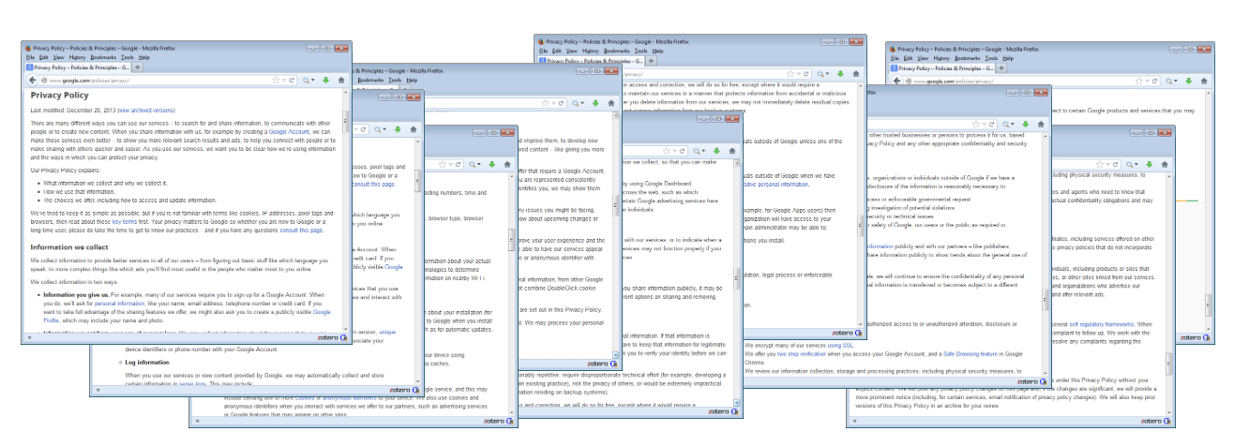
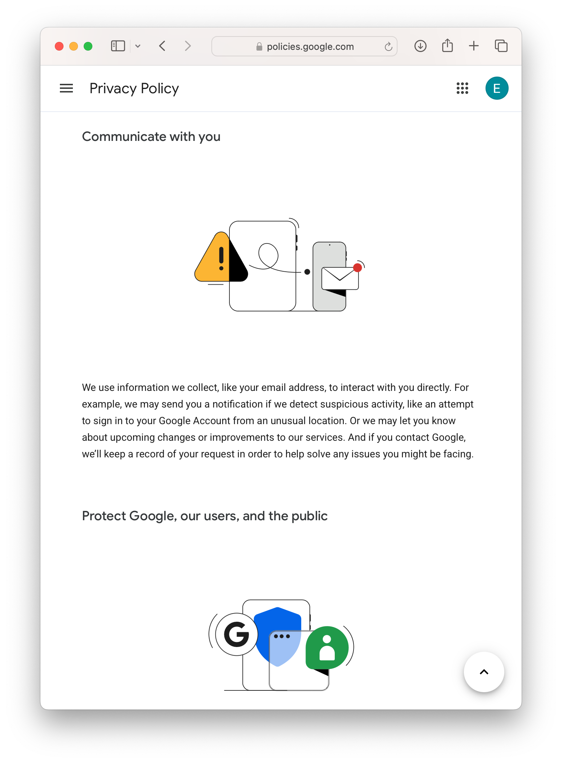
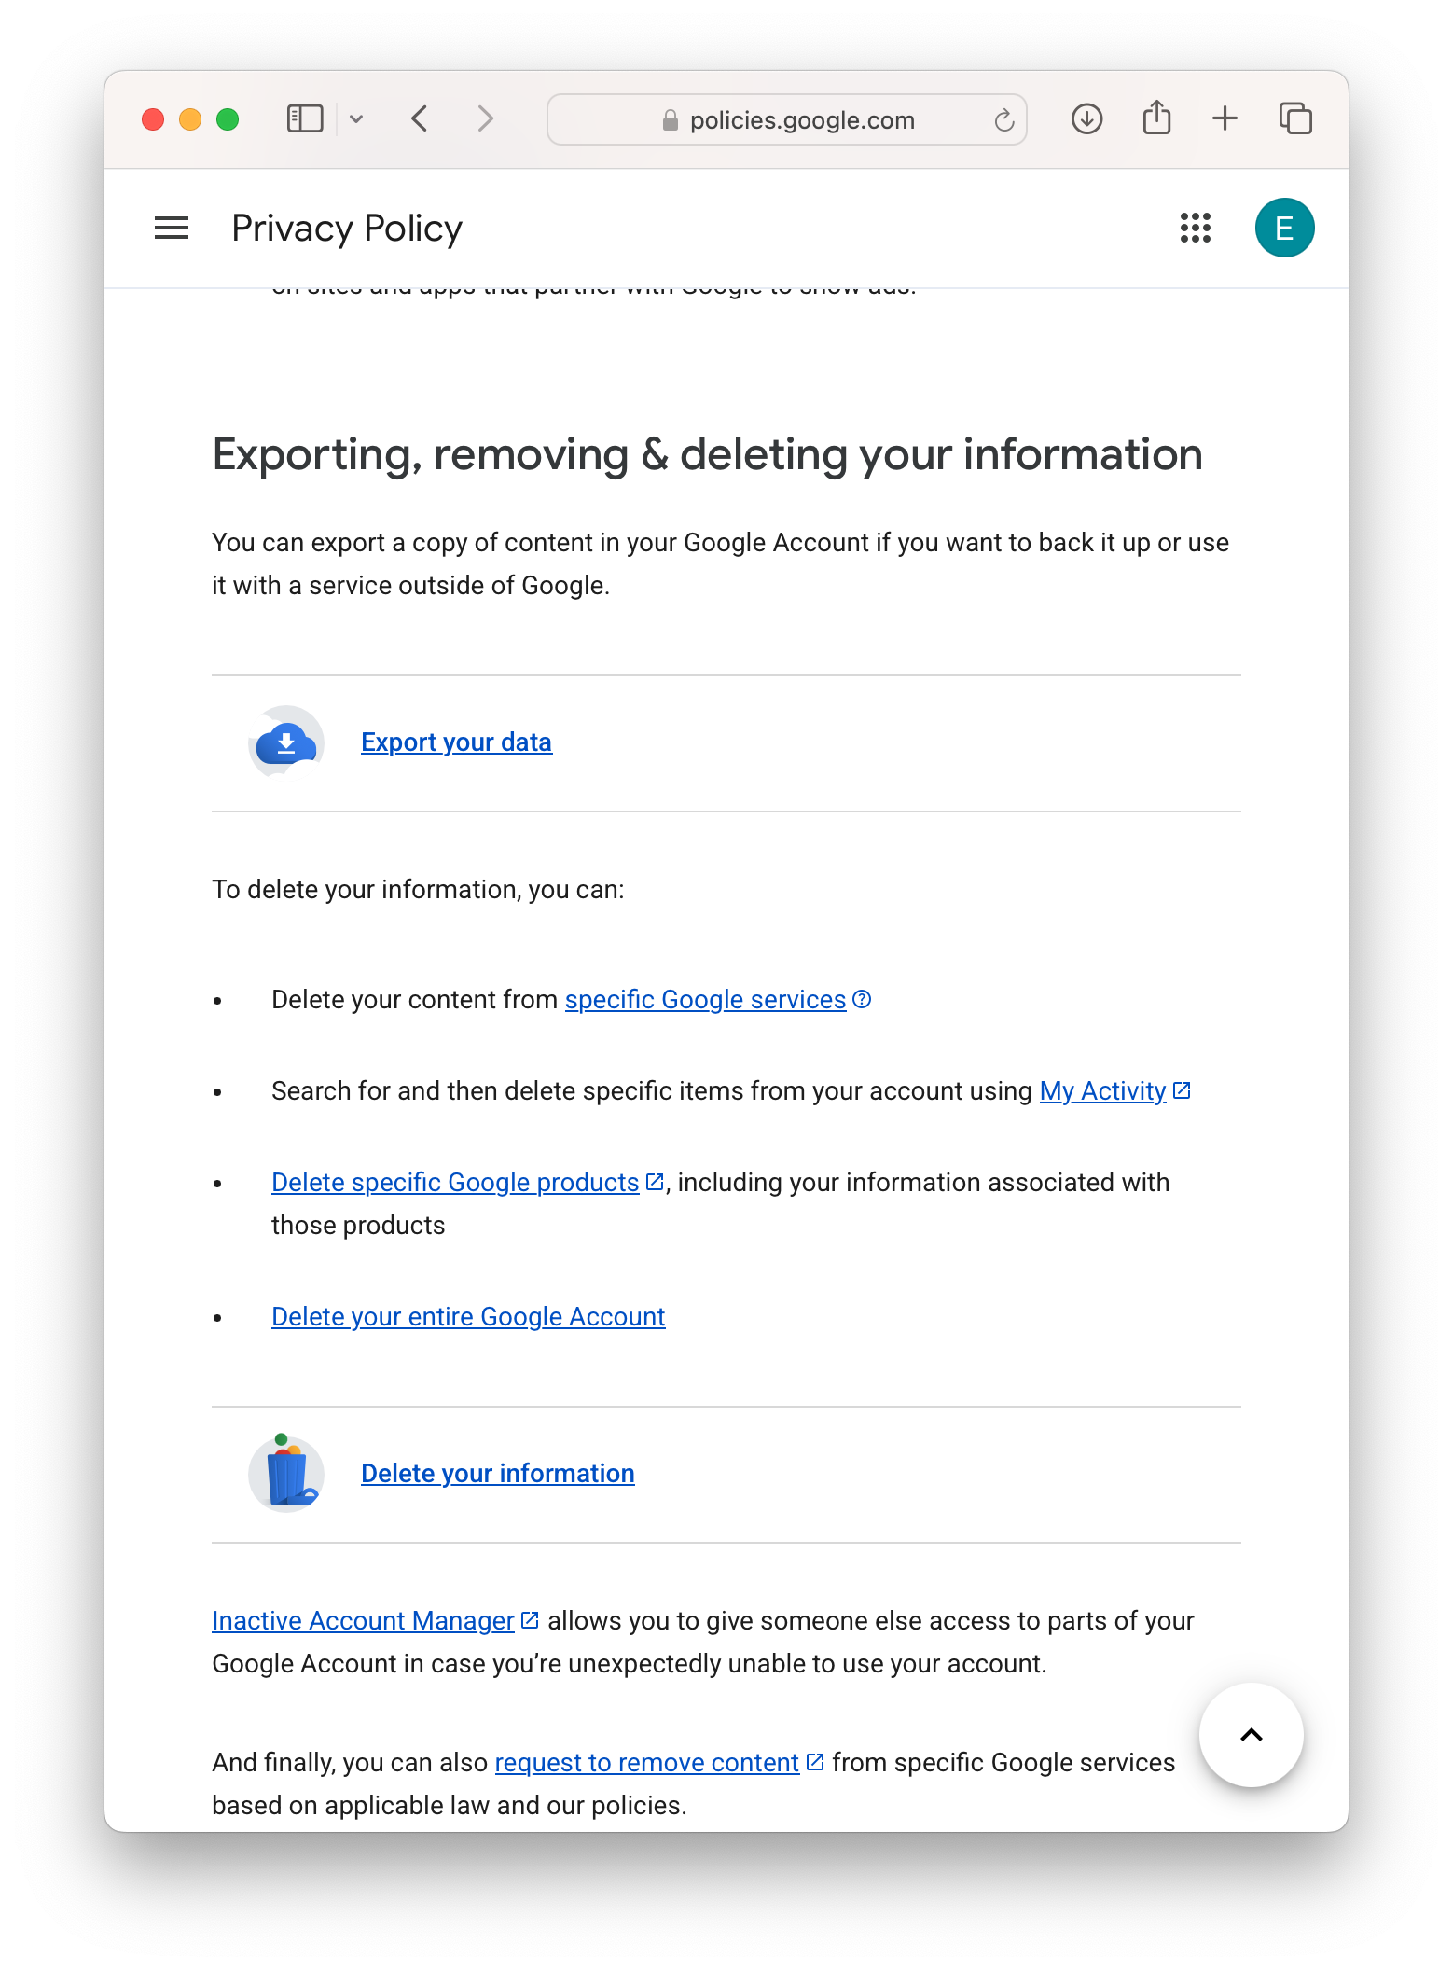
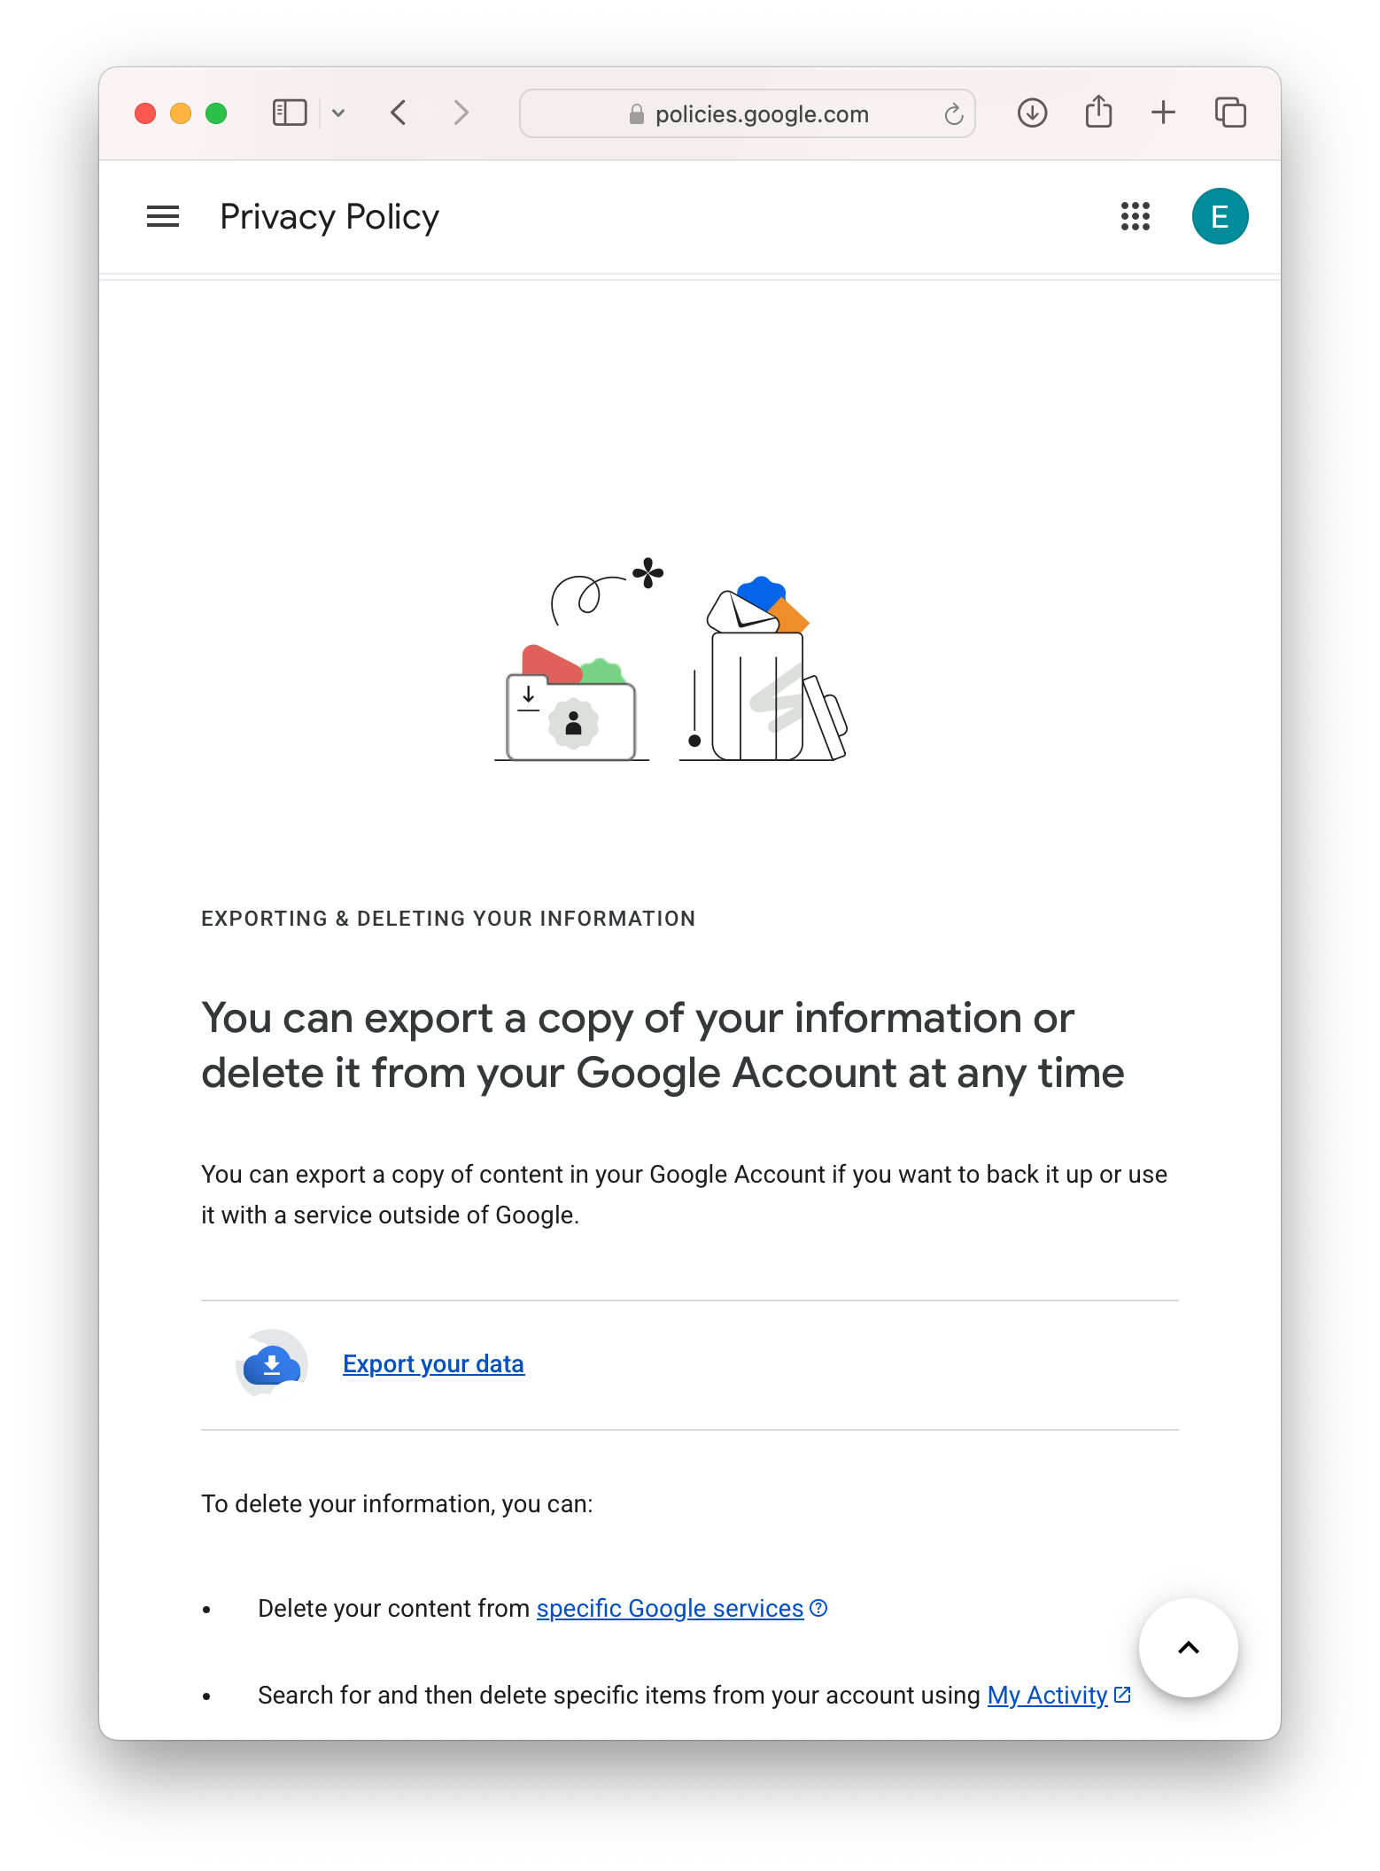
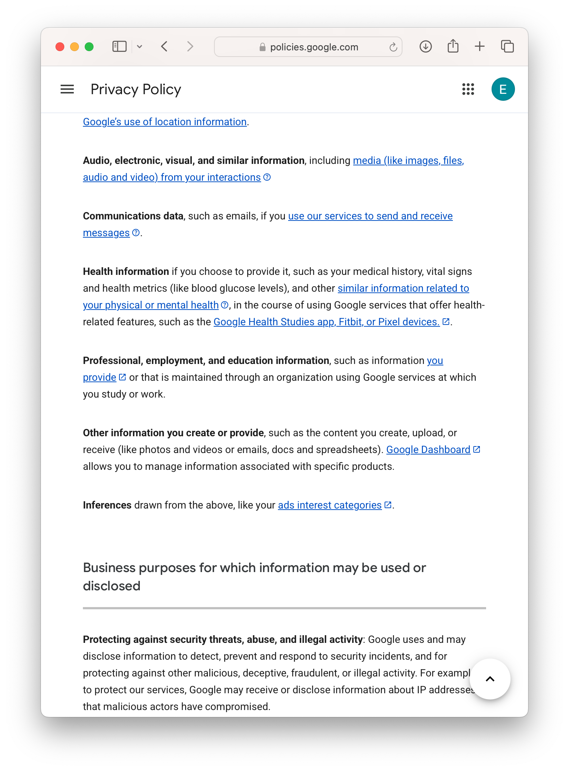
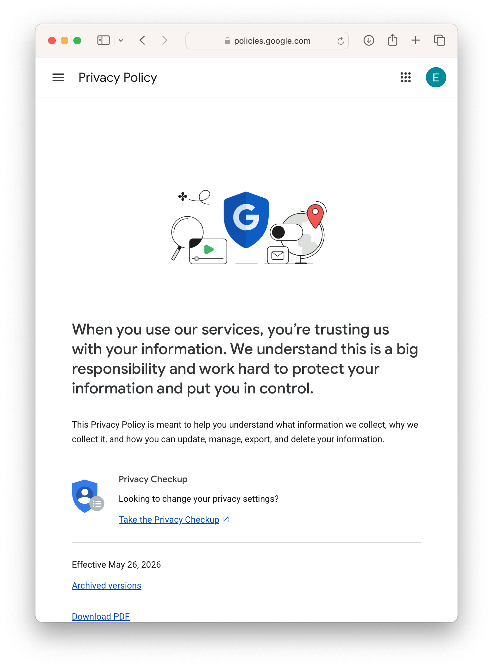
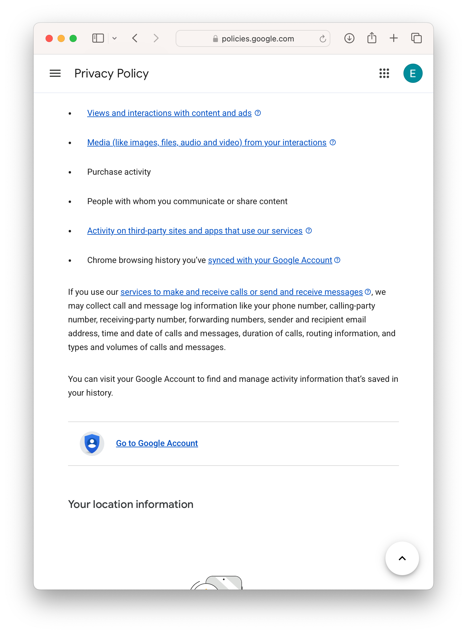
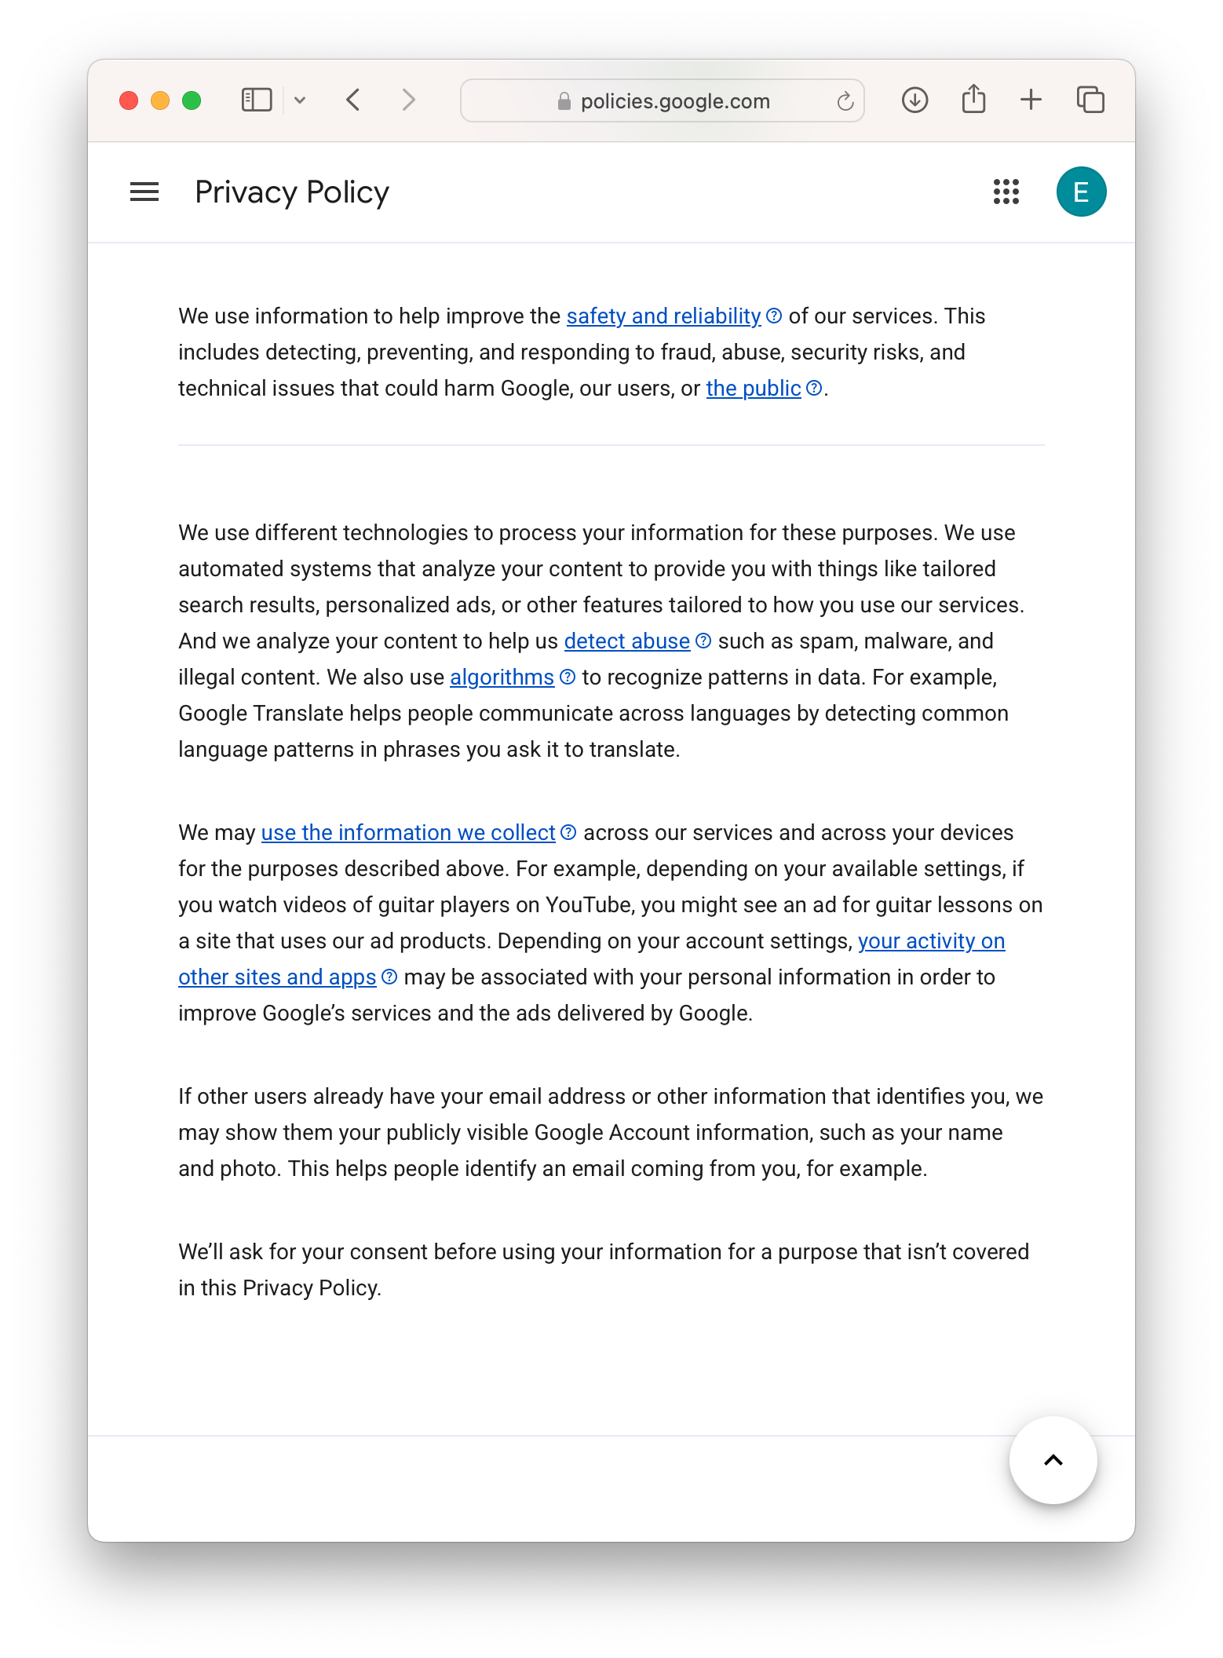
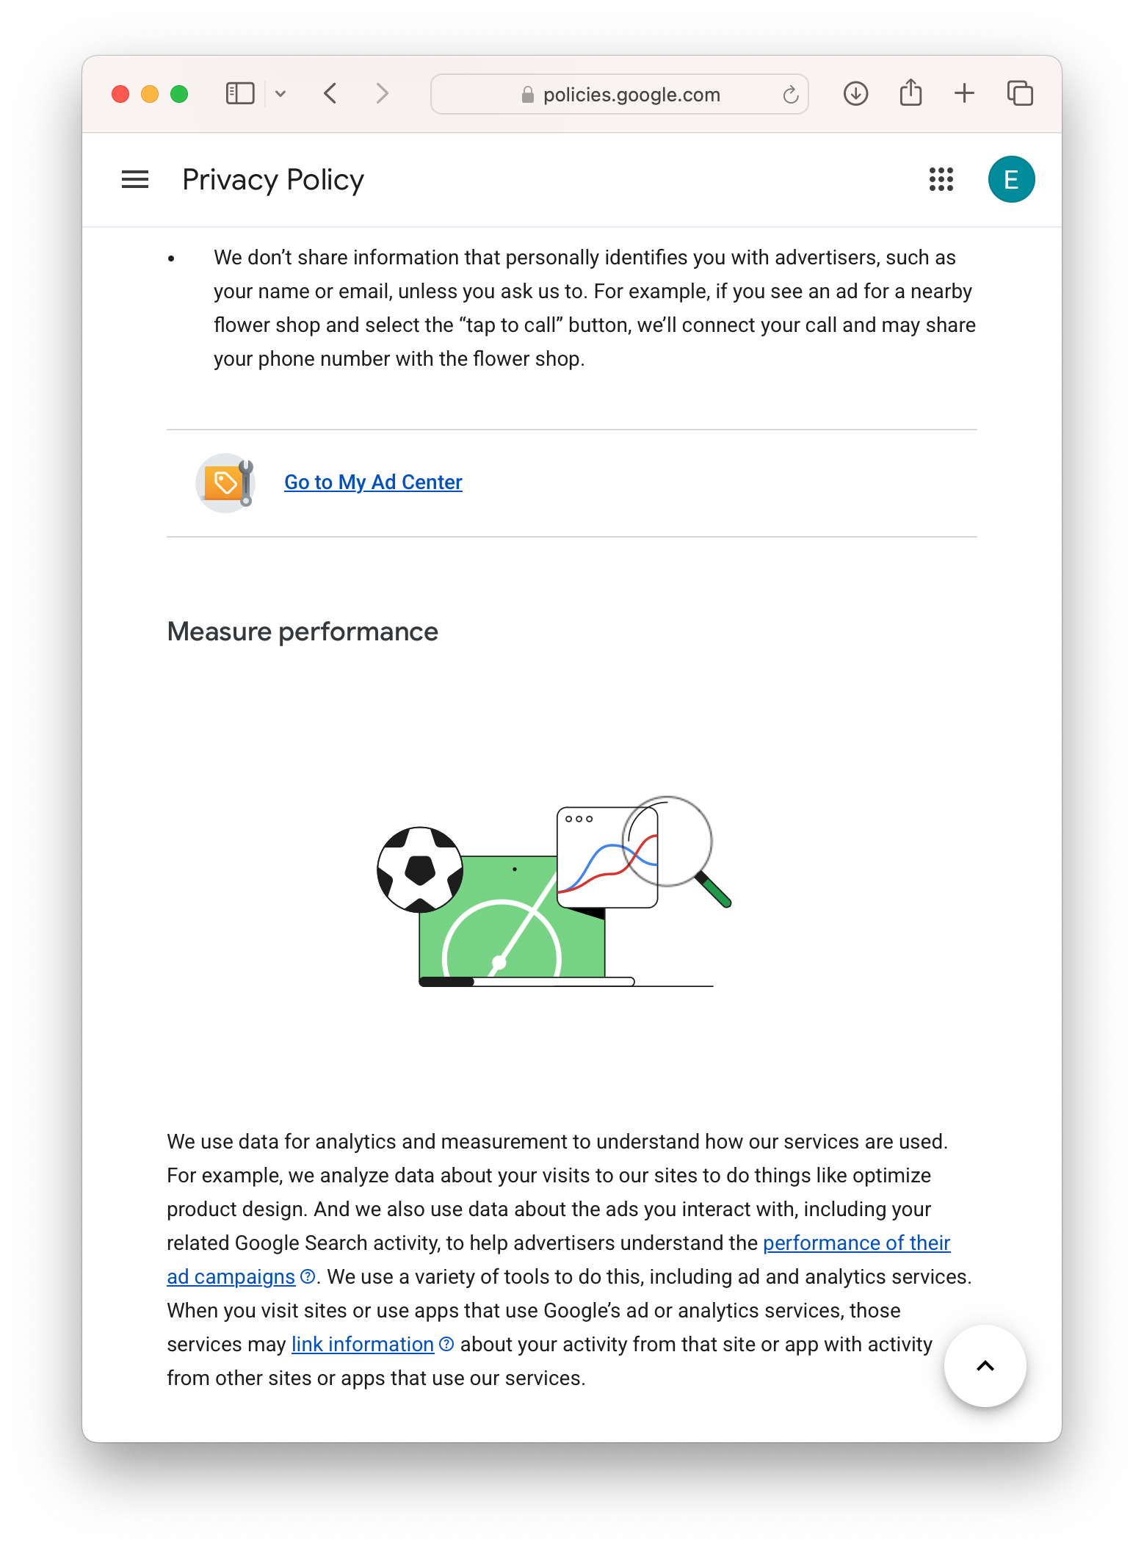
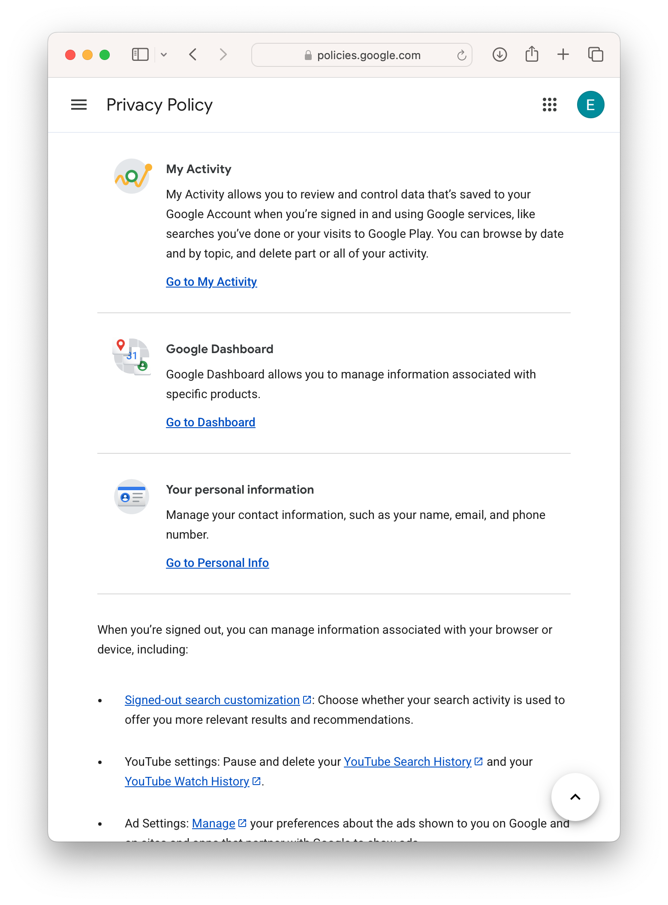
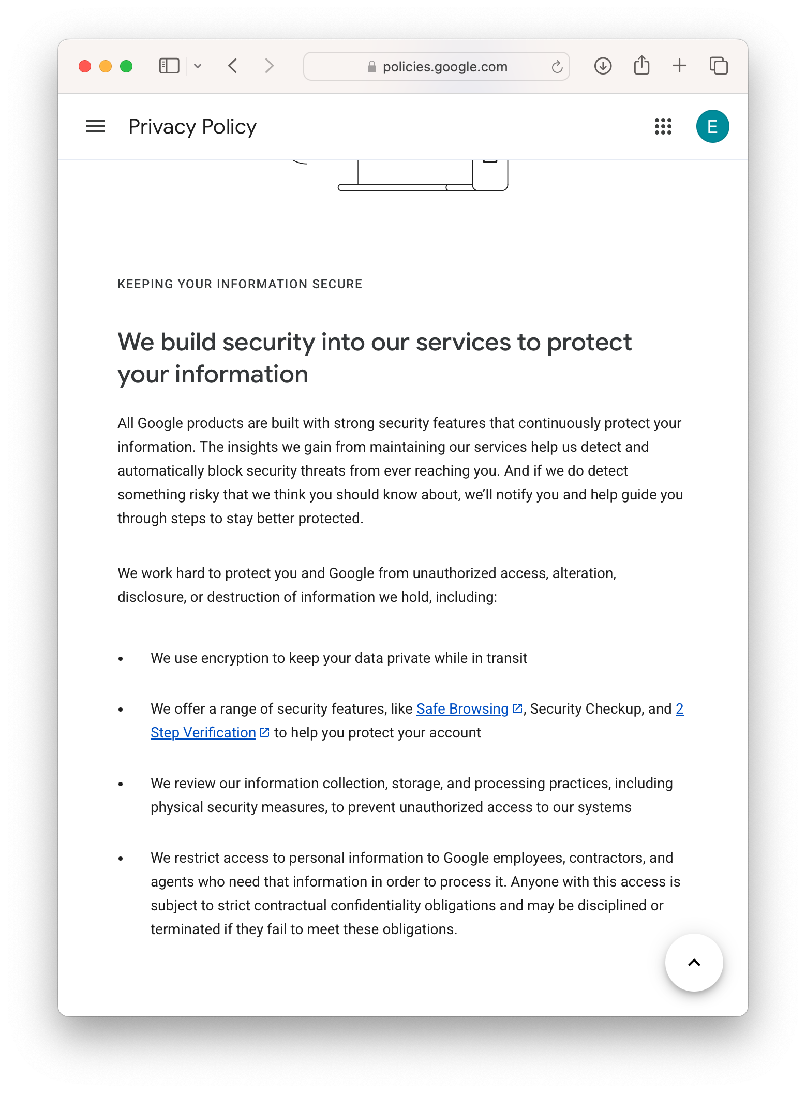
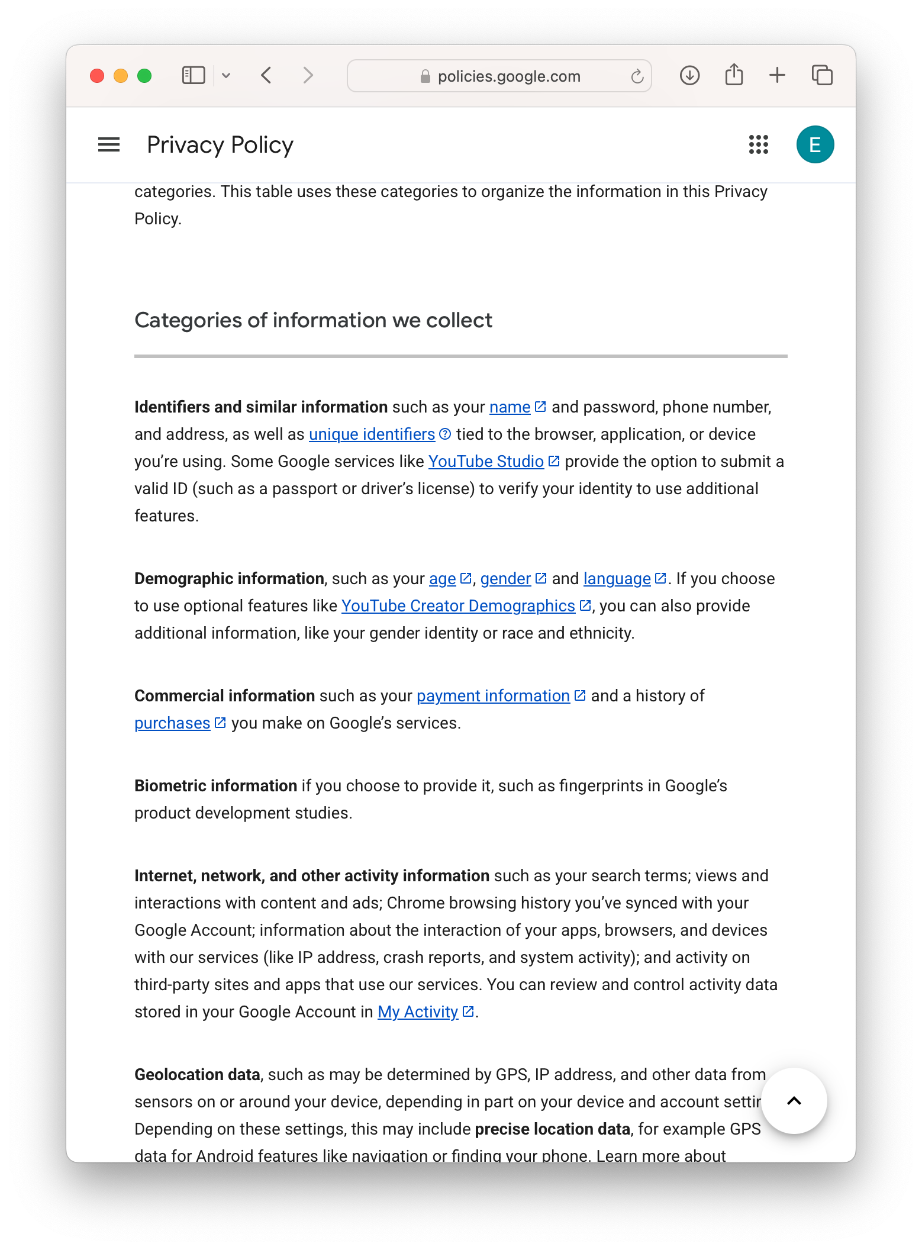
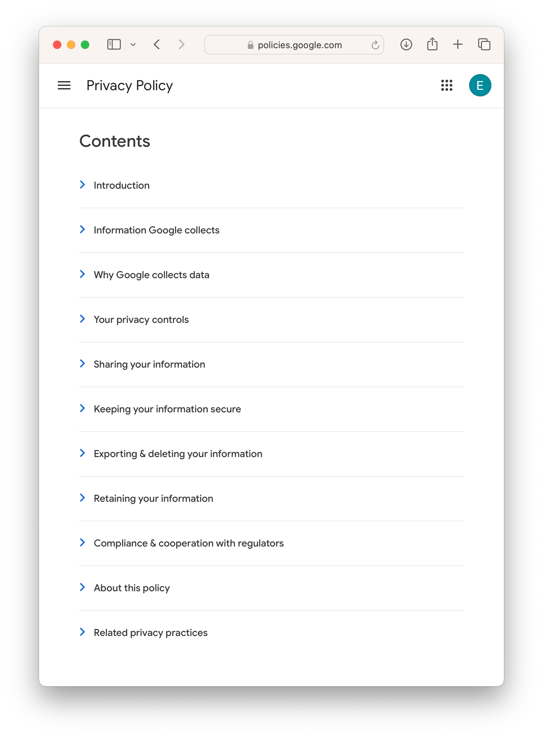
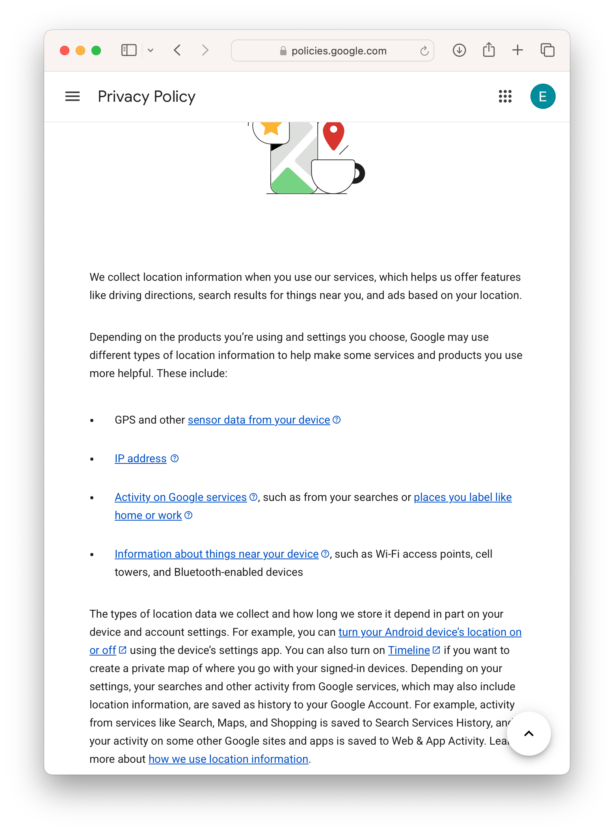
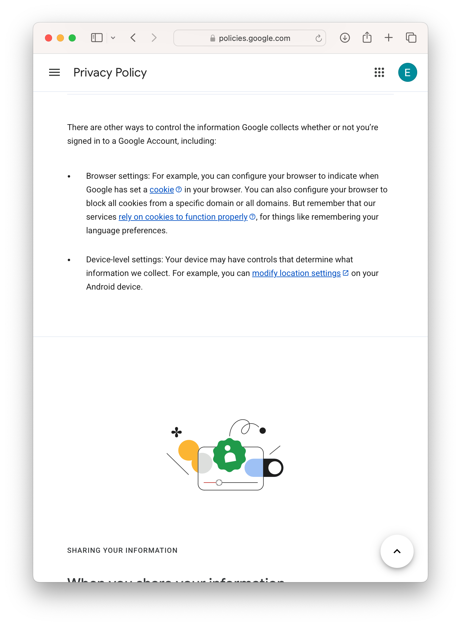
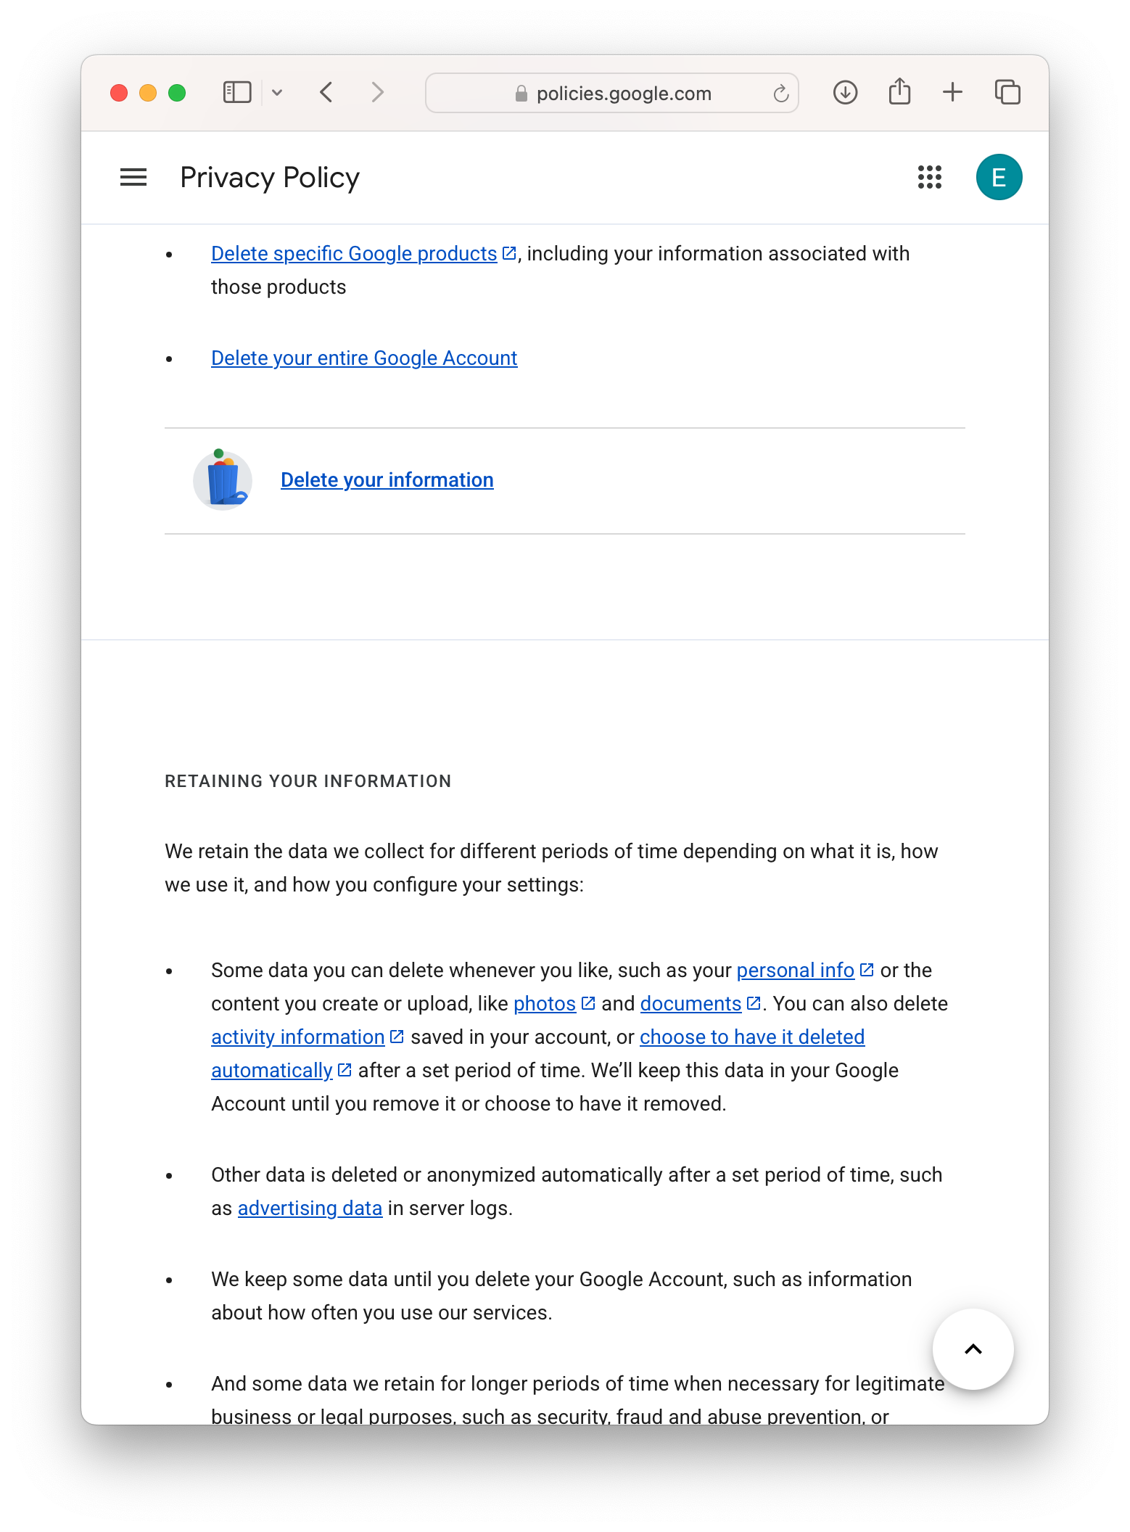
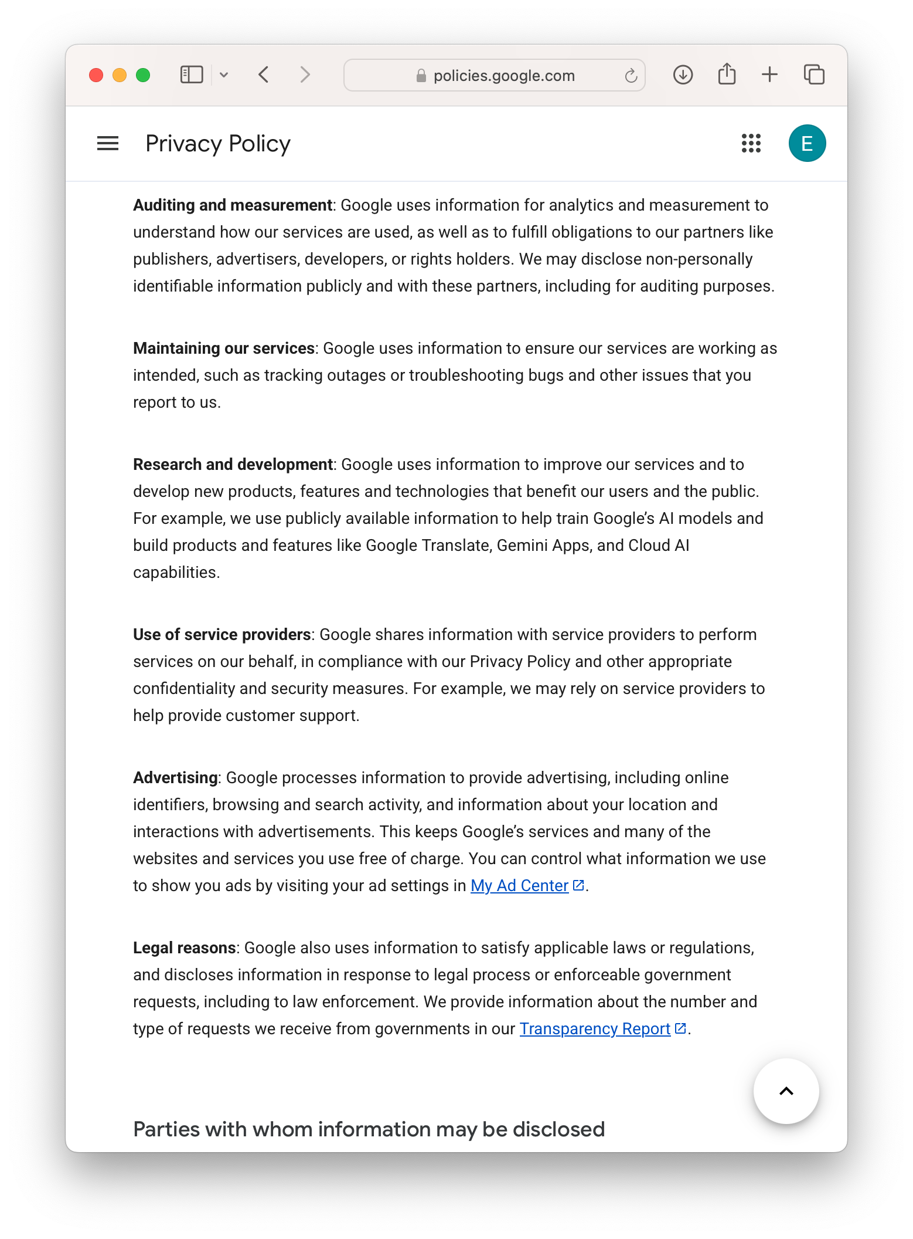
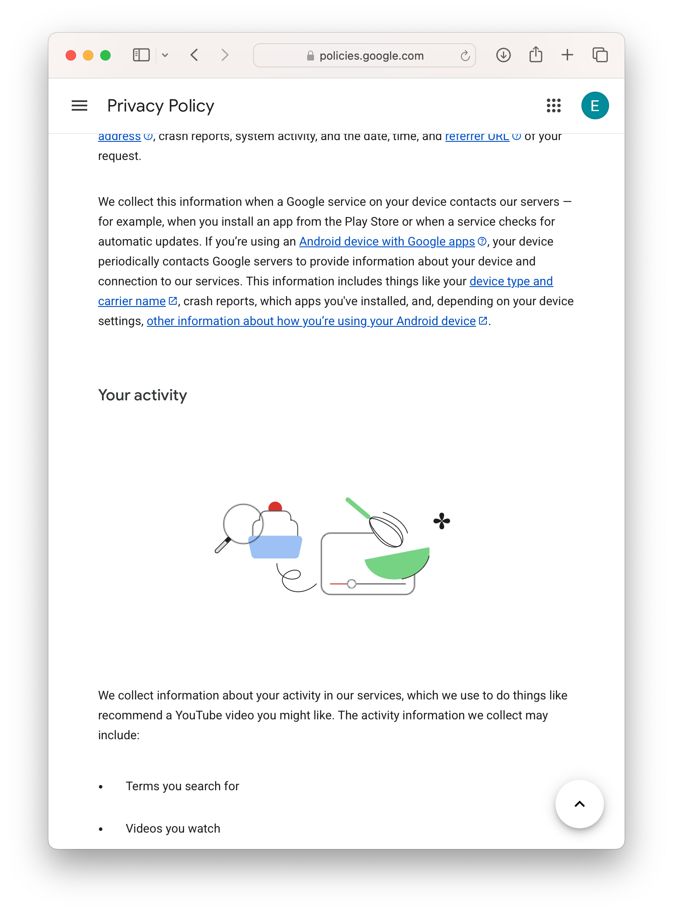
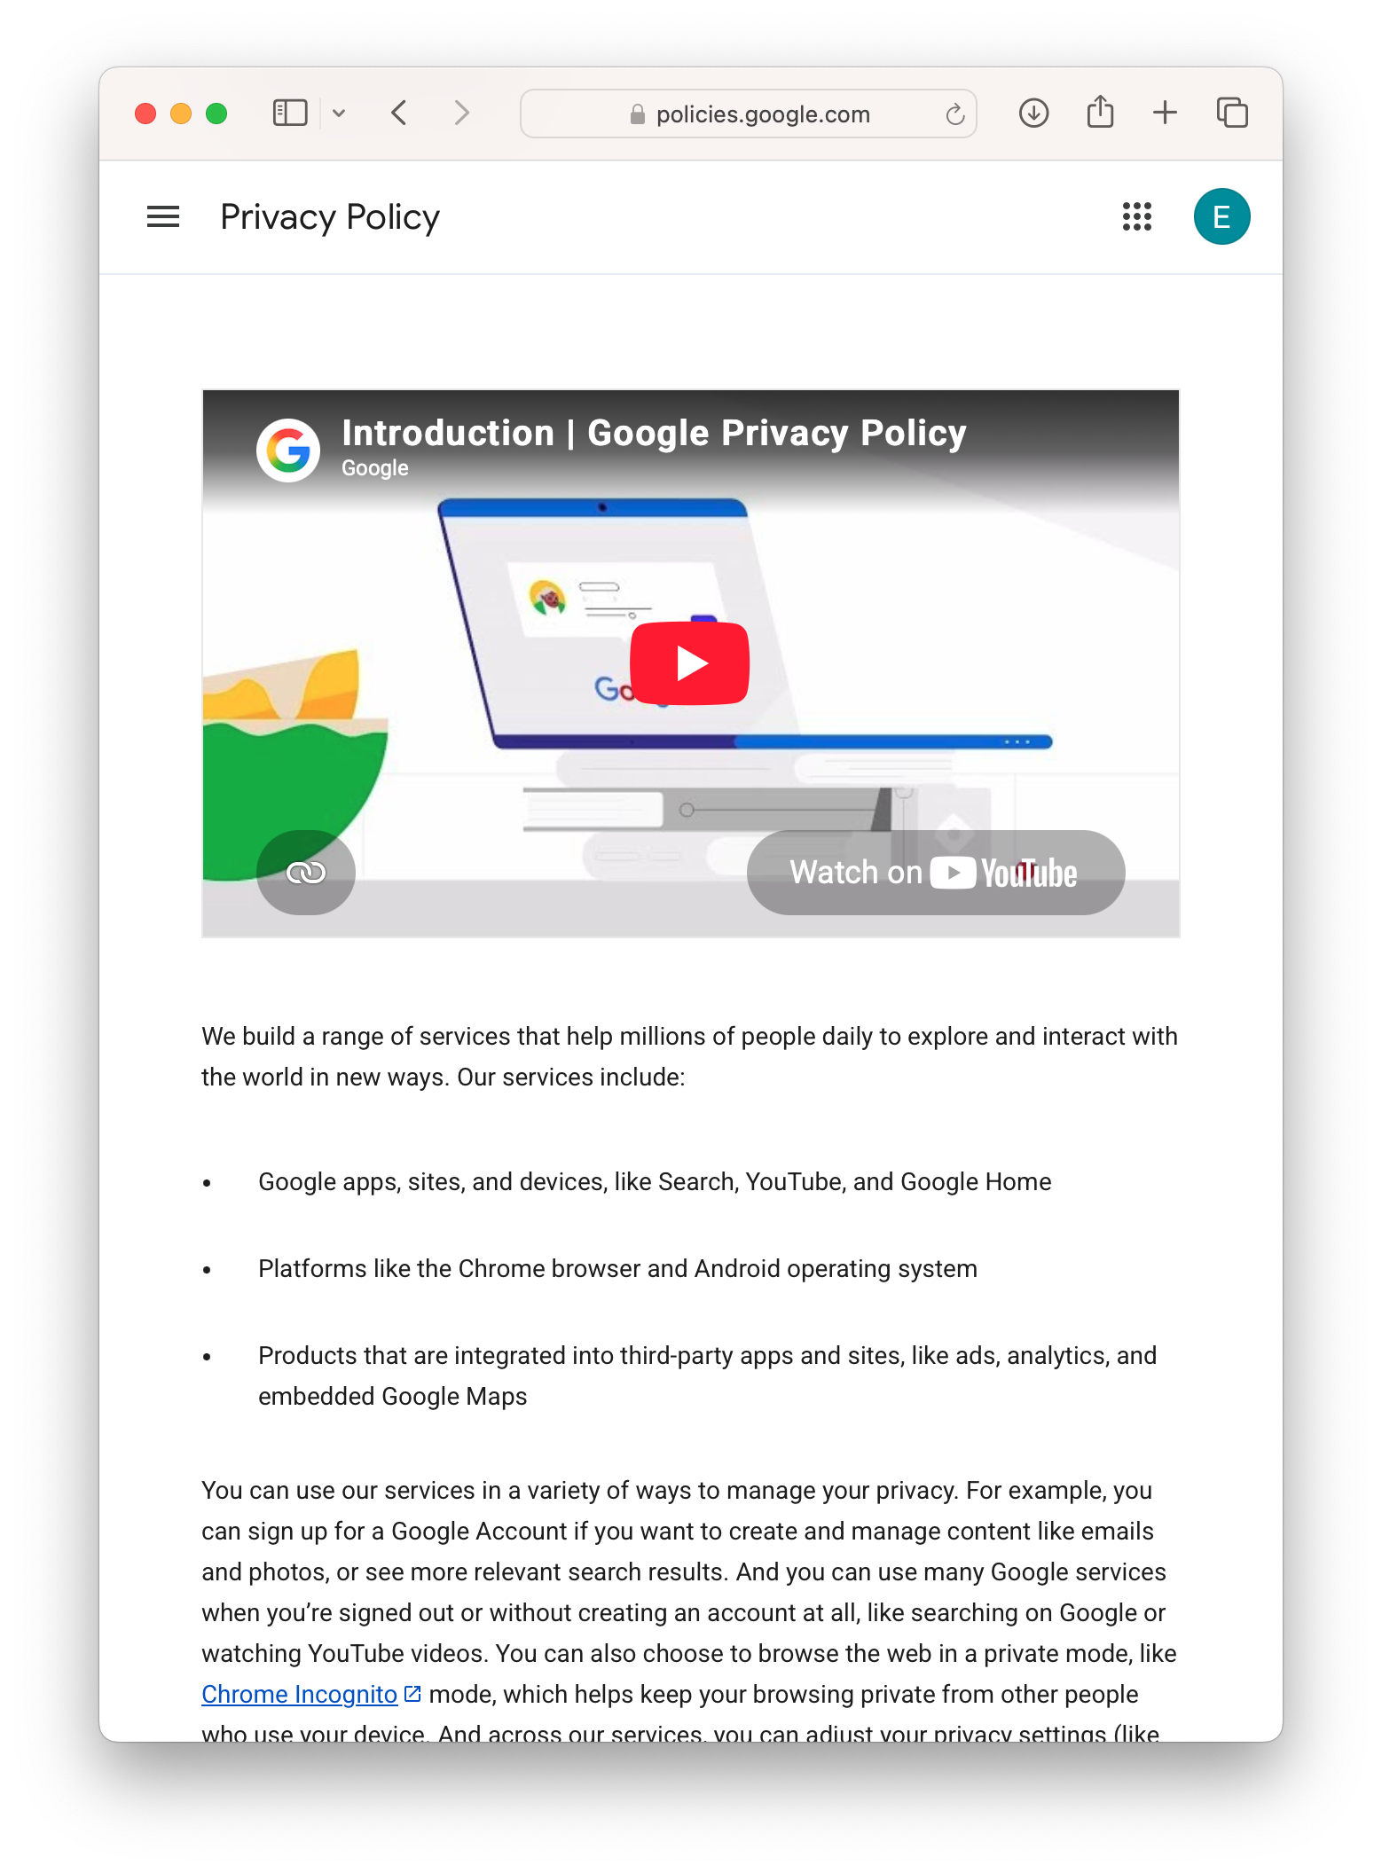
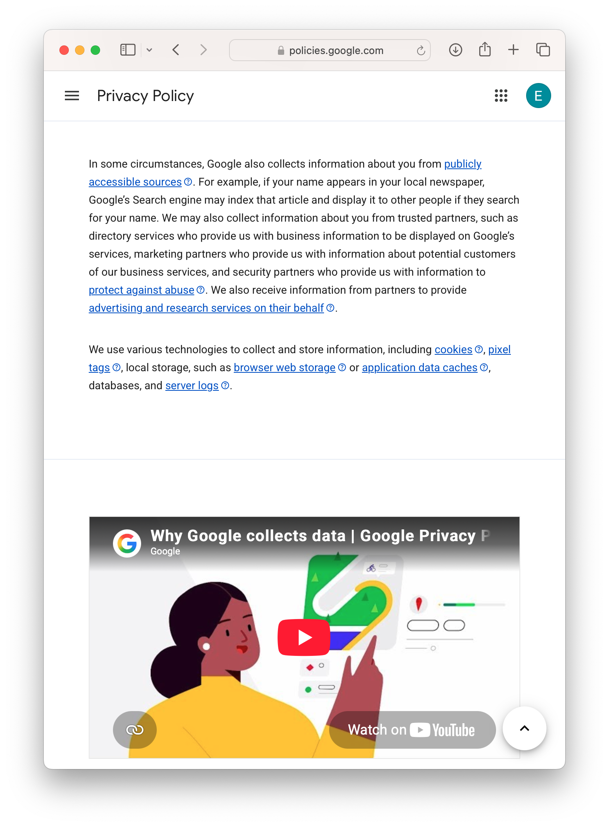
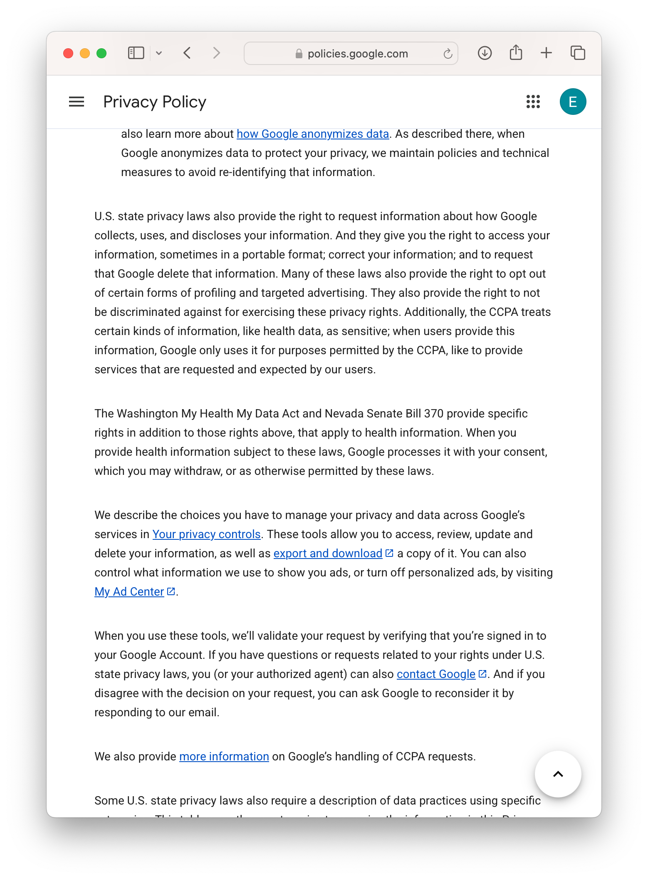
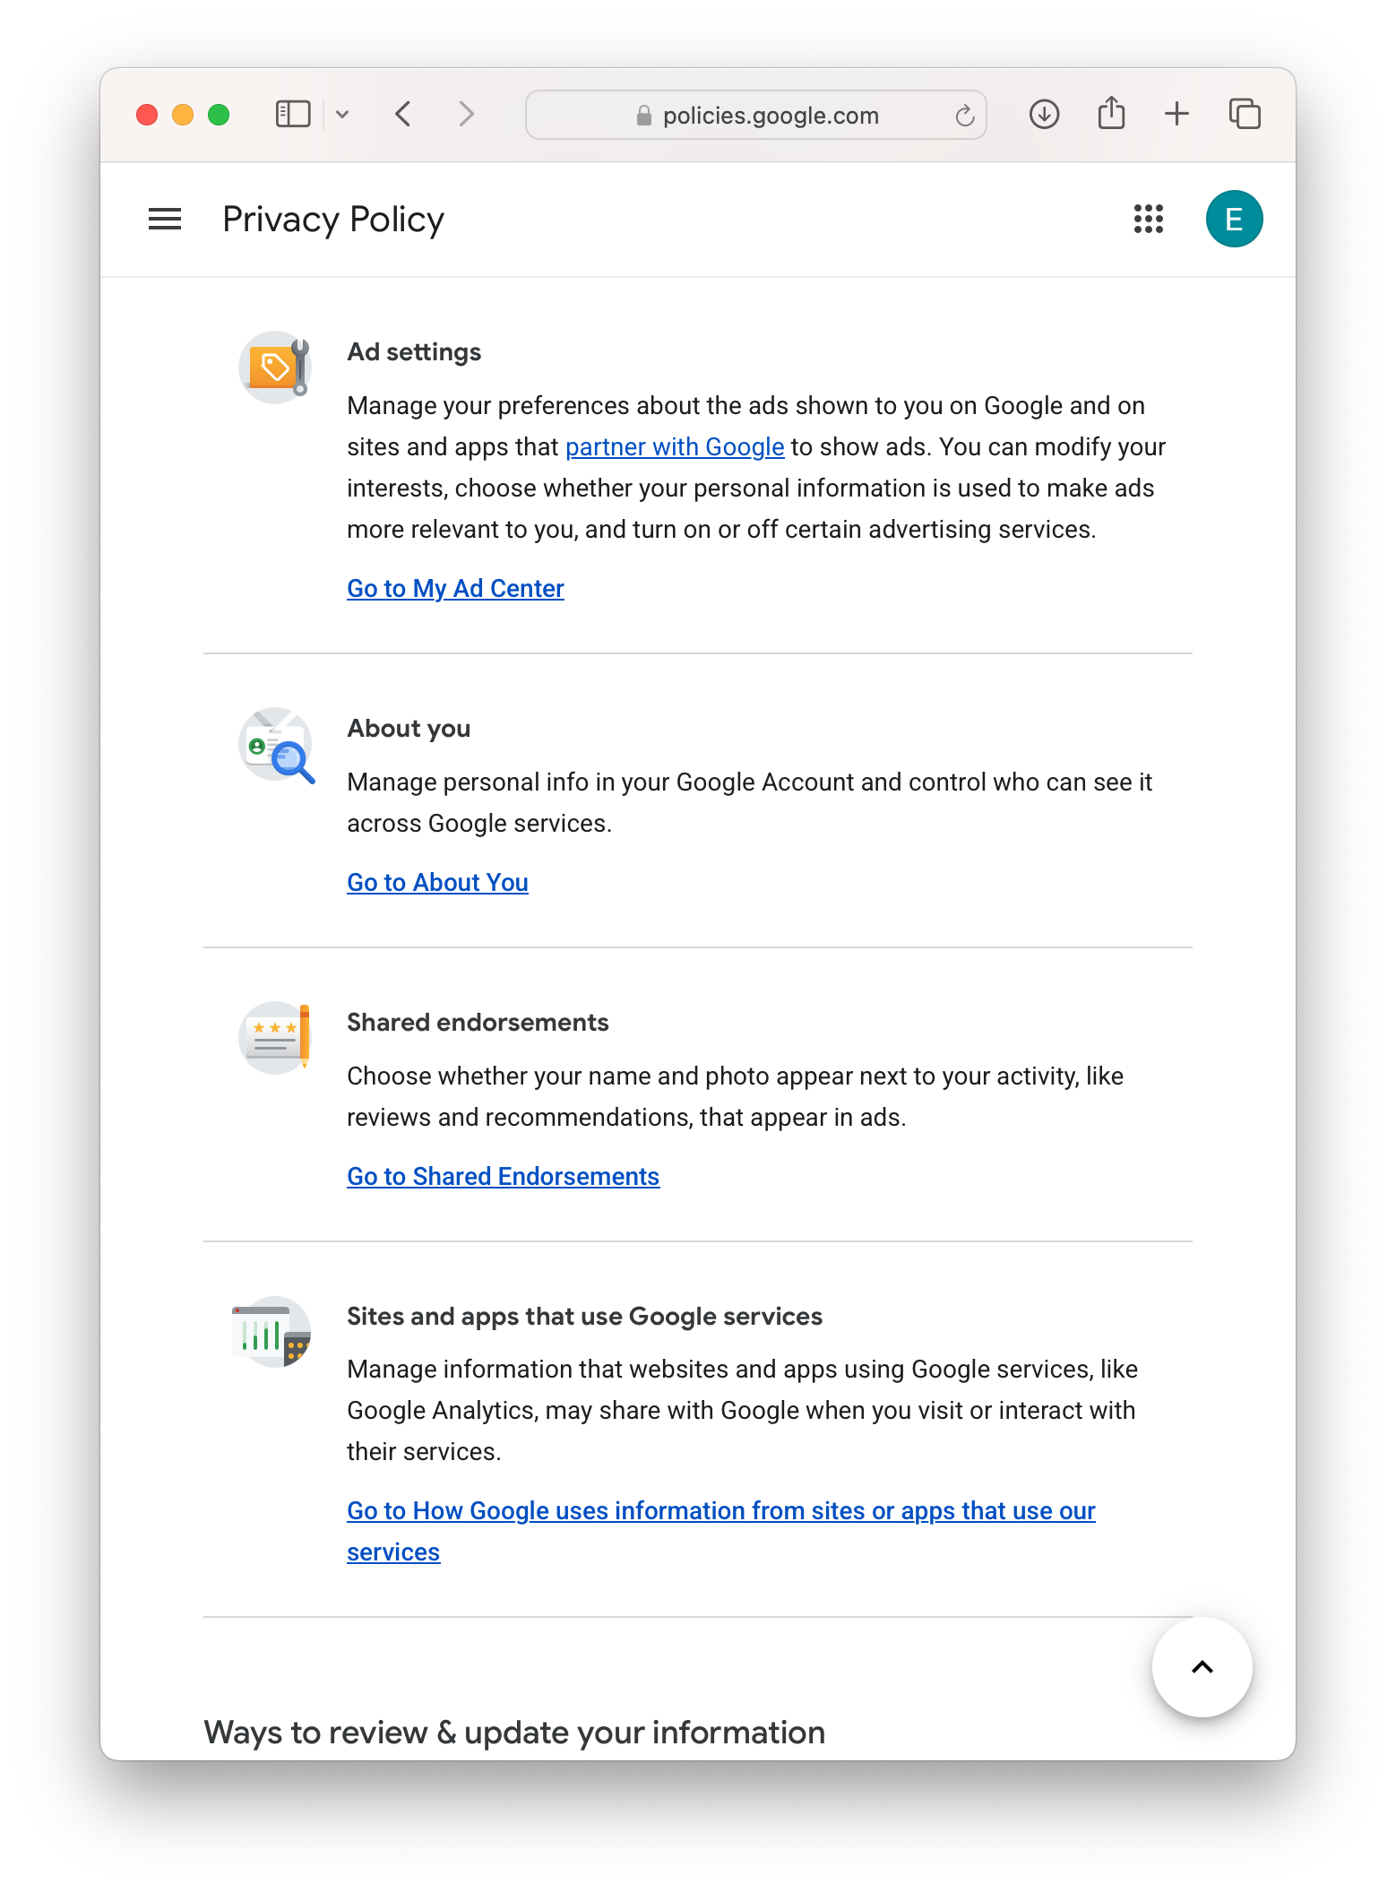
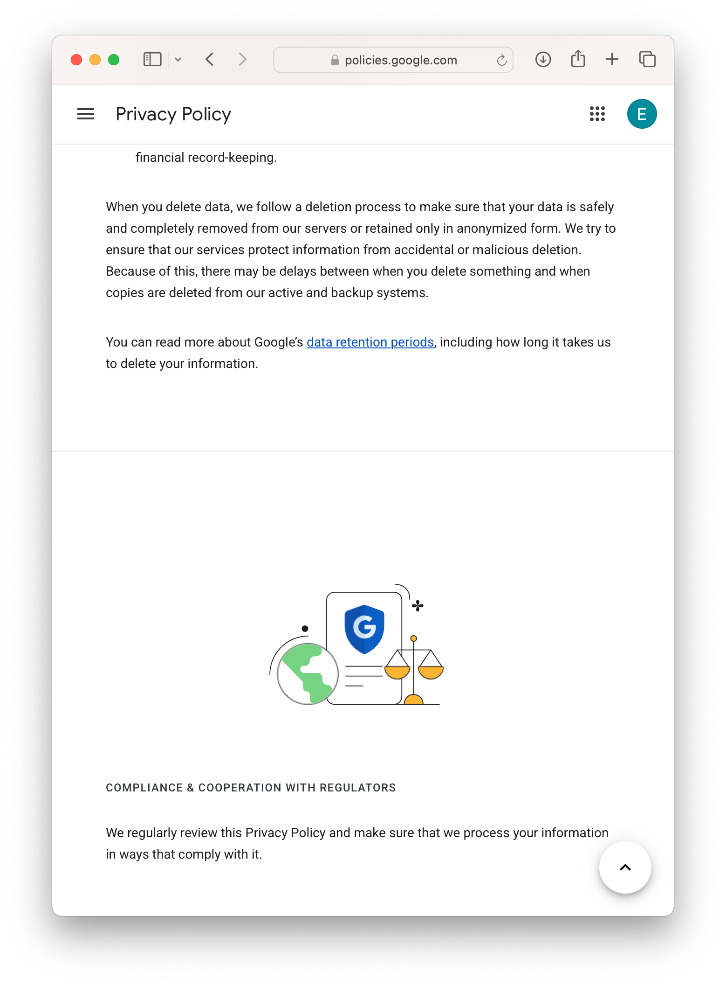
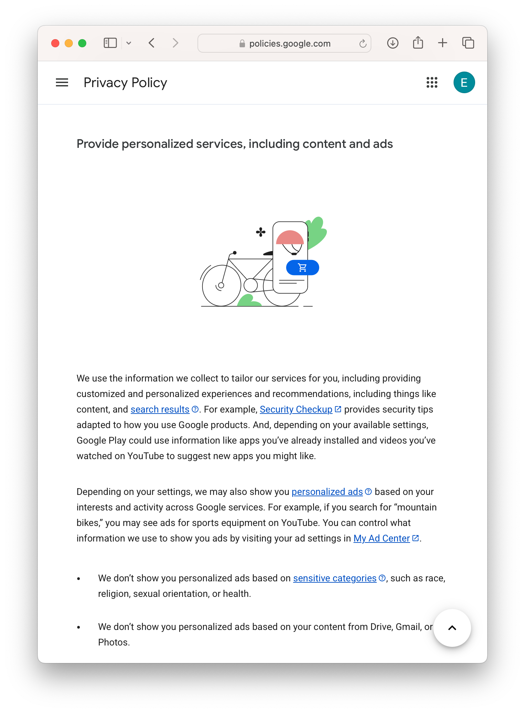
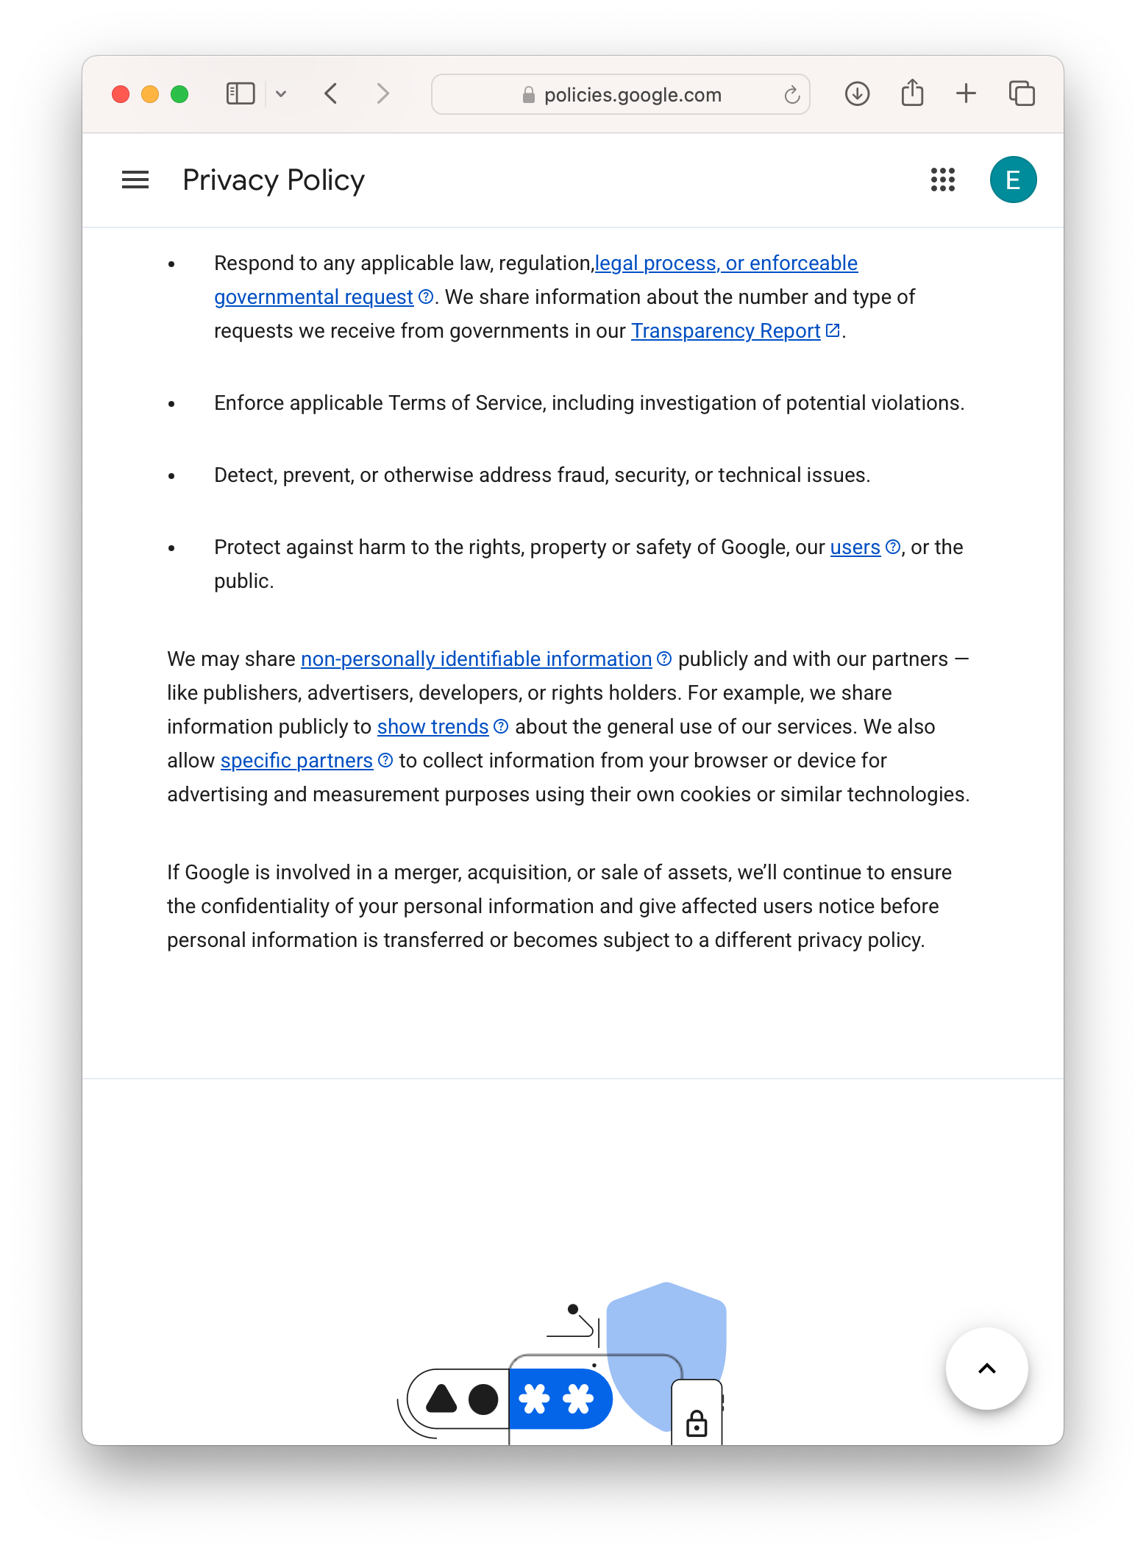
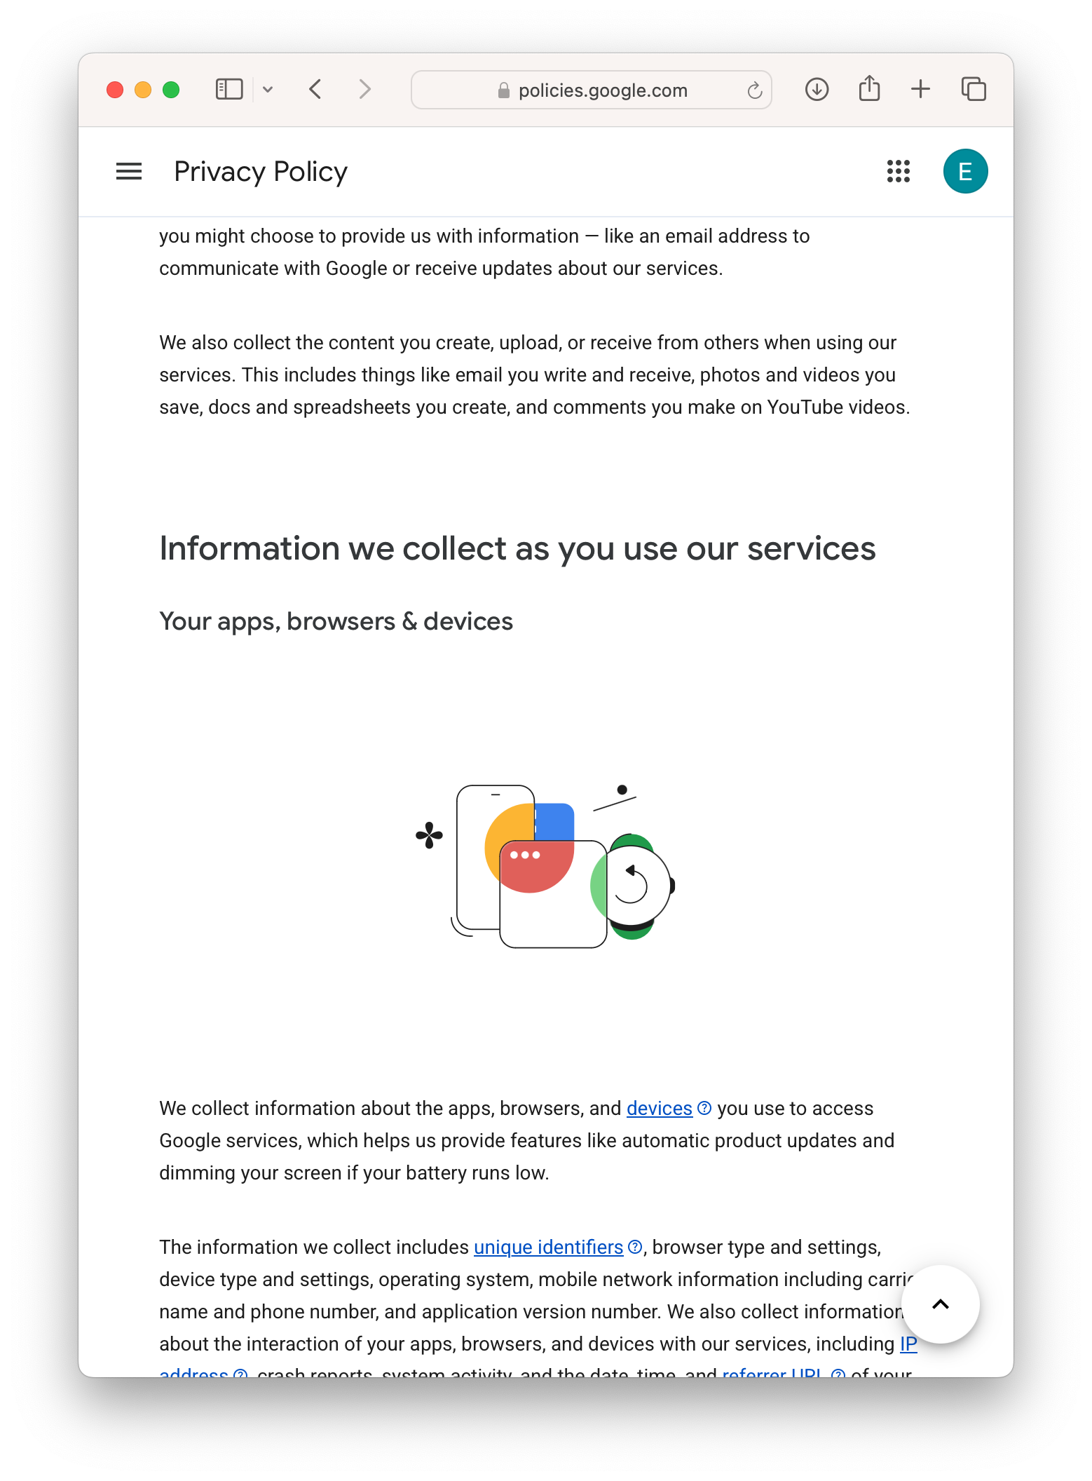
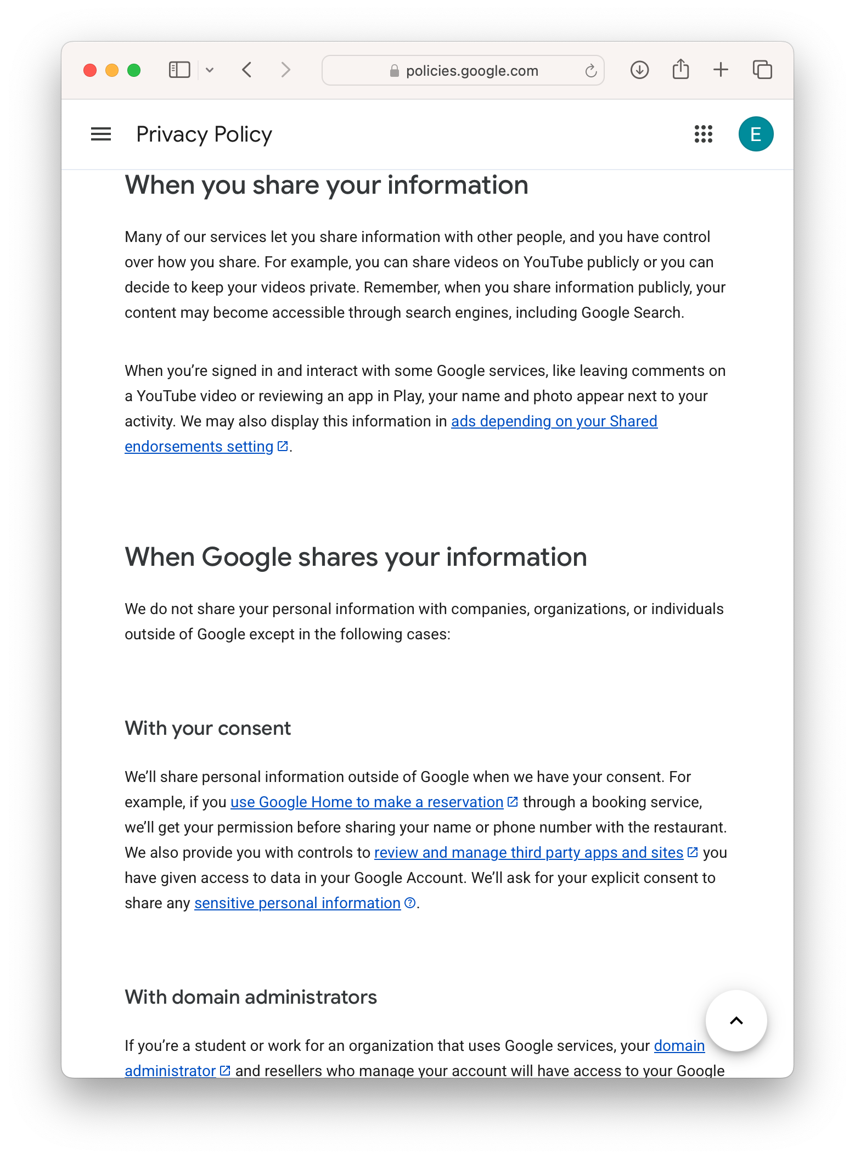
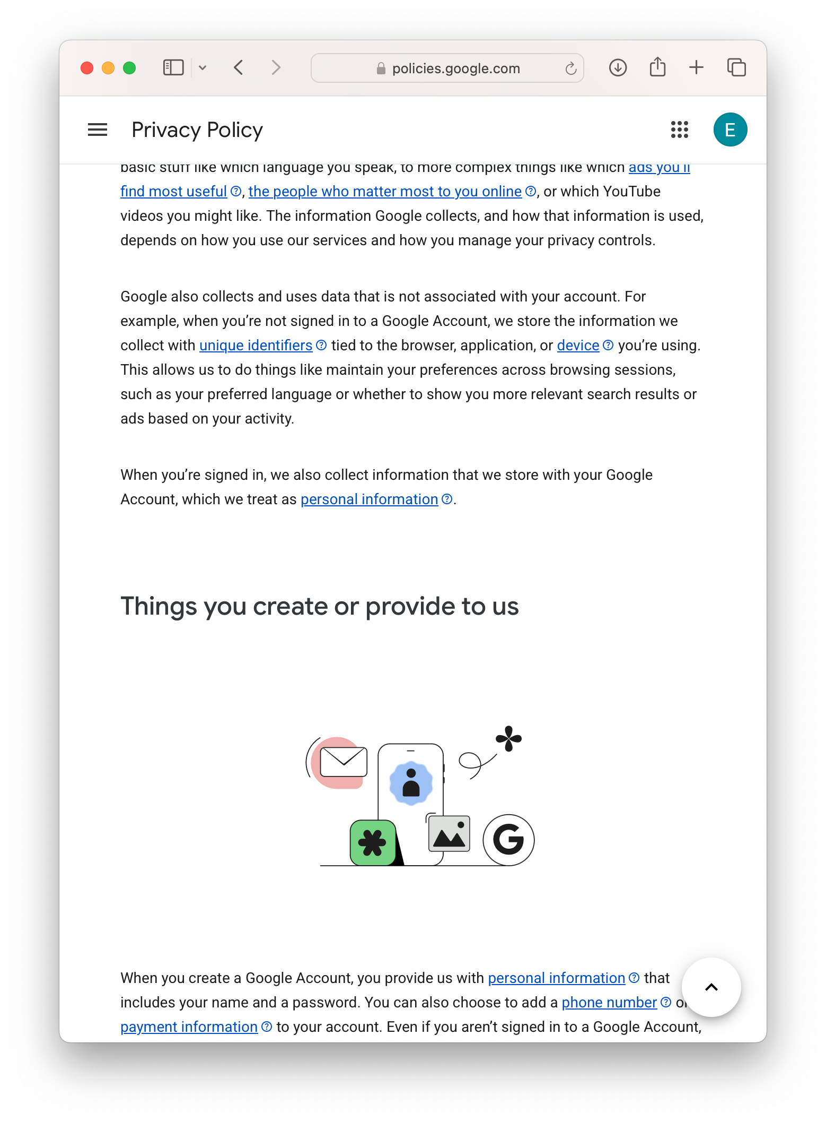
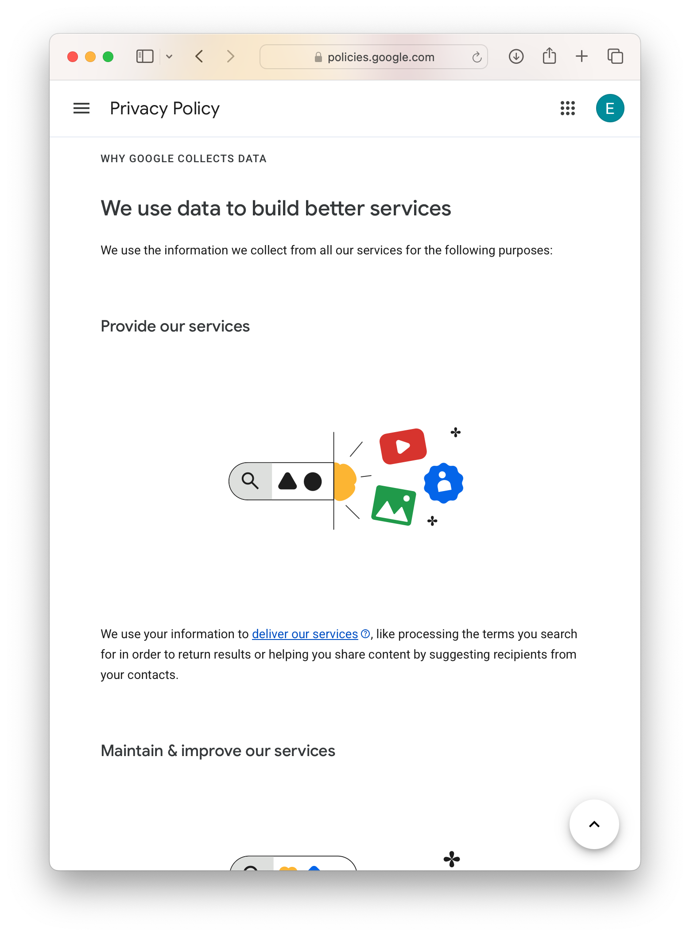
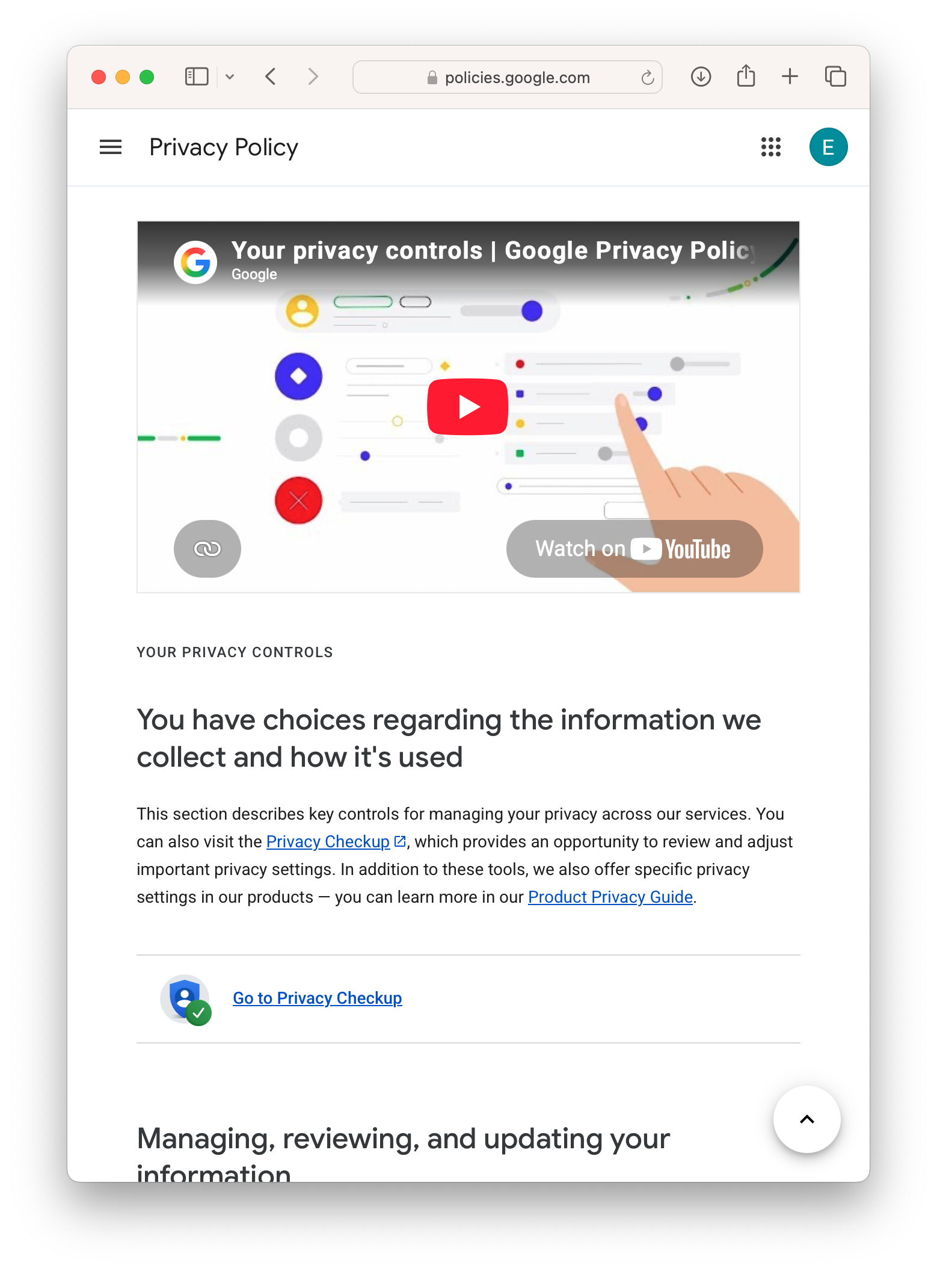
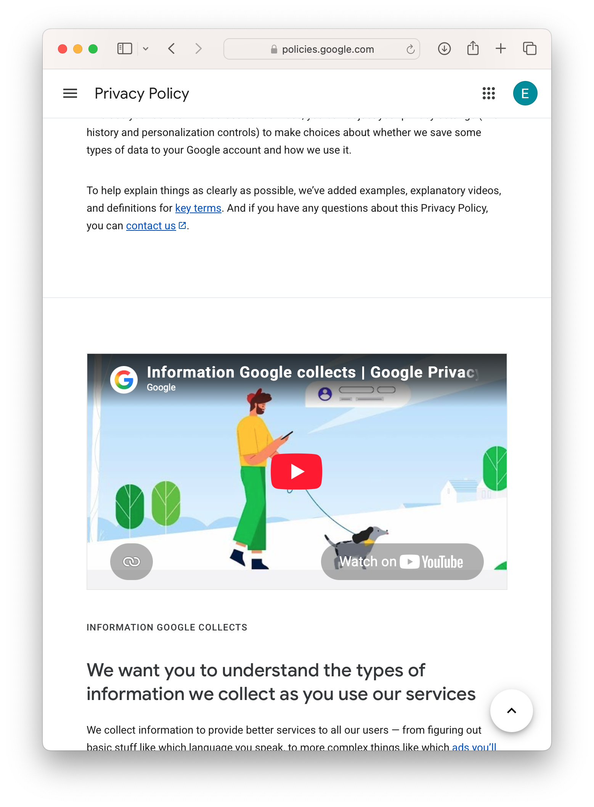
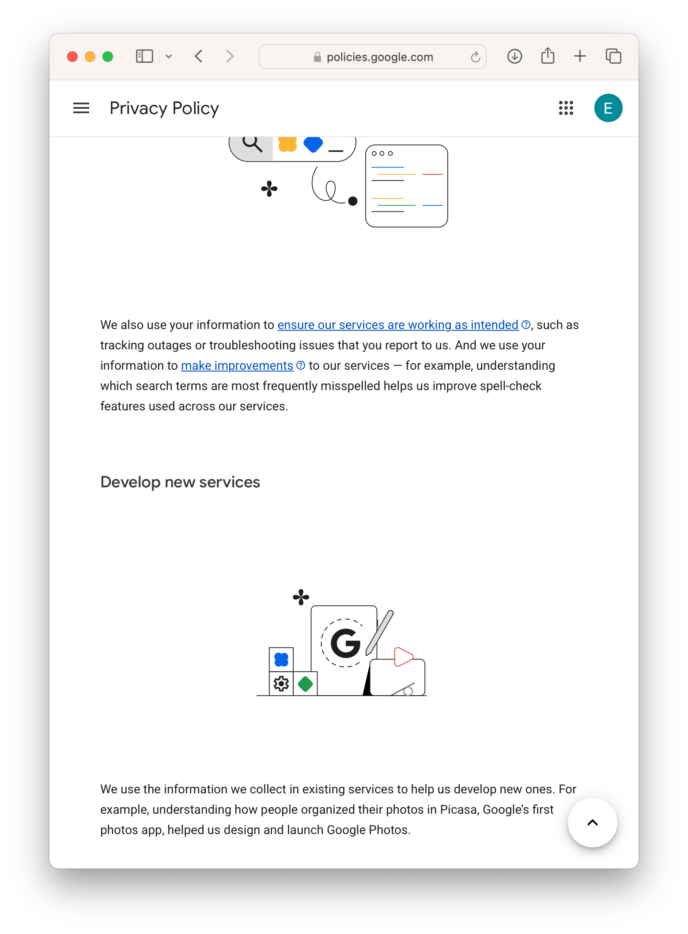
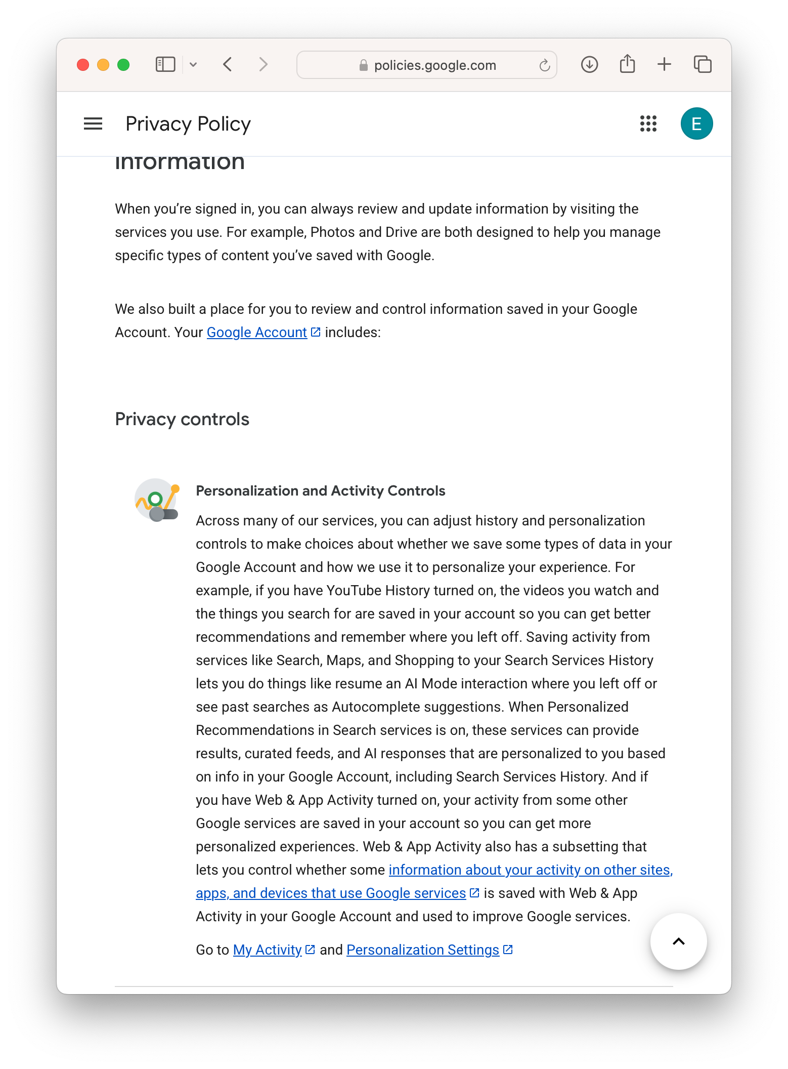
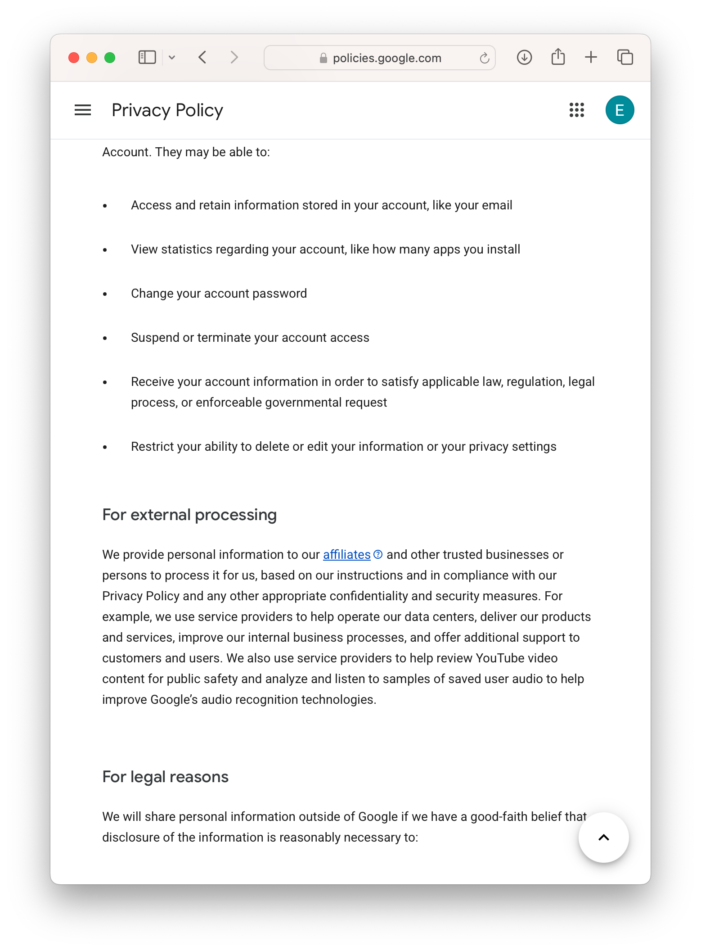
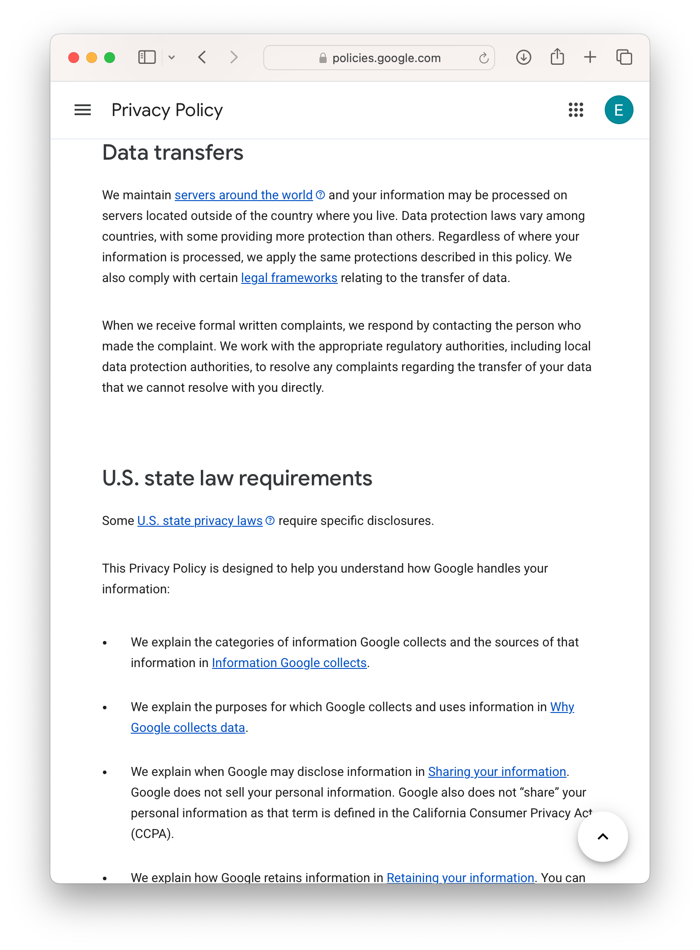
Notice and Consent

Slide 17
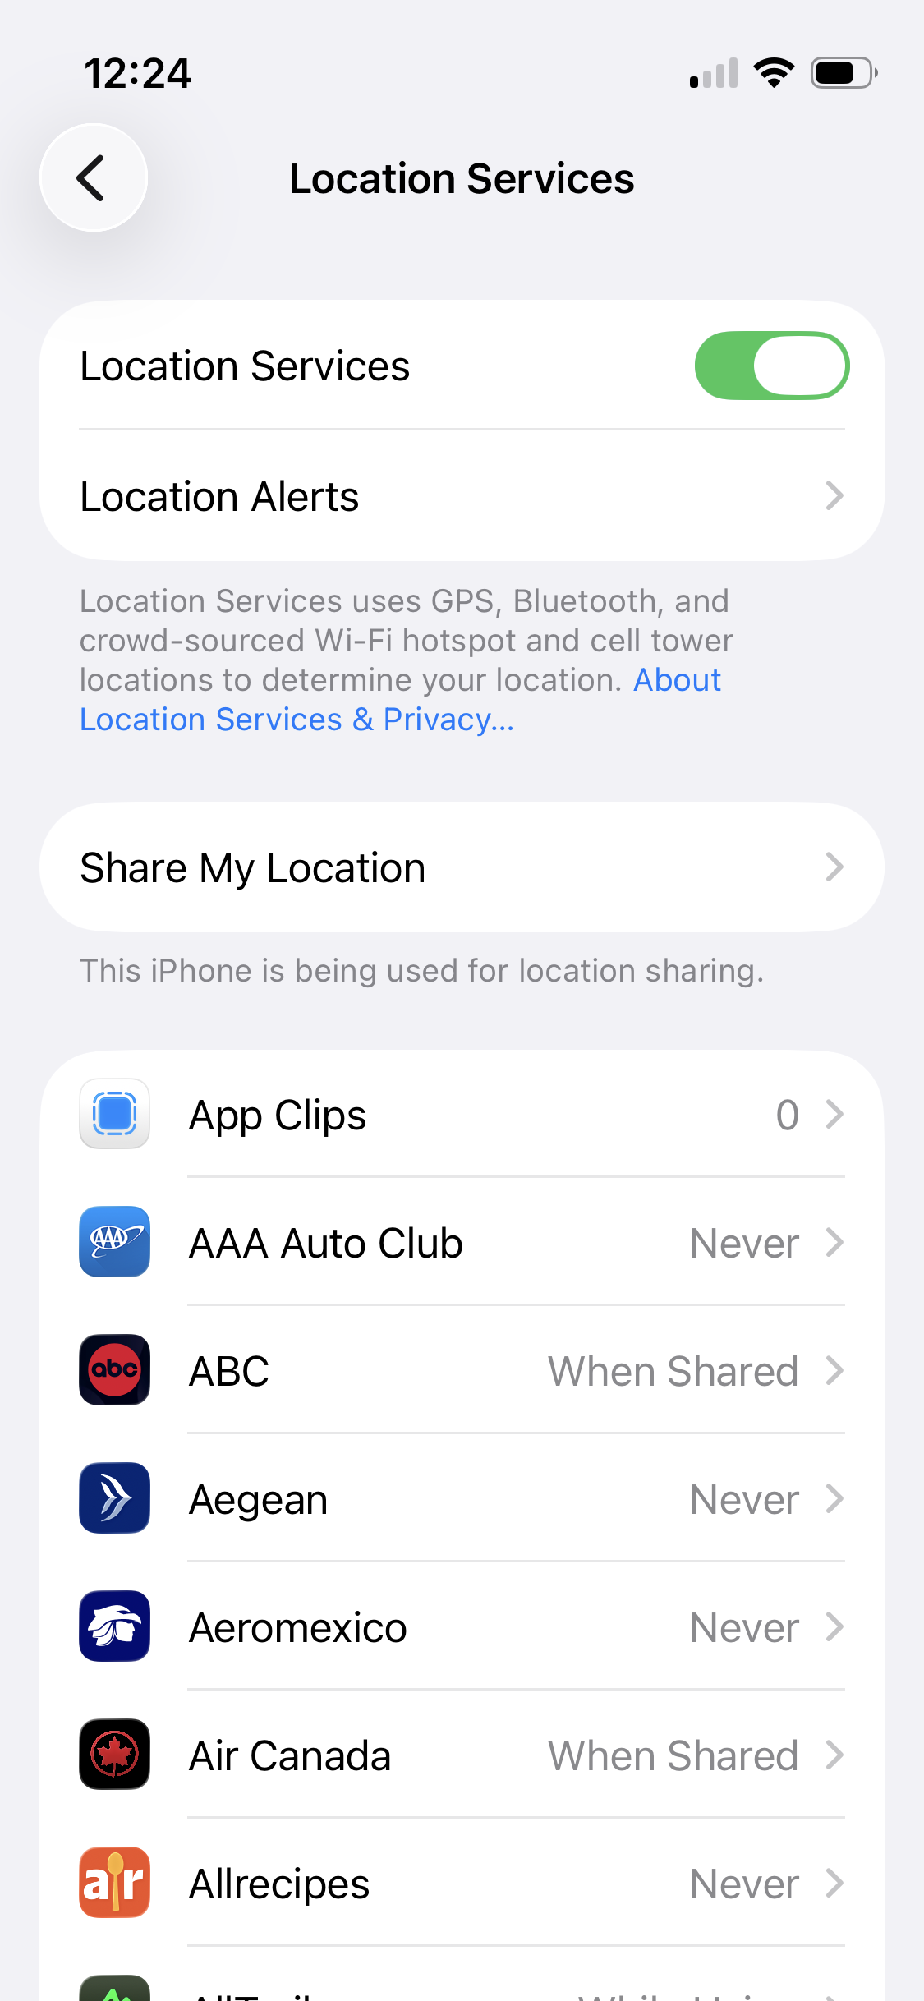
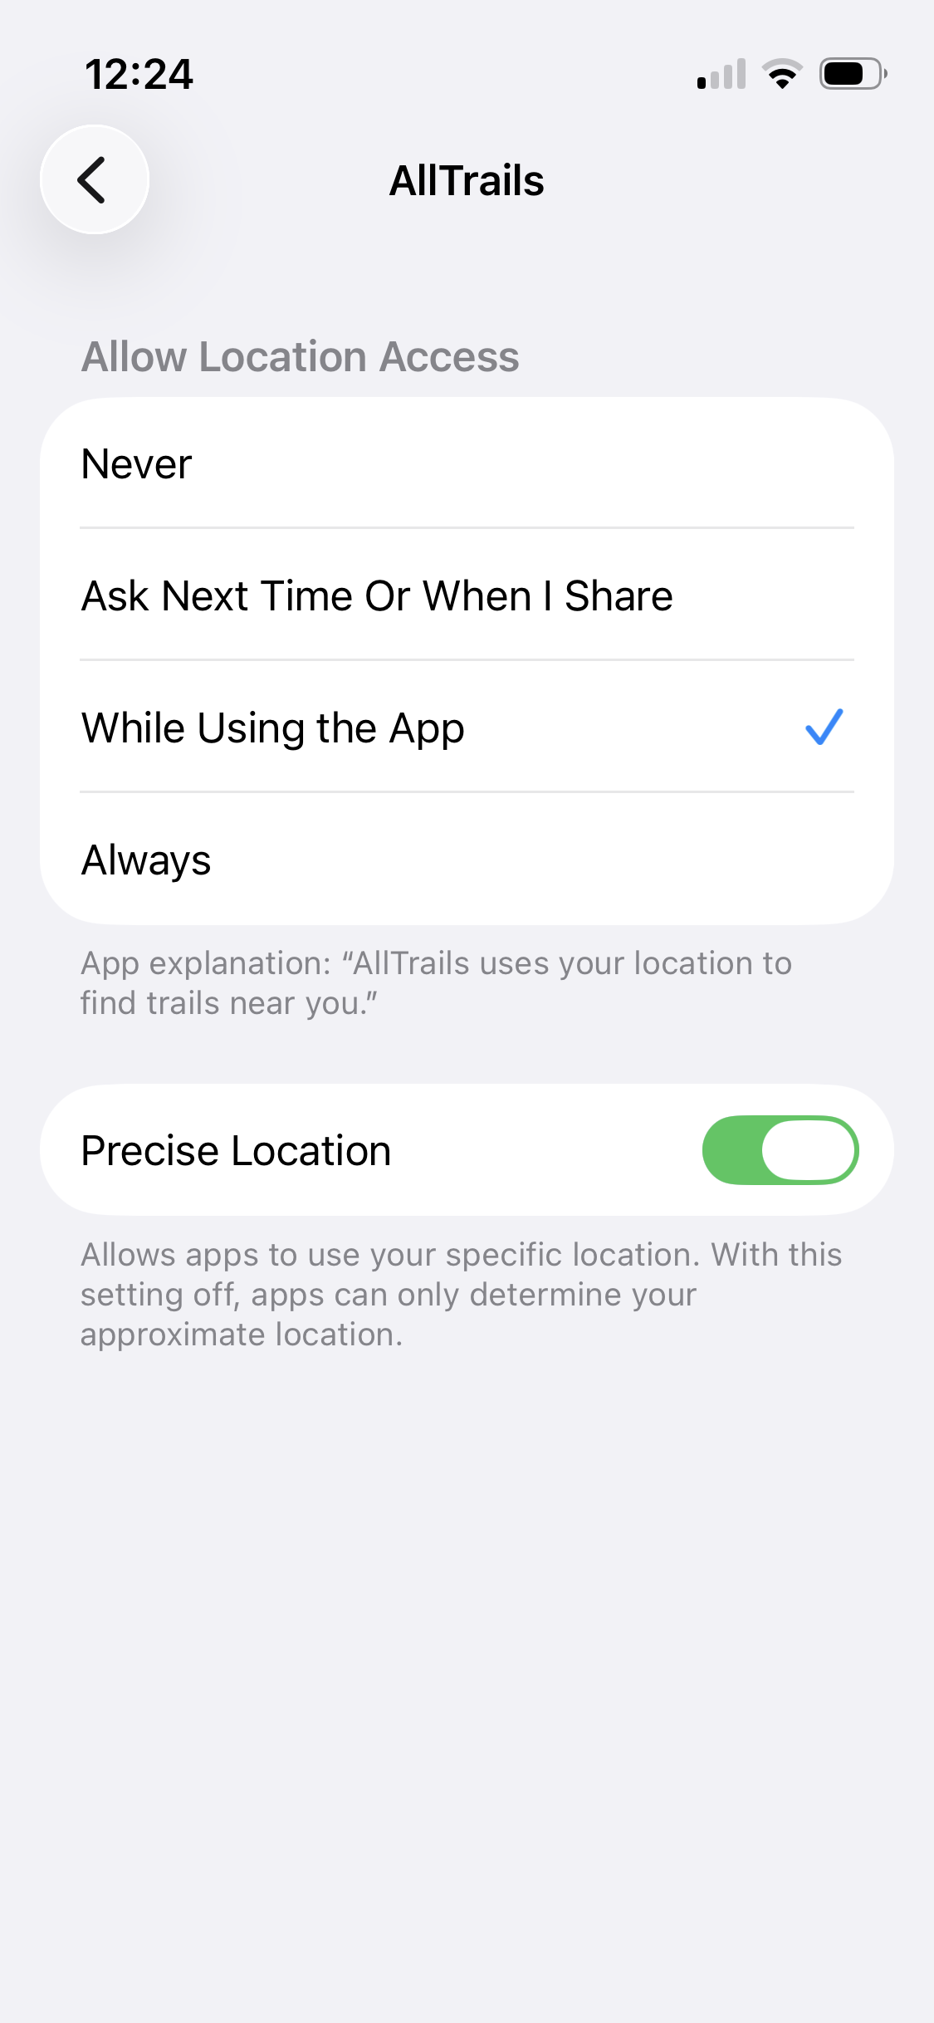
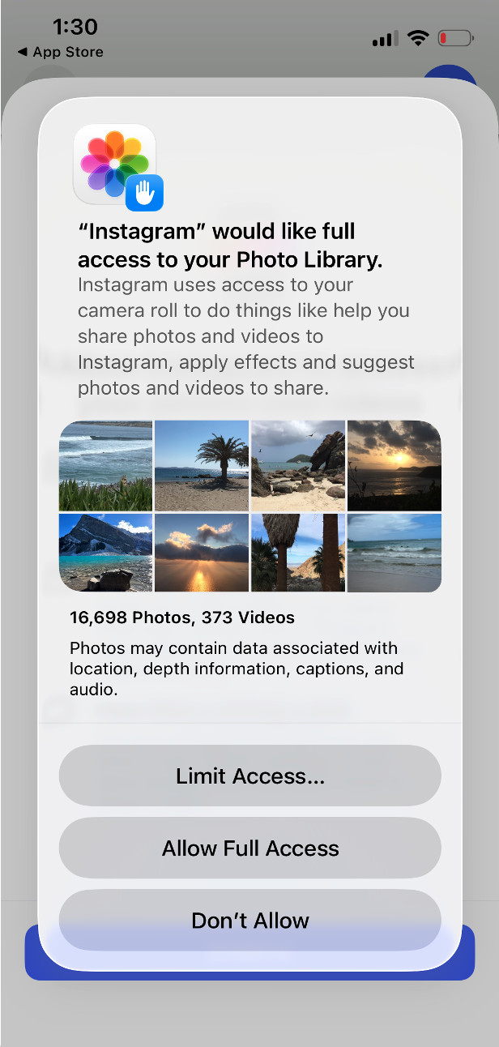
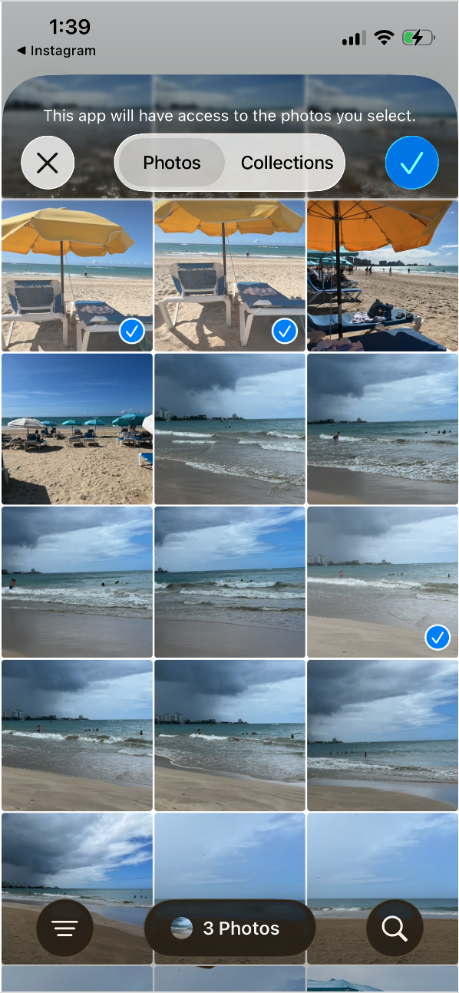
Privacy as Control

Slide 18
Exercise: Transparency and Consent
Choose a website or app that you regularly use/visit:
What information does this website/app collect?
What does this website/app do with that information?
What options do you have to control or limit the collection or use of personal info by this website/app?

Slide 19
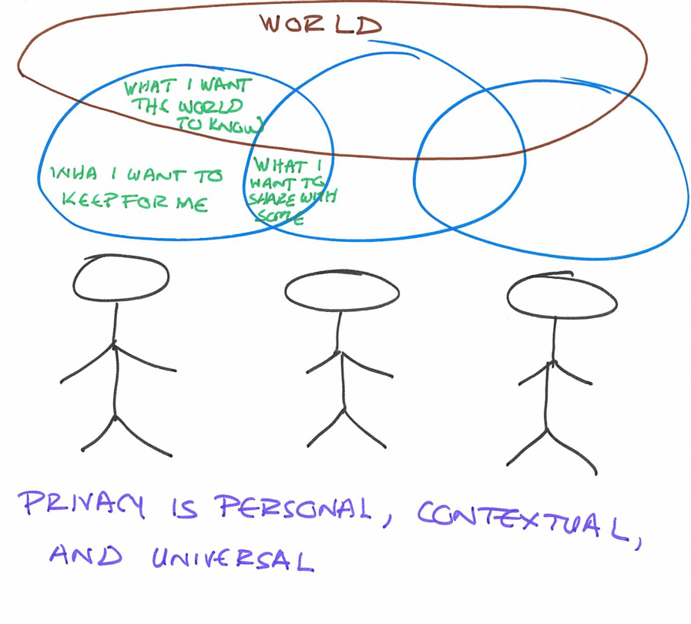
Societal Values
Privacy is a value that is very important to have in a society to work and progress
– Pedro, age 35

Slide 20

Contextual Integrity
defines privacy relative to appropriate context
considers information type, time, location, purpose, principals involved (subject, sender, receiver)
dependent on social norms
norms can change over time
Notes:
Nissenbaum, H., 2009. Privacy in context: Technology, policy, and the integrity of social life. Stanford University Press.

Slide 21
Contextual Integrity
CI says a context can be defined by:
Data Type: what sort of information is being shared?
Subject: who is the information about?
Sender: who is sharing the information?
Recipient: who is receiving the information?
Transmission Principle: constraints on data flow
  with subject’s consent
  with notice (some sort of advance announcement or disclosure)
  reciprocity (“I’ll show you mine if you show me yours”)
  subject to legal requirements
  the Chatham House Rule (information can be reshared only without attribution)
Norms are identified and flows are evaluated within this context

Slide 22
Contextual Integrity Example
Anyone can track a Venmo user’s purchase history and glean a detailed profile – including their drug deals, eating habits and arguments – because the payment app lacks default privacy protections.
Relevant Norm: My transaction only visible to me and the receiver by default.
Example flow violating norm:
data type = transaction information
sender=me, receiver=friend, subject=me
transmission principle = public/no constraints
Privacy-preserving solution: make app setting private by default

Slide 23
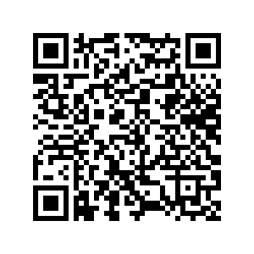
Exercise: Contextual Integrity
An Uber driver has put a video of hundreds of his passengers online without letting them know.
Pomona puts Amazon Echo devices in all dorm rooms.
Google tracks your movements even if you set the settings to prevent it.
Meta asked large U.S. banks to share financial information on their customers.
https://docs.google.com/spreadsheets/d/1KSZTSQNNmKc56xpE9Cck27sV8HNQJN_2_J0UENT9-fg/edit
Notes:
Exercise drawn from the 2nd Contextual Integrity Workshop (2018), developed by Yan Shvartzshnaider.
https://freedom-to-tinker.com/2018/09/27/privaci-challenge-context-matters/

Slide 24

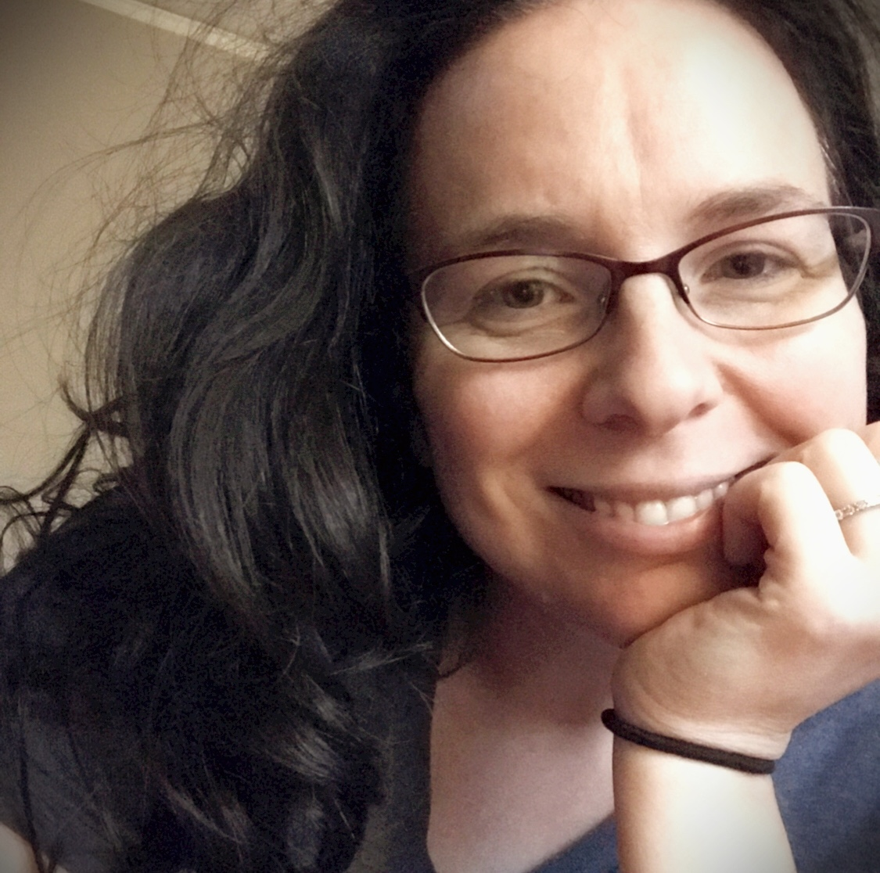
Privacy as Vulnerabilities
limitations of norms for protecting privacy
vulnerable populations
  more likely to be susceptible to violations
  harms are higher impact
draws on feminist and queer theory
Notes:
Nora McDonald and Andrea Forte. The Politics of Privacy Theories: Moving from Norms to Vulnerabilities
https://dl.acm.org/doi/abs/10.1145/3313831.3376167

Slide 25
How privacy is protected
Self regulation
Laws
Technology

Slide 26
FIPPs
The FTC's Fair Information Practice Principals (FIPPs) are the most broadly recognized guidelines for handling private data in information systems
  Seek consent
  Minimize data use
  Limit storage
  Avoid linking

Slide 27
OECD fair information principles
Collection limitation
Data quality
Purpose specification
Use limitation
Security safeguards
Openness
Individual participation
Accountability
Notes:
http://www.oecd.org/sti/ieconomy/oecdguidelinesontheprotectionofprivacyandtransborderflowsofpersonaldata.htm

Slide 28
Privacy laws around the world
Europe has comprehensive privacy laws (GDPR) and data protection commissioners in every country
162 countries have privacy or data protection laws
US has mostly sector-specific laws, minimal protections, often referred to as “patchwork quilt”
  No explicit constitutional right to privacy or general privacy law
  Narrow regulations for health, financial, education, children, etc.
  Federal Trade Commission jurisdiction over fraud + deceptive practices
  19 states have comprehensive privacy laws
    California laws: CCPA and CPRA

Slide 29
Rights to Control Today
GDPR
CCPA
Right to Access
Right to Rectification
Right to Erasure
Right to Data Portability
Right to Object to Automated Decision Making
Consent as basis for processing
Right to Know
Right to Correct
Right to Delete
Right to Opt-out of Sale or Sharing
Right to Limit Use of Sensitive Personal Info
Right to non-discrimination for exercising CCPA Rights

Slide 30
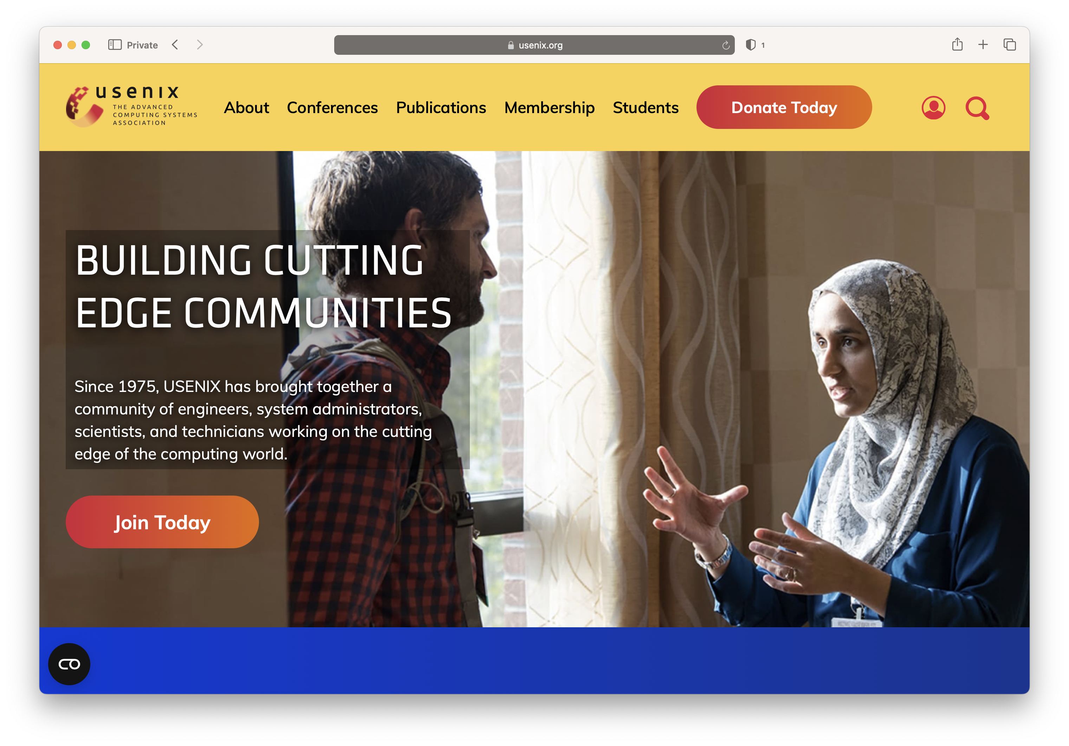
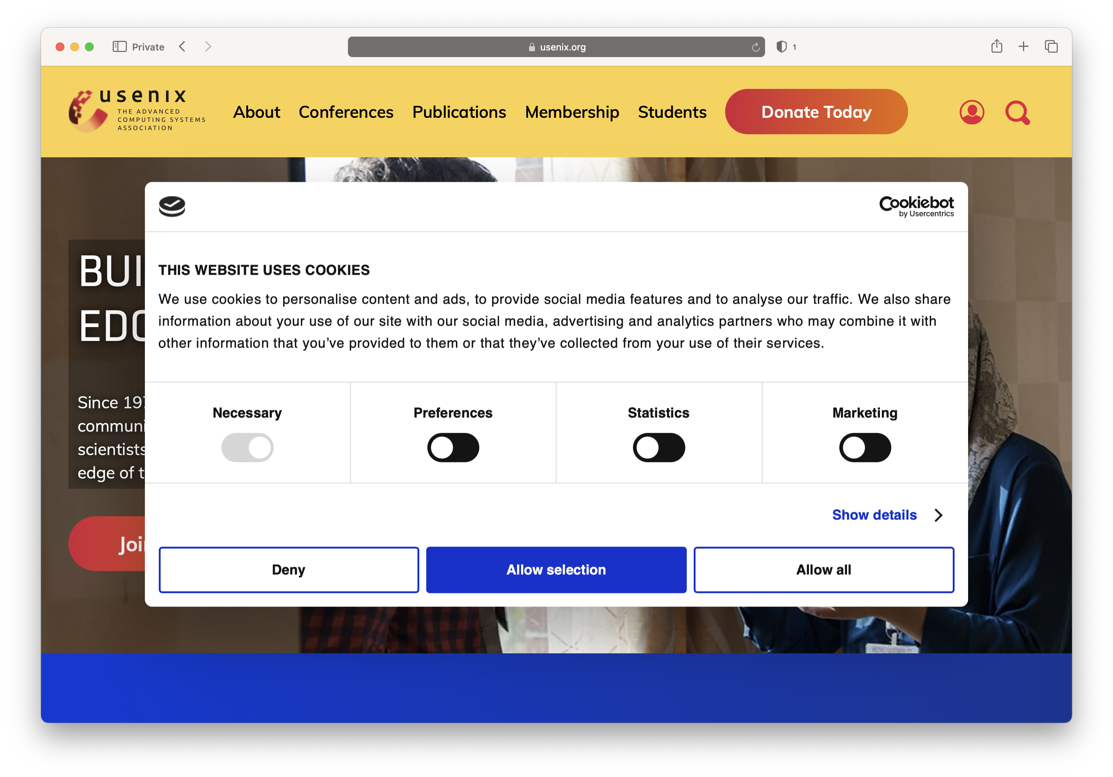
Right to Consent

Slide 31
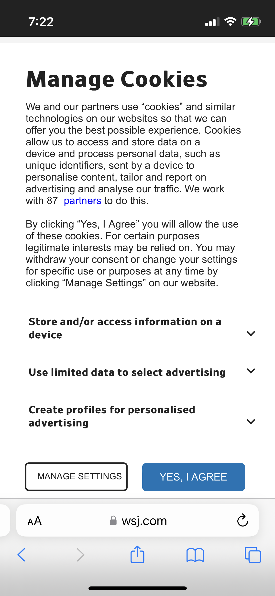
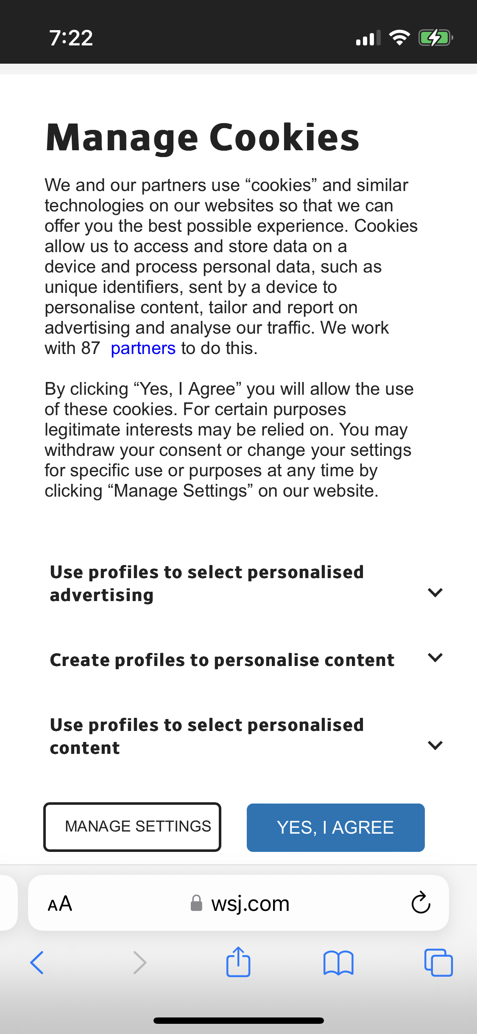





Right to Consent

Slide 32
Exercise: Exercising Privacy Rights
Choose a website or app that you regularly use/visit:
Figure out how to invoke your right to opt-out of sale
Figure out how to invoke your right to access
How usable are these rights? How many people do you think actually use them?

Slide 33
Privacy-Enhancing Tools
Cryptography
  encryption
  homomorphic encryption
  blinded signatures
  zero-knowledge proofs
  anonymous credentials
Differential Privacy
Onion Routing, VPNs
Privacy-preserving advertising
Privacy-preserving machine learning

Slide 34
Privacy mechanisms require usability
Clear and plain language
Concise, transparent, intelligible and easily accessible
Clear and conspicuous
Easy to find, read, and use
  Use of data
  Access data that organization has collected
  Request data deletion
  privacy-enhancing technologies

Slide 35
Internet Privacy

Slide 36
Internet Privacy

Slide 37

That's a private drawing and my idea is my privacy. :)
– XCY age 23

