Slide 1
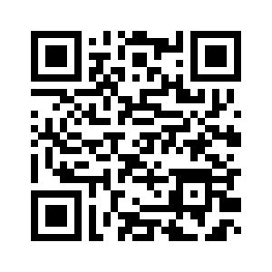
Lecture 1: Intro to Ethical Software Systems
CS 181E Fall 2026
https://cs.pomona.edu/classes/cs181e)

Slide 2
What is this class?

Slide 3
The (planned) approach
technical tools and techniques that advance (or impede) ethical best practices
  includes things like privacy, fairness, anti-bias/disparate impact, environment impact, societal impact
there will be a lot of programming (including ML)
there will be some math (including proofs)
Preqs: CS 54 + CS 62

Slide 4
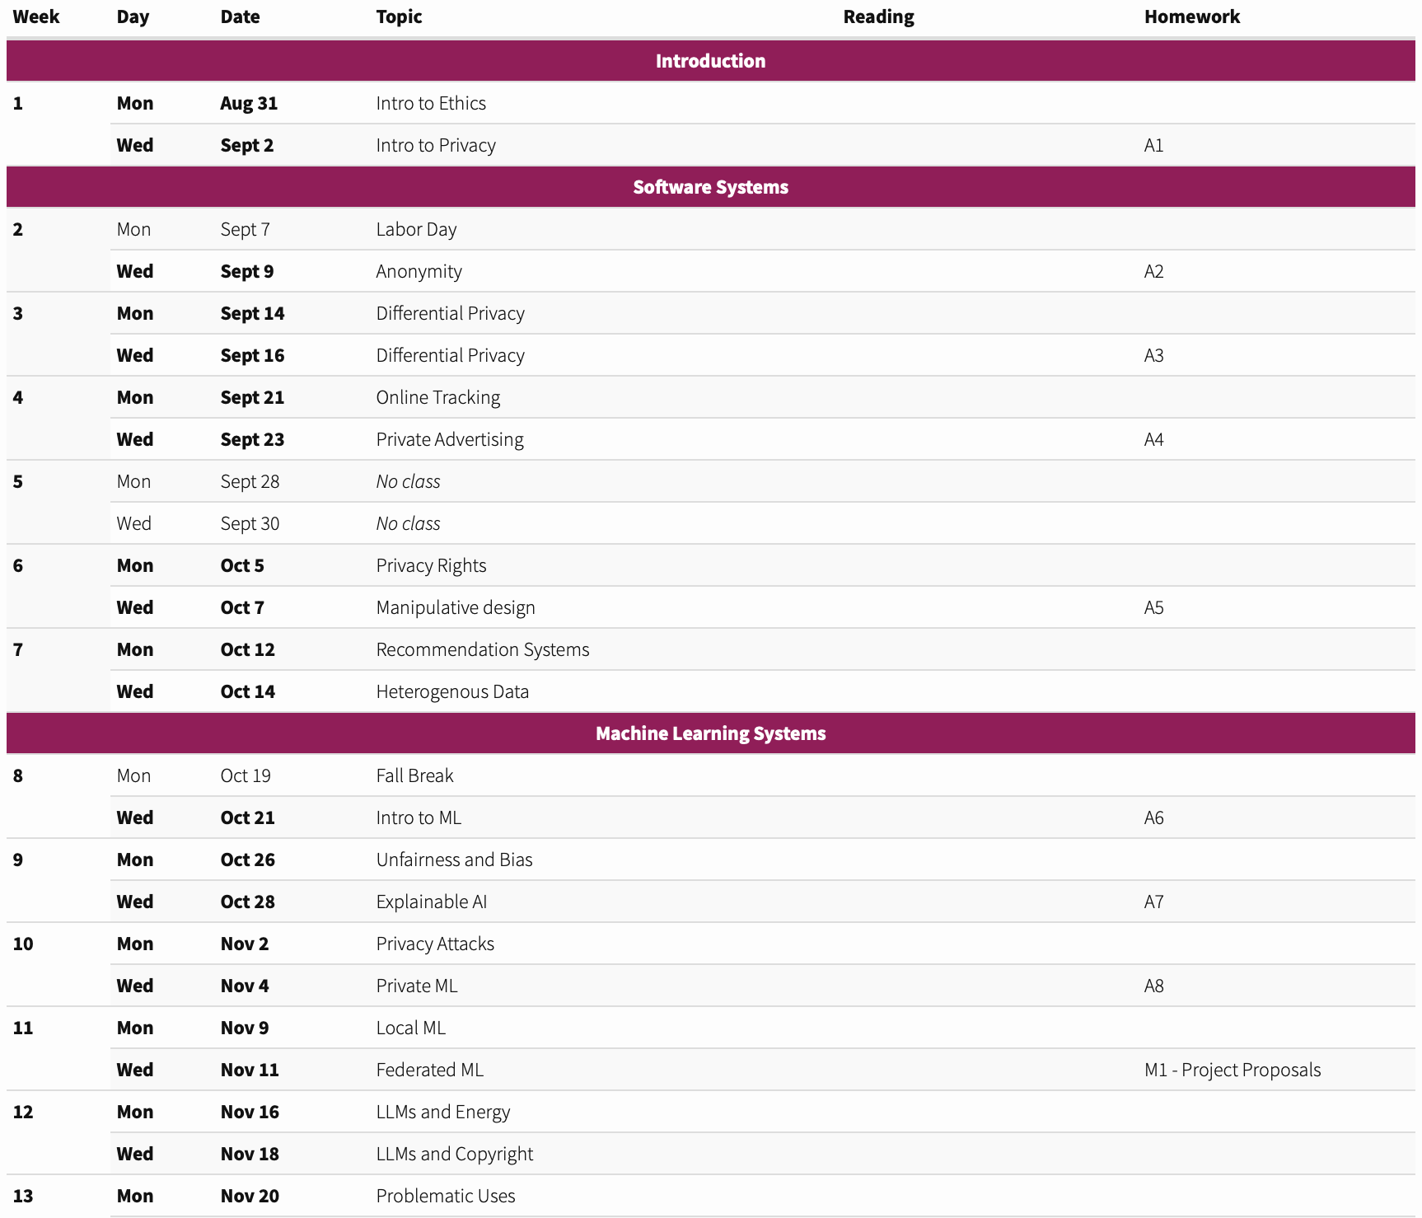
The (planned) approach

Slide 5
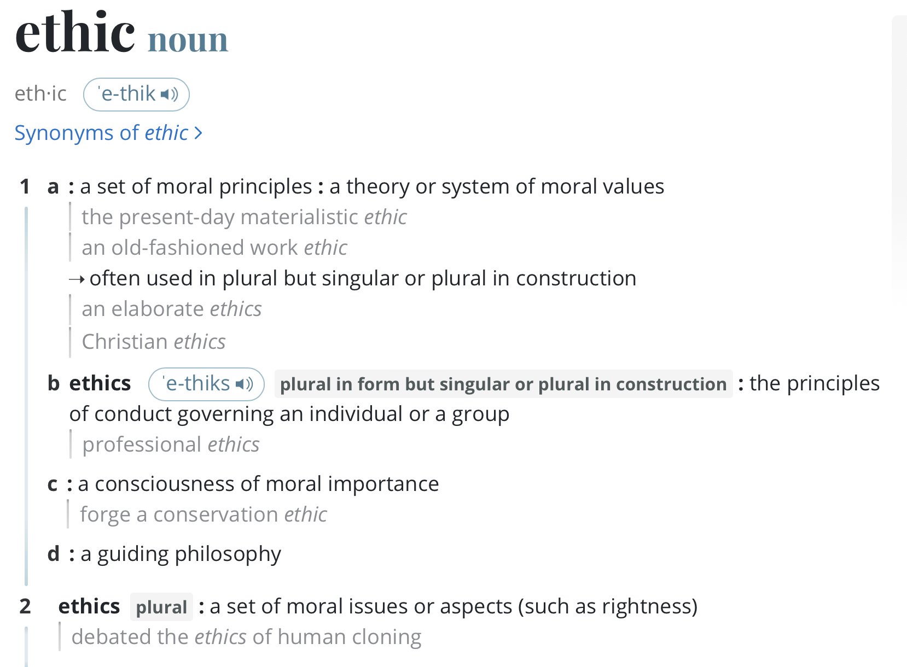
Ethics
Notes:
https://www.merriam-webster.com/dictionary/ethic

Slide 6

Example 1

Slide 7
Ethical Frameworks
Consequentialist Ethics
Deontological Ethics
what matters is the impact
assess benefits/harms each possible choice
maximize net benefit
what matters is process
consider what rights various stakeholders have
decisions should respect rights
“What sort of world do I want to live in?”

Slide 8
Consequentialist Ethics
General Idea: what matters is the impact
Approach: assess benefits/harms each possible choice
Ethical choice: maximize net benefit

Slide 9

Example: Applying Consequentialism
Scenario: A runaway trolly with no brakes. Five people are tied to the current track. One person is tied to the other track.
Do Nothing
Switch Tracks

Slide 10

Exercise: Applying Consequentialism
Scenario: Company A is designing a new social networking app and needs to decide which posts to display to users. They can either display recent posts from accounts the user follows or they can use information they know about the person to recommend content they thing they’d like. Preliminary user testing shows that most user prefer the recommended content and spend more time on the app that way.
Display recent content from friends
Display recommended content

Slide 11
Deontological Ethics
General idea: what matters is process
Approach: consider what rights/values various stakeholders have
Ethical choice: respect rights/values
  “What sort of world do I want to live in?”

Slide 12
Example: Applying deontology
Scenario: A runaway trolly with no brakes. Five people are tied to the current track. One person is tied to the other track.
Do Nothing
Switch Tracks

Slide 13
Exercise: Applying deontology
Scenario: Company A is designing a new social networking app and needs to decide which posts to display to users. They can either display recent posts from accounts the user follows or they can use information they know about the person to recommend content they thing they’d like. Preliminary user testing shows that most user prefer the recommended content and spend more time on the app that way.
Display recent content from friends
Display recommended content

Slide 14
Exercise: Combining Ethical Frameworks
Scenario: Company A discovers a new machine learning model that can predict hiring decisions with 90% accuracy. This software will streamline the hiring application and interview process.
Using the ML model to make hiring decisions
Using the ML model to do initial screening and then interview recommended candidates
Use a fully-human hiring process
What would be the most ethical decision according to consequentialist ethics?
What would be the most ethical decision according to deontological ethics?
What do you personally think is the most ethical decision?

Slide 15
Exercise: Applying Ethical Theory
Under what circumstances is it ethical to use LLMs generally?
Under what circumstances is it ethical to use LLMs in this course?
To what extent do consequentialist ethics, deontological ethics, and your personal instincts give different answers?

Slide 16
Logistics

Slide 17

Course Logistics
Prof. Eleanor Birrell
Research in usable security and privacy
OH: MW 3-5pm
Class Meetings:
  Monday and Wednesday, 1:15-2:30pm in Edmunds 101

Slide 18
Course Work
Homework (45%)
  Approximately 8 weekly homeworks
  Goal: reinforce and engage more deeply with material covered in class
  All assignments will be due Wednesdays at 11:59pm PT
Final course project (35%)
  Do something cool and individual relating to the course material
  Done in groups of 2-4
  Proposals due Nov 18
  Presentations in class Dec 7-9
  Final project due Dec 9
Participation (10%)
  Show up! Participate! Have fun!

Slide 19
Course website
https://cs.pomona.edu/classes/cs181e)
All information is on the course website

