Slide 1
Lecture 21: Dynamic Memory
CS 105 Spring 2023

Slide 2
Memory
0x7FFFFFFFFFFF
Stack
byte addressable array made up of four logical segments
stack provides local storage for procedures
  "top" of the stack stored in register %rsp
heap is an area of memory maintained by a dynamic memory allocator
  operating system maintains variable brk that points to the top of heap
data stores global variables
code stores program instructions
attempt to access uninitialized address results in exception (segfault)
%rsp
brk
Heap
Data
%rip
Code
0x000000000000

Slide 3
The Heap
0x7FFFFFFF
Stack
the heap is an area of memory for dynamic memory allocation
programmers can use a dynamic memory allocator to acquire additional memory at run time
programmers can use a system call to modify brk (e.g., extend the heap)
%rsp
brk
Heap
Data
%rip
Code
0x00000000

Slide 4
Dynamic Memory Allocation
Dynamic memory allocator
  Manages the heap
    organizes the heap as a collection of (variable-size) blocks, each of which is either allocated or free
    allocates and deallocates memory
    may ask OS for additional heap space using system call sbrk()
  Part of the process’s runtime system
    Linked into program
Example dynamic memory allocators
  malloc and free in C
  new and delete in C++
  object creation & garbage collection in Java
  object creation & garbage collection in Python
explicit allocators
implicit allocators

Slide 5
Allocation Example using malloc
#include <stdio.h>
#include <stdlib.h>
void foo(int n) {
int i, *p;
/* Allocate a block of n ints */
p = (int *) malloc(n * sizeof(int));
if (p == NULL) {
perror("malloc");
exit(0);
}
/* Initialize allocated block */
for (i=0; i<n; i++)
p[i] = i;
/* Return allocated block to the heap */
free(p);
}

Slide 6
Allocation Example
p1 = malloc(4)
p2 = malloc(5)
p3 = malloc(6)
free(p2)
p4 = malloc(2)

Slide 7
Allocator Requirements
Must handle arbitrary request sequences:
  cannot control number, size, or order of requests
  (but we'll assume that each free request corresponds to an allocated block)
Must respond immediately:
  no reordering or buffering requests
Must not modify allocated blocks:
  can only allocate from free memory on the heap
  cannot modify or move blocks once they are allocated
Must align blocks:
  8-byte (x86) or 16-byte (x86-64) alignment on Linux
  Ensures that allocated blocks can hold any type of data
Must only use the heap:
  any data structures used by the allocator must be stored in the heap

Slide 8
First Example: A Simple Allocator
void *malloc (size_t size) {
return sbrk(align(size));
}
void free (void *ptr) {
// do nothing
}
Advantages
Simple
Blazing fast
Disadvantages
Memory is never recycled
Wastes a lot of space

Slide 9
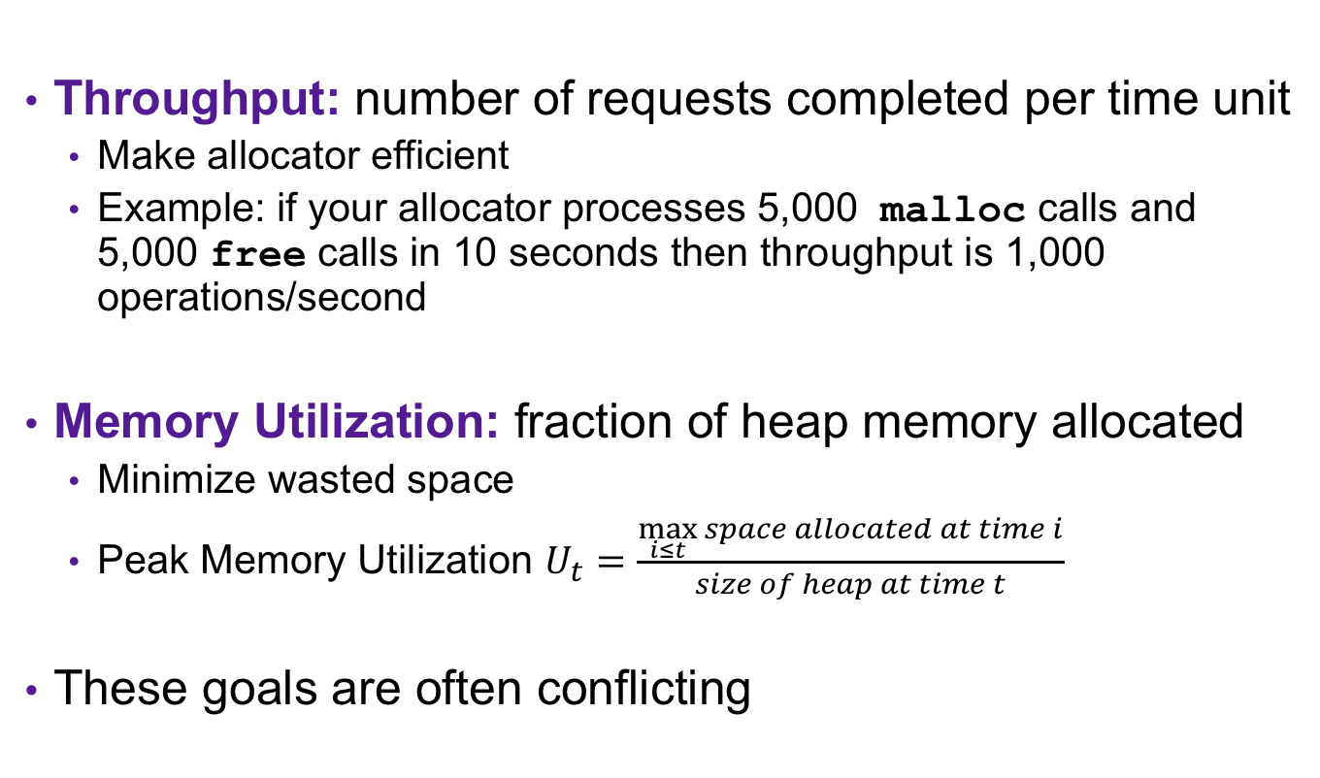
Allocator Goals
Throughput: number of requests completed per time unit
  Make allocator efficient
  Example: if your allocator processes 5,000 malloc calls and 5,000 free calls in 10 seconds then throughput is 1,000 operations/second
Memory Utilization: fraction of heap memory allocated
  Minimize wasted space
  Peak Memory Utilization $U_{t}=\frac{\max_{i≤t}{space allocated at time i}}{size of heap at time t}$
These goals are often conflicting

Slide 10



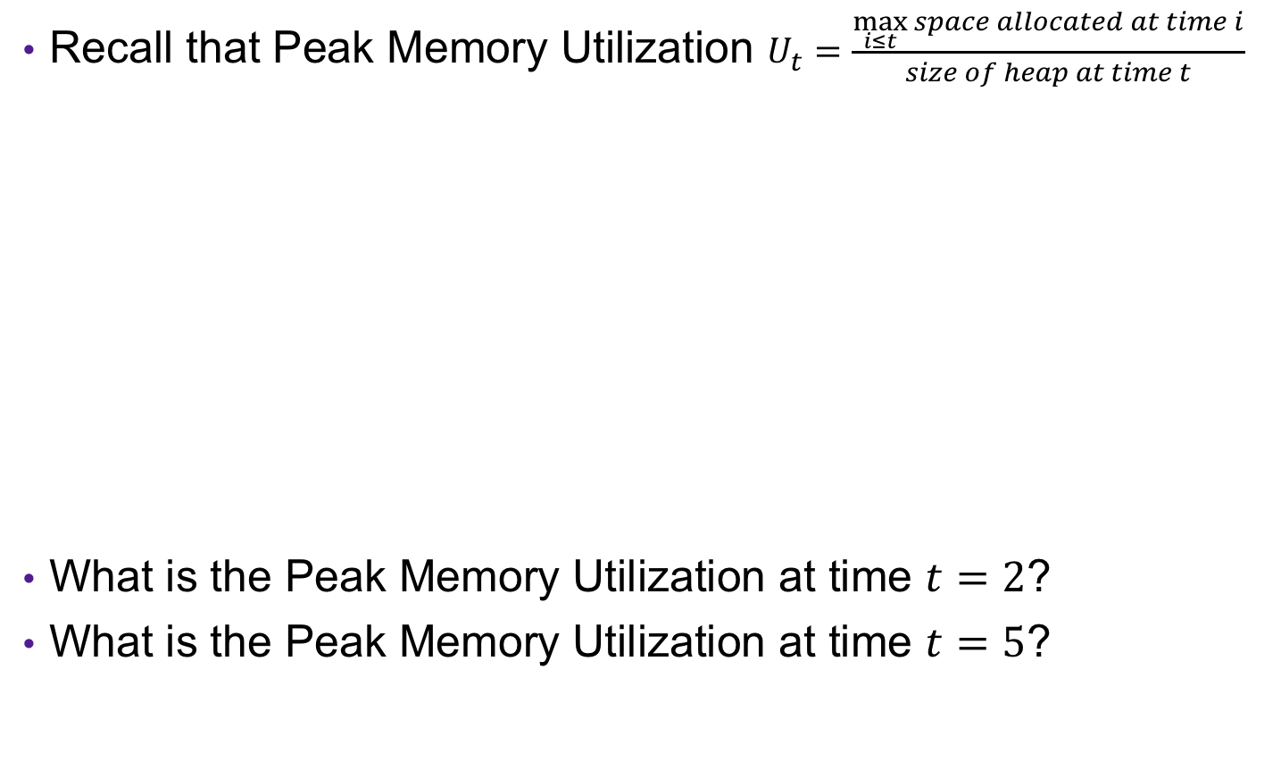





Exercise: Memory Utilization
Recall that Peak Memory Utilization $U_{t}=\frac{\max_{i≤t}{space allocated at time i}}{size of heap at time t}$
What is the Peak Memory Utilization at time $t=2$?
What is the Peak Memory Utilization at time $t=5$?
$$t=0$$
$$t=1$$
$$t=2$$
$$t=3$$
$$t=4$$
$$t=5$$
$$3/4$$
$$5/8$$

Slide 11
Utilization Blocker: Internal Fragmentation
For a given block, internal fragmentation occurs if payload is smaller than block size
Caused by
  Overhead of maintaining heap data structures
  Padding for alignment purposes
  Explicit policy decisions
  (for example, returning a big block to satisfy a small request)
Depends only on the pattern of previous requests
  Thus, easy to measure
Block
Internal
fragmentation
Payload
Internal
fragmentation

Slide 12
Utilization Blocker: External Fragmentation
Occurs when there is enough aggregate heap memory, but no single free block is large enough
Depends on the pattern of future requests
  Thus, difficult to measure
p1 = malloc(4)
p2 = malloc(5)
p3 = malloc(6)
free(p2)
p4 = malloc(6)

Slide 13
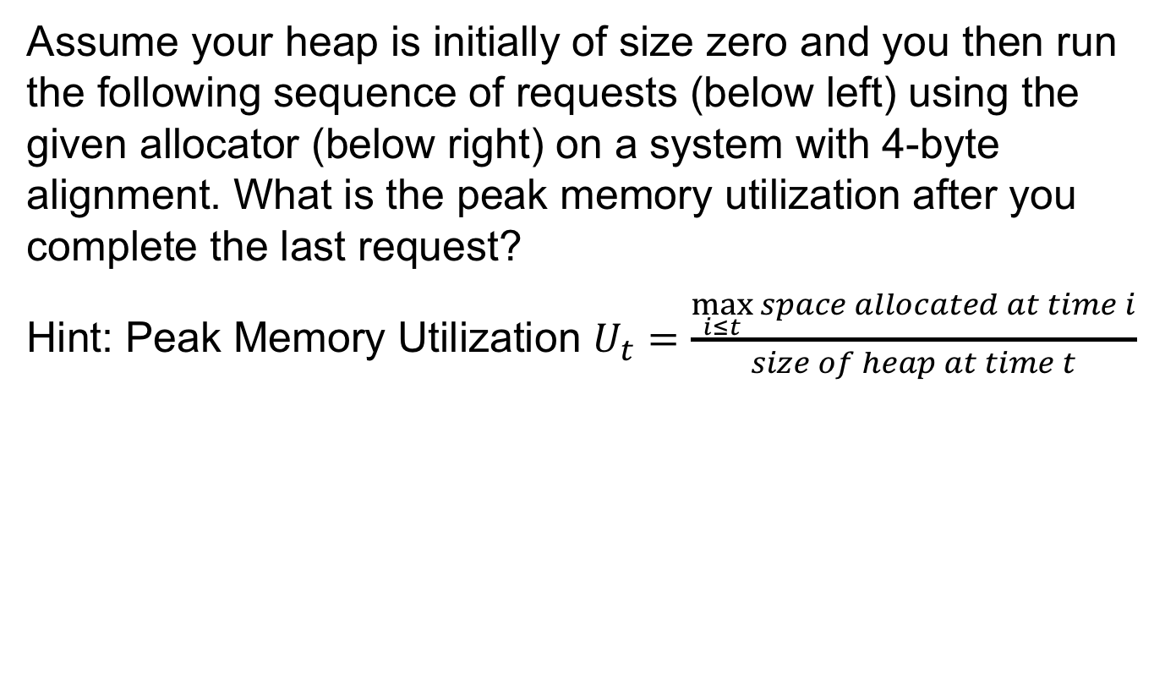
Exercise 1: Utilization
Assume your heap is initially of size zero and you then run the following sequence of requests (below left) using the given allocator (below right) on a system with 4-byte alignment. What is the peak memory utilization after you complete the last request?
Hint: Peak Memory Utilization $U_{t}=\frac{\max_{i≤t}{space allocated at time i}}{size of heap at time t}$
p1 = malloc(4)
void *malloc (size_t size) {
return sbrk(align(size));
}
void free (void *ptr) {
// do nothing
}
p2 = malloc(5)
p3 = malloc(6)
free(p2)
p4 = malloc(2)

Slide 14
Exercise 1: Utilization
p1 = malloc(4)
p2 = malloc(5)
p3 = malloc(6)
free(p2)
p4 = malloc(2)

Slide 15
Challenges
Goal: maximize throughput and peak memory utilization
Implementation challenges:
  How do we know how much memory to free given just a pointer?
  How do we keep track of the free blocks?
  How do we pick a block to use for allocation?
  What do we do with the extra space when allocating a structure that is smaller than the free block it is placed in?
  How do we reinsert a freed block?

Slide 16
Knowing How Much to Free
Standard method
  Keep the length of a block in the word preceding the block.
    This word is often called the header field or header
  Requires an extra (4 byte) word for every allocated block
p0
p0 = malloc(16)
20
header = block size
payload
free(p0)

Slide 17
Challenges
Goal: maximize throughput and peak memory utilization
Implementation Challenges:
  How do we know how much memory to free given just a pointer?
  How do we keep track of the free blocks?
  How do we pick a block to use for allocation?
  What do we do with the extra space when allocating a structure that is smaller than the free block it is placed in?
  How do we reinsert a freed block?

Slide 18
Keeping Track of Free Blocks
Method 1: Implicit list using length—links all blocks
20
16
24
8

Slide 19
Method 1: Implicit List
For each block we need both size and allocation status
  Could store this information in two words: wasteful!
Standard trick
  If blocks are aligned, some low-order address bits are always 0
  Instead of storing an always-0 bit, use it as a allocated/free flag
  When reading size word, must mask out this bit
4 bytes
Size
a
a = 1: Allocated block
a = 0: Free block
Size: block size
Payload: application data
(allocated blocks only)
Format of
allocated and
free blocks
Payload
Optional
padding

Slide 20
Detailed Implicit Free List Example
Start
of
heap
Unused
8/0
16/1
32/0
16/1
0/1
Allocated blocks: shaded
Free blocks: unshaded
Headers: labeled with size in bytes/allocated bit
8-byte aligned

Slide 21
Exercise 2: Block Headers
Determine the block sizes and header values that would result from the following sequence of malloc requests. Assume that the allocator uses an implicit list implementation with the block format just described and maintains 8-byte alignment.
4 bytes
Request | Block size (decimal) | Block header (hex)
malloc(1)
malloc(5)
malloc(12)
Size
a
8
0x00000009
Payload
16
0x00000011
16
0x00000011
Optional
padding

Slide 22
Implicit Lists: Summary
Implementation: very simple
Allocate cost: linear time in the worst case
Free cost: constant time worst case–even with coalescing
Memory usage: depends on the placement policy
  First-fit, next-fit, or best-fit
Not used in practice for malloc/free because of linear-time allocation
  used in many special purpose applications
However, the concepts of splitting and boundary tag coalescing are general to all allocators

Slide 23
Keeping Track of Free Blocks
Method 1: Implicit list using length—links all blocks
Method 2: Explicit list among the free blocks using pointers
Method 3: Segregated free list
  Different free lists for different size classes
Method 4: Blocks sorted by size
  Can use a balanced tree (e.g. Red-Black tree) with pointers within each free block, and the length used as a key
5
4
6
2
5
4
6
2
Notes:
Small group discussion: what data structure would you use?

Slide 24
Challenges
Goal: maximize throughput and peak memory utilization
Implementation Challenges:
  How do we know how much memory to free given just a pointer?
  How do we keep track of the free blocks?
  How do we pick a block to use for allocation?
  What do we do with the extra space when allocating a structure that is smaller than the free block it is placed in?
  How do we reinsert a freed block?

Slide 25
Implicit List: Finding a Free Block
  First fit. Search list from beginning, choose first free block that fits:
  Can take linear time in total number of blocks (allocated and free)
  In practice it can cause “splinters” at beginning of list
Next fit. Like first fit, but search list starting where previous search finished:
  Should often be faster than first fit: avoids re-scanning unhelpful blocks
  Some research suggests that fragmentation is worse
Best fit. Search the list, choose the best free block: fits, with fewest bytes left over:
  Keeps fragments small—usually improves memory utilization
  Will typically run slower than first fit
p = start;
while ((p < end) && \\ not passed end
((*p & 1) || \\ already allocated
(*p <= len))) \\ too small
p = p + (*p & -2); \\ goto next block (word addressed)

Slide 26
Challenges
Goal: maximize throughput and peak memory utilization
Implementation Challenges:
  How do we know how much memory to free given just a pointer?
  How do we keep track of the free blocks?
  How do we pick a block to use for allocation?
  What do we do with the extra space when allocating a structure that is smaller than the free block it is placed in?
  How do we reinsert a freed block?

Slide 27
Implicit List: Allocating in Free Block
Allocating in a free block: splitting
  Since allocated space might be smaller than free space, we might want to split the block
16
17
24
9
p
addblock(p, 4)
16
17
17
8
9
void addblock(ptr p, int len) {
int newsize = ((len + 1) >> 1) << 1; // round up to even
int oldsize = *p & -2; // mask out low bit
*p = newsize | 1; // set new length
if (newsize < oldsize)
*(p+newsize) = oldsize - newsize; // set length in remaining
} // part of block

Slide 28
Summary of Key Allocator Policies
Free-block storage policy:
  Implicit lists, with boundary tags (nice and simple)
  Explicit lists, exclude free blocks (faster, but more overhead)
  Segregated lists (different lists for different sized blocks)
  Fancy data structures (red-black trees, for example)
Placement policy:
  First-fit (simple, but lower throughput and higher fragmentation)
  Next-fit (higher throughput, higher fragmentation)
  Best-fit (lower throughput, lower fragmentation
  segregated free lists approximate a best fit placement policy without having to search entire free list
Splitting policy:
  When do we go ahead and split free blocks?
  How much internal fragmentation are we willing to tolerate?

Slide 29
Challenges
Goal: maximize throughput and peak memory utilization
Implementation Challenges:
  How do we know how much memory to free given just a pointer?
  How do we keep track of the free blocks?
  How do we pick a block to use for allocation?
  What do we do with the extra space when allocating a structure that is smaller than the free block it is placed in?
  How do we reinsert a freed block?

Slide 30
Implicit List: Freeing a Block
Simplest implementation:
  Need only clear the “allocated” flag
    void free_block(ptr p) { *p = *p & -2 }
  But can lead to “false fragmentation”
16
17
17
8
9
free(p)
p
16
17
16
8
9
malloc(20)
Oops!
  There is enough free space, but the allocator won’t be able to find it

Slide 31
Implicit List: Coalescing
Join (coalesce) with next/previous blocks, if they are free
  Coalescing with next block
  But how do we coalesce with previous block?
16
17
17
8
9
logically
gone
free(p)
p
16
17
24
8
9
void free_block(ptr p) {
*p = *p & -2; // clear allocated flag
next = p + *p; // find next block
if ((*next & 1) == 0)
*p = *p + *next; // add to this block if
} // not allocated

Slide 32
Implicit List: Bidirectional Coalescing
Boundary tags [Knuth73]
  Replicate size/allocated word at “bottom” (end) of free blocks
  Allows us to traverse the “list” backwards, but requires extra space
  Important and general technique!
16
16
17
17
24
24
17
17
Header
Size
a
a = 1: Allocated block
a = 0: Free block
Size: Total block size
Payload: Application data
(allocated blocks only)
Format of
allocated and
free blocks
Payload and
padding
Boundary tag
(footer)
Size
a

Slide 33
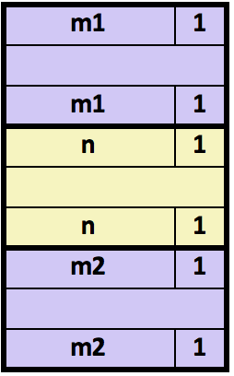
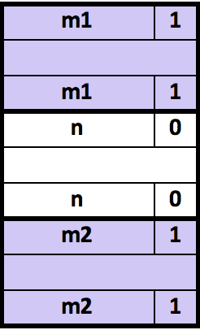
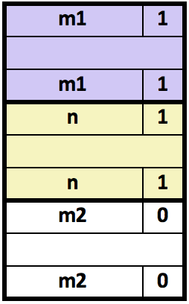
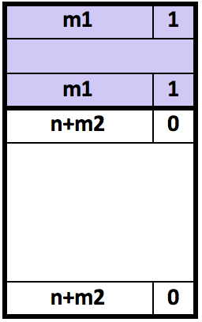
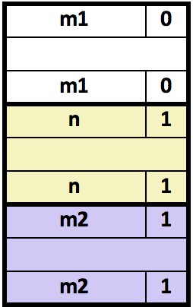
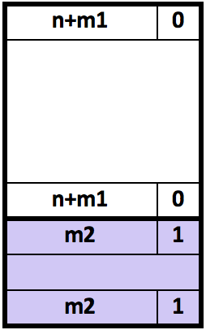
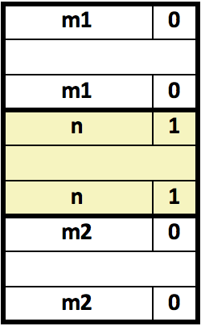
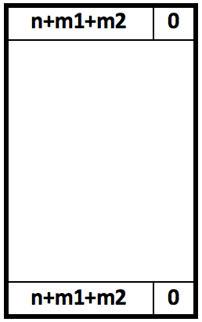
Constant-Time Coalescing
Case 1: Blocks above and below allocated
Case 2: Block above allocated, block below free
Case 2: Block above free, block below allocated
Case 4: Blocks above and below free

Slide 34
Exercise 1: Coalescing
Assume the current state of the heap is shown below. What would be the state of the heap after the function free(0x114) is executed?
0x00000018
0x0000000c
0x124
0x00000047
following block (free)
0x120
0x0000000c
0x11c
0x0000000d
0x118
0xdeadcafe
current block (allocated)
0x114
0x00000018
0x0000000d
0x110
0x00000011
0x10c
0x5ca1ab1e
0x108
previous block (allocated)
0x00000009
0x104
0x00000011
0x100

Slide 35
Summary of Key Allocator Policies
Storage policy:
  what data structure will you use to keep track of the free blocks?
Placement policy:
  First-fit, next-fit, best-fit, etc.
  Trades off lower throughput for less fragmentation
  segregated free lists approximate a best fit placement policy without having to search entire free list
Splitting policy:
  When do we go ahead and split free blocks?
  How much internal fragmentation are we willing to tolerate?
Coalescing policy:
  Immediate coalescing: coalesce each time free is called
  Deferred coalescing: try to improve performance of free by deferring coalescing until needed. Examples:
    Coalesce as you scan the free list for malloc
    Coalesce when the amount of external fragmentation reaches some threshold

