Slide 1
Lecture 18: Virtual Memory (cont'd)
CS 105 Spring 2023

Slide 2

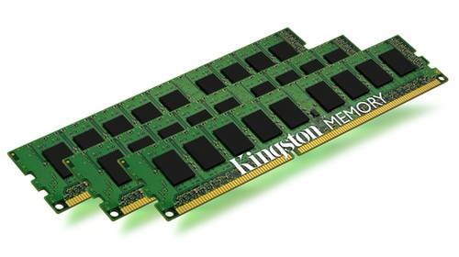
Review: Address Translation
Stack
MMU
Virtual Address
invalid
Exception
Heap
Data
Code
Physical Address
Data
Notes:
Define MMU

Slide 3
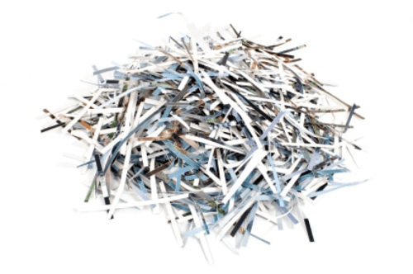
Review: Paging
Physical Memory
Frame 17
Virtual Memory
Frame 16
Page 7
Stack
Frame 15
Page 6
Frame 14
Page 5
Frame 13
Page 4
Frame 12
Page 3
Frame 11
Page 2
Heap
Frame 10
Page 1
Data
Frame 9
Page 0
Code
Frame 8
Frame 7
Frame 6
Frame 5
Frame 4
Frame 3
Frame 2
Frame 1
Frame 0

Slide 4
Review: Virtual Pages
Stack
NULL page or
access not allowed
SegFault
page#
offset
vaddr
MMU
Heap
page table
Invalid page
Data
v | Frame | Access
1 | 47 | R,W
0 | NULL | R,W
0 | 13 | R,W
1 | 42 | R,X
Page Fault
Code
paddr =
Frame[page#]
offset
…
Data
Notes:
Define MMU

Slide 5
Review: Paging
Assume that you are currently executing a process P with the following page table on a system with 256 byte pages:
What is the physical address that corresponds to the virtual address 0xEA882F?
What is the physical address that corresponds to the virtual address 0xEA8947?
What is the physical address that corresponds to the virtual address 0xEA8B13?
…
v | Frame | Access
0 | 0x47 | R,W
1 | 0x24 | R,W
0 | NULL | R,W
1 | 0x23 | R,X
0xEA8B
0xEA8A
0xEA89
0xEA88
…
0xEA88
0x2F
0x232F
0xEA89
0x47
segfault
0xEA8B
0x13
page fault

Slide 6


Review: Evaluating Paging
Isolation: don’t want different process states collided in physical memory
Efficiency: want fast reads/writes to memory
Sharing: want option to overlap for communication
Utilization: want best use of limited resource
Virtualization: want to create illusion of more resources
Notes:
Pros: easy allocation (keep bitmap of free frames), no external fragmentation, still allows access permissions, still allows sharing, easy to grow
Cons: internal fragmentation, slower (size of page tables etc -> multiple lookups)

Slide 7
Review: Problems with Paging
Memory Consumption: page table is really big
  Example: consider 48-bit address space, 4KB (2^12) page size, assume each page table entry is 8 bytes.
  Larger pages increase internal fragmentation
Performance: every data/instruction access requires two memory accesses:
  One for the page table
  One for the data/instruction
Notes:
problem 1: fill up all our memory with page table
2^48 addresses/2^12 page size => 2^36 pages* 8 bytes =>2^39 byte page table = .5 terabytes

Slide 8
Traditional Paging
page table is stored in physical memory
implemented as array of page table entries
Page Table Base Register (PTBR) stores physical address of beginning of page table
Page table entries are accessed by using the page number as the index into the page table
0 | NULL | R,W
0 | NULL | R,W
0 | NULL | R,W
1 | 59 | R,X
1 | 47 | R,W
0 | NULL | R,W
0 | 13 | R,W
1 | 42 | R,X
PTBR

Slide 9
Two-level Page Tables
page table is stored in virtual memory pages
page directory is stored in physical memory (page table for the page table)
Implemented as array of page directory entries
Page Table Base Register (PTBR) stores physical address of beginning of page directory
0 | NULL | R,W
0 | NULL | R,W
0 | NULL | R,W
1 | 59 | R,X
0 | NULL
1 | 62
0 | 17
1 | 77
PTBR
1 | 47 | R,W
0 | NULL | R,W
0 | 13 | R,W
1 | 42 | R,X

Slide 10
Two-level Page Tables
vaddr
idx1
idx2
offset
MMU
page dir
page table page
v | PTFrame
0 | NULL
1 | 62
0 | 17
1 | 77
v | Frame | Acc
1 | 47 | R,W
0 | NULL | R,W
0 | 13 | R,W
1 | 42 | R,X
Frame[idx1]
Frame[idx1]
offset
…
…
Data
only store in-use page table entries in physical memory
easier to allocate page table
more memory accesses
Notes:
Define MMU

Slide 11
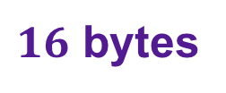
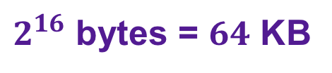
Example: Two-level Page Tables
Assume you are working on an architecture with a 32-bit virtual address space in which idx1 is 4 bits, idx2 is 12 bits, and offset is 16 bits.
How big is a page in this architecture?
How big is a page table entry in this architecture?
4 bit idx1
12 bit idx2
16 bit offset
$2^{16}$ bytes = $64$ KB
$16$ bytes

Slide 12

Exercise: Two-level Page Tables
page directory
page table
Assume you are still working on that architecture.
Compute the physical address corresponding to each of the virtual address (or answer "invalid"):
  0x00000013
  0x20022002
  0x10015555
v | PTFrame
1 | 0x0
1 | 0x2
0 | NULL
0 | NULL
Frame 0
v | Frame | Acc
1 | 0x0047 | R,W
0 | NULL | R,W
0 | 0x0013 | R,W
1 | 0x0042 | R,X
0x0
0x0
0x1
0x1
4 bit idx1
12 bit idx2
16 bit offset
0x2
0x2
0x3
0x3
…
…
0xF
0 | NULL
Frame 1
0x00470013
invalid
0xCAFE5555
Frame 2
0x0
0 | 0x002A | R
1 | 0xCAFE | R,W
0 | NULL | R,W
0 | 13 | R,W
0x1
0x2
0x3
…

Slide 13
Multi-level Page Tables
Problem: How big does the page directory get?
  Assume you have a 48-bit address space
  Assume you have 4KiB pages
  Assume you have 8 byte page table entries/page directory entries
Goal: Page Table Directory should fit in one frame
Multi-level page tables: add additional level(s) to tree
1 GB
27 bit idx1
9 bit idx2
12 bit offset
48 bits
9 bit idx1
9 bit idx2
9 bit idx3
9 bit idx4
12 bit offset
48 bits
Notes:
(2^27 directory entries)*(8 bytes/entry) = 2^30 bytes = 1 GB

Slide 14
Review: Problems with Paging
Memory Consumption: page table is really big
  Example: consider 64-bit address space, 4KB (2^12) page size, assume each page table entry is 8 bytes.
  Larger pages increase internal fragmentation
Performance: every data/instruction access requires two memory accesses:
  One for the page table
  One for the data/instruction
five
each of the four levels of page table
Notes:
problem 1: fill up all our memory with page table

Slide 15
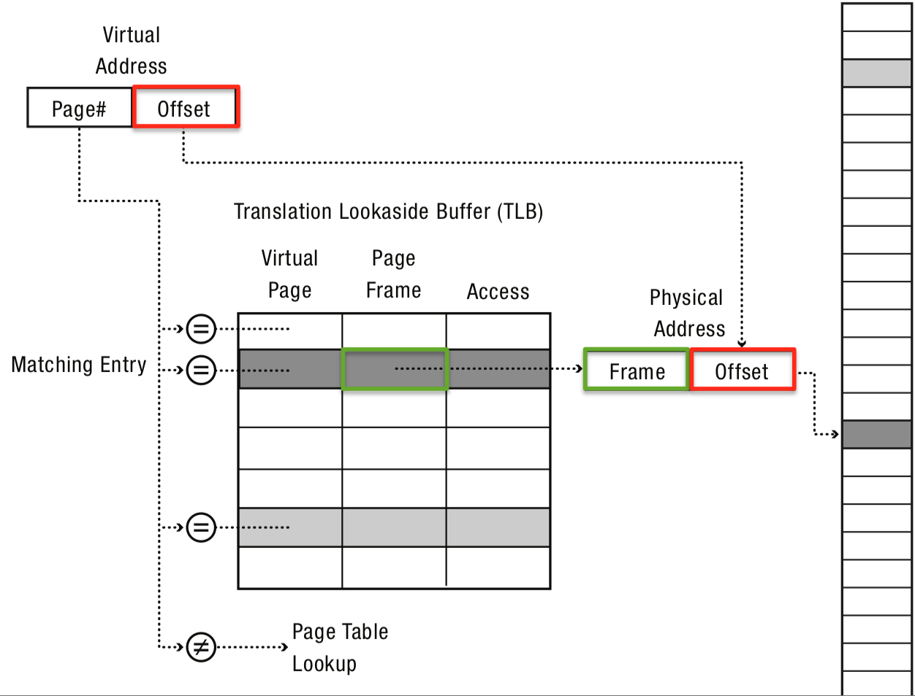
Translation-Lookaside Buffer (TLB)
General idea: if address translation is slow, cache some of the answers
Translation-lookaside buffer is an address translation cache that is built into the MMU

Slide 16
Exercise: TLB
TLB
idx | v | tag | PPN | v | tag | PPN | v | tag | PPN | v | tag | PPN
0 | 1 | 03 | B | 0 | 07 | 6 | 1 | 28 | 3 | 0 | 01 | F
1 | 1 | 31 | 0 | 0 | 12 | 3 | 1 | 3E | 4 | 1 | 0B | 1
2 | 0 | 2A | A | 0 | 11 | 1 | 1 | 1F | 8 | 1 | 07 | 5
3 | 1 | 07 | 3 | 0 | 2A | A | 0 | 1E | 2 | 0 | 21 | B
Assume you are running on an architecture with a one-level page table with 4096 byte pages. For each of the following virtual addresses, determine whether the address translation is stored in the TLB. If so, give the corresponding physical address
  0x7E37C
  0x16A48
0x7E
0x37c
0111 11
10
0x1F
2
0x837C
0x16
0xA48
0001 01
10
0x05
2
TLB miss

Slide 17
Example: The Linux x86 Address Space
Use "only" 48-bit addresses (top 16 bits not used)
4KiB pages by default
  supports larger "superpages"
Four-level page table
Physical memory stores memory pages, memory-mapped files, cached file pages
Updates are periodically written to disk by background processes
Page eviction algorithm uses variant of LRU called 2Q
  approximates LRU with clock
  maintains two lists (active/inactive)
Stack is marked non-executable
Virtual address of stack/heap start are randomized each time process is initialized
0xFFFFFFFFFFFF
Kernel (virtual)
Kernel (logical)
0x800000000000
Stack
Heap
Data
Code
Page 0: Invalid
0x000000000000

Slide 18
Example: Core i7 Address Translation
CPU
32/64
L2, L3, and
main memory
Result
Virtual address (vaddr)
36
12
VPN
VPO
L1
hit
L1
miss
32
4
TLBT
TLBI
L1 d-cache
(64 sets, 8 lines/set)
TLB
hit
TLB
miss
...
...
L1 TLB (16 sets, 4 entries/set)
9
9
9
9
40
12
40
6
6
VPN1
VPN2
VPN3
VPN4
PPN
PPO
CT
CI
CO
Physical
address
(paddr)
CR3
PTE
PTE
PTE
PTE
Page tables

