Slide 1
Lecture 3: Representing Signed Integers
CS 105

Slide 2
Review: Memory
bytes
Memory is an array of bits
A byte is a unit of eight bits
An index into the array is an address, location, or pointer
  Often expressed in hexadecimal
We speak of the value in memory at an address
  The value may be a single byte …
  … or a multi-byte quantity starting at that address
00110111
1
1
1
0
1
1
0
3
0
11010001
1
0
0
0
1
0
1
2
1
01010011
1
1
0
0
1
0
1
1
0
01101100
0
0
1
1
0
1
0
1
0

Slide 3
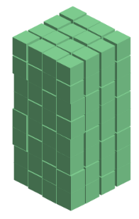
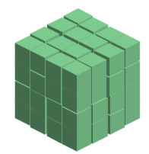
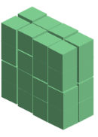





Review: Binary Numbers
128 (2⁷) | 64 (2⁶) | 32 (2⁵) | 16 (2⁴) | 8 (2³) | 4 (2²) | 2 (2¹) | 1 (2⁰)
0 | 0 | 0 | 0 | 0 | 1 | 0 | 1
0 | 0 | 1 | 0 | 1 | 1 | 1 | 1
1 | 1 | 1 | 1 | 1 | 1 | 1 | 1

Slide 4
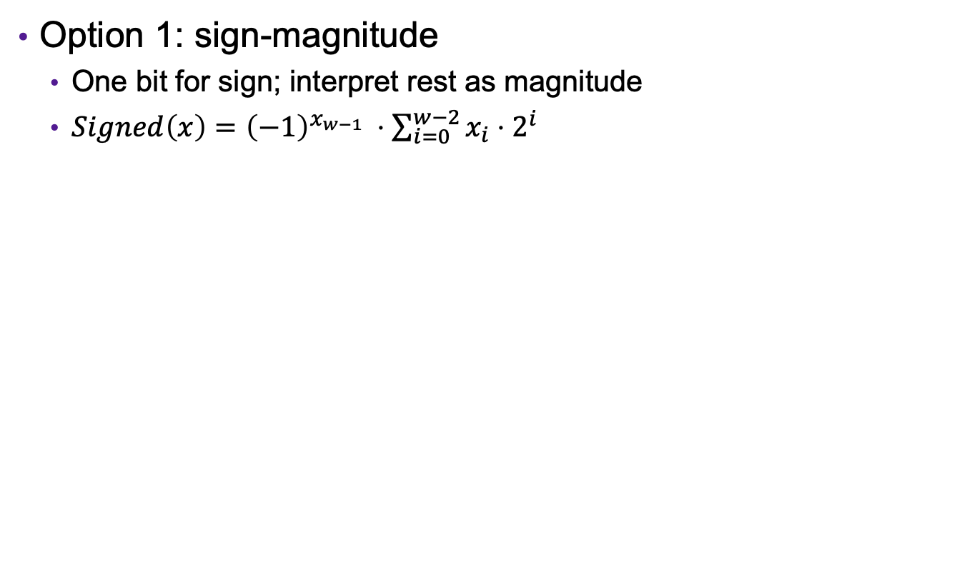
Representing Signed Integers
Option 1: sign-magnitude
  One bit for sign; interpret rest as magnitude
  $Signed\left(x\right)={{\left(−1\right)}^{x_{w−1}}}_{ }⋅\sum_{i=0}^{w−2}{x_{i}⋅2^{i}}$
+/- | 64 (2⁶) | 32 (2⁵) | 16 (2⁴) | 8 (2³) | 4 (2²) | 2 (2¹) | 1 (2⁰)
-
0 | 0 | 0 | 0 | 0 | 1 | 0 | 1
1 | 0 | 0 | 0 | 0 | 1 | 0 | 1
1 | 1 | 1 | 1 | 1 | 1 | 1 | 1
Notes:
Issues: two zeros, arithmetic is different for pos vs neg (and weird around zero), e.g, try 5+1 vs -5+1 vs. -5 + 6

Slide 5
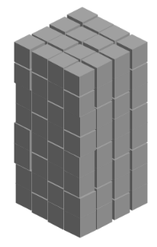

Representing Signed Integers
Option 2: excess-K
  Choose a positive K in the middle of the unsigned range
  $Signed\left(x\right)=\sum_{i=0}^{w−1}{x_{i}⋅2^{i} }−2^{w−1}$
128 (2⁷) | 64 (2⁶) | 32 (2⁵) | 16 (2⁴) | 8 (2³) | 4 (2²) | 2 (2¹) | 1 (2⁰) | -128
0 | 0 | 0 | 0 | 0 | 1 | 0 | 1
1 | 0 | 0 | 0 | 0 | 1 | 0 | 1
1 | 1 | 1 | 1 | 1 | 1 | 1 | 1
Notes:
issue: zero no longer zero -> multiplication is weird

Slide 6

Representing Signed Integers
Option 3: two’s complement
  Like unsigned, except the high-order contribution is negative
  $Signed\left(x\right)=−x_{w−1}⋅2^{w−1}+\sum_{i=0}^{w−2}{x_{i}⋅2^{i}}$
-128 (-2⁶) | 64 (2⁶) | 32 (2⁵) | 16 (2⁴) | 8 (2³) | 4 (2²) | 2 (2¹) | 1 (2⁰)
0 | 0 | 0 | 0 | 0 | 1 | 0 | 1
1 | 0 | 0 | 0 | 0 | 1 | 0 | 1
1 | 1 | 1 | 1 | 1 | 1 | 1 | 1

Slide 7
Two’s Complement Signed Integers
“Signed” does not mean “negative”
High order bit is the sign bit
  To negate, complement all the bits and add 1
Arithmetic is the same as unsigned—same circuitry
(Error conditions and comparisons are different)
Notes:
-1 is all 1’s
Sign extension

Slide 8
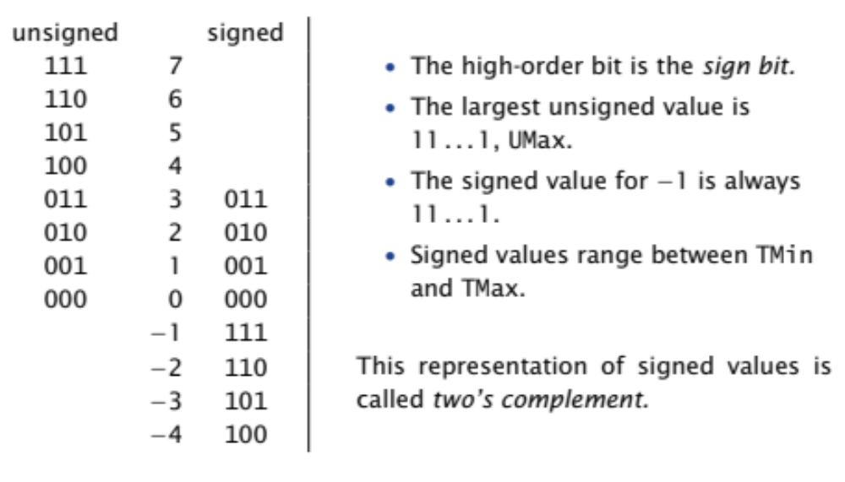
Example: Three-bit integers

Slide 9
Important Signed Numbers
 | 8 | 16 | 32 | 64
TMax | 0x7F | 0x7FFF | 0x7FFFFFFF | 0x7FFFFFFFFFFFFFFF
TMin | 0x80 | 0x8000 | 0x80000000 | 0x8000000000000000
0 | 0x00 | 0x0000 | 0x00000000 | 0x0000000000000000
-1 | 0xFF | 0xFFFF | 0xFFFFFFFF | 0xFFFFFFFFFFFFFFFF

Slide 10
Exercise 1: Signed Integers
Assume an 8 bit (1 byte) signed integer representation:
  What is the binary representation for 47?
  What is the binary representation for -47?
  What is the number represented by 10000110?
  What is the number represented by 00100101?
Notes:
47 = 0x2F = 0b0000 0000 0010 1111
-47 = oxFFD1 = 0b1111 1111 1101 0001

Slide 11
Casting between Numeric Types
Casting from shorter to longer types preserves the value
Casting from longer to shorter types drops the high-order bits
Casting between signed/unsigned types preserves the bits (it just changes the interpretation)
Implicit casting occurs in assignments and parameter lists. In mixed expressions, signed values are implicitly cast to unsigned
    Source of many errors!
Notes:
Note: casting part of signed demo

Slide 12
Exercise 2: Casting
Assume you have a machine with 6-bit integers/3-bit shorts
Assume variables: int x = -17; short sy = -3;
Complete the following table
Expression | Decimal | Binary
x | -17
sy | -3
(unsigned int) x
(int) sy
(short) x

Slide 13
When to Use Unsigned
Rarely
When doing multi-precision arithmetic, or when you need an extra bit of range … but be careful!
unsigned i;
for (i = cnt-2; i >= 0; i--){
a[i] += a[i+1];
}

Slide 14
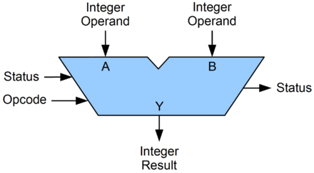
Arithmetic Logic Unit (ALU)
circuit that performs bitwise operations and arithmetic on integer binary types

Slide 15
Bitwise vs Logical Operations in C
Bitwise Operators &, |, ~, ^
  View arguments as bit vectors
  operations applied bit-wise in parallel
Logical Operators &&, ||, !
  View 0 as “False”
  View anything nonzero as “True”
  Always return 0 or 1
  Early termination
Shift operators <<, >>
  Left shift fills with zeros
  For signed integers, right shift is arithmetic (fills with high-order bit)

Slide 16
Exercise 3: Bitwise vs Logical Operations
Assume signed char data type (one byte)
  ~(-30)
  !(-30)
  -30 & 21
  -30 && 21
  -30 << 2
  -30 >> 2
  21 >> 2
Notes:
0xBE, 0xFF, 0x41
0x41, 0x7D
0x00, 0x01, 0x01
0x01, 0x01

Slide 17
Addition Example
Compute 5 + -3 assuming all ints are stored as four-bit signed values
1
1
0 1 0 1
+ 1 1 0 1
0
0
1
0
= 2 (Base-10)
Exactly the same as unsigned numbers!
… but with different error cases

Slide 18
Addition/Subtraction with Overflow
Compute 5 + 3 assuming all ints are stored as four-bit signed values
1
1
1
0 1 0 1
+ 0 0 1 1
1
0
0
0
= -8 (Base-10)

Slide 19



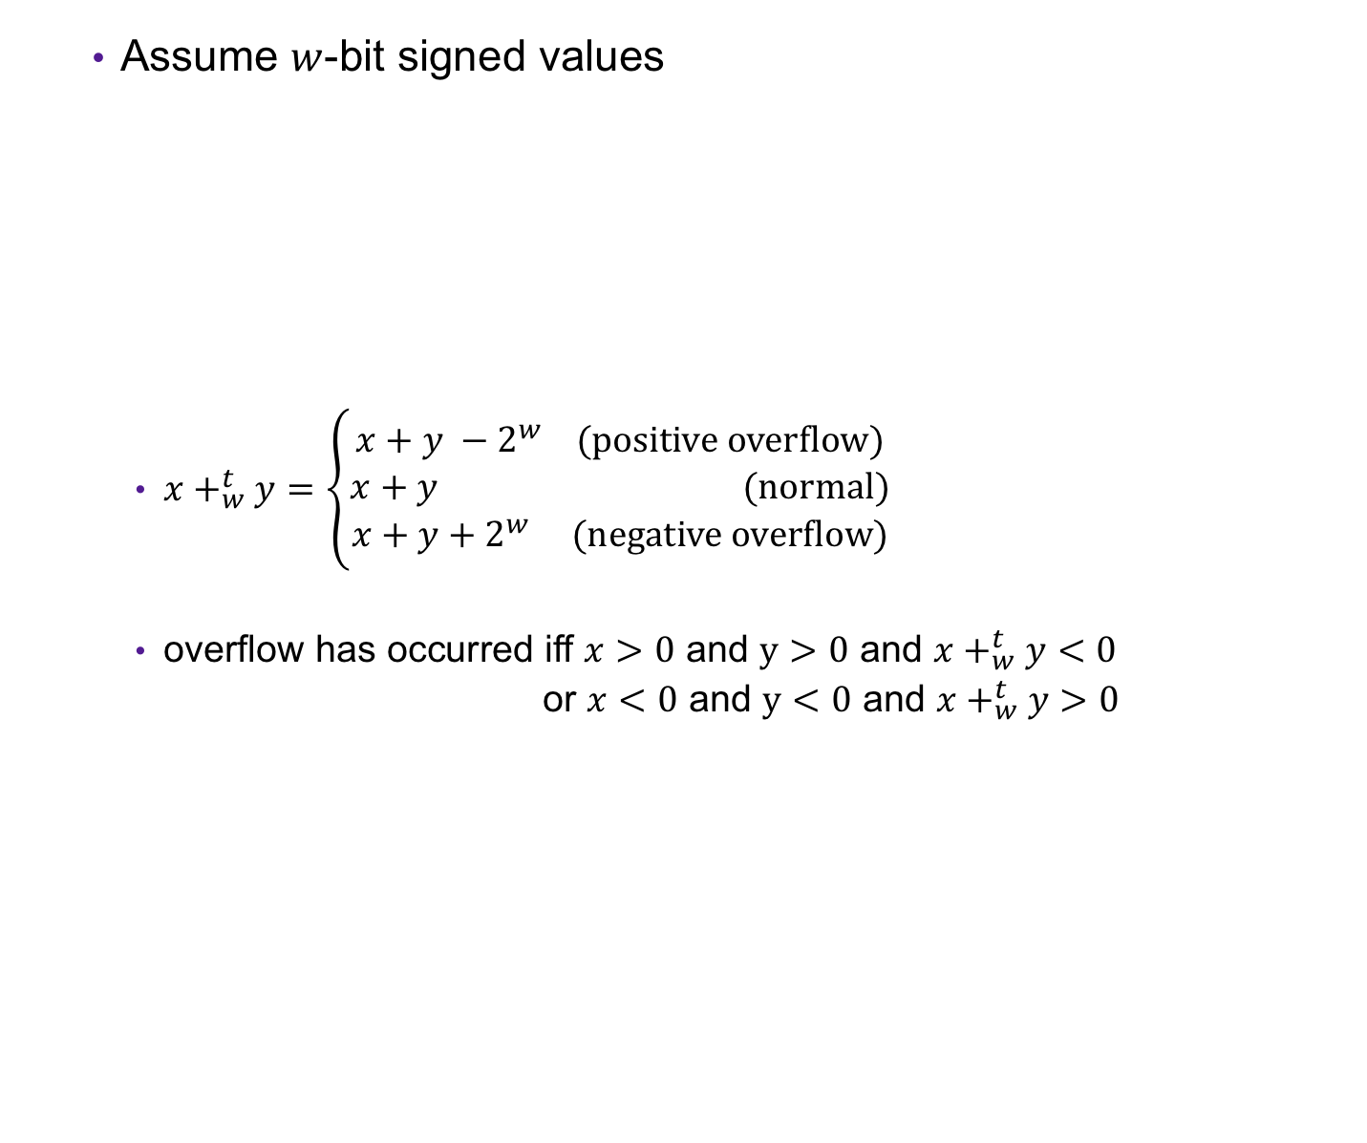



Error Cases
Assume $w$-bit signed values
  $x+_{w}^{t}y=\left\{\begin{aligned}x+y −2^{w} (positive overflow) \\ x+y (normal) \\ x+y+2^{w} (negative overflow)\end{aligned}\right.$
  overflow has occurred iff $x>0$ and $y>0$ and $x+_{w}^{t}y<0$
  or $x<0$ and $y<0$ and $x+_{w}^{t}y>0$
$${−2⋅2}^{w−1}$$
$${−2}^{w−1}$$
$$0$$
$$2^{w−1}$$
$${2⋅2}^{w−1}$$
[ )
representable values
( )
Possible values of $x+y$

Slide 20
Exercise 4: Binary Addition
Given the following 5-bit signed values, compute their sum and indicate whether or not an overflow occurred
x | y | x+y | overflow?
00010 | 00101
01100 | 00100
10100 | 10001

Slide 21
Multiplication Example
Compute 3 x 2 assuming all ints are stored as four-bit signed values
0 0 1 1
x 0 0 1 0
0 0 0 0
0 0 1 1 0
+ _
0 1 1 0
= 6 (Base-10)
Exactly like unsigned multiplication!
… except with different error cases

Slide 22
Multiplication Example
Compute 5 x 2 assuming all ints are stored as four-bit signed values
0 1 0 1
x 0 0 1 0
0 0 0 0
0 1 0 1 0
+ _
1 0 1 0
= -6 (Base-10)

Slide 23



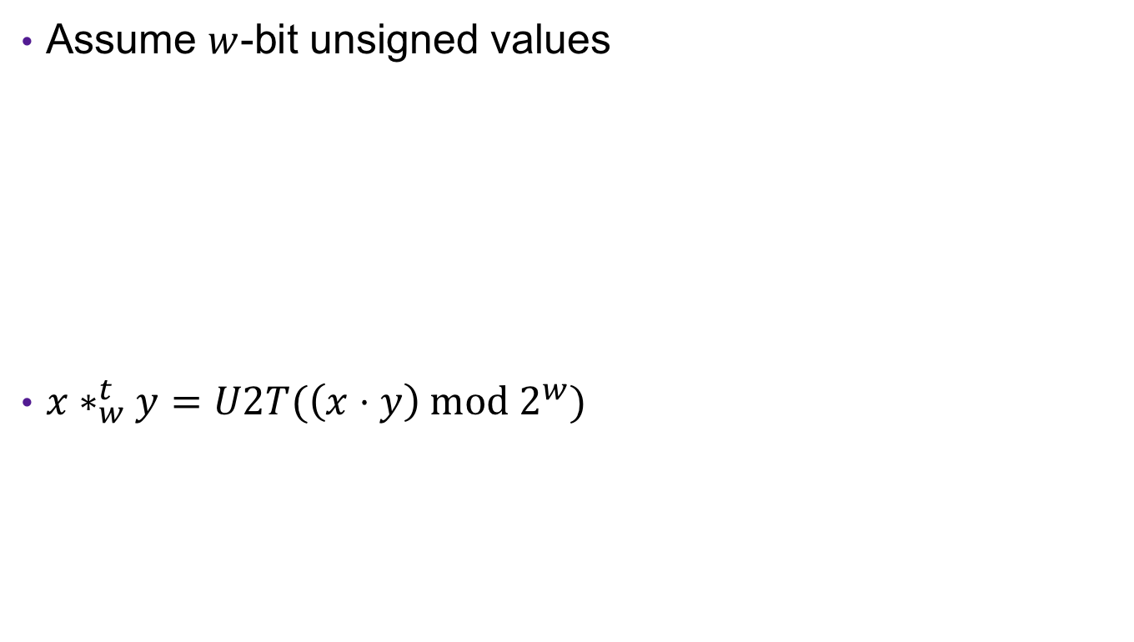


Error Cases
Assume $w$-bit unsigned values
$x∗_{w}^{t}y=U2T(\left(x⋅y\right) mod 2^{w})$
$${−2}^{2(w−1)}$$
$${−2}^{w−1}$$
$$0$$
$$2^{w−1}$$
$${ 2}^{2(w−1)}$$
[ )
representable values
[ )
Possible values of $x∗y$

Slide 24
Exercise 5: Binary Multiplication
Given the following 3-bit signed values, compute their product and indicate whether or not an overflow occurred
x | y | x*y | overflow?
100 | 101
010 | 011
111 | 010

