Slide 1
Lecture 2: Representing Integers
CS 105

Slide 2
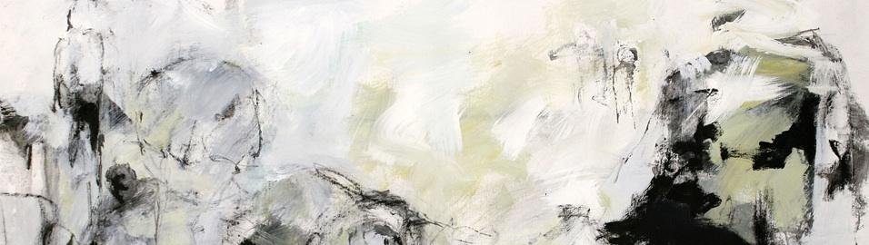



Review: Abstraction

Slide 3
Review: Memory
bytes
Memory is an array of bits
A byte is a unit of eight bits
An index into the array is an address, location, or pointer
  Often expressed in hexadecimal
We speak of the value in memory at an address
  The value may be a single byte …
  … or a multi-byte quantity starting at that address
00110111
1
1
1
0
1
1
0
3
0
11010001
1
0
0
0
1
0
1
2
1
01010011
1
1
0
0
1
0
1
1
0
01101100
0
0
1
1
0
1
0
1
0

Slide 4
Review: Bits Require Interpretation
10001100 00001100 10101100 00000000
might be interpreted as
  The integer 3,485,745
  A floating point number close to 4.884569 x 10⁻³⁹
  The string “105”
  A portion of an image or video
  An address in memory

Slide 5


Representing Integers
Arabic Numerals: 47
Roman Numerals: XLVII
Brahmi Numerals:
Tally Marks: IIII IIII IIII IIII IIII IIII IIII IIII IIII II

Slide 6
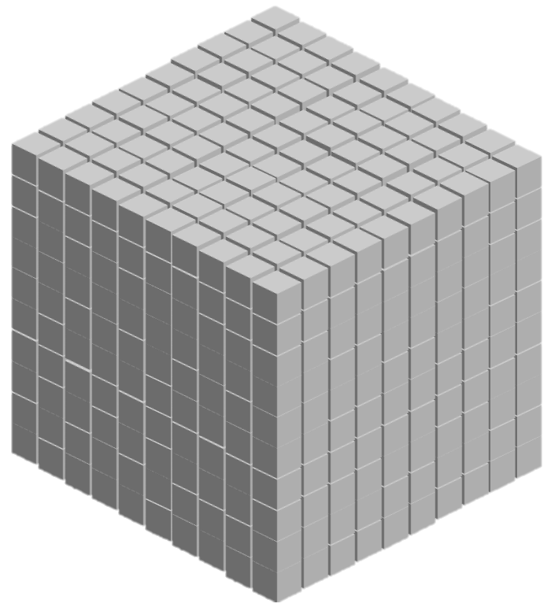
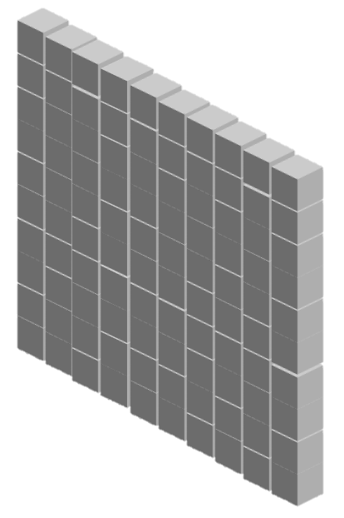

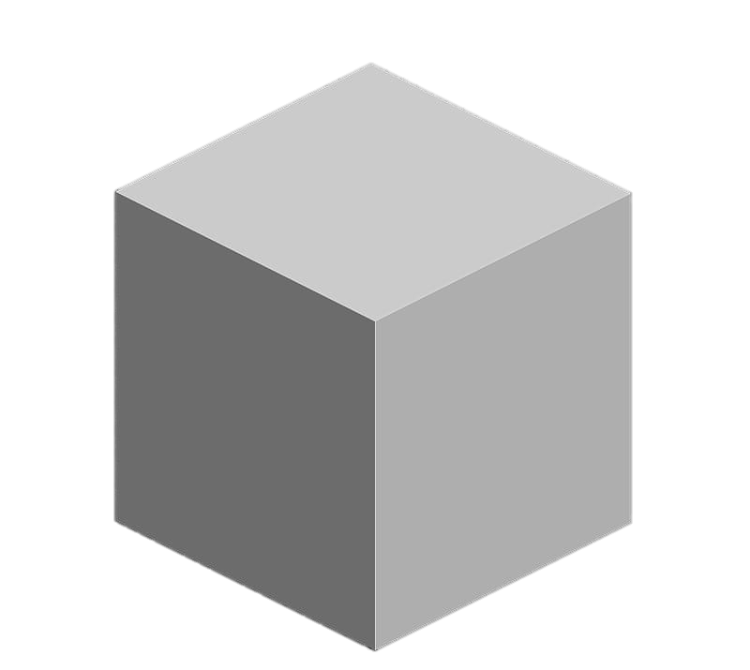
Base-10 Integers
1000 (10³) | 100 (10²) | 10 (10¹) | 1 (10⁰)
0 | 0 | 0 | 5
0 | 0 | 4 | 7
1 | 8 | 8 | 7

Slide 7
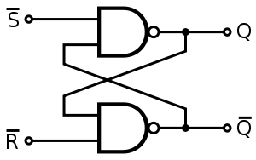
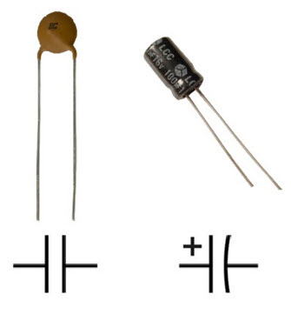
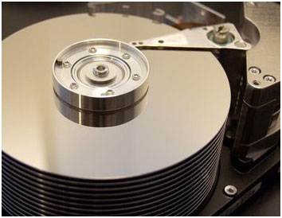
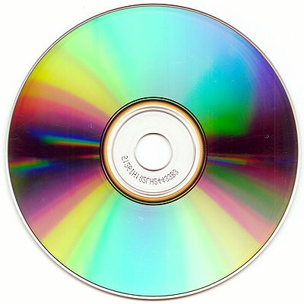
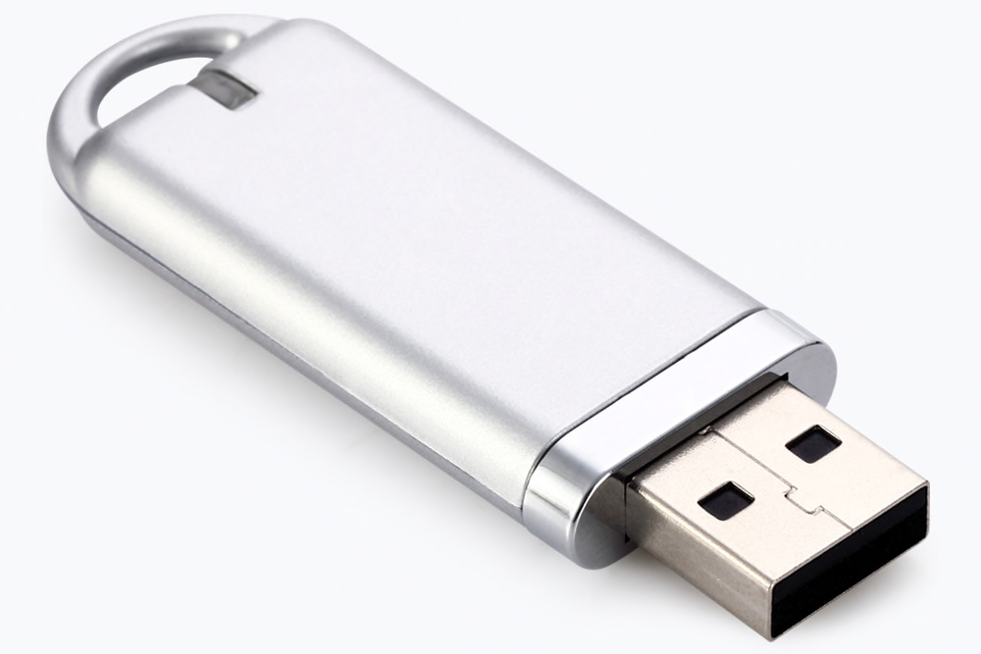
Storing bits
Static random access memory (SRAM): stores each bit of data in a flip-flop, a circuit with two stable states
Dynamic Memory (DRAM): stores each bit of data in a capacitor, which stores energy in an electric field (or not)
Magnetic Disk: regions of the platter are magnetized with either N-S polarity or S-N polarity
Optical Disk: stores bits as tiny indentations (pits) or not (lands) that reflect light differently
Flash Disk: electrons are stored in one of two gates separated by oxide layers

Slide 8
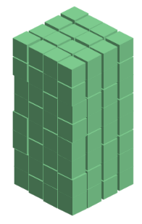
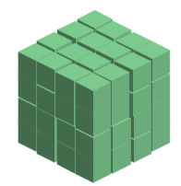
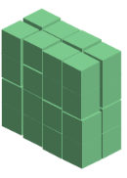
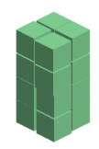



Base-2 Integers (aka Binary Numbers)
128 (2⁷) | 64 (2⁶) | 32 (2⁵) | 16 (2⁴) | 8 (2³) | 4 (2²) | 2 (2¹) | 1 (2⁰)
0 | 0 | 0 | 0 | 0 | 1 | 0 | 1
0 | 0 | 1 | 0 | 1 | 1 | 1 | 1
1 | 1 | 1 | 1 | 1 | 1 | 1 | 1

Slide 9
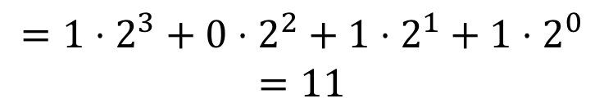
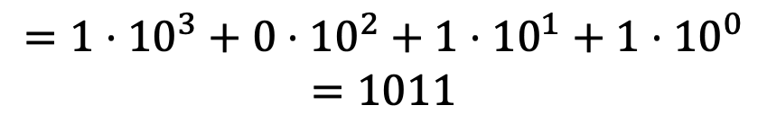
Binary Numbers
Decimal (Base-10):
Binary (Base-2):
1011
$$=1⋅{10}^{3}+0⋅{10}^{2}+1⋅{10}^{1}+1⋅{10}^{0}$$
$$=1011$$
1011
$$=1⋅2^{3}+0⋅2^{2}+1⋅2^{1}+1⋅2^{0}$$
$$=11$$

Slide 10
Exercise 1: Binary Numbers
Consider the following four-bit binary values. What is the (base-10) integer interpretation of these values?
  0001
  1010
  0111
  1111

Slide 11
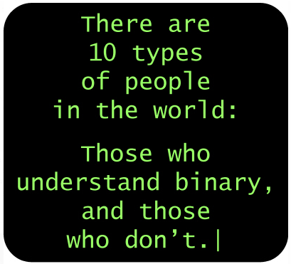
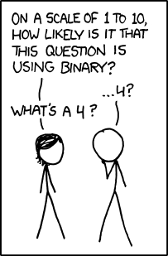
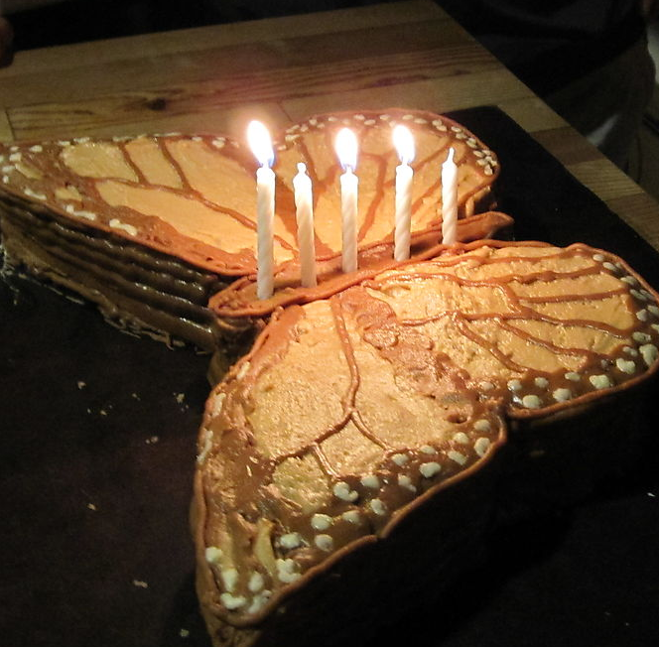
Binary Numbers

Slide 12
Exercise 2: Binary Number Range
What are the max number and min number that can be represented by a w-bit binary number?
  w = 3
  w = 4
  w = 8

Slide 13
Unsigned Integers in C
C Data Type | Size (bytes)
unsigned char | 1
unsigned short | 2
unsigned int | 4
unsigned long | 8
Notes:
Note: unsigned demo

Slide 14
ASCII characters
Char | Dec | Binary
! | 33 | 00100001
" | 34 | 00100010
# | 35 | 00100011
$ | 36 | 00100100
% | 37 | 00100101
& | 38 | 00100110
' | 39 | 00100111
( | 40 | 00101000
) | 41 | 00101001
* | 42 | 00101010
+ | 43 | 00101011
, | 44 | 00101100
- | 45 | 00101101
. | 46 | 00101110
/ | 47 | 00101111
0 | 48 | 00110000
Char | Dec | Binary
1 | 49 | 00110001
2 | 50 | 00110010
3 | 51 | 00110011
4 | 52 | 00110100
5 | 53 | 00110101
6 | 54 | 00110110
7 | 55 | 00110111
8 | 56 | 00111000
9 | 57 | 00111001
: | 58 | 00111010
; | 59 | 00111011
< | 60 | 00111100
= | 61 | 00111101
> | 62 | 00111110
? | 63 | 00111111
@ | 64 | 01000000
Char | Dec | Binary
A | 65 | 01000001
B | 66 | 01000010
C | 67 | 01000011
D | 68 | 01000100
E | 69 | 01000101
F | 70 | 01000110
G | 71 | 01000111
H | 72 | 01001000
I | 73 | 01001001
J | 74 | 01001010
K | 75 | 01001011
L | 76 | 01001100
M | 77 | 01001101
N | 78 | 01001110
O | 79 | 01001111
P | 80 | 01010000
Char | Dec | Binary
Q | 81 | 01010001
R | 82 | 01010010
S | 83 | 01010011
T | 84 | 01010100
U | 85 | 01010101
V | 86 | 01010110
W | 87 | 01010111
X | 88 | 01011000
Y | 89 | 01011001
Z | 90 | 01011010
[ | 91 | 01011011
\ | 92 | 01011100
] | 93 | 01011101
^ | 94 | 01011110
_ | 95 | 01011111
` | 96 | 01100000
Char | Dec | Binary
a | 97 | 01100001
b | 98 | 01100010
c | 99 | 01100011
d | 100 | 01100100
e | 101 | 01100101
f | 102 | 01100110
g | 103 | 01100111
h | 104 | 01101000
i | 105 | 01101001
j | 106 | 01101010
k | 107 | 01101011
l | 108 | 01101100
m | 109 | 01101101
n | 110 | 01101110
o | 111 | 01101111
p | 112 | 01110000

Slide 15
Hexidecimal Numbers
00101100 00110101 00110000 11100001
Dec | Hex
0
1
2
3
4
5
6
7
8
9
10
11
12
13
14
15
0
1
2
3
4
5
6
7
8
9
2
c
3
5
3
0
e
1
0x2c3530e1
a
b
c
d
e
f

Slide 16
Exercise 3: Hexidecimal Numbers
Consider the following hexidecimal values. What is the representation of each value in (1) binary and (2) decimal?
  0x0a
  0x11
  0x2f

Slide 17
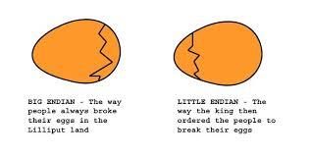
Endianness
47 vs 74

Slide 18
Endianness
Big Endian: low-order bits go on the right (47)
  I tend to think in big endian numbers, so examples in class will generally use this representation
  Networks generally use big endian (aka network byte order)
Little Endian: low-order bits go on the left (74)
  Most modern machines use this representation
I will try to always be clear about whether I'm using a big endian or little endian representation
When in doubt, ask!

Slide 19
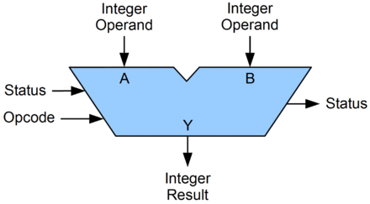
Arithmetic Logic Unit (ALU)
circuit that performs bitwise operations and arithmetic on integer binary types

Slide 20
Bitwise vs Logical Operations in C
Bitwise Operators &, |, ~, ^
  View arguments as bit vectors
  operations applied bit-wise in parallel
Logical Operators &&, ||, !
  View 0 as “False”
  View anything nonzero as “True”
  Always return 0 or 1
  Early termination
Shift operators <<, >>
  Left shift fills with zeros
  For unsigned integers, right shift is logical (fills with zeros)

Slide 21
Exercise 4: Bitwise vs Logical Operations
Assume unsigned char data type (one byte). What do each of the following expressions evaluate to (interpreted as unsigned integers and expressed base-10)?
  ~226
  !226
  120 & 85
  120 | 85
  120 && 85
  120 || 85
  81 << 2
  81 >> 2
Notes:
0xBE, 0xFF, 0x41
0x41, 0x7D
0x00, 0x01, 0x01
0x01, 0x01

Slide 22
Example: Using Bitwise Operations
x & 1
(x + 7) & 0xFFFFFFF8
x << 2
“x is odd”
“round up to a multiple of 8”
"multiply by 4"
Notes:
Note: int demo

Slide 23
Addition Example
Compute 5 + 6 assuming all ints are stored as eight-bit (1 byte) unsigned values
1
0 0 0 0 0 1 0 1
+ 0 0 0 0 0 1 1 0
0
0
0
0
1
0
1
1
= 11 (Base-10)
Like you learned in grade school, only binary!
… and with a finite number of digits

Slide 24
Addition Example with Overflow
Compute 200 + 100 assuming all ints are stored as eight-bit (1 byte) unsigned values
1
1
1 1 0 0 1 0 0 0
+ 0 1 1 0 0 1 0 0
0
0
1
0
1
1
0
0
= 44 (Base-10)
Like you learned in grade school, only binary!
… and with a finite number of digits

Slide 25

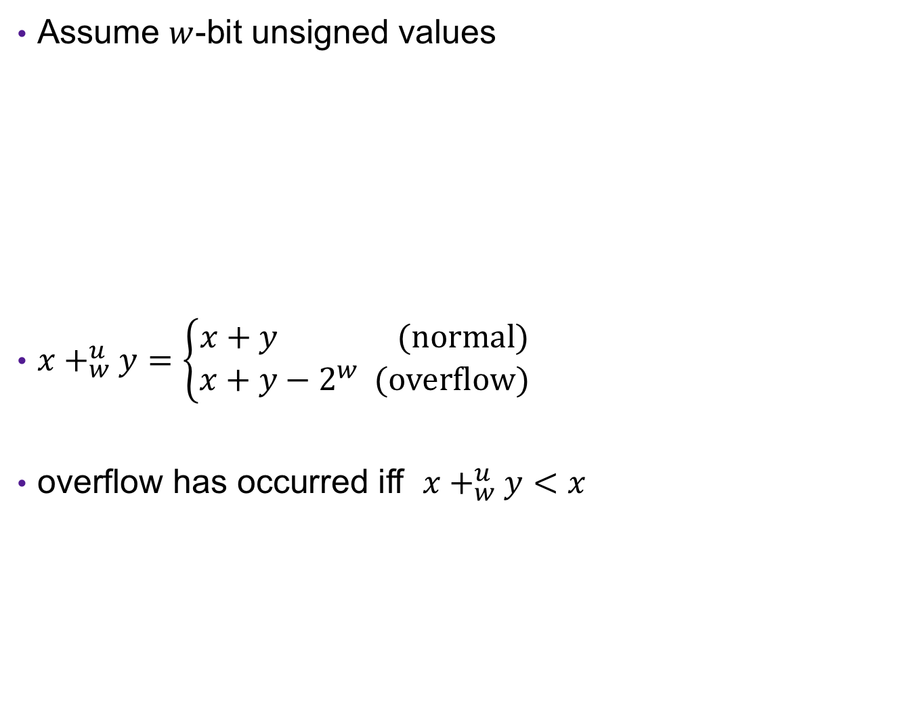



Error Cases
Assume $w$-bit unsigned values
$x+_{w}^{u}y=\left\{\begin{aligned}x+y (normal) \\ x+y−2^{w} (overflow)\end{aligned}\right.$
overflow has occurred iff $x+_{w}^{u}y<x$
$$0$$
$$2^{w}$$
$${2⋅2}^{w}$$
[ )
representable values
[ )
Possible values of $x+y$

Slide 26
Exercise 5: Binary Addition
Given the following 5-bit unsigned values, compute their sum and indicate whether or not an overflow occurred
x | y | x+y | overflow?
00010 | 00101
01100 | 00100
10100 | 10001

Slide 27
Multiplication Example
Compute 5 x 6 assuming all ints are stored as eight-bit (1 byte) unsigned values
0 0 0 0 0 1 0 1
x 0 0 0 0 0 1 1 0
0 0 0 0 0 0 0 0
0 0 0 0 0 1 0 1 0
0 0 0 0 0 1 0 1 0 0
+ _
0 0 0 1 1 1 1 0
= 30 (Base-10)
Like you learned in grade school, only binary!
… and with a finite number of digits

Slide 28
Multiplication Example
Compute 200 x 3 assuming all ints are stored as eight-bit (1 byte) unsigned values
1 1 0 0 1 0 0 0
x 0 0 0 0 0 0 1 1
1 1 0 0 1 0 0 0
1 1 0 0 1 0 0 0 0
+ _
1 0
0 1 0 1 1 0 0 0
= 88 (Base-10)
Like you learned in grade school, only binary!
… and with a finite number of digits

Slide 29
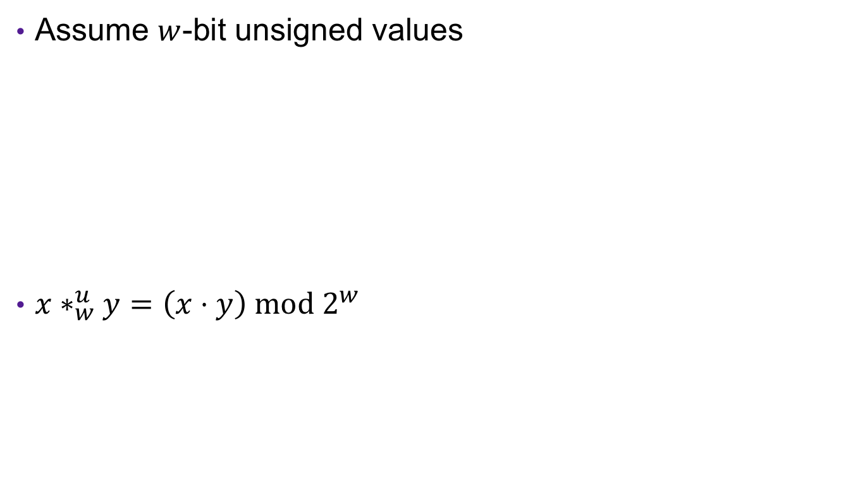


Error Cases
Assume $w$-bit unsigned values
$x∗_{w}^{u}y=\left(x⋅y\right) mod 2^{w}$
$$0$$
$$2^{w}$$
$${2^{w}⋅2}^{w}$$
[ )
representable values
[ )
Possible values of $x∗y$

Slide 30
Exercise 6: Binary Multiplication
Given the following 3-bit unsigned values, compute their product and indicate whether or not an overflow occurred
x | y | x*y | overflow?
100 | 101
010 | 011
111 | 010

Slide 31
Multiplying with Shifts
Multiplication is slow
Bit shifting is kind of like multiplication, and is often faster
  x * 8 = x << 3
  x * 10 = x << 3 + x << 1
Most compilers will automatically replace multiplications with shifts where possible

